Slide 1
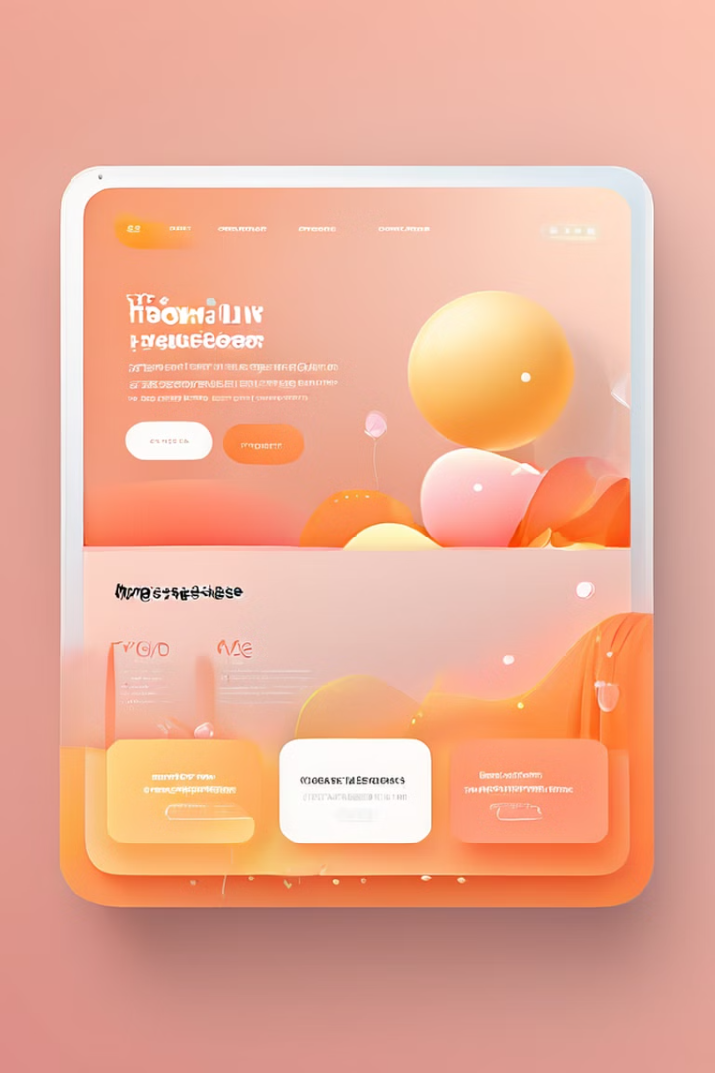
Trust fund Bank Web Application
Welcome to the Trust fund Bank Web Application presentation, designed to revolutionize banking services in Sri Lanka. This presentation will provide a comprehensive overview of the application, highlighting its key features, technological foundation, and commitment to providing secure and innovative financial solutions.

Slide 2

Introduction to Trustfund Bank of Sri Lanka (TFBS)
Mission
Empowering customers with secure, innovative, and accessible financial solutions, enabling individuals and businesses to achieve their financial goals.
Vision
To become the most trusted and preferred financial institution in Sri Lanka, known for its exceptional customer service, cutting-edge technology, and commitment to ethical practices.
Values
Integrity, transparency, innovation, customer-centricity, and social responsibility drive our every decision, ensuring trust and reliability in all our endeavors.

Slide 3
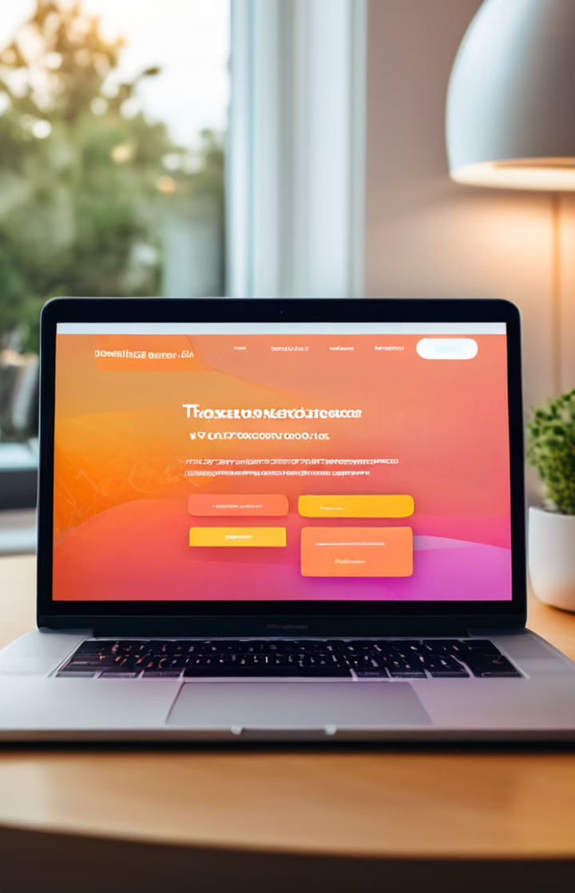
Project Overview: Revolutionizing Banking
1
Purpose
To provide individuals, businesses, and communities with a comprehensive and secure online banking platform that simplifies financial transactions, streamlines financial management, and enhances access to financial services.
2
Target Audience
The application caters to a wide range of users, including individuals seeking personal banking services, businesses needing financial management tools, and communities requiring access to financial literacy resources.
3
Key Features
The Trustfund Bank web application offers a robust suite of features, including online banking, account management, loan services, financial tracking, and 24/7 customer support.
4
Impact
By providing a user-friendly and secure digital platform, the application aims to empower customers, enhance financial literacy, and drive economic growth within Sri Lanka.

Slide 4
Application Features: Simplifying Your Financial Life
Online Banking
Account Management
Loan Services
Seamlessly access and manage your accounts, view transaction history, transfer funds, pay bills, and set up recurring payments, all from the convenience of your device.
Effortlessly manage multiple accounts, including savings, checking, and loans, with clear account summaries, detailed transaction records, and customizable settings.
Apply for various types of loans online, including personal loans, home loans, and business loans, with personalized loan calculators and easy-to-understand terms.

Slide 5
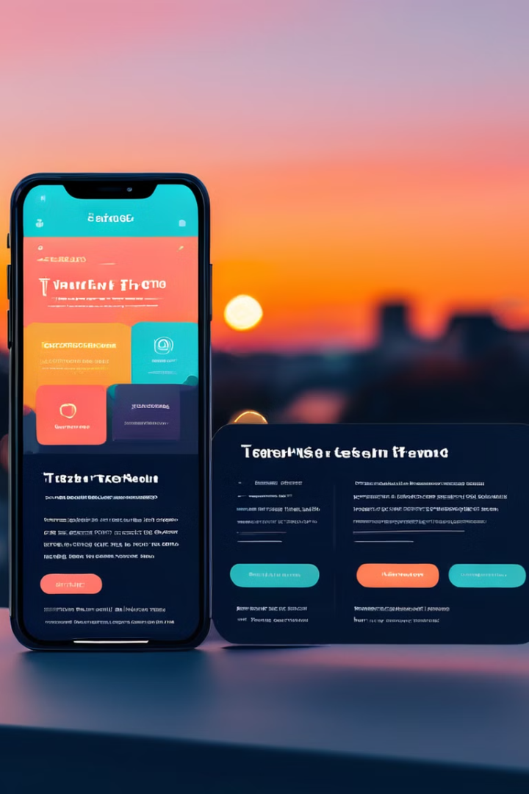
Design and User Experience: A Focus on Simplicity and Accessibility
1
User-Centered Design
The application's design prioritizes user needs, focusing on simplicity, intuitive navigation, and clear visual hierarchy to ensure an easy and enjoyable user experience.
2
Mobile-Responsive Design
The application is fully responsive, adapting seamlessly to different screen sizes and devices, ensuring a consistent and optimal user experience across desktops, tablets, and smartphones.
3
Accessibility Features
The application incorporates accessibility features, such as screen reader compatibility, adjustable font sizes, and high-contrast themes, to cater to diverse user needs and ensure inclusivity.

Slide 6
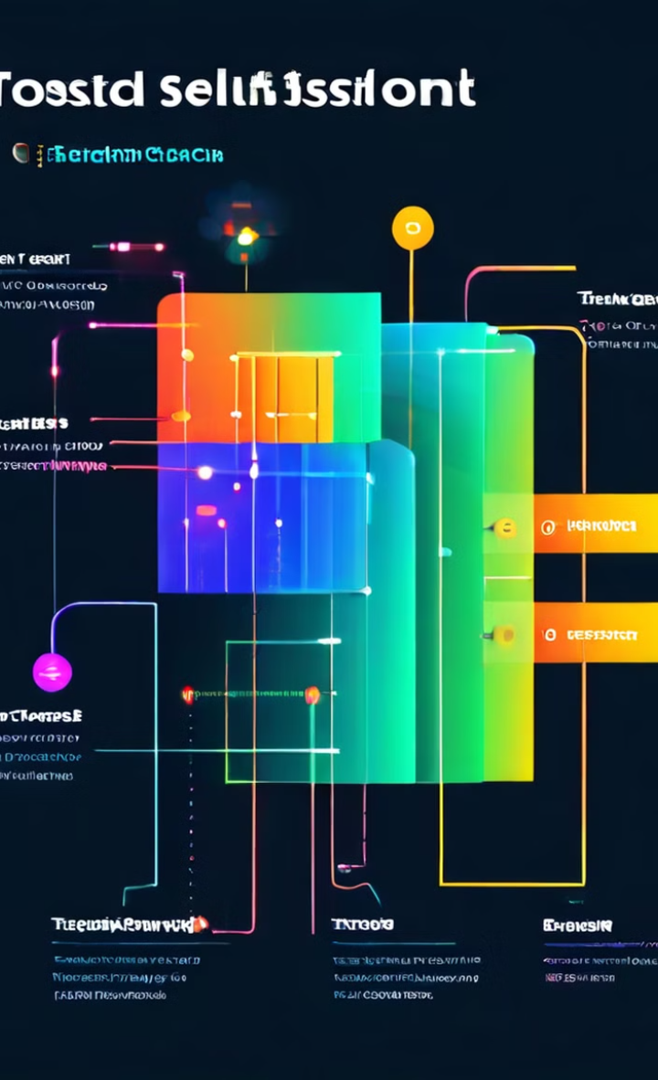
Technology Stack: Building a Robust and Secure Platform
Component
Technology
Purpose
Frontend
React
Develops the user interface and provides a dynamic and interactive experience.
Backend
PHP
Handles server-side logic, database interactions, and data processing, ensuring efficient and secure operation.
Database
MySQL
Stores and manages user data, financial transactions, and application settings securely and efficiently.
Security
SSL Encryption
Protects user data and financial transactions with robust security measures, ensuring confidentiality and integrity.

Slide 7
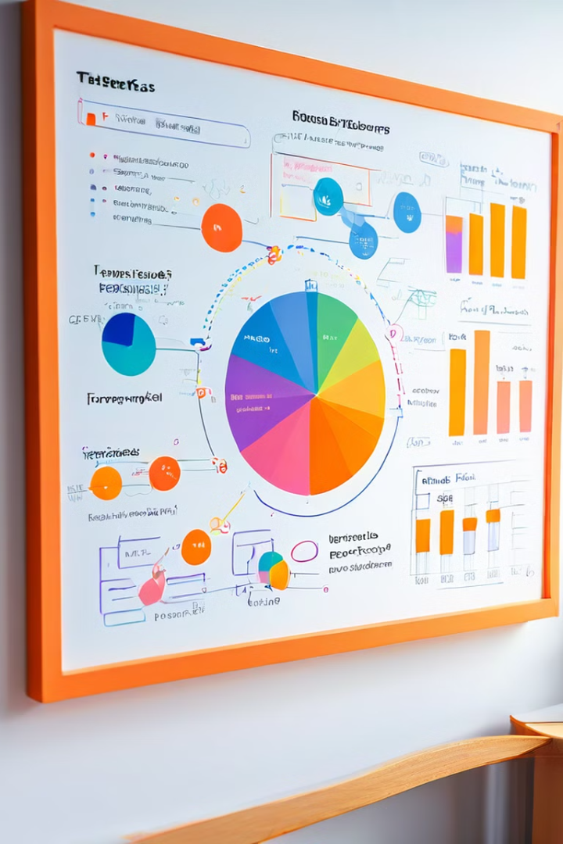



Development Process: Iterative and Agile Approach
Planning and Design
A thorough planning phase, involving collaboration with stakeholders and subject matter experts, ensured the application met specific requirements and aligned with the bank's vision.
Development
The application was developed using an iterative and agile approach, with continuous feedback loops and regular updates to ensure a high-quality and user-friendly product.
Testing and Deployment
Rigorous testing, including unit testing, integration testing, and user acceptance testing, ensured the application's stability, security, and functionality before deployment.

Slide 8


Security and Compliance: Protecting User Data and Ensuring Trust
Data Encryption
Two-Factor Authentication
Compliance with Regulations
Sensitive user data is protected with industry-standard encryption techniques, ensuring confidentiality and preventing unauthorized access.
An extra layer of security is implemented using two-factor authentication, requiring users to provide two forms of identification before accessing their accounts.
The application adheres to all relevant Sri Lankan financial regulations and international security standards, ensuring compliance and maintaining user trust.

Slide 9

Conclusion: Empowering Customers and Shaping the Future of Banking
The Trustfund Bank web application represents a significant step forward in Sri Lanka's financial landscape, empowering customers with innovative and secure banking solutions. By leveraging technology, prioritizing user experience, and upholding the highest security standards, the application aims to transform how individuals and businesses manage their finances.
As we continue to evolve and improve the application, we invite your feedback and encourage you to explore its features. We believe that together, we can shape a future where banking is more accessible, secure, and empowering for everyone.

