Slide 1
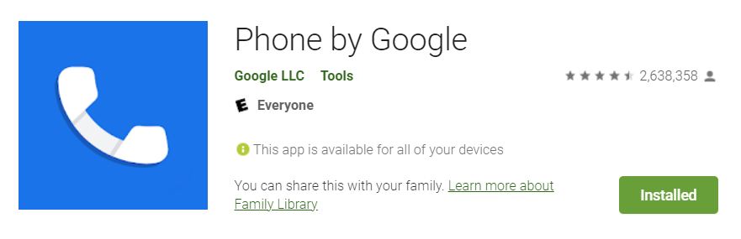
GMS Apps/Packages Investigations
Part 2: GMS Google Phone Dialer App

Slide 2
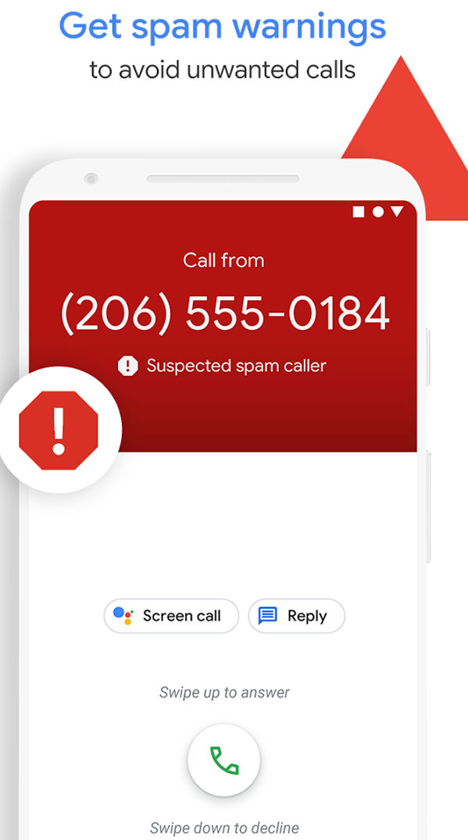
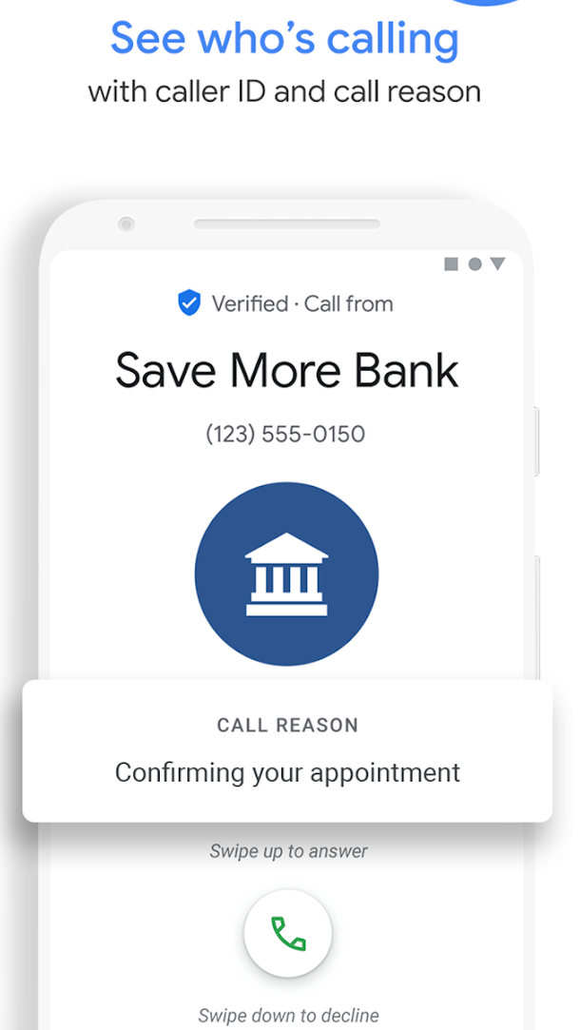
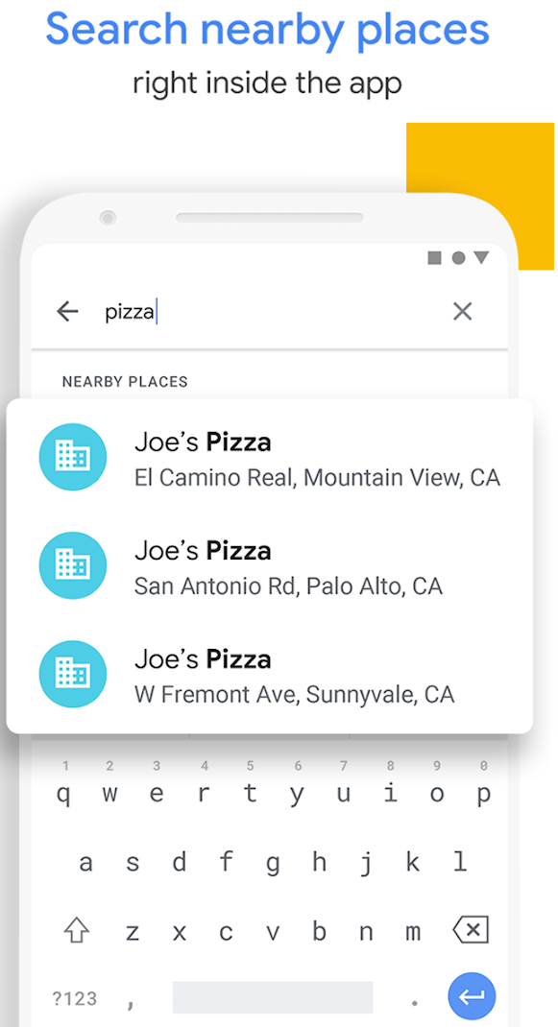
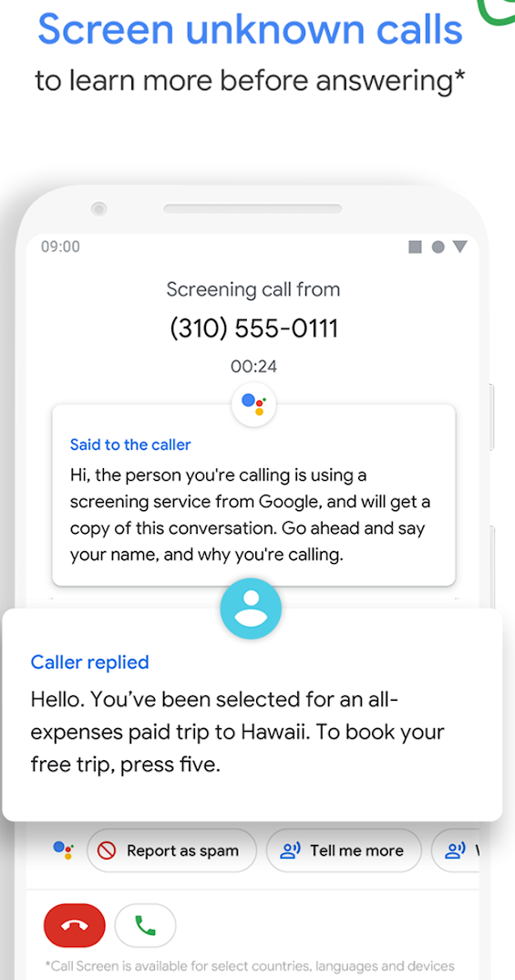
Phone App by Google id=com.google.android.dialer

Slide 3
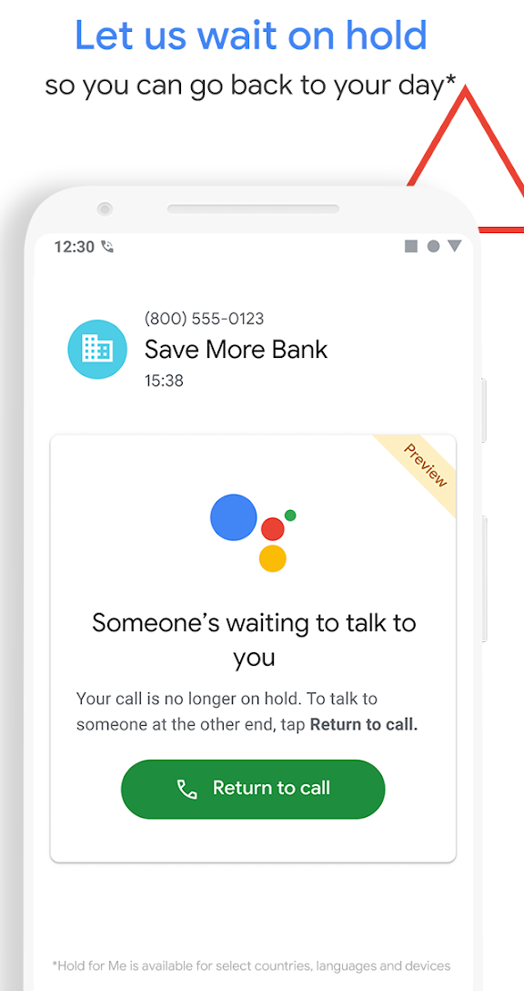
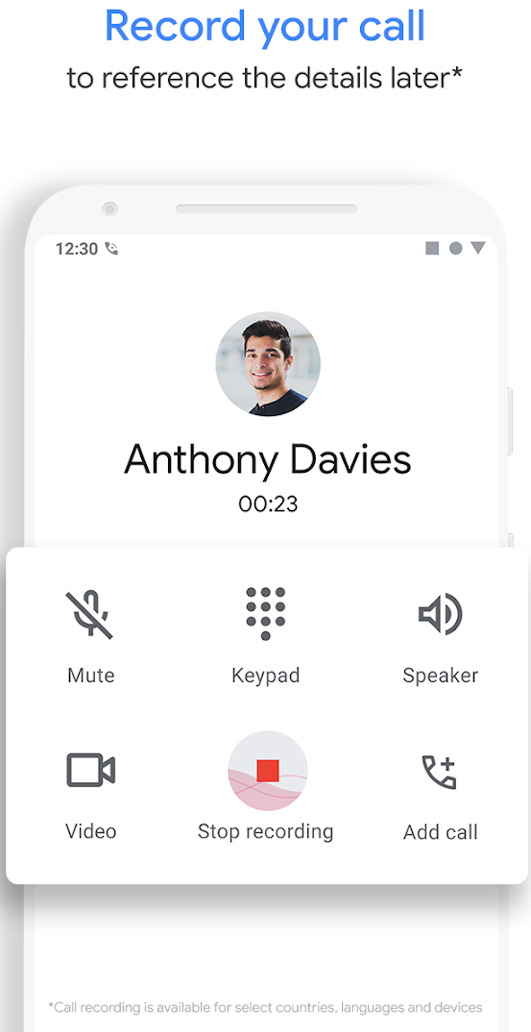
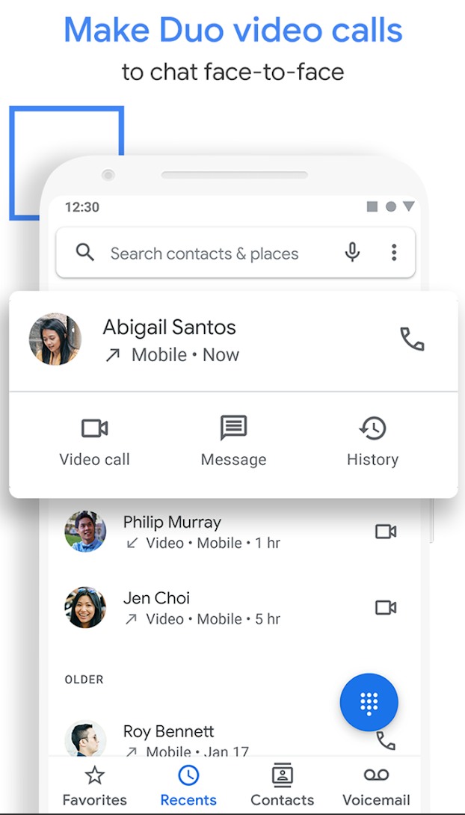
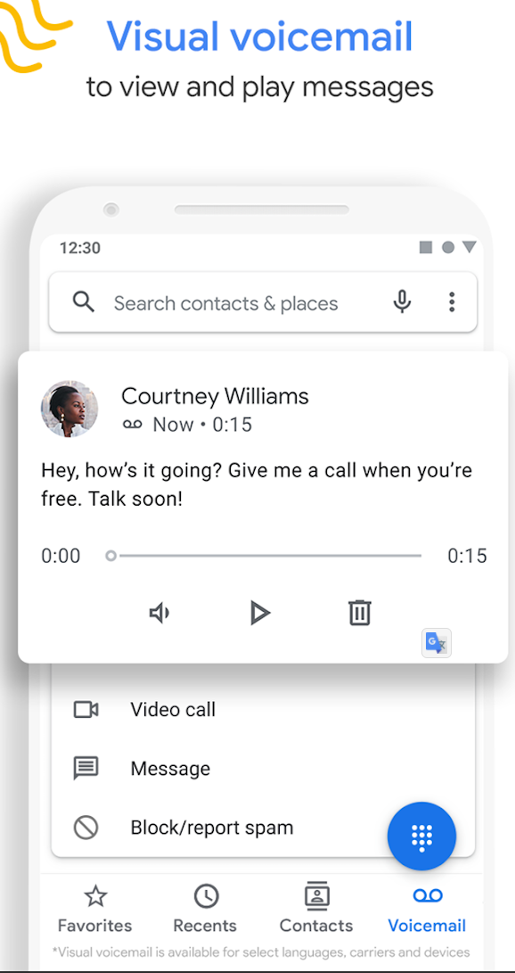

Slide 4
Questions
List all incoming calls
Did any callers leave voice mails?

Slide 5
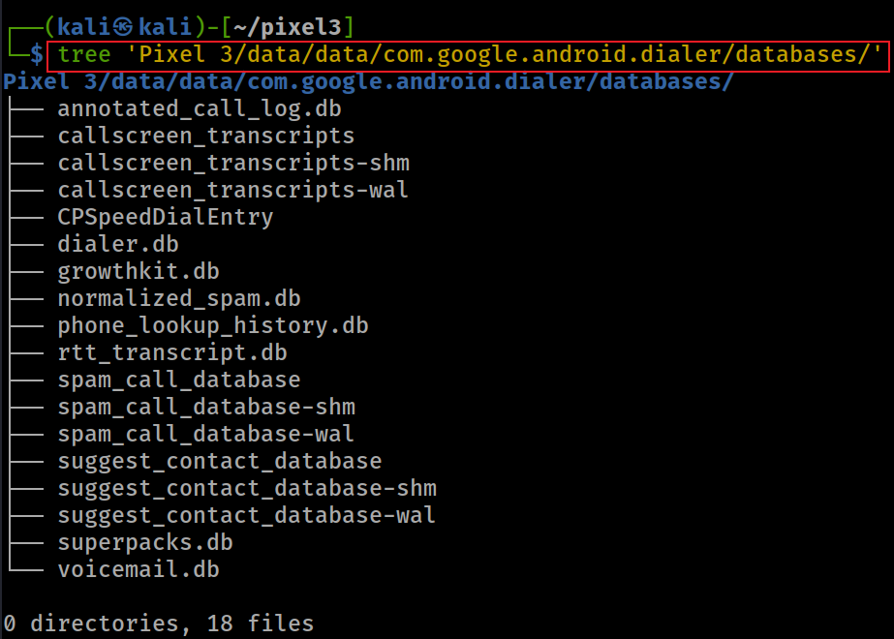
Notes:
tree 'Pixel 3/data/data/com.google.android.dialer/databases/'

Slide 6
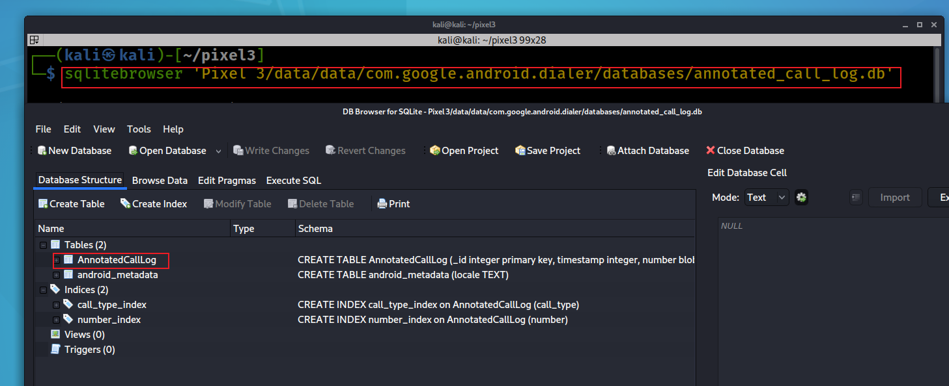
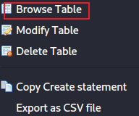
Notes:
sqlitebrowser 'Pixel 3/data/data/com.google.android.dialer/databases/annotated_call_log.db'

Slide 7
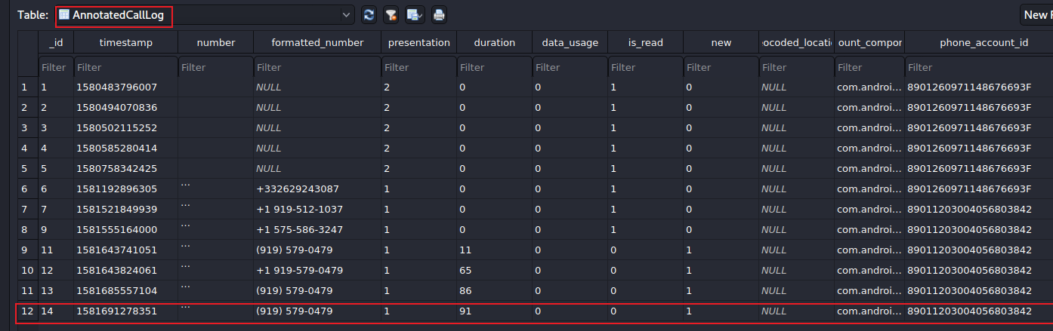

phone_account_component_name
com.android.phone/com.android.services.telephony.TelephonyConnectionService
calling/
received number
91 seconds
0: took the call
1: missed
The identifier for the account used to place or receive the call.
The phone has two accounts
calling/received time
Number is allowed to display for caller id.
1: number # showed
2: private #
The component name of the account used to place or receive the call
Notes:
date -d '@1581691278’ –u
https://developer.android.com/reference/android/provider/CallLog.Calls

Slide 8
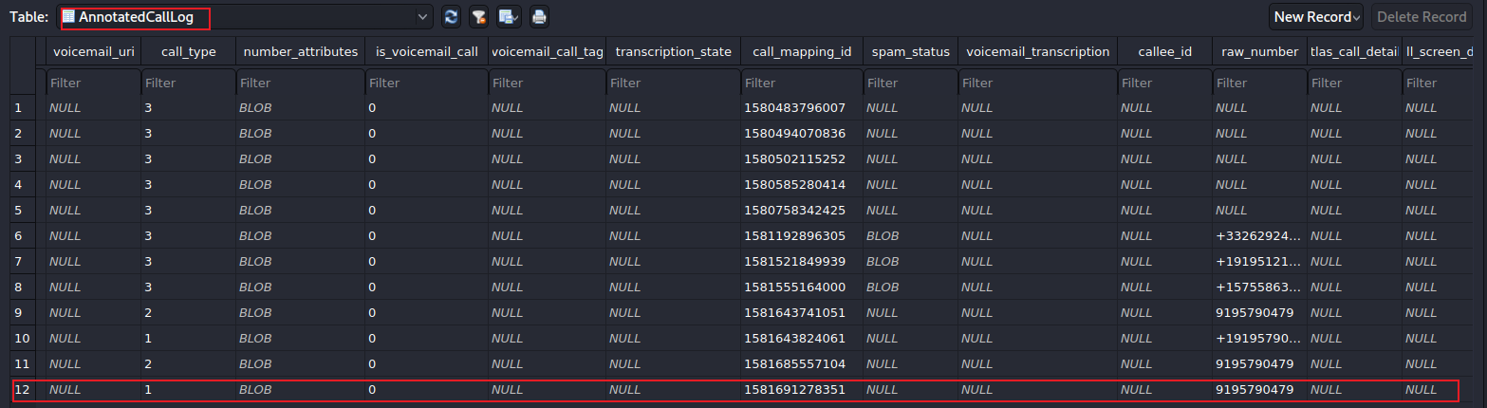
url to voicemail
1: incoming
2: outgoing
3: missed
left voice mail?
Voicemail transcription state, ie. in-progress, failed
Notes:
https://developer.android.com/reference/android/provider/CallLog.Calls.html#TYPE
https://android.googlesource.com/platform/packages/apps/Dialer/+/5d01ebb84a25c097a58ea8a3e1b4a521456e6f17/java/com/android/dialer/calllogutils/PhoneCallDetails.java

Slide 9

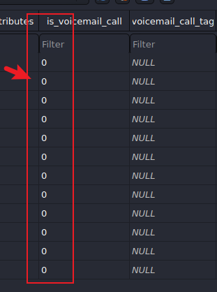
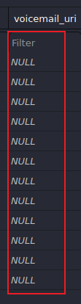
Answer
List all incoming calls
2
Did any callers leave voice mails?
none

Slide 10
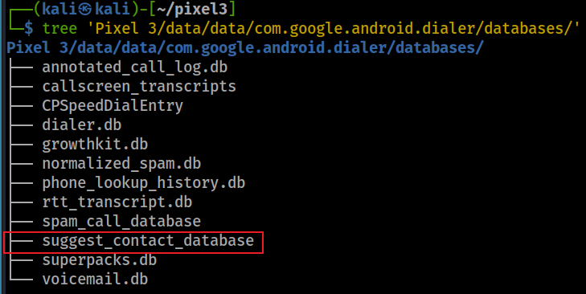
What are frequently contacted phone numbers?
When you try and share photos or anything from Google pixel, you will see suggested contacts pops up with several frequently contacted people in the phone

Slide 11
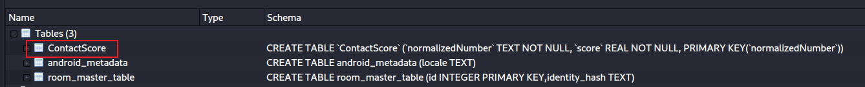
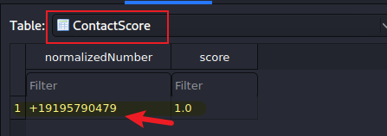
Open suggest_contact_database
Find thefrequently contacted phone numbers

Slide 12
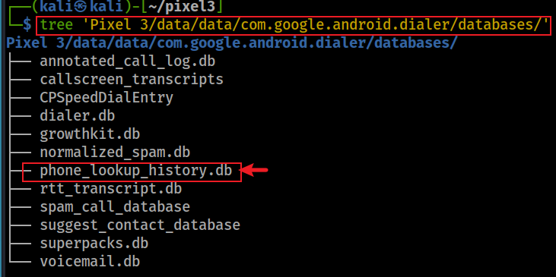
List phone lookup history
The phone number is recorded when an entry of contact is saved/modified.

Slide 13
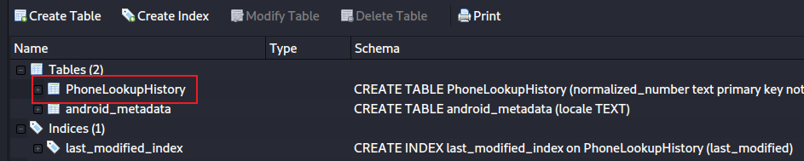
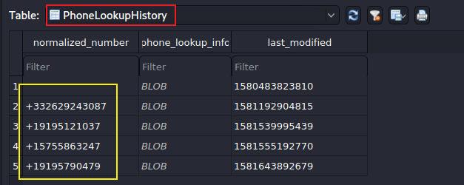
Open phone_lookup_history.db
Two contacts are saved

Slide 14
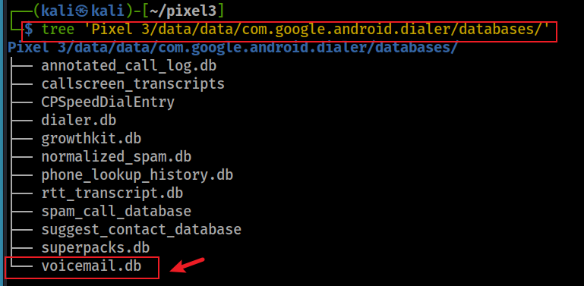
What is the greeting message?
The owner often provides greeting message. Did the owner use a greeting message?

Slide 15
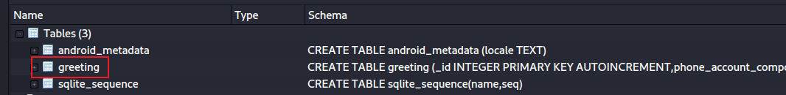
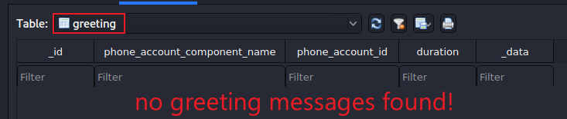
Open voicemail.db
Find thefrequently contacted phone numbers

Slide 16
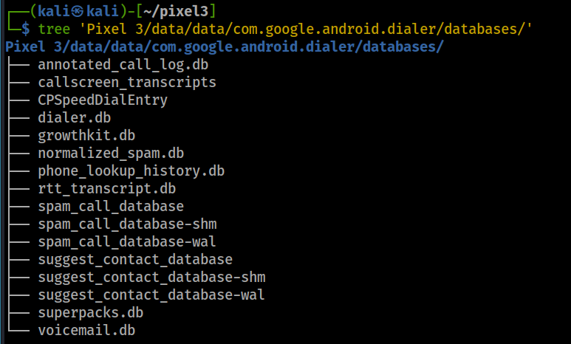
Other valuable information in databases
speed dial entry
spam call database

