Slide 1
Forensic Investigation of Eufy Video Doorbell
Introduction

Slide 2
Overview of Labs

Slide 3
# | Lab | Topic Covered | No. of Slides
1 | Lab 0 | Introduction of Eufy Doorbell | 08
2 | Lab 1 | Scenarion Simulation | 15
3 | Lab 2 | Device Teardown, eMMC Chip-off and Image Acquisition | 20
4 | Lab 3 | Image Analysis and Mounting | 09
5 | Lab 4 | Evidence Extraction | 06
6 | Lab 5 | Analysing p2p Communication | 18
7 | Lab 6 | Analysing Daily (Section) Log | 12
8 | Lab 7 | Analysing Camera00 Directory | 11
9 | Lab 4.2.2 | Analysing sqlite Directory | 18

Slide 4
Links to Disk Images, PPTs & Lab Data Folders
Description | Link
Eufy Hub (Homebase2) eMMC Image | https://miya.teracloud.jp/share/11d1e631cf6f8456 MD5: b58fa04967161c158723c7b00a636533
PPTs
Lab files

Slide 5
Introduction

Slide 6
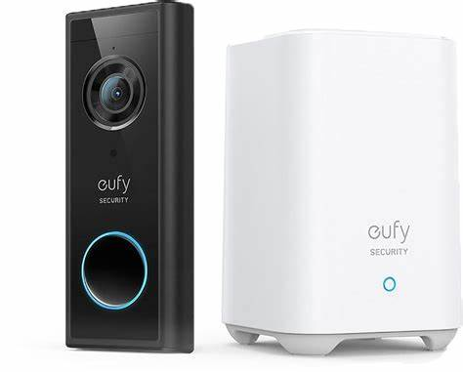
Eufy Video Doorbell
What is Eufy Doorbell? A smart home device that monitors and records activity at the entrance doors.
Features: High-resolution video, two-way audio communication, remote access through the app, local storage
Forensic Significance: Timeline (user behavior) reconstruction and related evidence
Image source: https://www.netonnet.se/GetFile/ProductImagePrimary/hem-fritid/smarta-hem/smarta-dorrklockor/eufy-video-doorbell-2k-black-kit-with-homebase(1018348)_440721_1_Normal_Extra.jpg

Slide 7


Two Units – Doorbell and Hub
Doorbell
Primary doorbell device mounted at entrances
Provides functionalities of video recording, audio communication, & motion detection.
Hub
A distinct unit from the doorbell is placed inside the home.
Acts as a central hub for other Eufy security devices
Equipped with built-in local storage to s tore video recordings securely
Local storage means no monthly fees and reduced risk of cloud breaches.

Slide 8
Specifications of Device Investigated
Doorbell
Name: Eufy Wireless Video Doorbell 2K
Video Resolution: Up to 2560 x 1920 pixels (defaults to 1600 x 1200 pixels).
Connectivity: 2.4GHz Wi-Fi.
Hub
Name: Eufy HomeBase 2
Wireless Range: Supports up to 16 Eufy Cam
Storage: 16GB of local encrypted eMMC storage.

