Slide 1
Forensic Investigation of Eufy Video Doorbell
Scenario Simulation

Slide 2
Devices and Accounts Used/Created
Accounts
An Outlook account was created for the simulation.
A Eufy security account was created to use the Eufy App.
An Amazon account was used to connect Alexa through Echo Show.
Devices
Eufy Wireless Video Doorbell 2K
Eufy HomeBase 2
iPhone 12 Pro was used as a client device

Slide 3
Accounts Created/Used

Slide 4
Outlook Account Information
First Name: Adrian
Last Name: Monk
Date of Birth: March 17, 1984
Gender: Male
User ID: adrian.monkbell@outlook.com
Password: drbell1@

Slide 5
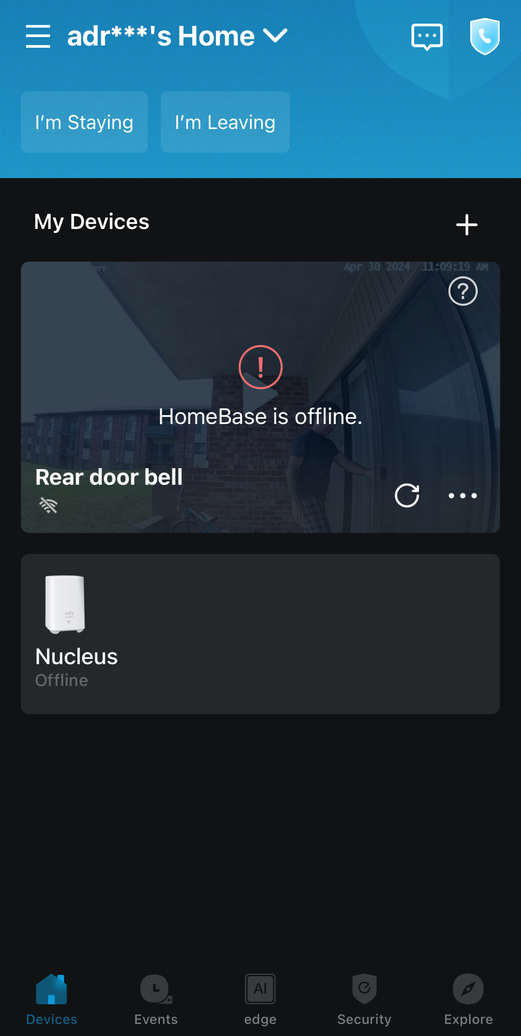
Eufy Account Information
Email: Adrian.monkbell1@outlook.com
Password: Eybase1@
Region: United States
Nickname: Adrian
(username)

Slide 6
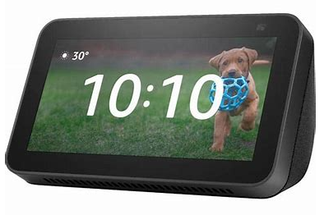
Linked Amazon Account
Amazon User ID: carfy53@gmail.com

Slide 7
Devices Created/Used

Slide 8
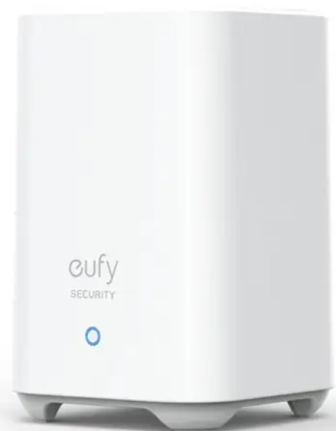
Home Base Information
Name: Nucleus
Storage: 0.05/14.68
Model: HomeBase2
Serial No: T8010P1323230B6F
System Version: 3.3.3.2h (04-19 01:40 AM)
Subsystem version: 1.3.0.9
IP Address: 192.168.1.151
MAC Address: 04:17:B6:BC:6B:DB
Time Zone: EDT (New York)

Slide 9
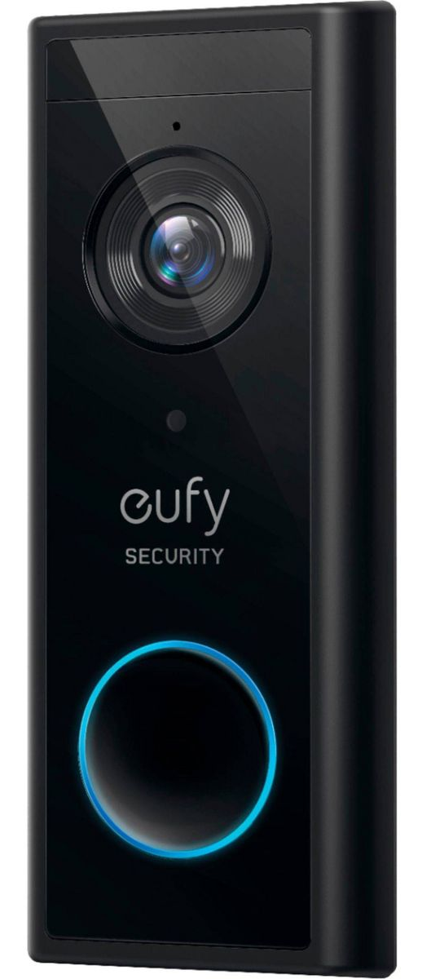
Doorbell Information
Name: Rear doorbell
Model No.: T8210C
Serial Number: T8210P812324252D
System Version: 3.0.7.4 (04-05 10:13 AM)

Slide 10
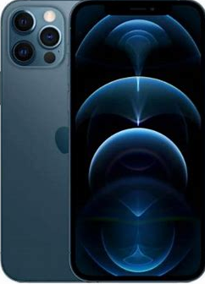
Client Device - iPhone
Model: iPhone 12 Pro
iOS: 17.4.1
App: Eufy Security
Login Time: 04-30-2024 09:56:47
Version: V4.8.22_1419

Slide 11
Scenario Simulation

Slide 12
Events Simulated
S. No. | Event Type | Timestamp | Description
1 | Ring | Apr 30, 10:06 am | Bell was rung
2 | Human | Apr 30, 10:36 am | Human motion detected (movement of a person)
3 | Ring | Apr 30, 10:37 am | Human motion detected (movement of a person)
4 | Human, Ring | Apr 30, 10:39 am | A person rang the bell (video and audio recorded)
5 | Human, Ring | Apr 30, 10:40 am | A person rang the bell, owner answered (video and audio recorded)

Slide 13
Events Simulated
S. No. | Event Type | Timestamp | Description
6 | Human, Ring | Apr 30, 10:42 am | A person rang the bell (video and audio recorded)
7 | Human, Ring | Apr 30, 10:44 am | A person rang the bell, owner answered (video and audio recorded)
8 | Human | Apr 30, 10:45 am | Human motion detected (movement of a person)
9 | Human | Apr 30, 10:47 am | Human motion detected (Package delivered by a person)
10 | Human | Apr 30, 10:48 am | Human motion detected (Someone stole the package)

Slide 14
Events Simulated
S. No. | Event Type | Timestamp | Description
11 | Human | Apr 30, 10:49 am | Human motion detected (Someone stole the soccer ball)
12 | Human | Apr 30, 10:50 am | Human motion detected (Someone roaming the view)
13 | Human, Ring | Apr 30, 10:51 am | A person rang the bell (video and audio recorded), pre recorded answer by owner
14 | Away Mode | Apr 30, 10:53 am | Away mode set
15 | Human, Ring | Apr 30, 10:54 am | A person rang the bell, (video and audio recorded)

Slide 15
Events Simulated
S. No. | Event Type | Timestamp | Description
16 | Home Mode | Apr 30, 10:55 am | Home mode set
17 | Human, Ring | Apr 30, 10:59 am | A person rang the bell, (video and audio recorded)
18 | Human | Apr 30, 11:09 am | Human motion detected (movement of a person)
A total of 18 events were simulated on the Eufy doorbell

