Slide 1
Forensic Investigation of Eufy Video Doorbell
Mounting and Analysis of Image File

Slide 2
Analysis of Image File

Slide 3
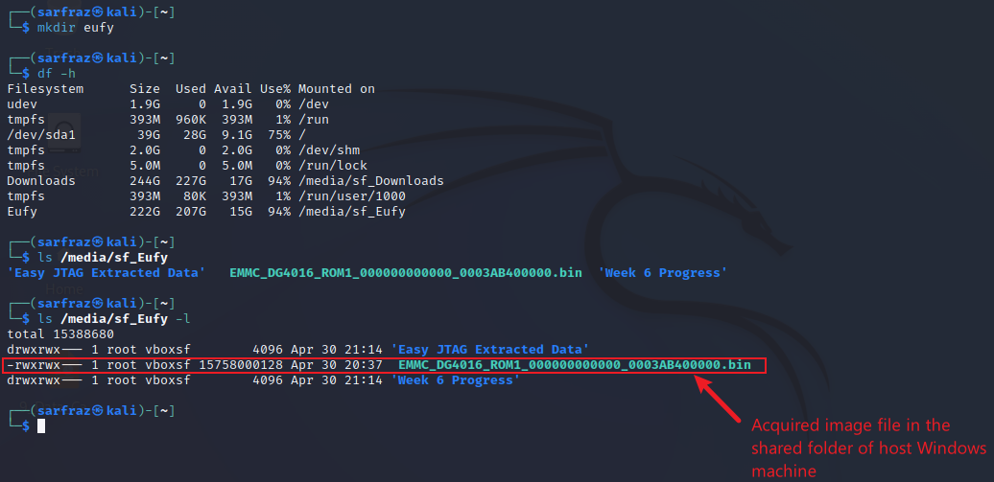
Check Image File Size
List the image file with details
15758000128 bytes
=
14.67578125 Gigabytes

Slide 4
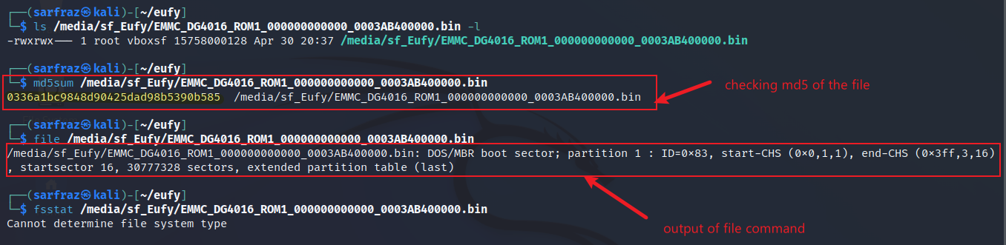
Check MD5 and File Type
Determine the md5, file, and file system
MD5: 0336a1bc9848d90425dad98b53906585
File type: DOS/MBR boot sector (code to start OS)
File System: Unknown

Slide 5
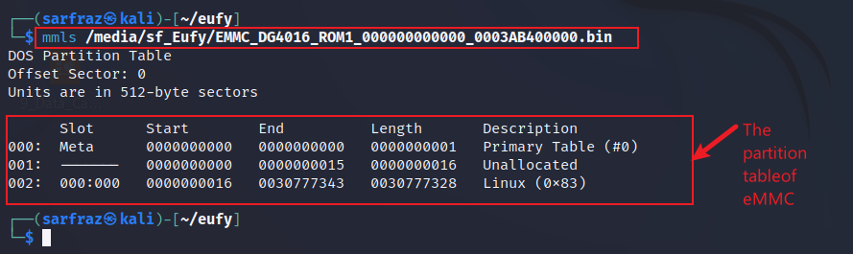
Check Partition Table
Use mmls command to display the partition layout
Partition Table: DOS
Partitions: One
Partition File System: Linux

Slide 6
Mounting the Image File

Slide 7
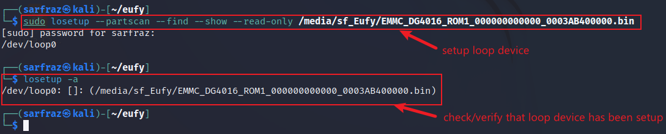
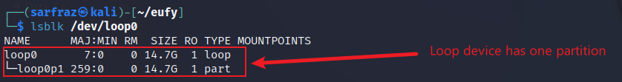
Setup Loop Device
Use losetup command to set up image as loop device
Display partitions in the loop device
Loop device has one partition – 14.7 GB

Slide 8
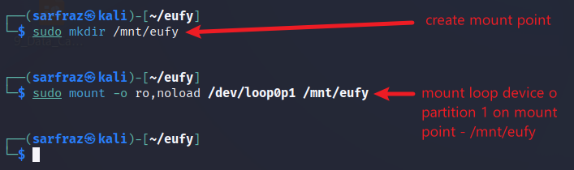
Mount the Loop Device
Use mount command to mount the loop device
Mounting image with the noload option ensures it's mounted in read-only mode.
This prevents the kernel from accidentally writing to the image and helps preserve the original data.

Slide 9
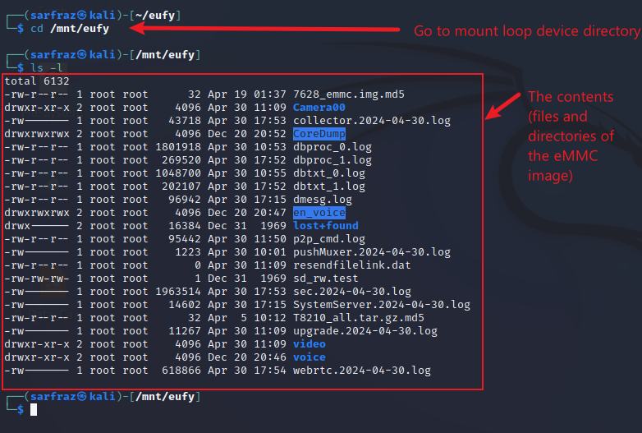
Display the Contents of Mounted Image File
List the content of mounted image/loop device
There are:
06 directories
16 files

