Slide 1
Forensic Investigation of Eufy Video Doorbell
Evidence Extraction

Slide 2
Evidence Extraction

Slide 3
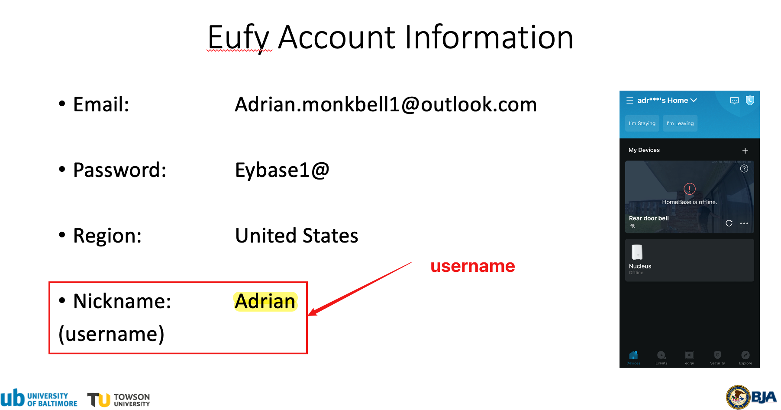
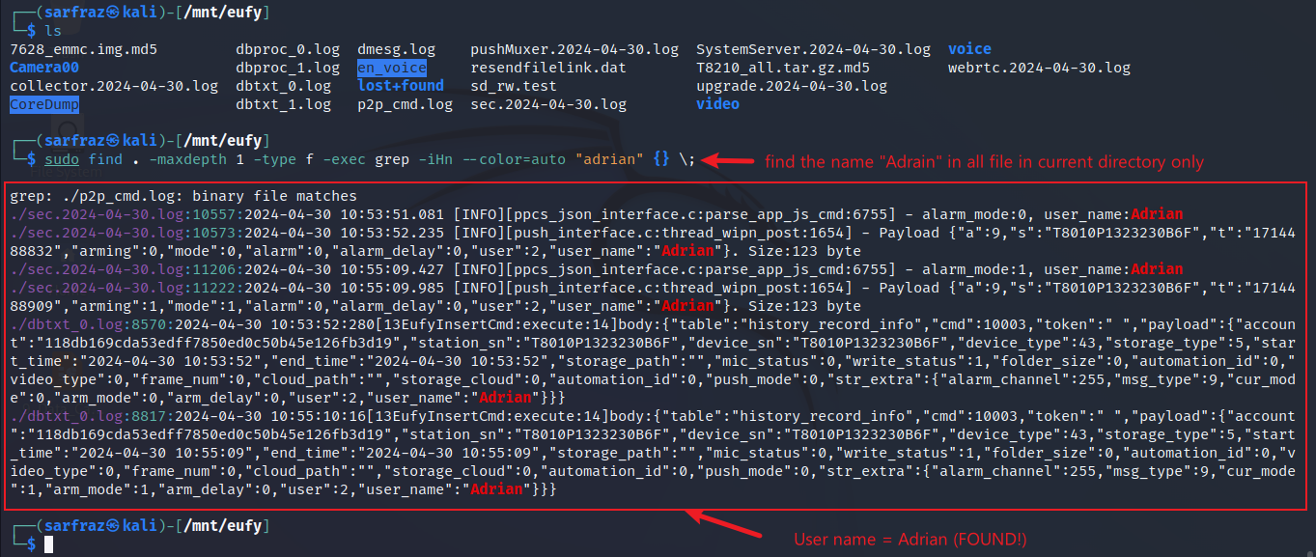
Search Username ‘Adrain’
Use find command to search username ‘Adrain’

Slide 4
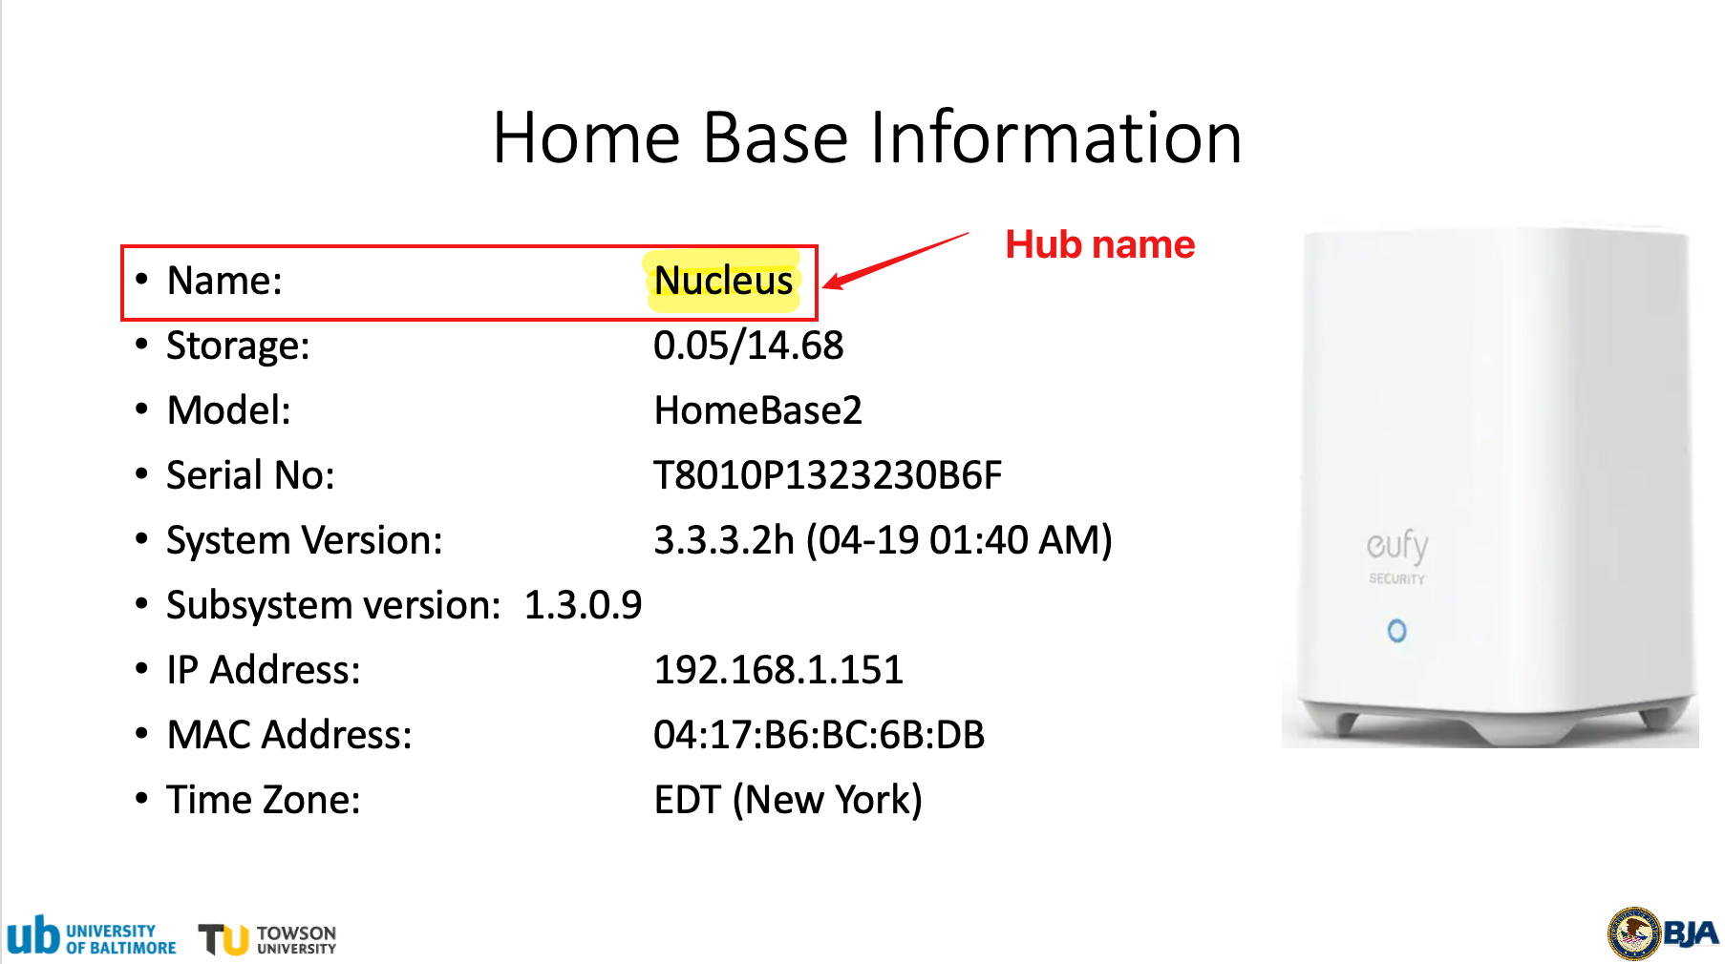
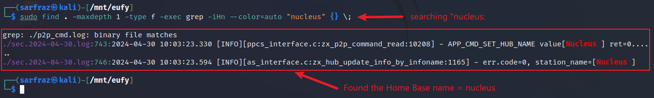
Search Hub (Homebase2) Name ‘Nucleus’
Use find command to search hub name ‘Nucleus’

Slide 5
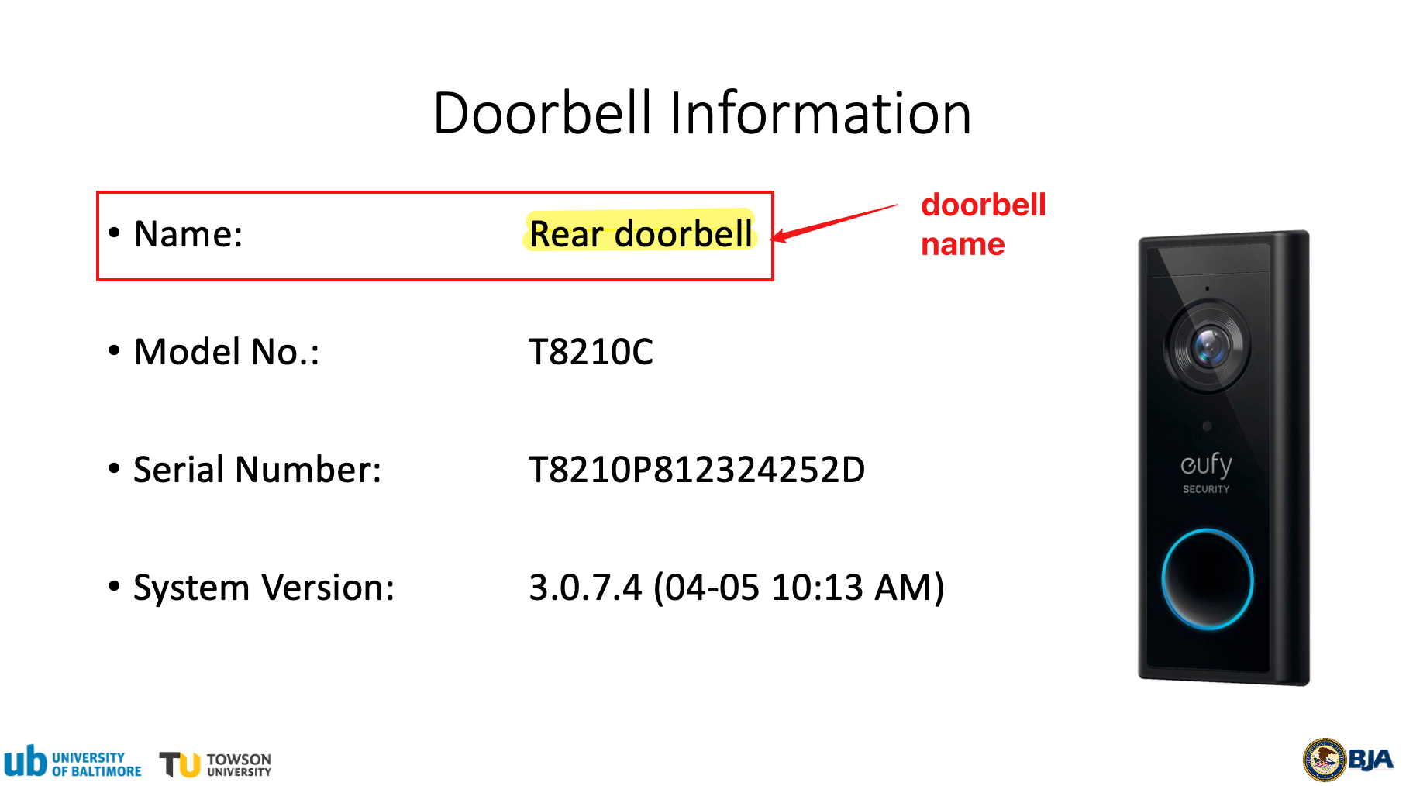
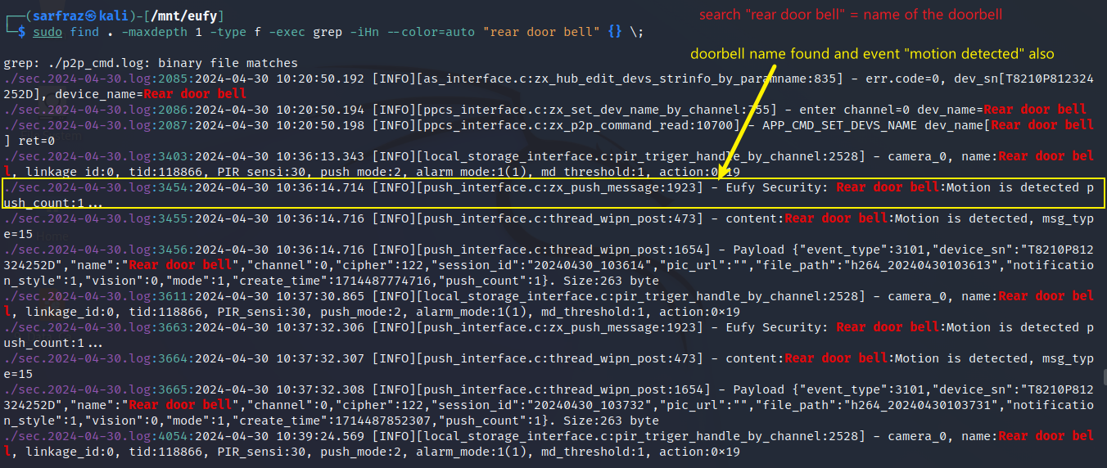
Search Doorbell name ‘Rear door bell’
Use find command to search device name ‘Rear doorbell’

Slide 6
Important Directories and Files Containing Potential Evidence
S. No. | Directory/File | What it contains
1 | /media/mmcblk0p1/.sqlite | Database files recording event histories
2 | /media/mmcblk0p1/video/ | Thumbnails & cropped human pictures of recorded event videos
3 | media/mmcblk0p1/Camera* | Encrypted event video files and text files containing the event details
4 | p2p_cmd.log | Log file containing log of commands / interaction with client device (p2p) app
5 | sec.YYYY-MM-DD.log | Log files containing log of activities for a particular date
* Represents the number of camera, like 00 for first camera and so on

