Slide 1
Forensic Investigation of Eufy Video Doorbell
P2p Communication

Slide 2
Important Directories and Files Containing Potential Evidence
S. No. | Directory/File | What it contains
1 | /media/mmcblk0p1/.sqlite | Database files recording event histories
2 | /media/mmcblk0p1/video/ | Thumbnails & cropped human pictures of recorded event videos
3 | media/mmcblk0p1/Camera* | Encrypted event video files and text files containing the event details
4 | p2p_cmd.log | Log file containing log of commands / interaction with client device (p2p) app
5 | sec.YYYY-MM-DD.log | Log files containing log of activities for a particular date
* Represents the number of camera, like 00 for first camera and so on

Slide 3
Analyzing p2p communication log
P2p_cmd.log

Slide 4
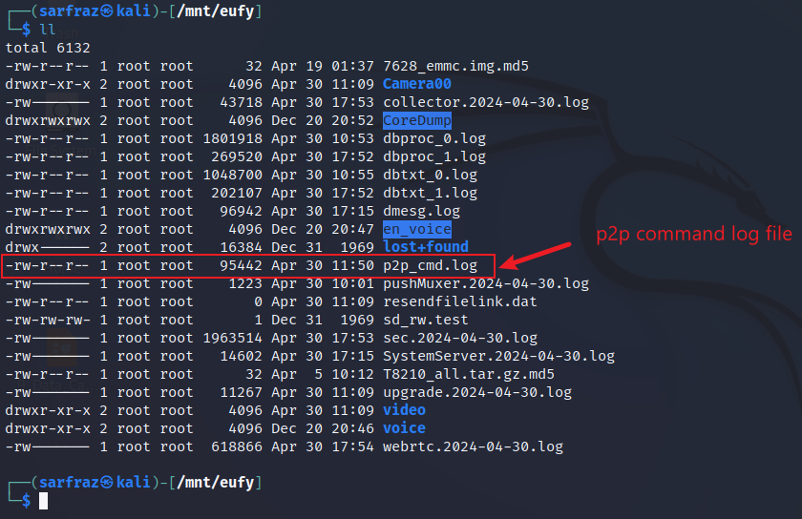
p2p (peer-to-peer) Communications
Look for p2p_cmd.log file
The p2p_cmd.log file is a log file.
It contains records of communication between the Home Base and the connected client device (iPhone in this case).
Includes various commands exchanged between the devices facilitated through the Eufy app on the iPhone.

Slide 5
Some important p2p commands
S. No | Command | Description
1 | APP_CMD_BIND_SYNC_ACCOUNT_INFO_EX | Bind account to device
2 | APP_CMD_SET_LANGUAGE | Set language
3 | APP_CMD_SET_TIMEZONE | Set timezone
4 | APP_CMD_SET_COUNTRYCODE | Set country
5 | APP_CMD_SET_DEVS_NAME | set name of device (doorbell)
6 | APP_CMD_SET_HUB_NAME | Set name of hub (home base)
7 | APP_CMD_START_REALTIME_MEDIA | Start live view
8 | APP_CMD_STOP_REALTIME_MEDIA | End live view
9 | APP_CMD_START_TALKBACK | Start talking to bell
10 | APP_CMD_STOP_TALKBACK | Stop talking to bell
11 | APP_CMD_RECORD_VIEW | View recorded video
12 | APP_CMD_RECORD_PLAY_CTRL | Play recorded video
13 | APP_CMD_DOWNLOAD_VIDEO | Downloaded recorded video

Slide 6
2 Accounts were Used on the Eufy Device
S. No. | Username (email address) | Nickname | Usage Dates
1 | carfy53@gmail.com | Sarfraz | April 5 – April 22
2 | adrian.monkbell1@outlook.com | Adrian | April 30

Slide 7
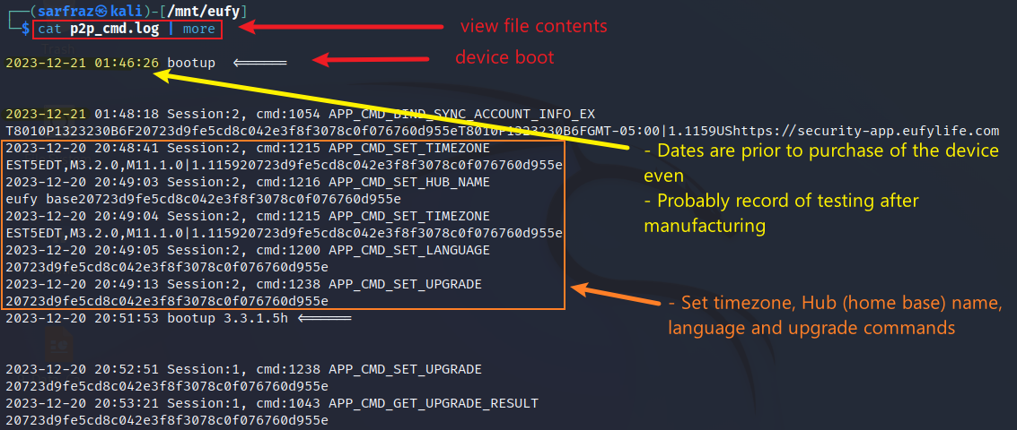
p2p (peer-to-peer) Communications
Display contents of p2p_cmd.log file
P2p log shows interaction prior to purchase date – probably testing of device

Slide 8
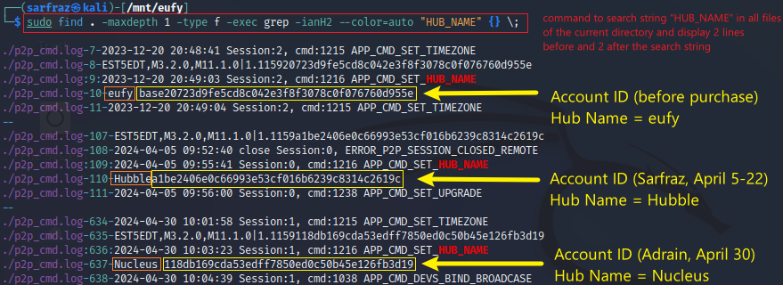
Each Account has Different ID
Search string “HUB_NAME” in all files of current directory
Account 1: created by manufacturer for testing (assumption)
Account 2: Sarfraz (created during simulation, used from April 5 to 22)
Account 3: Adrian (created during simulation, used on April 30)

Slide 9
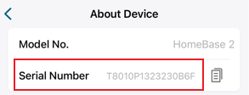
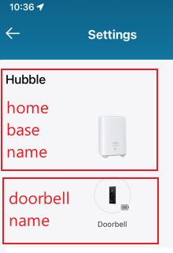
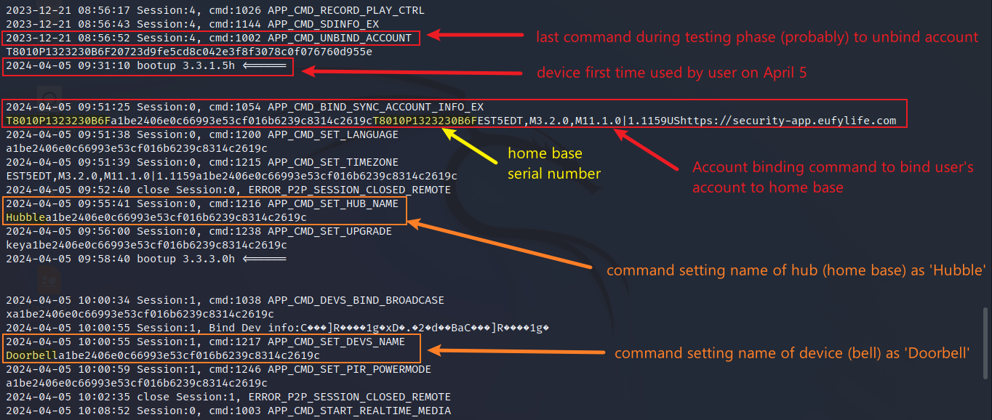
Serial number & name of home base and doorbell
Display contents of p2p_cmd.log file & scroll down
Evidence related to account 1 (Sarfraz) since dates between April 5 – April 22

Slide 10
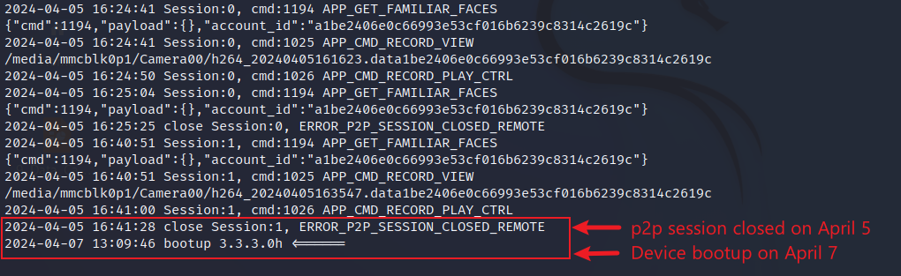
p2p Session Closed on April 5
Scroll down the p2p_cmd.log file
Evidence related to account 1 (Sarfraz) since dates between April 5 – April 22

Slide 11
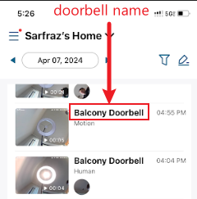
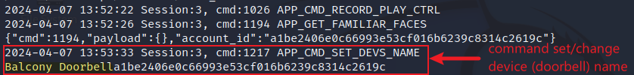


Log Showing Setting of Doorbell Name
Scroll down the p2p_cmd.log file
Excerpts from log file showing p2p session close and bootup on various dates

Slide 12
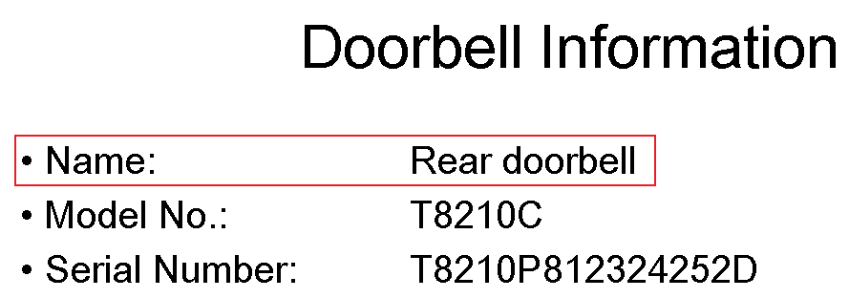
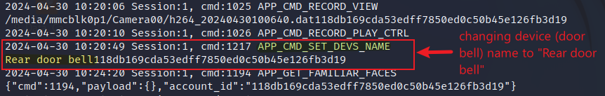
Log File Showing Change of the doorbell name
Scroll down the log to view setting device name

Slide 13
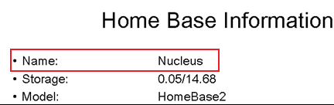
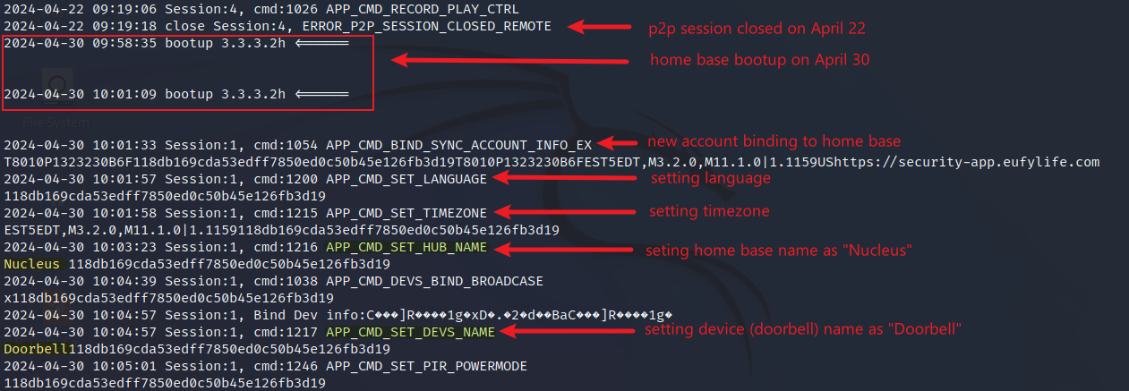
Log File Showing New Account Binding with Device
Scroll down the log to view p2p session established on April 30
Evidence related to account 2 (Adrian) since date is April 30

Slide 14
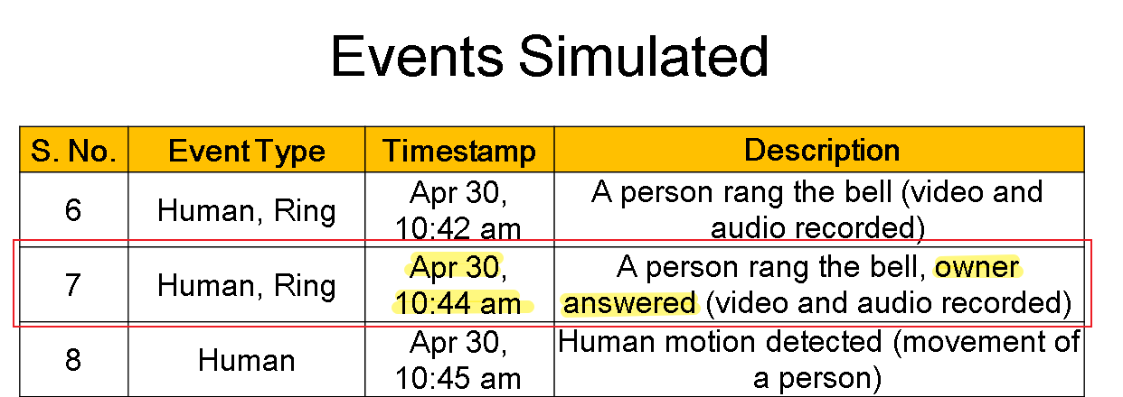
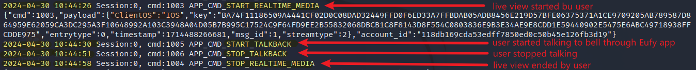
Log File Showing an Event (User Talking Through Bell & Viewing Live Video)
Details of the Event Simulated
‘ClientOS = IOS’ indicates that the client device connected to home base through p2p is an iPhone
Scroll down the log to view the details the event shown above

Slide 15
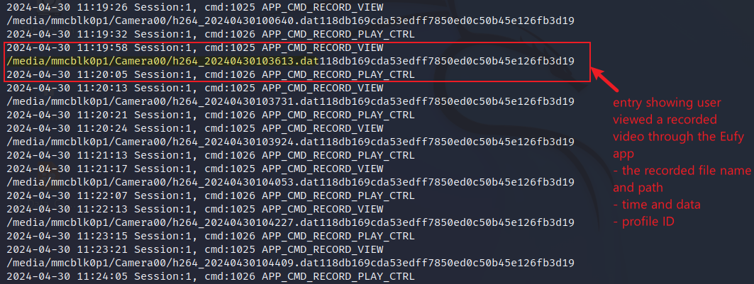
Log file showing user viewed recorded videos
Entries showing user viewed recorded videos

Slide 16
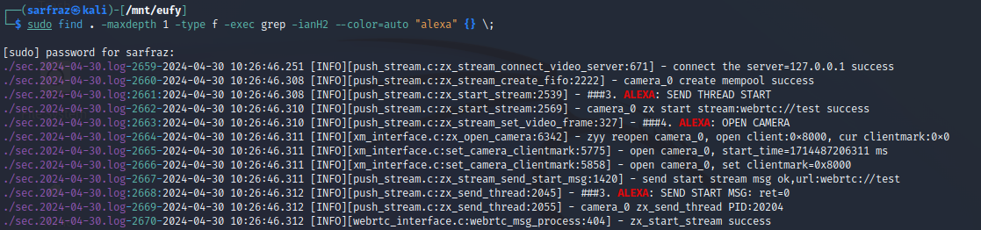
Evidence of use of Alexa device
Search string “HUB_NAME” in all files of current directory

Slide 17
Timeline of p2p communication
p2p_cmd.log

