Slide 1
Forensic Investigation of Eufy Video Doorbell
Daily (Section) Log File

Slide 2
Important Directories and Files Containing Potential Evidence
S. No. | Directory/File | What it contains
1 | /media/mmcblk0p1/.sqlite | Database files recording event histories
2 | /media/mmcblk0p1/video/ | Thumbnails & cropped human pictures of recorded event videos
3 | media/mmcblk0p1/Camera* | Encrypted event video files and text files containing the event details
4 | p2p_cmd.log | Log file containing log of commands / interaction with client device (p2p) app
5 | sec.YYYY-MM-DD.log | Log files containing log of activities for a particular date
* Represents the number of camera, like 00 for first camera and so on

Slide 3
Analyzing daily log file
sec.2024-04-30.log

Slide 4
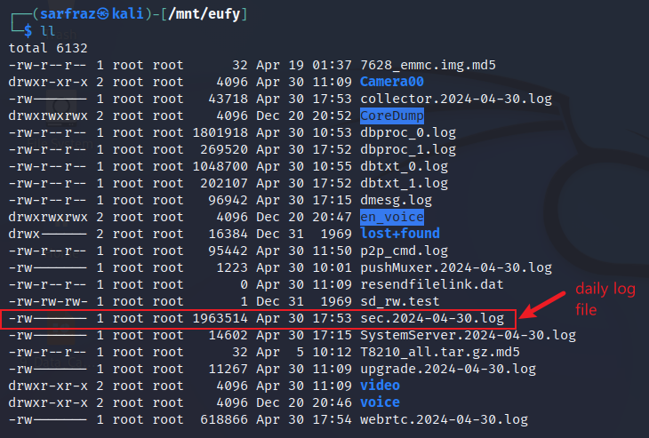
Daily Log File
Look for sec.2024-04-30.log
The sec.2024-04-30.log file is a log file.
It contains records of all activities on the home base on April 30, 2024.
Since this device was used only on April 30, so only one file. Otherwise, there should have been multiple files – one for each date.

Slide 5
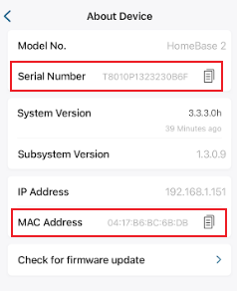
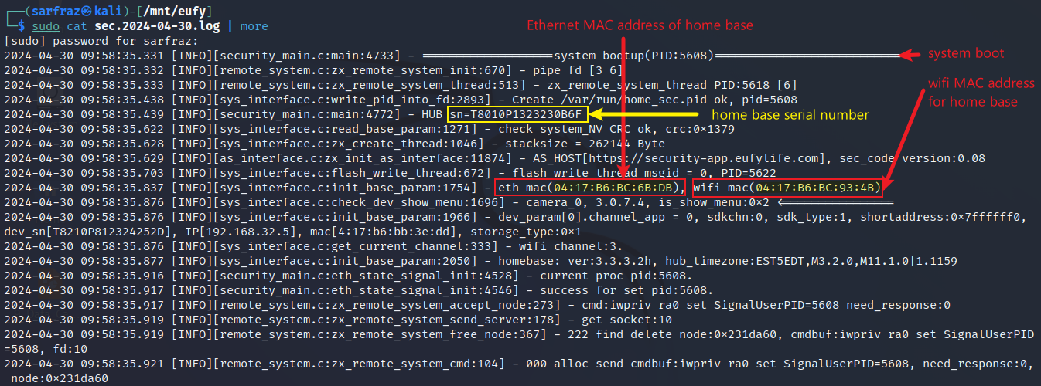
Daily Log Showing MAC address
Display contents of sec.2024-04-30. log file

Slide 6
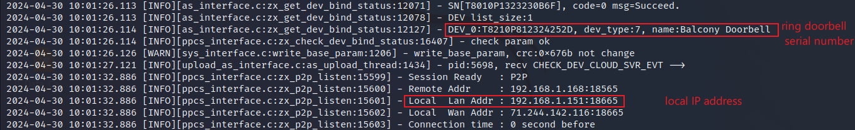
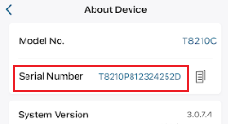
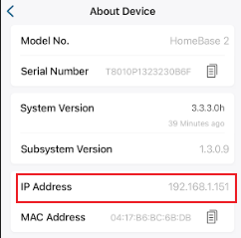
Doorbell Name, Serial Number and Home Base Local IP Address
Scroll down the log file to view the IP address, doorbell name, and serial no.

Slide 7
Log Showing Old and New Account IDs
New account binding to the device
Old and new accounts IDs

Slide 8
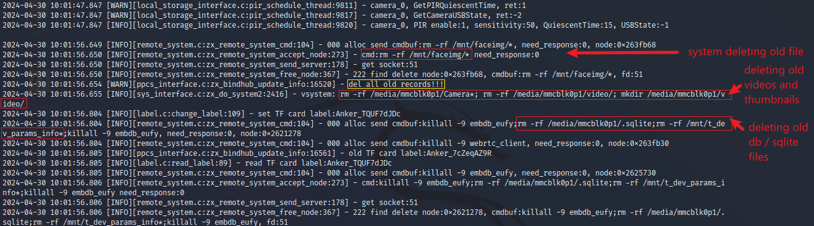
System Deleting Old Files & Directories and Creating New
Scroll down the log file to view delete files command

Slide 9
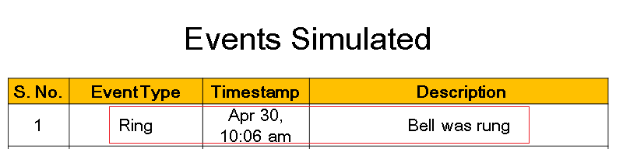
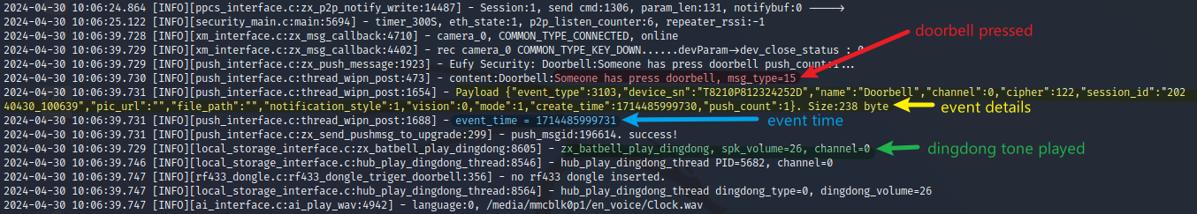

Log Shows the First Event
Scroll down the log file to view first event
Convert timestamp to EDT

Slide 10
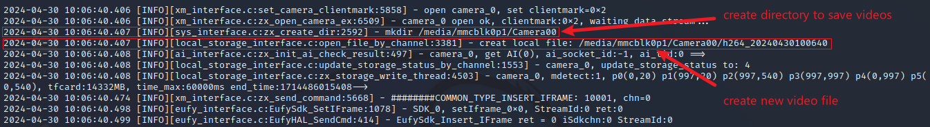
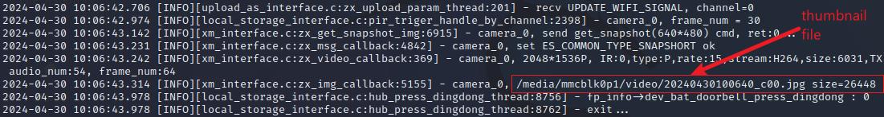
Log Shows the Creation of a Directory and a Video File for the New Event
New directory and video file created
Thumbnail file created

Slide 11
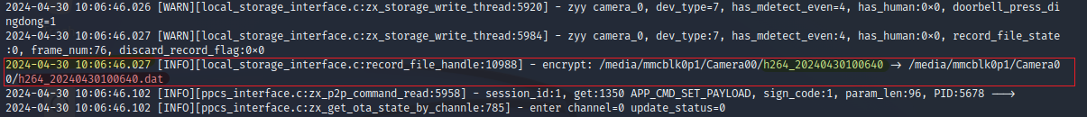
Log Shows Encryption of the Video File
Log file showing encrypt the video file

