Slide 1
Forensic Investigation of Eufy Video Doorbell
Analyzing Camera00 File

Slide 2
Important Directories and Files Containing Potential Evidence
S. No. | Directory/File | What it contains
1 | /media/mmcblk0p1/.sqlite | Database files recording event histories
2 | /media/mmcblk0p1/video/ | Thumbnails & cropped human pictures of recorded event videos
3 | media/mmcblk0p1/Camera* | Encrypted event video files and text files containing the event details
4 | p2p_cmd.log | Log file containing log of commands / interaction with client device (p2p) app
5 | sec.YYYY-MM-DD.log | Log files containing log of activities for a particular date
* Represents the number of camera, like 00 for first camera and so on

Slide 3
Analyzing Camera Directory
Camera00

Slide 4
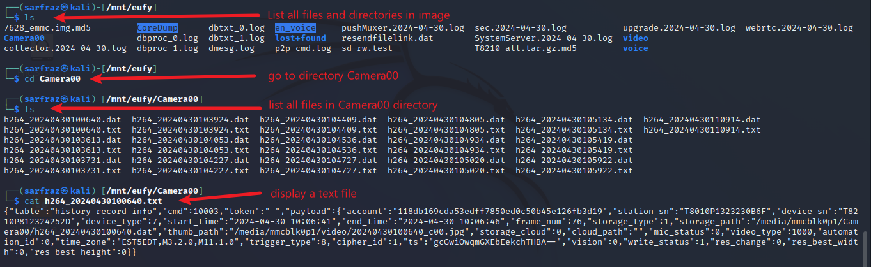
One Text File for Each Event in the Directory ‘Camera00’
List files in the ‘Camear00’ directory

Slide 5
One Text File and One dat File For Each Event in the Directory ‘Camera00’
List files in the ‘Camear00’ directory
Dat file is probably the encrypted recorded video

Slide 6
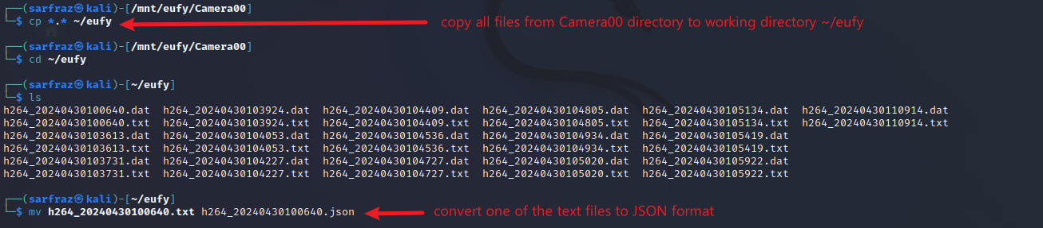
Convert the Text File to JSON Format for Better Readability
Use mv command to rename txt file to JSON

Slide 7
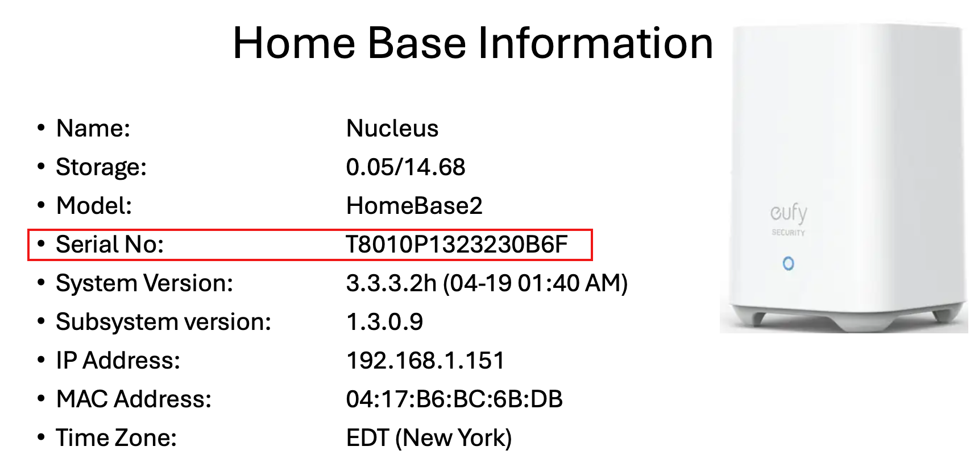
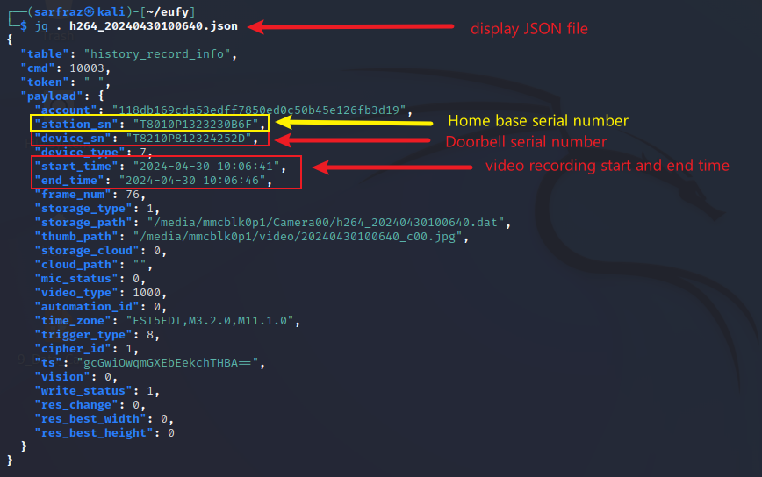
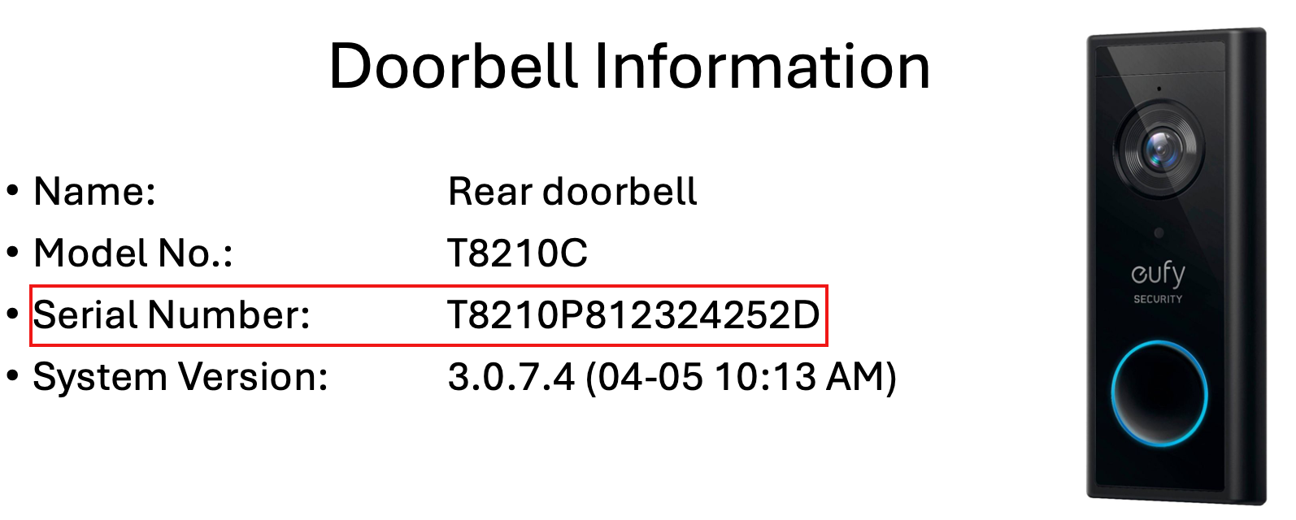
View the Event Details in JSON File
Use jq command to parse JSON file

Slide 8
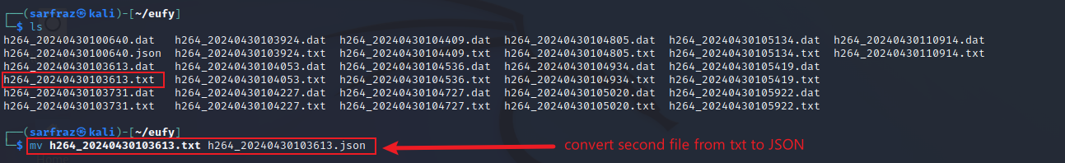
Convert Another Text File to JSON File
Use mv command to rename txt file to JSON

Slide 9
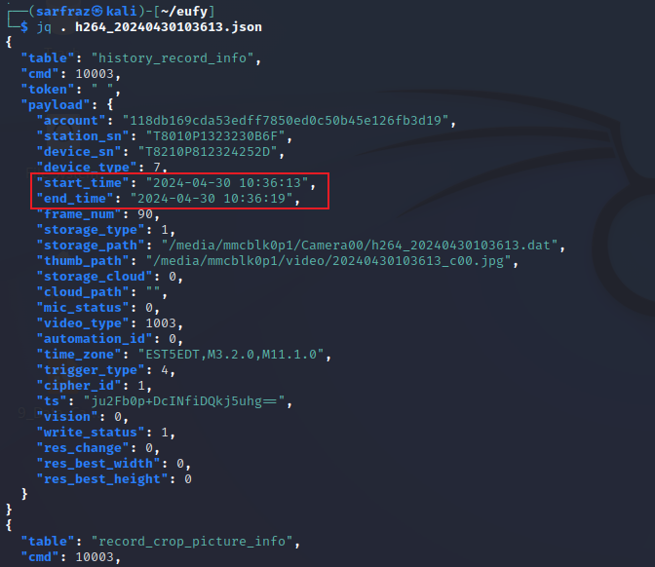
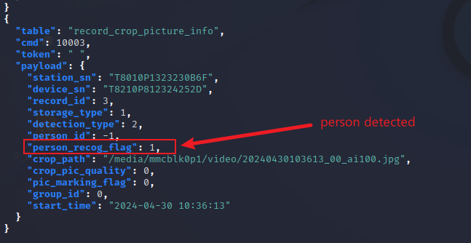
View the Event Details of Second Event in JSON File
Use jq command to parse JSON file

