Slide 1
Forensic Investigation of Eufy Video Doorbell
Analyzing sqlite Directory

Slide 2
Important Directories and Files Containing Potential Evidence
S. No. | Directory/File | What it contains
1 | /media/mmcblk0p1/.sqlite | Database files recording event histories
2 | /media/mmcblk0p1/video/ | Thumbnails & cropped human pictures of recorded event videos
3 | media/mmcblk0p1/Camera* | Encrypted event video files and text files containing the event details
4 | p2p_cmd.log | Log file containing log of commands / interaction with client device (p2p) app
5 | sec.YYYY-MM-DD.log | Log files containing log of activities for a particular date
* Represents the number of camera, like 00 for first camera and so on

Slide 3
Analysis of the database files in .sqlite directory
.sqlite

Slide 4
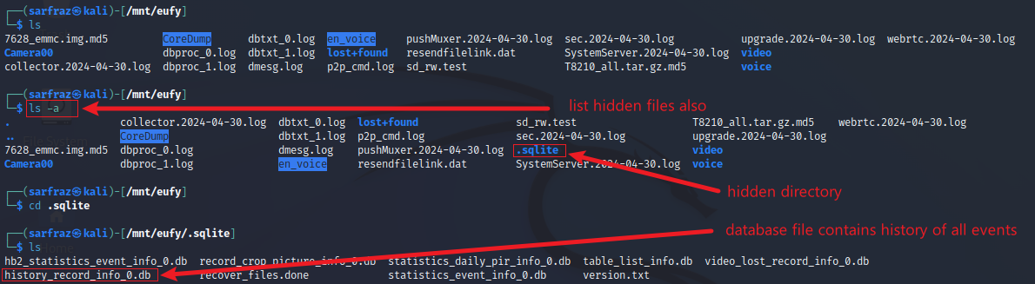
Database files are in a hidden directory (.sqlite)
List hidden files and directories
Directory (.sqlite) containing database files is hidden, so use ls –a t list hidden directories
.sqlite directory contains various database files related to events on connected cameras/doorbell

Slide 5
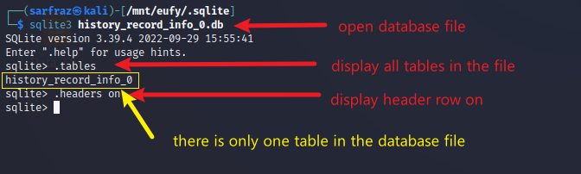
Open Database File history_record_info_0 File
Open databse (.db) file & turn headers on

Slide 6
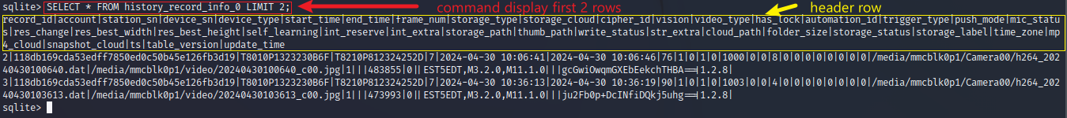
Display Selected Contents of history_record_info_0 File
Display first 2 rows with all columns from table
The table has many rows so it is difficult to view
Limit display columns to necessary columns only

Slide 7
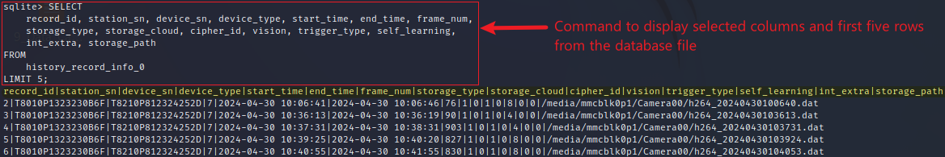
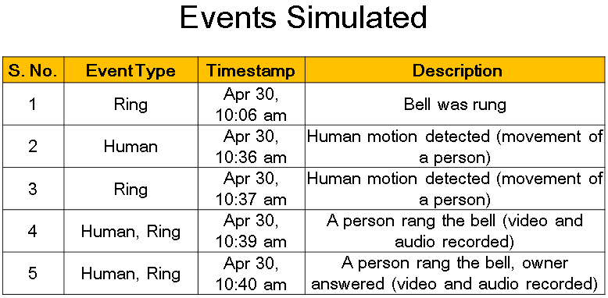
Display Selected Contents of history_record_info_0 File
Display first 5 rows with selected columns from table

Slide 8
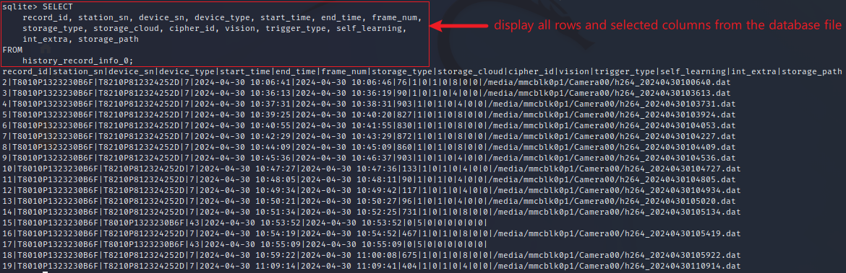
Display All Contents of history_record_info_0 File
Display all rows with selected columns from table

Slide 9
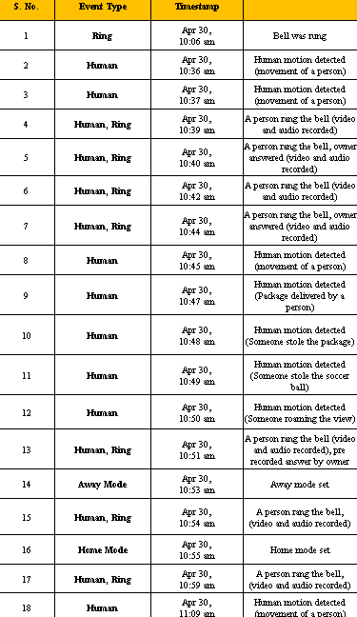
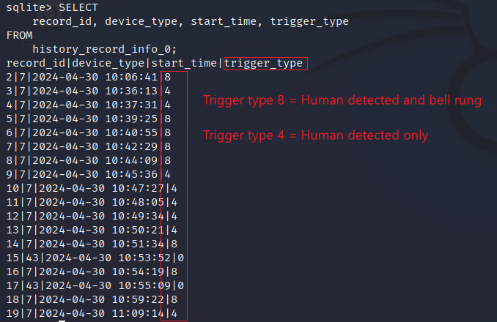
Event Types
Display selected columns from table
Total events = 18
Human detection = 8 events
(trigger type = 4
Human + Ring = 8 events
(trigger type = 8)
Mode change = 2 events
(trigger type = 0)

Slide 10
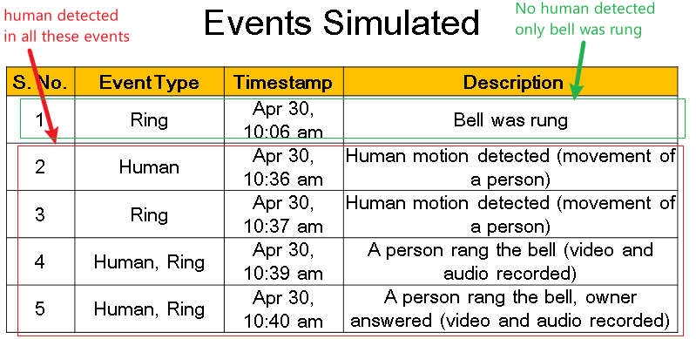
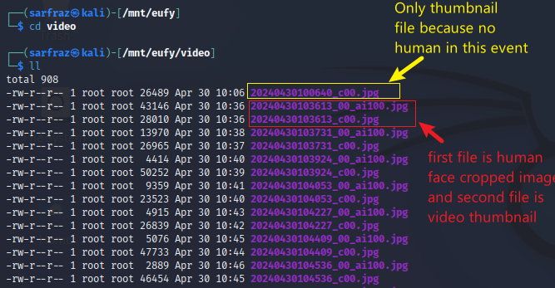
Two Types of jpg Files
List files in /video directory
The directory /video contains encrypted image (jpg) files
Two types
Video thumbnails (YYYYMMDDHHMMSS_cxx)
Human face cropped images (YYYYMMDDHHMMSS_cxx_ai100)
Where xx represents camera number

Slide 11
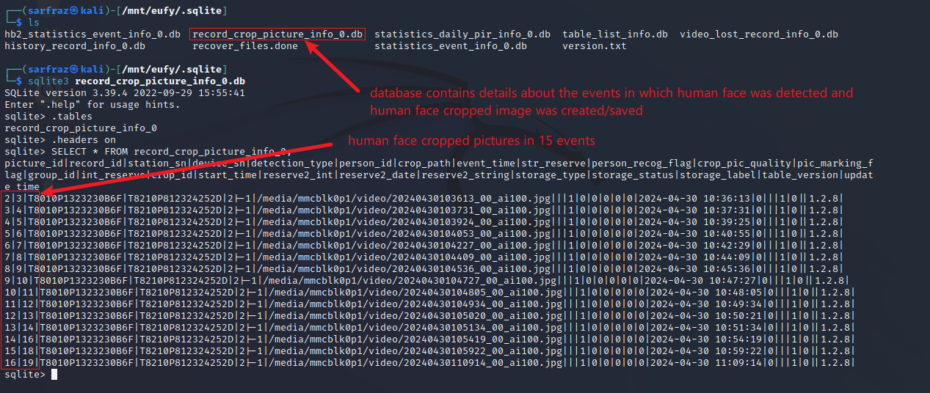
Human Face Cropped Pictures Database
Parse record of cropped pictures database

