Slide 1
Scenario: BombAppetit
Group A24:
Diogo Venâncio, 95555
Pedro Martins, 99303
Pedro Abreu, 92541
Notes:
Diogo

Slide 2
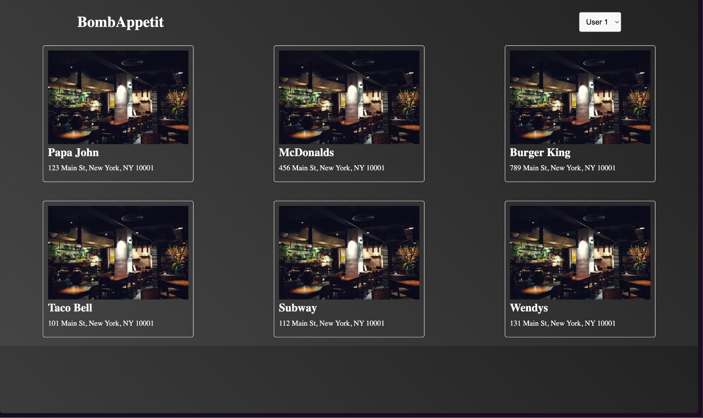
Business Scenario
Web app for restaurant reservations
Services
Web: SvelteKit
Backend: FastAPI + Python
DB: MySQL
Security
Network
Vouchers
Reviews
Notes:
Diogo

Slide 3
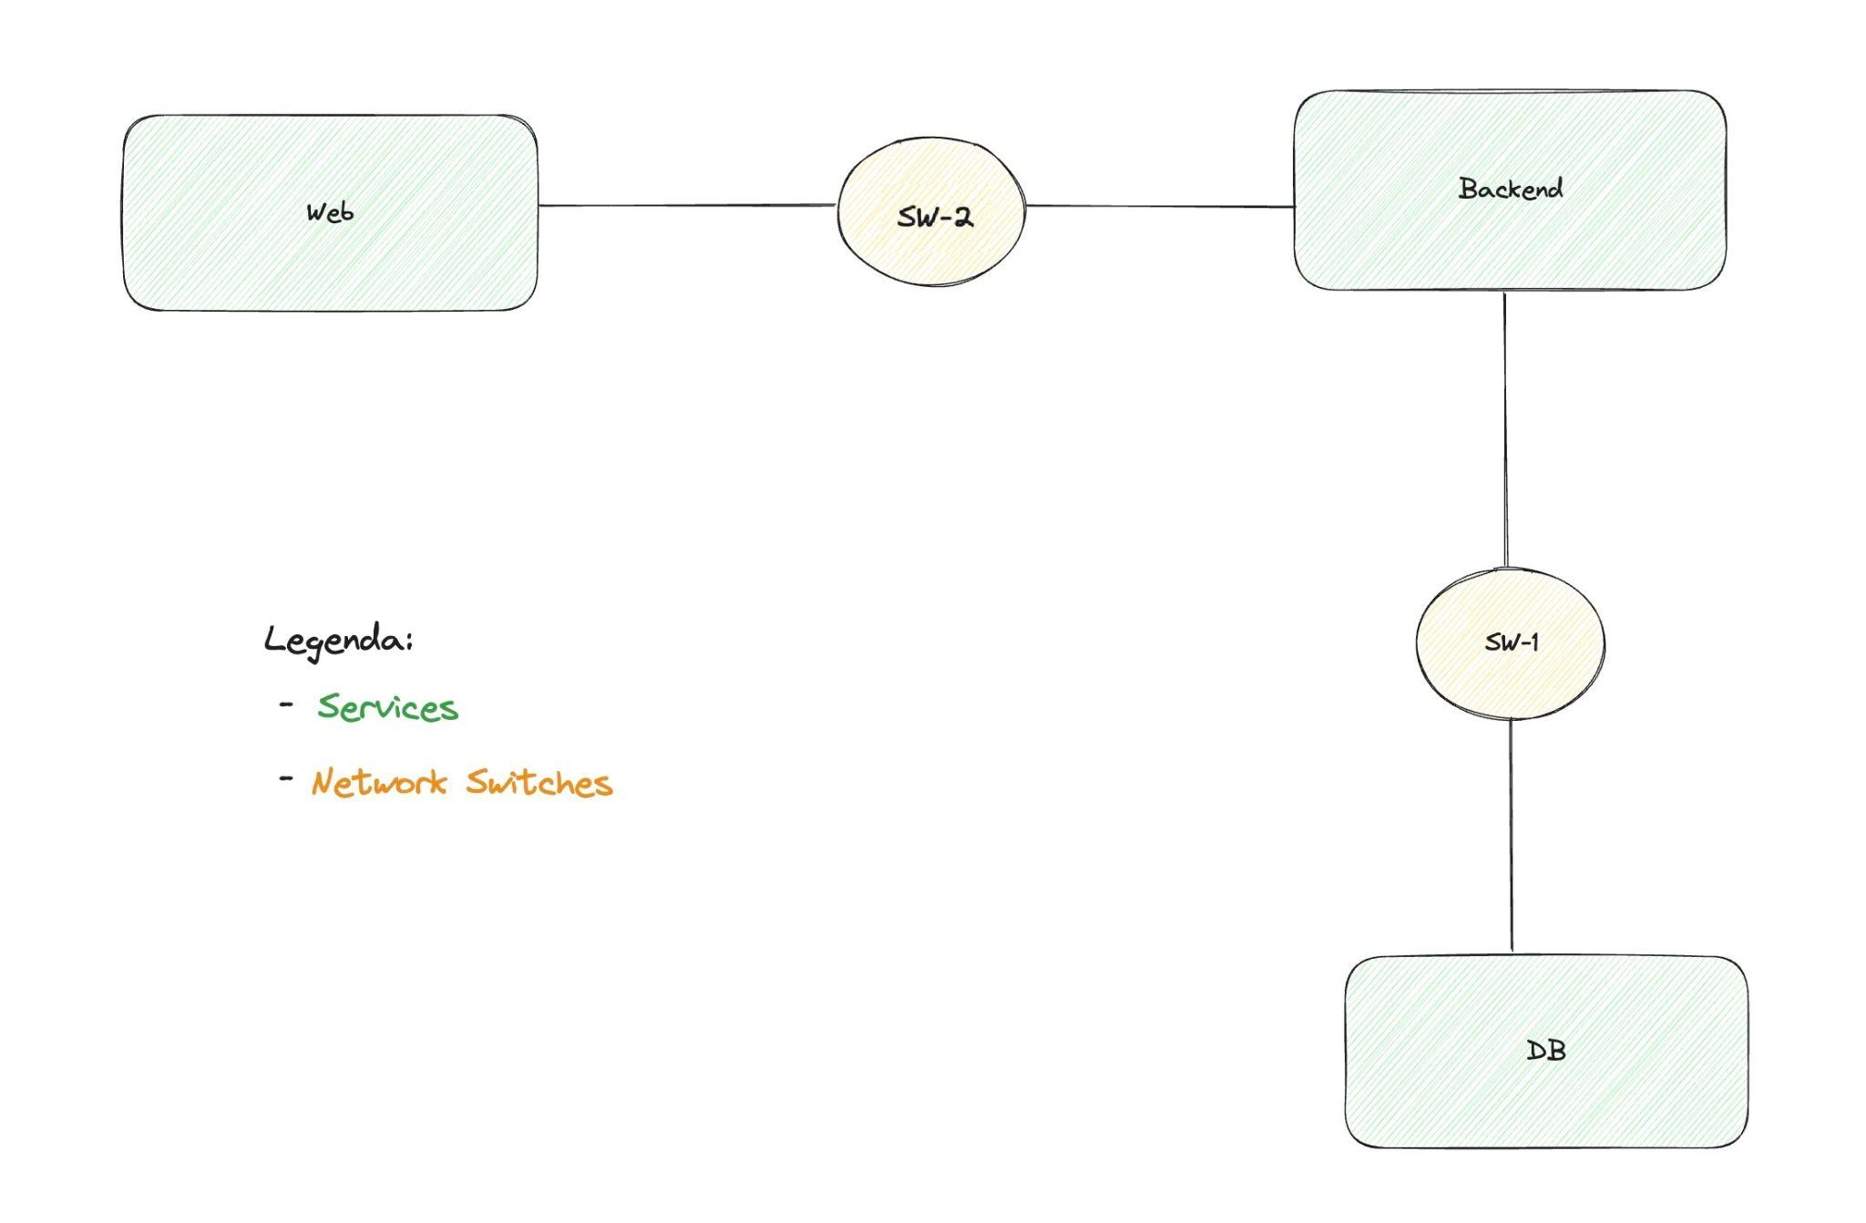
Infrastructure
3 VM’s setup with Vagrant
Isolated networks setup by Vagrant too
Firewalls setup with iptables rules
Notes:
Pedro Abreu
Moving on to the infrastructure, we are using Vagrant and VirtualBox to set up three virtual machines. Each of these machines corresponds to a service and they are all Ubuntu machines.
We made the decision to use Vagrant because it allows us to build and run our project with just the press of a button. It's also very easy to set up isolated networks with Vagrant. We are setting up 2 networks: switch one and switch two. Switch one is used by the backend to communicate with database and switch two is used between the web and the backend. We also forwarded a port from the web machine to the host machine so you can use our application on the host machine browser on port 8080.
The firewalls are set up with IP tables rules and the machines are configured to drop any packets that aren't necessary to the normal operation of our app. These are added using a script which is ran by Vagrant when booting the machines up for the first time.

Slide 4
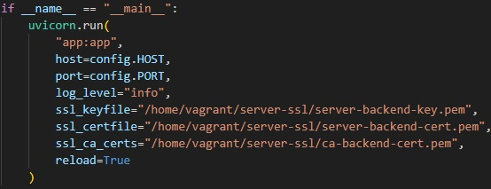
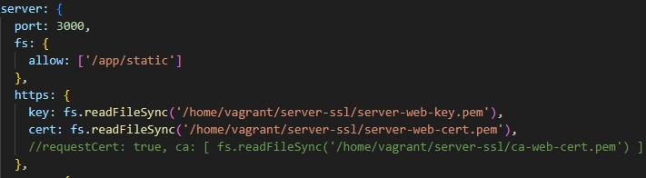
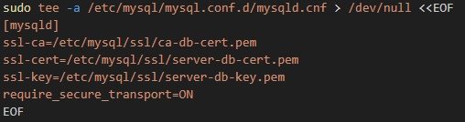
Secure channels
All communications encrypted with SSL
Certificates and certificate keys generated on first run
web
backend
db
Notes:
Pedro Abreu
Regarding secure channels, all communications between VMs and with the user are encrypted using SSL. The certificates and the keys are generated on the first boot and the keys are generated using an Eliptic Curve algorithm. We have used Wireshark to ensure that all communications are indeed encrypted. The images shows how easy it was to implement SSL on each of the services

Slide 5
Keys
The app uses elliptic curve prime 256k1
Non-repudiation (ECDSA) + Key exchange (ECDH)
Currently used in Bitcoin, Ethereum and Tor
More secure and efficient than RSA
Web (users keys) and Backend store all public keys. The private keys are only stored in the servers they belongs to
No keys are transmitted over the network during application runtime!
Notes:
Pedro Martins
These keys are generated once
The web and backend server stores all public keys
The web stores all the users private keys and the backend stores it private key
And we made sure that no keys are …

Slide 6
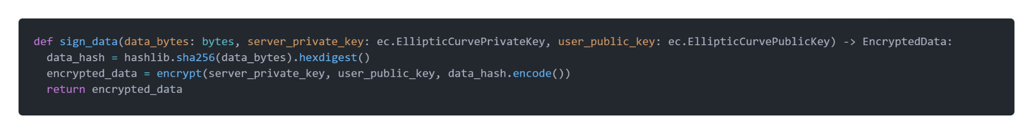
Authenticity
Our solution uses key exchange to encrypt the hash (SHA-256)
Bonus: only the user requesting the data can successfully validate it
Used to authenticate all HTTP responses’ payloads backend -> web
Meaning all restaurant, voucher, and review data (inside the payloads) is authenticated
Non-repudiation (security challenge)
Key exchange provides authenticity, but doesn’t provide non-repudiation
When non-repudiation is required, the team used ECDSA
Notes:
Pedro Martins
This is a snippet of our code. This function provides authenticity. It works by generating a hash using SHA-256 …
A bonus of this implementation …
… is authenticated
For the security challenge, non-repudiation was needed. Key exchange …

Slide 7
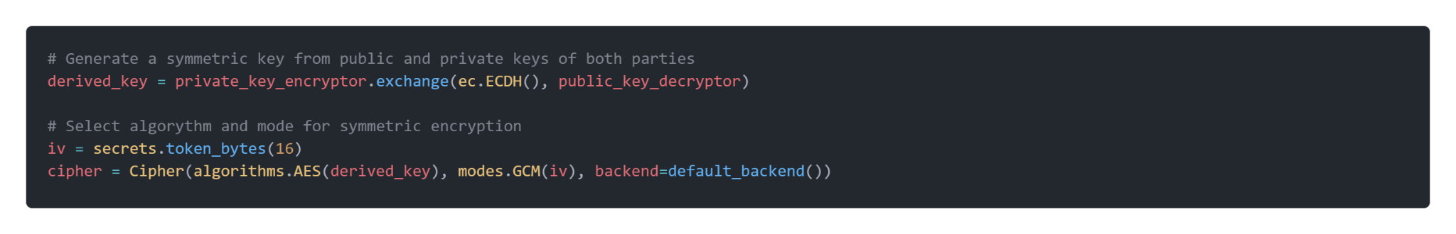
Vouchers
When queried, the voucher data is encrypted using key exchange
Only the backend and user assigned to the voucher can decrypt it
Shared secret is used as key in AES-128 GCM mode
Faster than asymmetric encryption, without sacrificing security
Security challenge: Gift voucher
Key exchange is used to share the encrypted voucher data with the new owner
Uses a series of encryption and decryption steps
The original owner signs the request and send the newly encrypted voucher data. The backend verifies and changes the voucher’s user
Notes:
Pedro Martins
When the backend queries the database, the voucher …
Key exchange generates a key, which is used as a key in AES-128 GCM mode
decryption steps… In practice, this exchange changes the from being encrypted encryption between the original owner and the backend to the new owner and the baclend

Slide 8
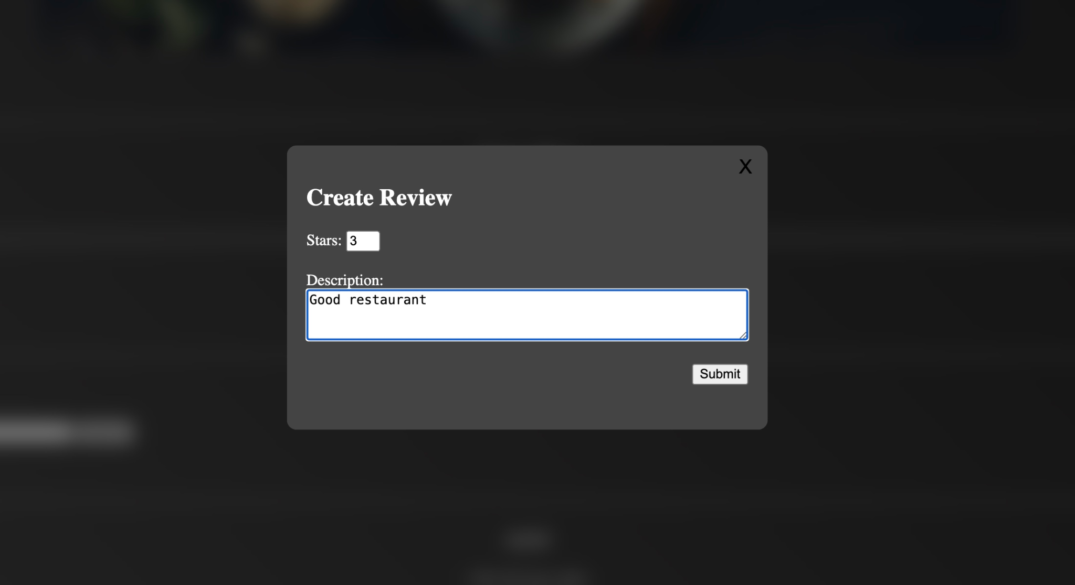
Reviews
Only introduced in the security challenge
To fulfil the non-repudian requirement, we added signature validation.
Flow
User A creates review and signs it
User B fetches review
User B validates signature with user A’s public key
Notes:
Diogo

Slide 9
Demo
Notes:
Authenticity requests
evil action
Vouchers
redeem
gift
reviews
validate
evil action

Slide 10
Conclusion
The requirements were satisfied and the team is proud of its work.
Authenticity
All data
Confidentiality
Vouchers
Non-repudiation
Reviews
Validation
Reviews
Notes:
Pedro Abreu
To conclude our presentation we would like to say that we are proud of our work because We met all the requirements, all the data is authenticated, the vouchers are confidential, the reviews are non-repudiable and users can validate reviews. Everything is working as intended. We think we could have made our lives easier if we did a console application instead of a web application, but that's a requirement we set for ourselves and we're happy with it. We would have liked to implement true user authentication and not just for predefined users. This concludes our presentation for today. Thank you.

