Slide 1
scikit-learn: A Tutorial
Building a SVM Classifier
Miguel Costa, a68584

Slide 2




What is scikit-learn?
It is an open-source machine learning library, introduced by David Cournapeau, for the Python programming language
  It supports a wide range of machine learning problems:
    Classification
    Regression
    Clustering
    Dimensionality Reduction
  It even provides mechanisms for model selection and data preprocessing:
    Model selection, via parameter tuning
    Data preprocessing, via feature selection and normalization
It is compatible with:
  Microsoft Windows
  Linux
  Mac OS X

Slide 3



Installing scikit-learn
Scikit-learn (0.19.1) requires:
  Python (>= 2.7 or >= 3.3)
  NumPy (>= 1.8.2)
  SciPy (>= 0.13.3)
The most convenient way to install these packages is via a Python bundle, such as:
  Anaconda (https://www.anaconda.com/download/)
  Canopy (https://store.enthought.com/downloads/)
To start coding, it is advised the use of a Python IDE:
  PyCharm (https://www.jetbrains.com/pycharm/download/#section=windows)

Slide 4
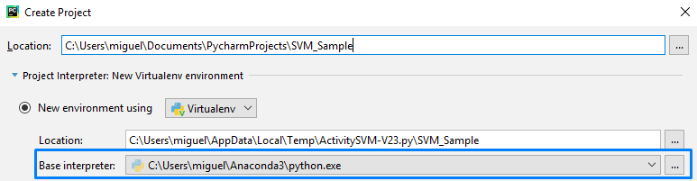
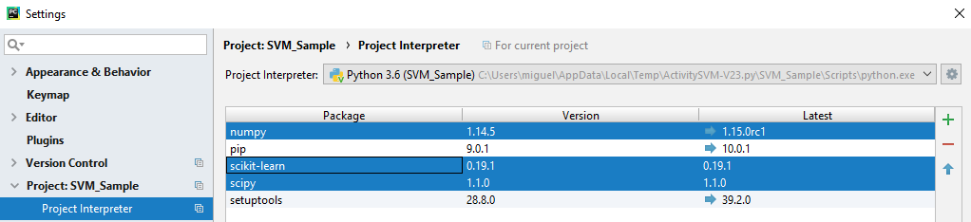
Building a SVM Classifier
Configuring PyCharm
Select the correct Project Interpreter…
Configure the Project Interpreter under “File->Settings” menu…
  Add the packages: (i) numpy, (ii) scipy and (iii) scikit-learn

Slide 5
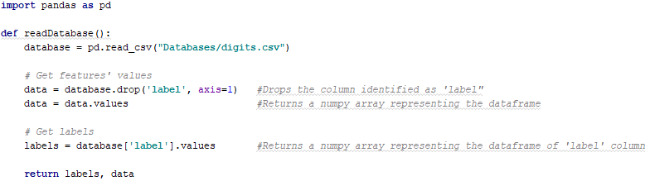
Building a SVM Classifier
Loading an external dataset
The machine learning system provided by scikit-learn works on any numeric data stored as numpy arrays or scipy sparse matrices
The most convenient way to read a database stored in CSV, Excel, JSON or SQL format is by using the pandas.io API
  It provides mechanisms to convert the acquired database to a numeric array suitable for scikit-learn
To use pandas.io, it is necessary to add the pandas package on the Project Interpreter
At this point, a CSV database can be loaded…
Notes:
axis=0 -> row
axis=1 -> column

Slide 6
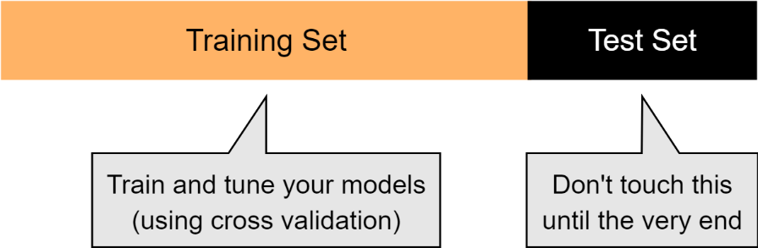
Building a SVM Classifier
Splitting the dataset
To test the model with data the model has not seen before, it is fundamental to divide the dataset into two subsets: (i) one for training (60%) and (ii) another for testing (40%).
The dataset must be shuffled before being splitted, in order to avoid any correlation between consequent samples.
It must be ensured that the training subset remains balanced, i.e., all classes are represented by the same number of samples.
Notes:
The full dataset must be randomly shuffled, prior to the splitting phase, in order to avoid any correlation between consequent samples.
The percentage of data belonging to each label must be maintained in the training and testing datasets.

Slide 7
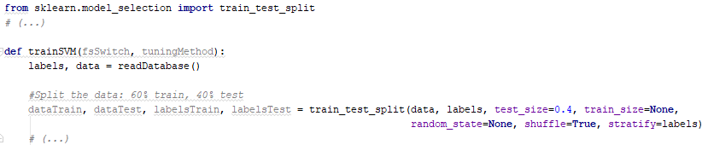
Building a SVM Classifier
Splitting the dataset
The dataset splitting is performed by the “train_test_split” function, provided by the scikit-learn module “model_selection”.
  These are the parameters to be configured:
Parameter | Description
arrays | Allowed inputs are lists, numpy arrays, scipy-sparse matrices or pandas dataframes
test_size | Proportion of the dataset to include in the test split
train_size | Proportion of the dataset to include in the train split
random_state | Seed used by the random number generator for splitting the dataset
shuffle | Whether or not to shuffle the data before splitting
stratify | If not None, data is split in a stratified fashion, using this as the class labels

Slide 8
Building a SVM Classifier
Dataset Normalization
Normalizing the entire dataset prevents…
  One feature with a scale/variance larger than other from dominating the classifier’s inference function
  Prevents the classification algorithm from getting stuck on a local optima
The dataset normalization must be performed always after the dataset split into training and test subsets
  This avoids the leaking of information about the data range on the future test subset, preventing over-optimistic performance results
The scaling instance created during the training phase must be saved in order to reapply the same transformation on new and unseen data, including the test dataset
  scikit-learn provides mechanisms to handle with this requirement

Slide 9
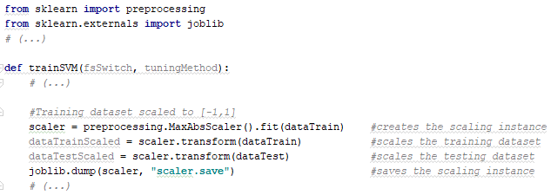
Building a SVM Classifier
Dataset Normalization
The “preprocessing” module of scikit-learn provides a very rich set of functions for normalizing datasets
  The most common functions are:
Function | Description
StandardScaler | Turns a dataset into standard normally distributed data (zero mean and unit variance)
MinMaxScaler | Scales the values of each feature to the range [0, 1]
MaxAbsScaler | Scales the values of each feature to the range [-1, 1]
Notes:
The motivation to use the MaxAbsScaler include robustness to very small standard deviations of features and preserving zero entries in sparse data.
The technique to be used depends on the type of the dataset being used.

Slide 10
Building a SVM Classifier
Feature Selection
scikit-learn provides two types of algorithms for feature selection:
  Filter algorithms: select features based on a performance measure, regardless of the employed data classification algorithm
  Wrapper algorithms: relies on the employed classification algorithm to evaluate different feature subsets
Filter algorithms:
  Removing features with low variance: Removes all features whose variance is equal or lower than a given threshold. This mechanism does not consider the desired outputs (labels)
  Univariate feature selection: Selects the best features based on univariate statistical tests
Wrapper algorithms:
  Recursive feature elimination: Select features by recursively considering smaller and smaller sets of features, until getting the best n features
  Feature selection using “SelectFromModel”: selects the set of features whose score, attributed by a given classification algorithm, is higher than a specific threshold
Notes:
Removing features with low variance: can also be used in unsupervised learning.
Recursive feature elimination: First, the estimator is trained on the initial set of features and the importance of each feature is obtained. Then, the least important features are pruned from current set of features. That procedure is recursively repeated on the pruned set until the desired number of features to select is eventually reached.

Slide 11
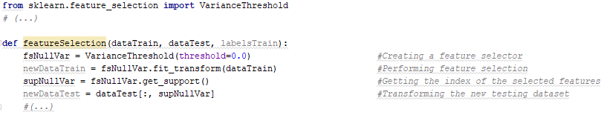
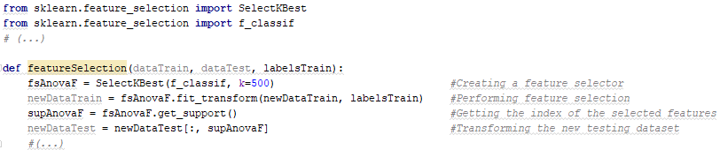
Building a SVM Classifier
Feature Selection
The “digits_short.csv” dataset is composed by 783 features
  Some of them assume the same value during the entire dataset
Removing features with null-variance…
Selecting the best 500 features according to the ANNOVA F-value…
  The methods based on F-test estimate the degree of linear dependency between two random variables

Slide 12
Building a SVM Classifier
Hyper-Parameter Tuning
scikit-learn provides two different approaches to tune hyper-parameters:
  Exhaustive Grid Search: exhaustively generates and evaluates classification models for each combination of hyper-parameter values specified in a grid
  Randomized Parameter Optimization: implements a randomized search over hyper-parameters, where each setting is sampled from a distribution over possible hyper-parameter values

Slide 13
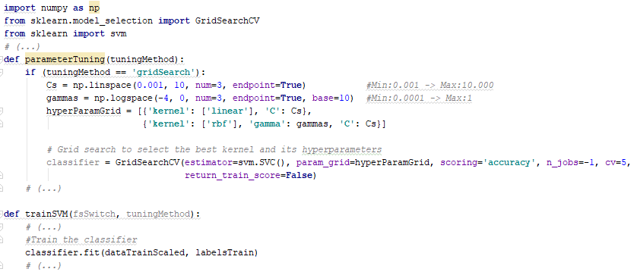
Building a SVM Classifier
Hyper-Parameter Tuning
Choosing between Linear and RBF kernels via Grid Search
Parameter | Description
estimator | Instance of a machine learning classifier
param_grid | List of dictionaries with parameters name as keys and lists of parameters to try as values
scoring | Metric or list of metrics to be evaluated
n_jobs | Number of jobs to run in parallel
pre_dispatch | Controls the number of jobs that get dispatched during parallel execution
cv | Determines the cross-validation splitting strategy
Notes:
The module implementing the grid search delivers a panoply of parameters to configure. The most relevant, the ones you should pay some attention when performing a grid search are delineated here…
n_jobs vs. pre_dispatch: https://stackoverflow.com/questions/32673579/scikit-learn-general-question-about-parallel-computing

Slide 14
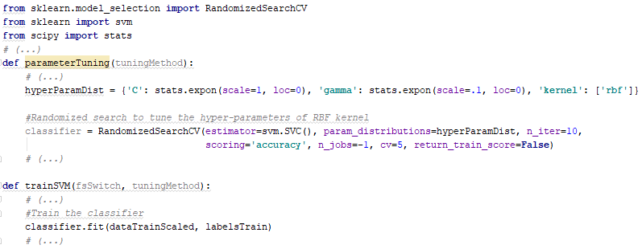


Building a SVM Classifier
Hyper-Parameter Tuning
Tuning the hyper-parameters of RBF kernel via Randomized Search
Parameter | Description
estimator | Instance of a machine learning classifier
param_distributions | Dictionary with parameters names as keys and distributions to try as values
n_iter | Number of parameter settings that are sampled
scoring | Metric or list of metrics to be evaluated
n_jobs | Number of jobs to run in parallel
pre_dispatch | Controls the number of jobs that get dispatched during parallel execution
cv | Determines the cross-validation splitting strategy
random_state | Seed for the random number generator
$$e^{x}, x ∈[0, +∞]$$
$${0.1e}^{x}, x ∈[0, +∞]$$
Notes:
The module implementing the randomized search delivers a panoply of parameters to configure. The most relevant, the ones you should pay some attention when performing a grid search are delineated here…
n_jobs vs. pre_dispatch: https://stackoverflow.com/questions/32673579/scikit-learn-general-question-about-parallel-computing

Slide 15

Building a SVM Classifier
Hyper-Parameter Tuning
The score of the best SVM model created during the hyper-parameter tuning is returned by the function “best_score_”, provided by the instance returned by the hyper-parameter tuning mechanism…

Slide 16

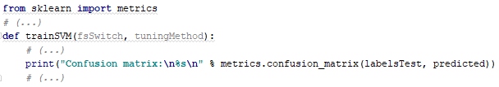
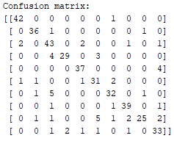
Building a SVM Classifier
SVM Model Testing
The SVM model must be tested against a dataset the model has not seen before…
  …such as the testing dataset created in the beginning of this tutorial
Getting the Confusion Matrix…
  Summarizes the number of correct and incorrect predictions per class
Notes:
A confusion matrix summarizes the number of correct and incorrect predictions per class.

Slide 17


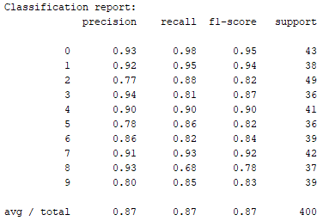
Building a SVM Classifier
SVM Model Testing
Getting the average accuracy…
  Proportion of correct classifications among all classifications performed
Getting a detailed report in terms of Precision, Recall and F1-Score…
  Precision: Proportion of positive samples correctly classified
  Recall: Proportion of positive samples detected
  F1-Score: A weighted measure of precision and recall
Notes:
The support is the number of samples of the true response that lie in that class.

Slide 18

Thanks for the attention!

