Slide 1
ACA
Assignment 1
Presented by:
Diogo Guedes, nºmec: 76318 MIECT
Miguel Carvalho, nºmec: 80169 MIECT

Slide 2
Introduction
For the practical assignment we were tasked with creating 2 different circuits using VHDL, one for an encoder and another for a decoder.
We started by choosing which circuit would be implemented in a sequential and combinatorial way.

Slide 3

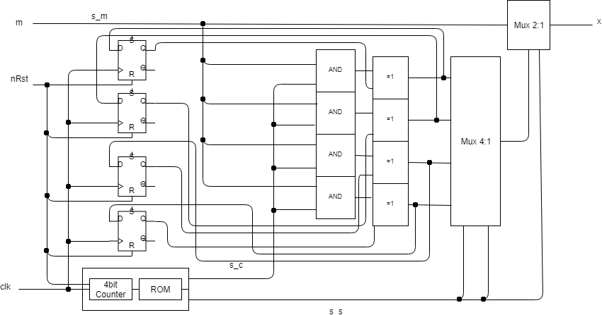
Encoder - Sequential

Slide 4
Encoder - Sequential
To encode a given message “m” with 11 bits to an encoded message “x” with 15 bits:
The Control Unit (4 bit counter + ROM) is responsible for keeping track of the number of bits already encoded and sending the correct control bits to the designated components for each bit that is encoded.
After the original message is fully encoded, the first 11 bits are at the output, the rest of the bits will be redundant bits generated by the following equations:
p1 = x1 ⨁ x2 ⨁ x5 ⨁ x8 ⨁ x9 ⨁ x10 ⨁ x11 ⨁ x12
p2 = x1 ⨁ x4 ⨁ x6 ⨁ x7 ⨁ x9 ⨁ x10 ⨁ x11 ⨁ x13
p3 = x3 ⨁ x5 ⨁ x6 ⨁ x7 ⨁ x8 ⨁ x10 ⨁ x11 ⨁ x14
p4 = x2 ⨁ x3 ⨁ x4 ⨁ x7 ⨁ x8 ⨁ x9 ⨁ x11 ⨁ x15

Slide 5
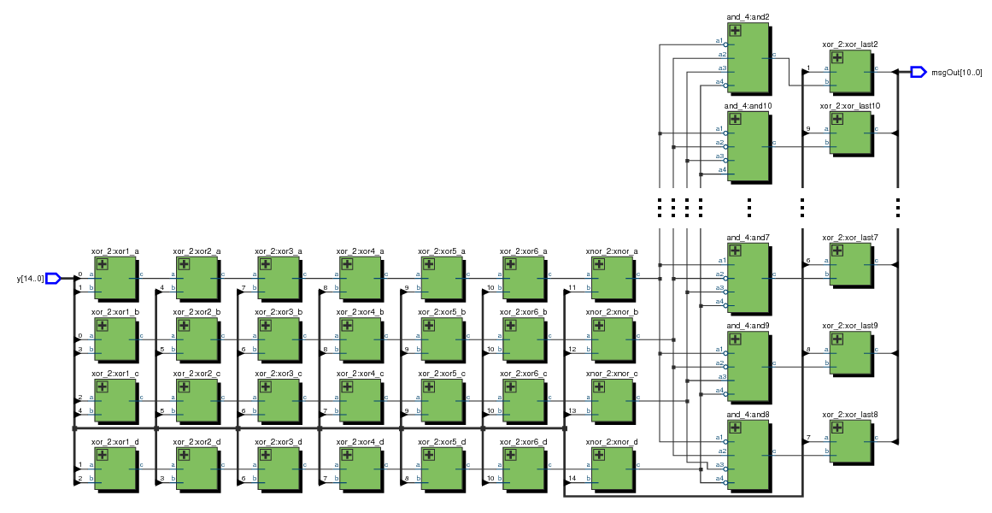
Decoder - Combinatorial
H matrix check
Parity check
1-bit error correction

Slide 6
Decoder - Combinatorial
To decode a given message, the decoder was split into 3 parts:
the parity check “block”: which generates the check bits for the received message
the H matrix check “block”: finds the wrong bit in the message, making the corresponding AND gate to output the value ‘1’
the 1-bit error correction “block”: flips the erroneous bit and outputs the decoded and error free message
Notes:
H matrix check : compara os bits de paridade com a matriz H para detetar o bit errado

Slide 7
EXTRA

Slide 8
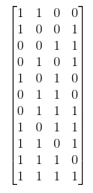
Matriz A^{T}

