Slide 1


Escala
LABDSOF 2026/27
Masters in Software Engineering
Fire Station Shift Management Platform
TEAM
Diogo Pereira
1221137
Diogo Sousa
1250505
Sprint 1 · Idea Presentation
and Progress Status Report
Pedro Costa
1211439
Diogo Costa
1211514
Porto, 10 October 2026
Notes:
Escala is a shift management platform for a Portuguese fire station. This presentation covers the Sprint 1 idea presentation and the current status of the Sprint A deliverables.

Slide 2




The problems Escala must address
TODAY
WITH ESCALA
Checking the schedule
Members travel to the station or wait for a WhatsApp photo that may never be posted.
One always-current schedule on phones and station computers, with a notification for every change.
Tracking changes
Extensions and swaps get lost, and every change means editing and reprinting.
Every change is recorded in the app. Firefighters register extensions after the emergency, for approval.
Requesting swaps
Members find a partner themselves and report it, and often only one of them does.
Members request swaps in the app. Both see the result at once, and the supervisor gets a log.
Notes:
Escala is a shift management app built for the station, whose need was raised by the cadets, volunteers and former members themselves. It also gives dispatchers an on-shift board alongside the existing dispatch app, and it is designed to be used from day one without training, since senior staff have little experience with technology.

Slide 3
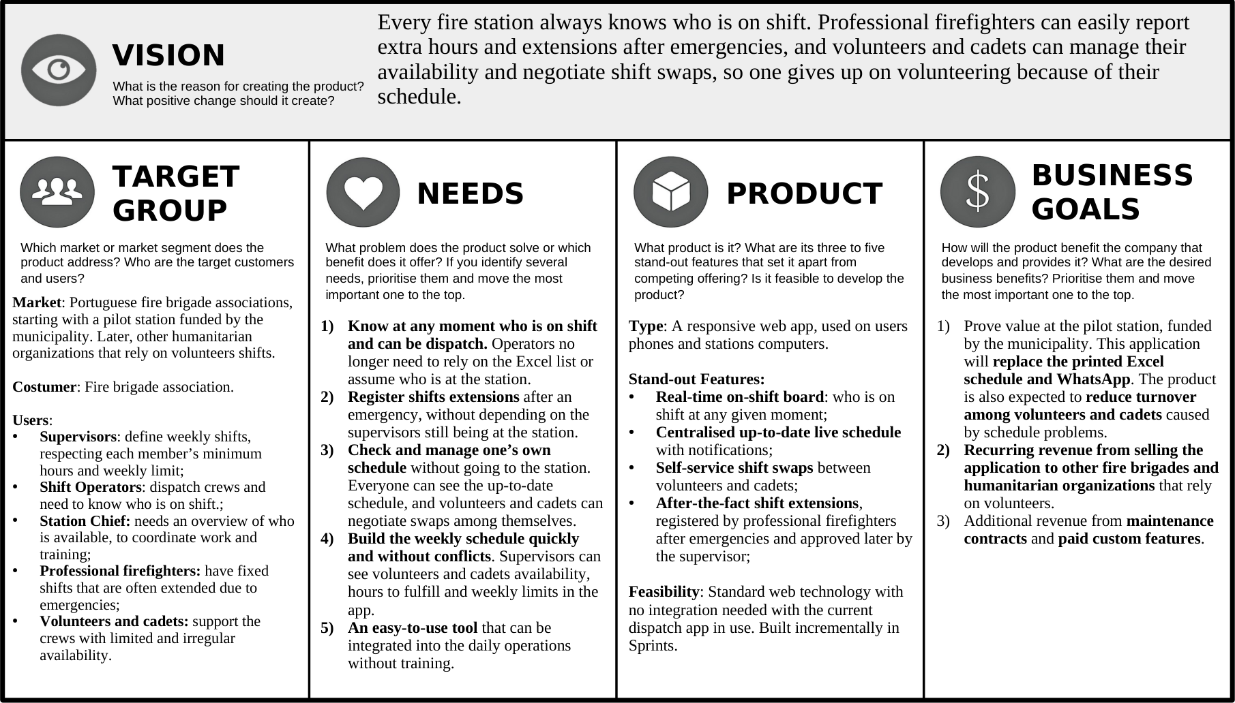
Product Vision Board
VISION
Every fire station always knows who is on shift, so no one gives up on volunteering because of their schedule.
BUSINESS GOALS
Prove value at the pilot station
Recurring revenue from other brigades
Maintenance and custom features
Notes:
Vision: every fire station always knows who is on shift. Professional firefighters can easily report extra hours and extensions after emergencies, and volunteers and cadets can manage their availability and negotiate shift swaps, so no one gives up on volunteering because of their schedule.

Slide 4





Personas at a glance
PERSONA
CURRENT PROBLEMS
WANTS SOLVED
Bernardino Santos
Supervisor, 59
Every change means editing and reprinting the schedule
Changes and extensions made after he leaves get lost
Tracks minimum hours and weekly limits by hand
See availability, hours left and weekly limits
Update the schedule without reprinting it
Review and approve extensions registered in the app
Rui Carvalho
Station chief, 52
Hard to find times when enough people can train
No quick overview of who is on shift
Couldn't learn Google Calendar or Notion
Fewer volunteers and cadets quitting
See at a glance who is on shift and available
Plan training around known availability
Pedro Pacheco
Professional firefighter, 31
Extra hours are hard to report and often go missing
Only learns his day off on Monday, at the station
Confirming a swap means the station or WhatsApp
Register every extra hour himself
Know his schedule and day off in advance
Check schedules on his phone when asked to swap
Diogo Ribeiro
Volunteer, 23
Depends on WhatsApp to know about changes
Misses updates that are never posted
Station shifts clash with his Red Cross Sundays
Know his schedule at any moment, on his phone
Set availability around his job and Red Cross shifts
Swap shifts and see the update straight away
Rita Machado
Former volunteer, 25
Irregular ICU shifts with frequent changes
Relied on colleagues to report her swaps
Was scheduled on top of her ICU shifts
Mark when she isn't available, and update it easily
Request swaps from her phone and see them confirmed
Notes:
Each persona stands for one of the target user groups: supervisors, station command, professional firefighters, volunteers and cadets, and volunteers who quit. The table summarises who they are, their main current problems and what they want solved. The full persona templates are in the report.

Slide 5



Three things Escala cannot get wrong
01
02
03
Usable from the first use
One central schedule
Weekly hours tracking
Senior members must adapt quickly
Simple screens, large buttons, few steps, in Portuguese
No training needed
Always up to date, with real-time updates
The people affected are notified of every change
Minimum hours and weekly limit of each member, counted automatically
Simplicity decides adoption. The station already dropped Google Calendar and Notion because senior staff could not learn them quickly enough.
Notes:
Beyond its features, these points are essential for Escala to be adopted by the station.

Slide 6
Five principal user journeys
Plan the weekly schedule
Members, supervisor
Members set unavailability; the supervisor fills the schedule and Escala checks conflicts
UJ1
Register a shift extension
Firefighter, supervisor
Extra hours registered after the emergency, then approved or rejected with a reason
UJ2
Ask for a shift swap
Member, colleague, supervisor
Swap with a colleague or anyone; Escala validates roles and weekly limits
UJ3
See who is on shift
Dispatcher
The on-shift board shows who is on shift, their role and shift end
UJ4
Plan a training session
Station chief, members
Pick a shift and members; Escala keeps key roles covered
UJ5
Notes:
UJ1 covers planning the weekly schedule. UJ2 covers registering a shift extension or off-hours shift. UJ3 covers asking for a shift swap. UJ4 covers seeing who is on shift to dispatch. UJ5 covers planning a training session.

Slide 7
Sprint A deliverables: current status
PHASE 1
PHASE 2
PHASE 3
Project setup
Research and elicitation
Scope and backlog
Git repository (GitHub)
Project domain research
Functional scope proposal
Issue tracking (Jira)
Related works research
Product Backlog
Team methodology (Scrum)
Questions to customers
MoSCoW prioritisation with the customer
Definition of Ready
Customer interviews
Sprint B backlog (meets DoR)
Definition of Done
Initial functional requirements and NFRs
Roles identified and assigned
Done
In progress
Not started
Notes:
Phase 1: GitHub repository created; Jira project with epics, stories and decisions; Scrum with a pre-game phase, sprints and a post-game phase; Definition of Ready and Definition of Done documented in Confluence; Product Owner, Scrum Master and Developers assigned. Phase 2: domain research and related works done; questions prepared for the station, with more personas still to be created; interview findings used for the personas, with notes still to be documented; epics in Jira being aligned with the current scope. Phase 3: product vision, personas and user journeys done, domain model drafted for team review, epics being updated; user stories in Jira being aligned; MoSCoW prioritisation and Sprint B backlog not started.

Slide 8
Artifacts for the first delivery: status
GREEN
GREEN
DoR / DoD
Team roles and work process
Definition of Ready and Definition of Done agreed and documented in Confluence
Product Owner, Scrum Master and Developers assigned; Scrum process with working agreements defined
GREEN
YELLOW
High-level system architecture
Domain model
Done and available in the docs folder of the GitHub repository
Draft done and in the docs folder of the GitHub repository; still needs a thorough review by the team
Notes:
DoR and DoD are agreed and documented in Confluence. Team roles are assigned and the Scrum process with working agreements is defined. The high-level system architecture is done and in the docs folder of the repository. The domain model draft is in the docs folder but still needs a thorough team review.

Slide 9
Thank you
Questions?
Diogo Pereira · Diogo Sousa · Pedro Costa · Diogo Costa
LABDSOF 2026/27 · ISEP

