Slide 1
Synthetic Tests

Slide 2
Synthetic Tests
Conservative transport
Reactive transport (biogeochemistry)

Slide 3
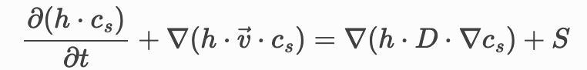
Synthetic Tests: Conservative Transport (conservative tracer)
Governing physical processes:
Pure Advection
(steady-state/uniform velocity field)
Pure Diffusion/Dispersion
(no flow)
Advection-Dispersion
(steady-state/uniform velocity field)
Domain/Media:
Free surface
River (1D)
Lake (1D-2D)
Runoff (2D)
Porous media
Soil
Snow (during melt, multi-phase)
Load type:
No load (conc = 1)
Point Instantaneous
Point Continuous
Diffuse
Combinations:
(derivation of 12 analytical solutions)

Slide 4
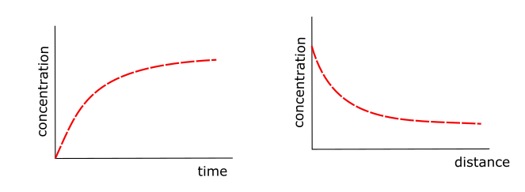
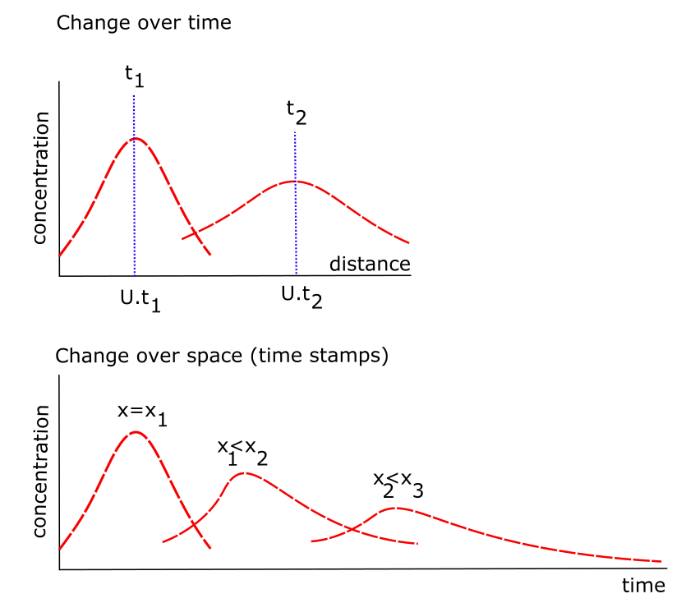
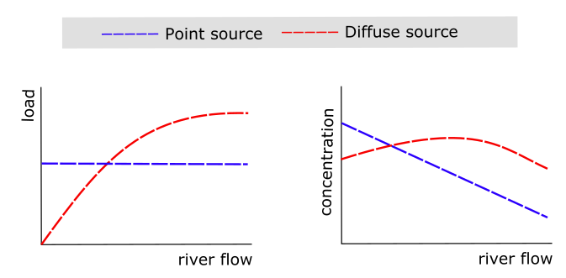
Synthetic Tests: Conservative Transport (conservative tracer) (examples of the analytical solutions)
Governing Eq: advection and dispersion
Domain/Media: free surface
Load Type: point source
Governing Eq: advection only
Domain/Media: porous media or free surface
Load Type: continuous source
Governing Eq: advection and dispersion
Domain/Media: free surface
Load Type: diffuse vs point sources

Slide 5
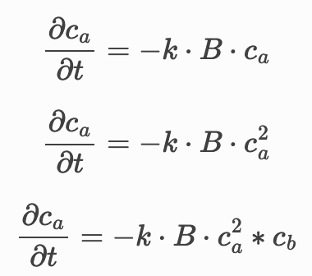
Synthetic Tests: Reactive Transport (non-conservative tracer)
Single species reactor (no flow)
1st order kinetics
(CSTR)
2nd order kinetics
(CSTR)
3rd order kinetics
(CSRT)
Multi-species reactor (no flow)
Reaction networks based on combinations of 1s, 2nd and 3 order reaction species
Single species reactor
(with steady-state/uniform flow)
Advection & Disperion (PDE)
+
1st , 2nd , and/or 3rd order kinetics
Multi-species reactor
(with steady-state/uniform flow)
Advection & Disperion (PDE)
+
Reaction networks based on combinations of 1s, 2nd and 3 order reaction species

Slide 6
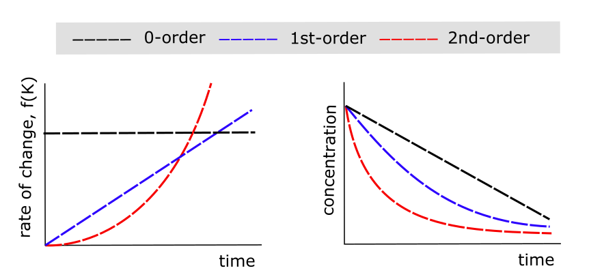
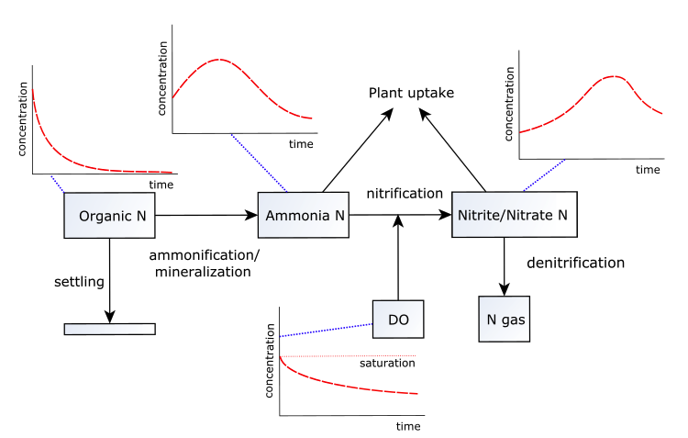
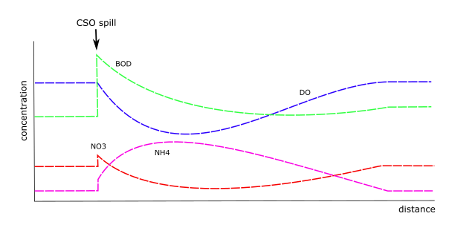
Synthetic Tests: Reactive Transport (conservative tracer) (examples of the analytical solutions)
Governing Eq: CSTR (no flow)
Domain/Media: free surface or porous media
Reactions: 1st, 2nd and 3rd order (single species)
Governing Eq: CSTR (no flow)
Domain/Media: free surface or porous media
Reactions: reaction networks
Governing Eq: advection and dispersion
Domain/Media: free surface
Load Type: Point source and reaction network

Slide 7
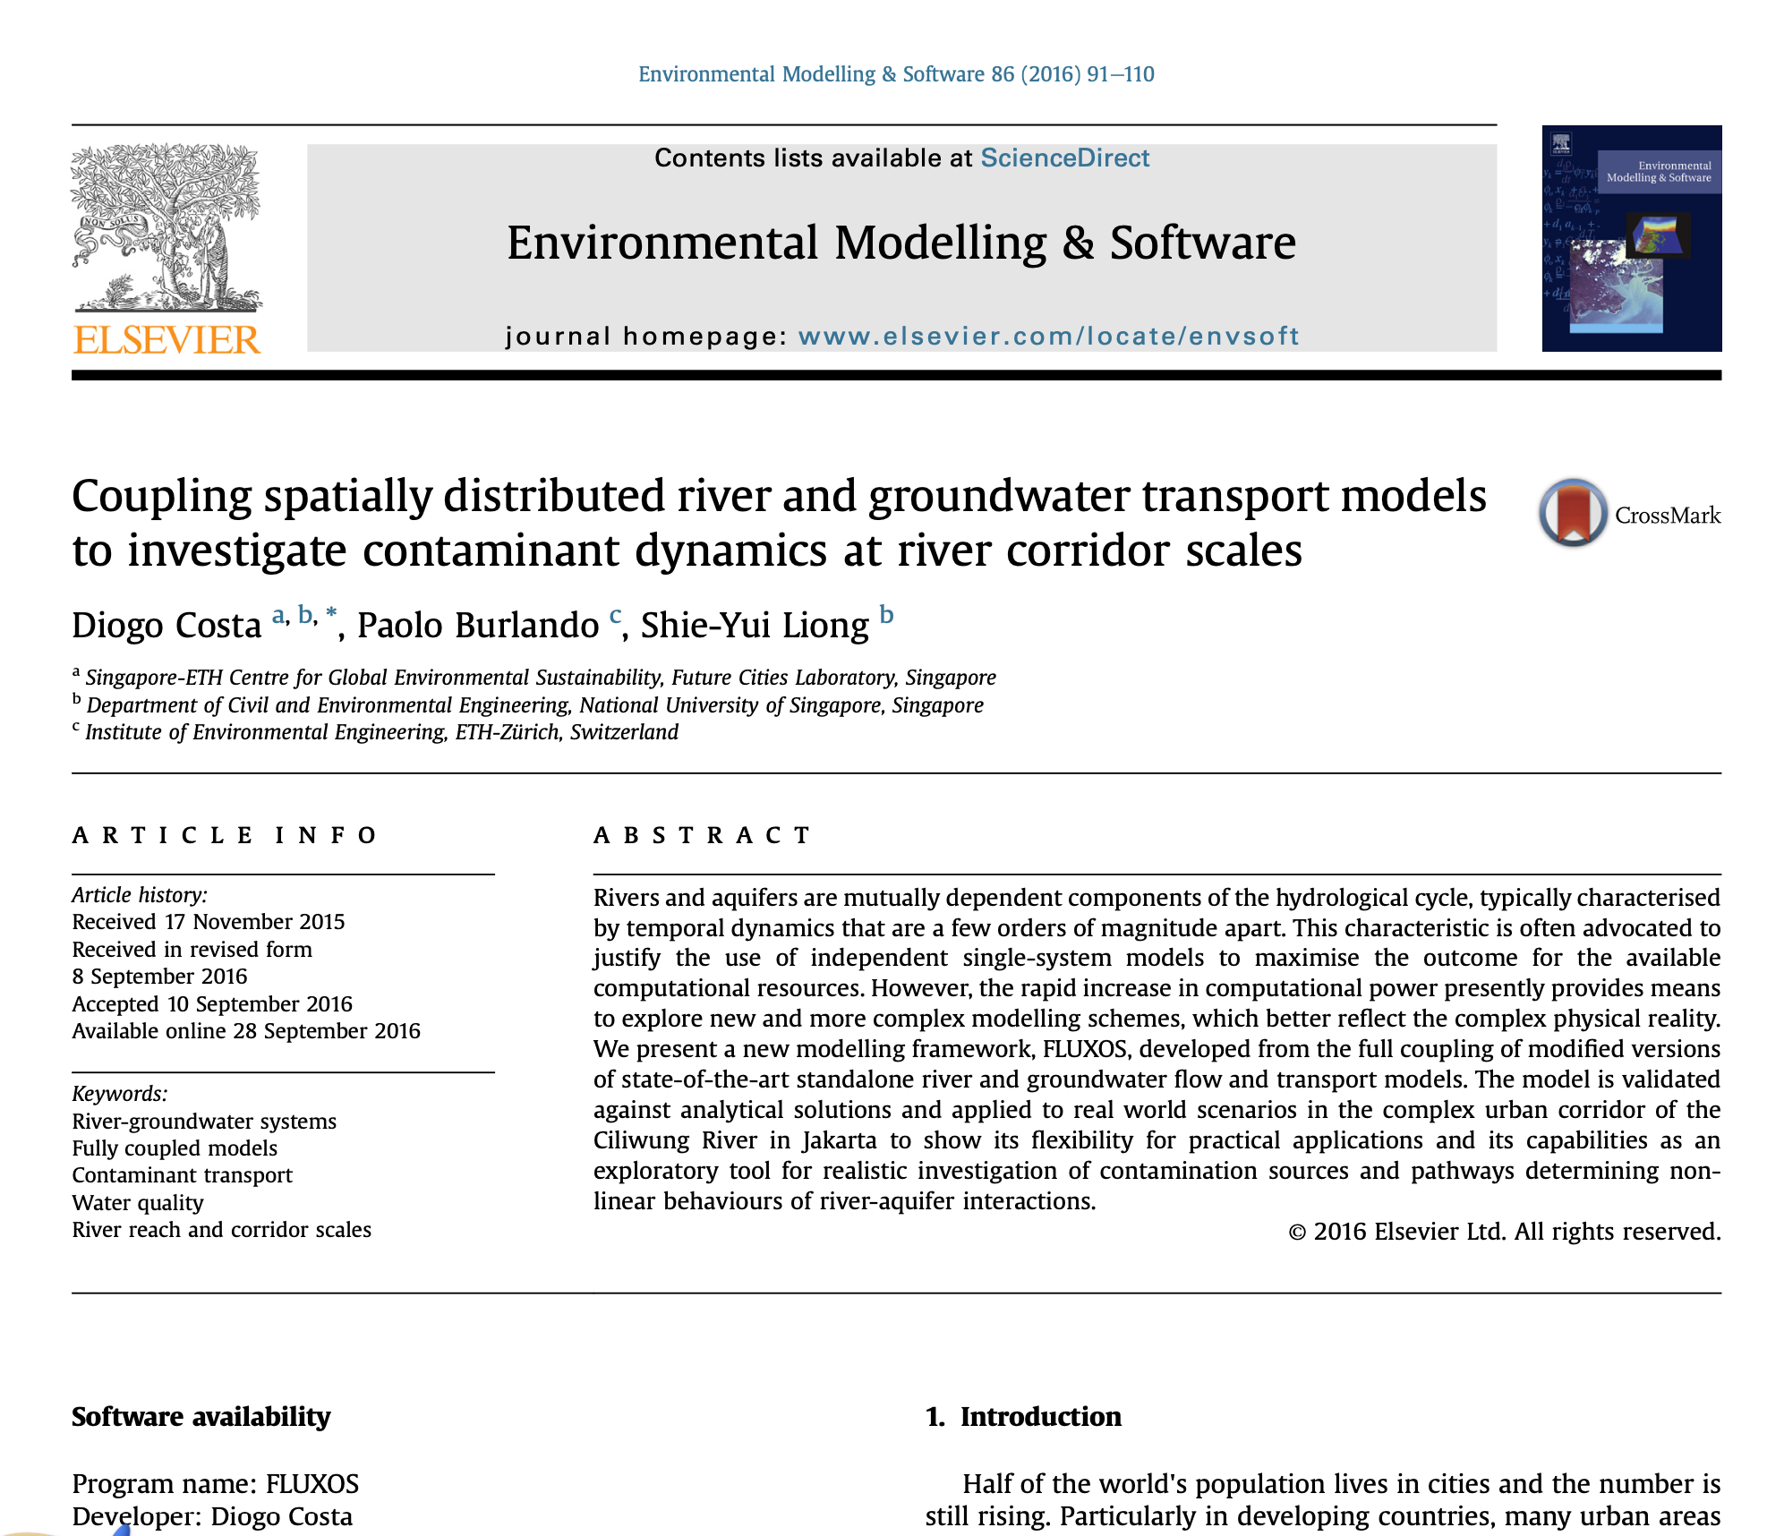
Will try to have within the next 2 weeks: (see example of my paper)
Synthetic Tests defined
3 or 4 for conservative transport
3 or 4 for reactive transport
Analytical solutions derived for each synthetic test
Prepare OpenWQ’s input files (JSON) to represent each synthetic test
Paper: write the section on Synthetic Tests

Slide 8
Synthetic Tests (to test)
4 Non-Reactive Transport
4 Reactive Transport
6 Batch reactor

Slide 9
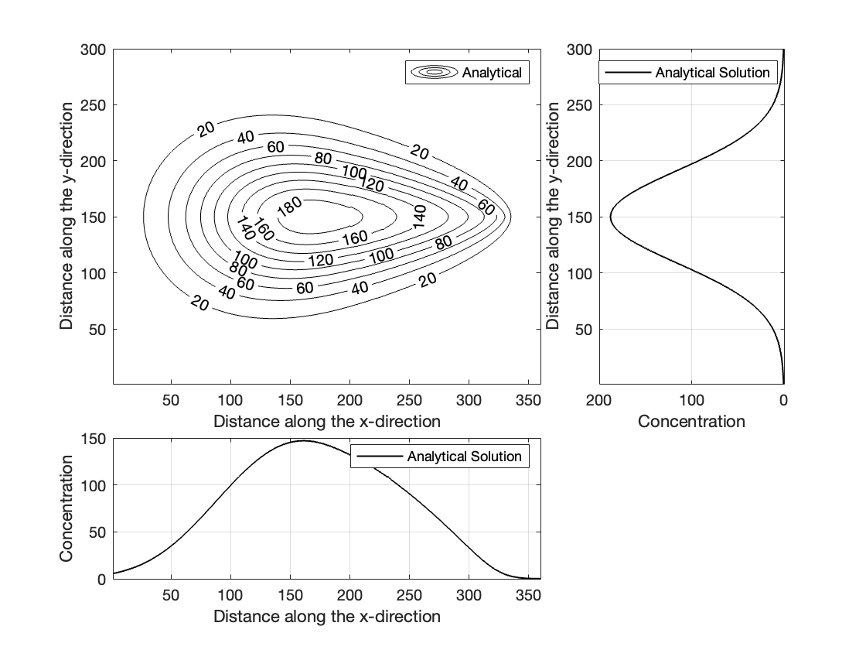
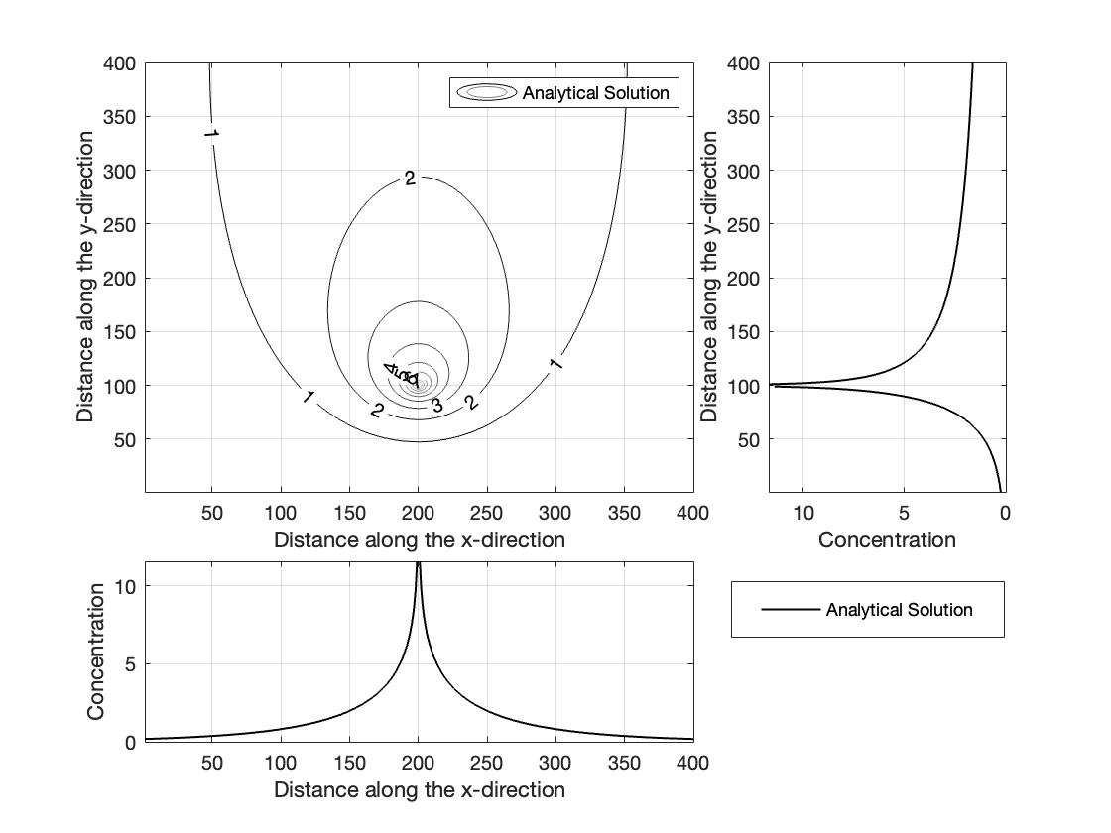
Non-Reactive Transport
Test # | Paper (derivation of analytical sol.) | Simulation complete | Comparison (numerical vs analytical)
1_nrTrans_instS_FreeSurf | Complete
2_nrTrans_instS_PorMedia | Complete
3_nrTrans_contS_FreeSurf | Complete
4_nrTrans_contS_PorMedia | Complete

Slide 10
Reactive Transport (linear decay)
Test # | Paper (derivation of analytical sol.) | Simulation complete | Comparison (numerical vs analytical)
1_nrTrans_instS_FreeSurf_linDecay | Complete
2_nrTrans_instS_PorMedia_linDecay | Complete
3_nrTrans_contS_FreeSurf_linDecay | Complete
4_nrTrans_contS_PorMedia_linDecay | Complete

Slide 11
Batch Reactor
Test # | Paper (derivation of analytical sol.) | Simulation complete | Comparison (numerical vs analytical)
9_batch_singleSp_1storder | Complete | Complete | Complete
10_batch_singleSp_2ndorder | Complete | Complete | Complete
11_batch_2species | Complete | Complete | Complete
11.2_batch_3species | Complete | Complete | Complete
12_batch_nitrogencycle | Complete | Complete | Complete
13_batch_oxygenBODcycle | Complete | Complete | Complete

Slide 12
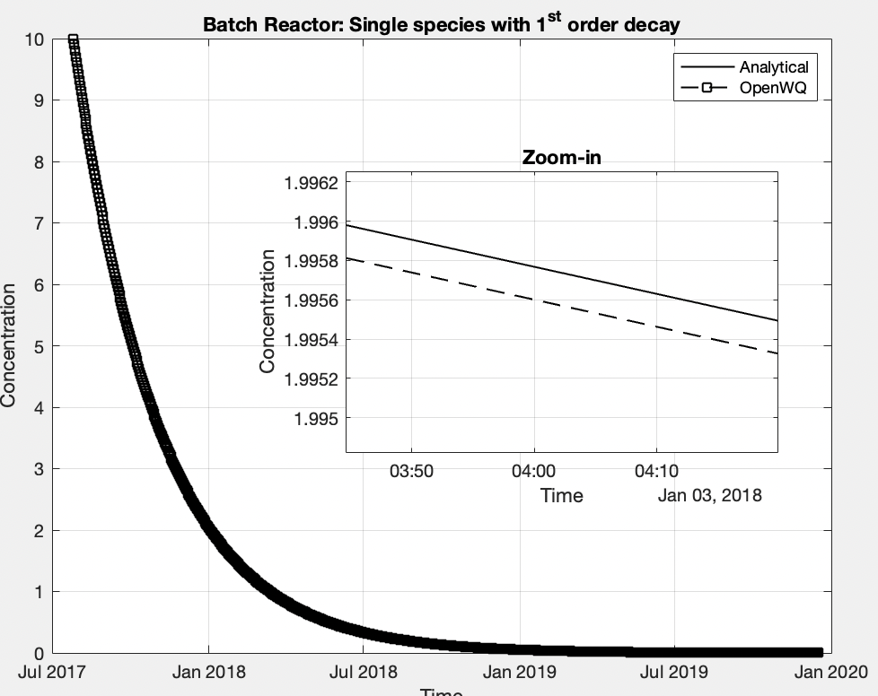
Results BATCH REACTOR: 9_batch_singleSp_1storder
GOOD!

Slide 13
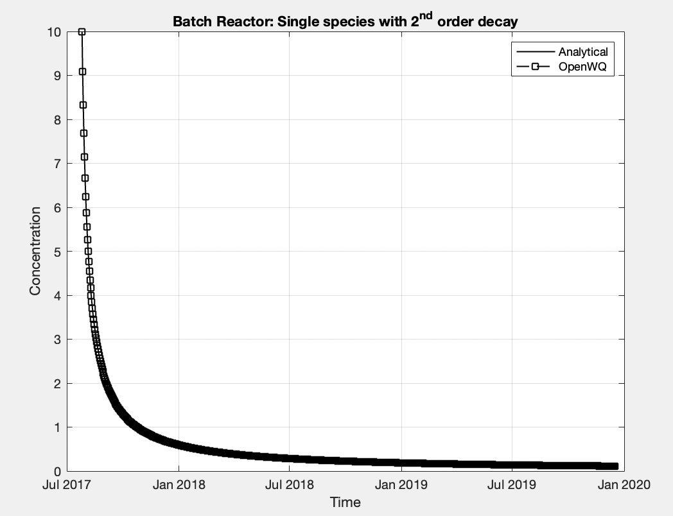
Results BATCH REACTOR: 10_batch_singleSp_2ndorder
GOOD!

Slide 14
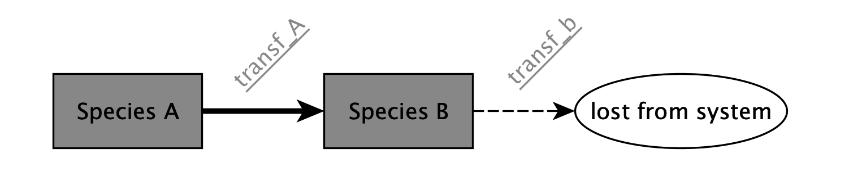
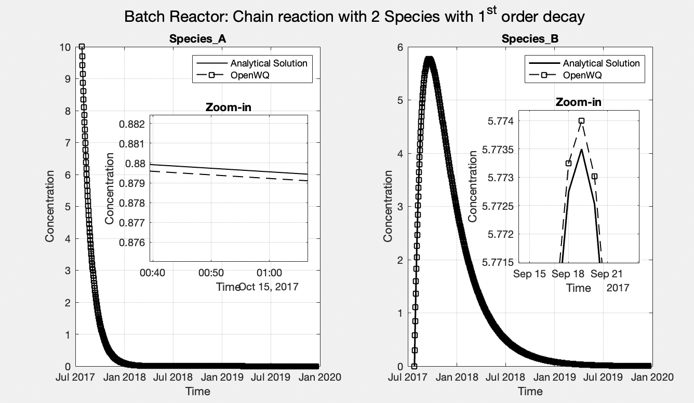
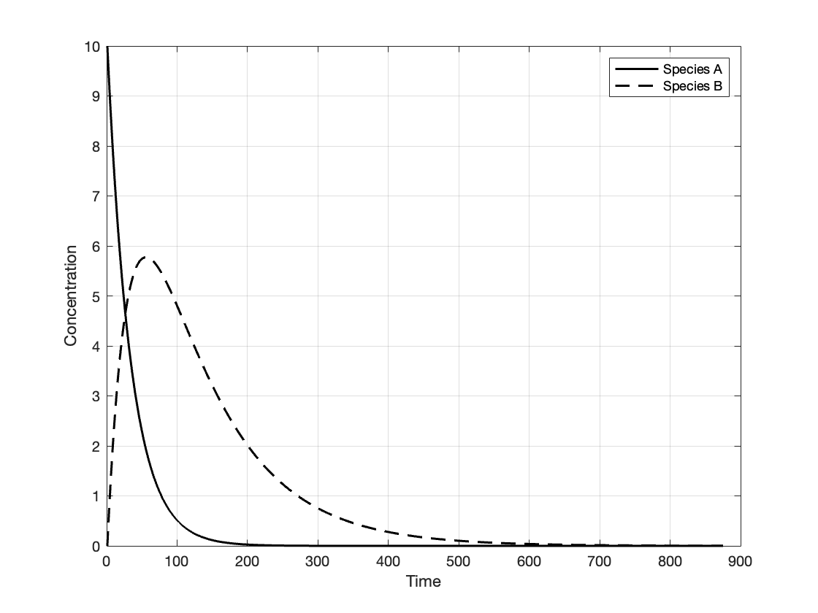
Results BATCH REACTOR: 11_batch_2species
GOOD!

Slide 15
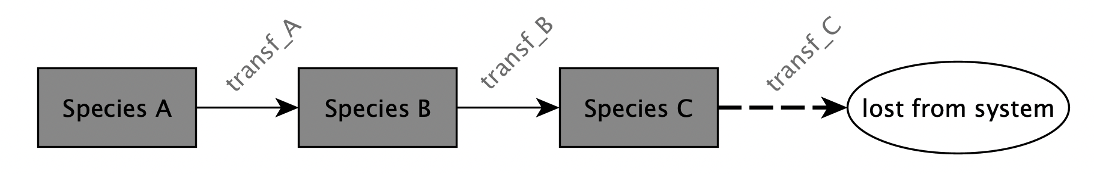
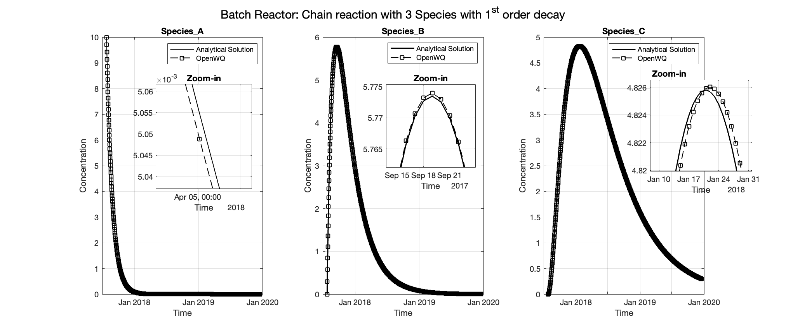
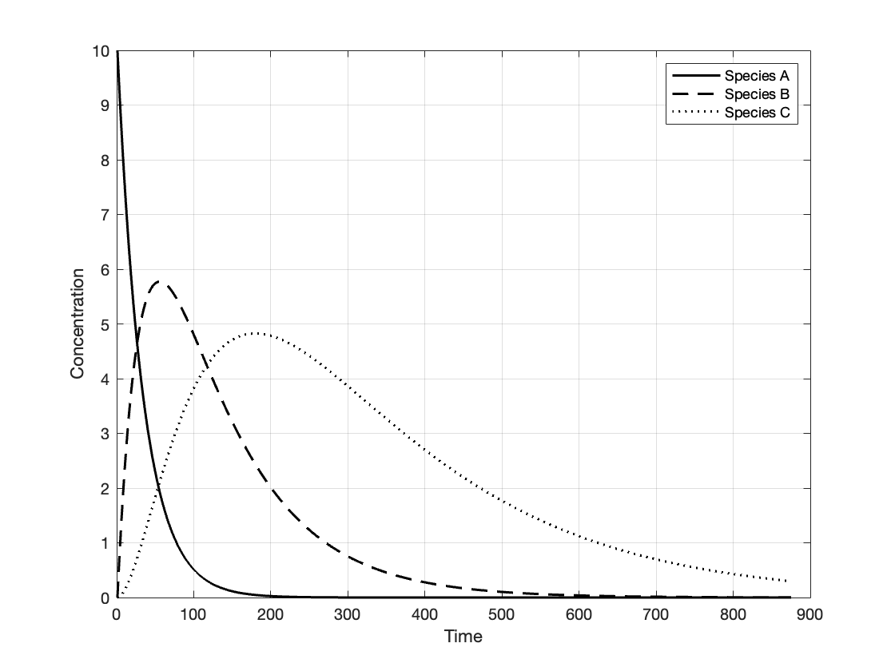
Results BATCH REACTOR: 11.2_batch_3species
GOOD!

Slide 16
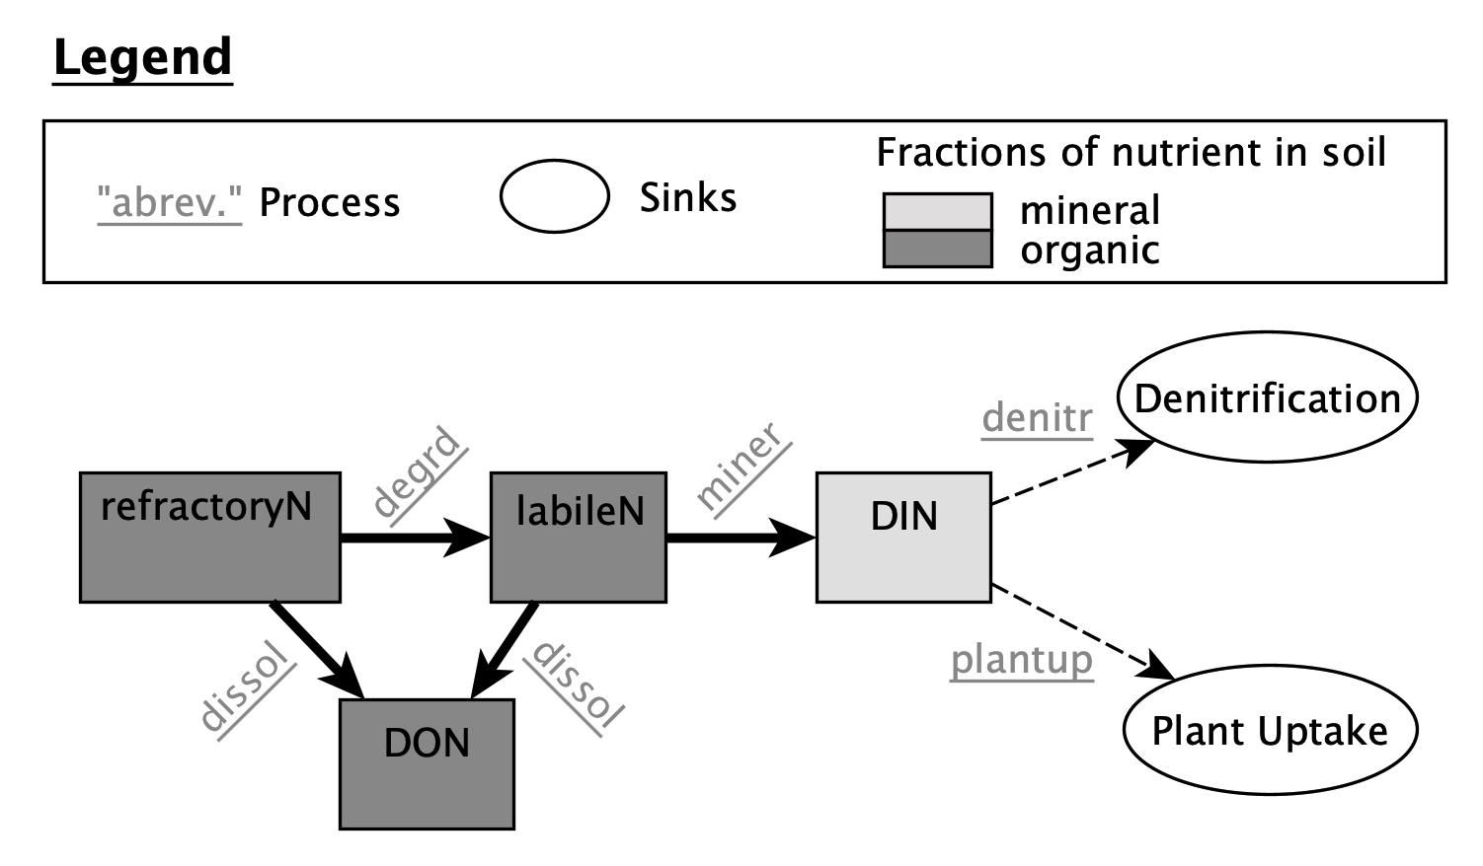
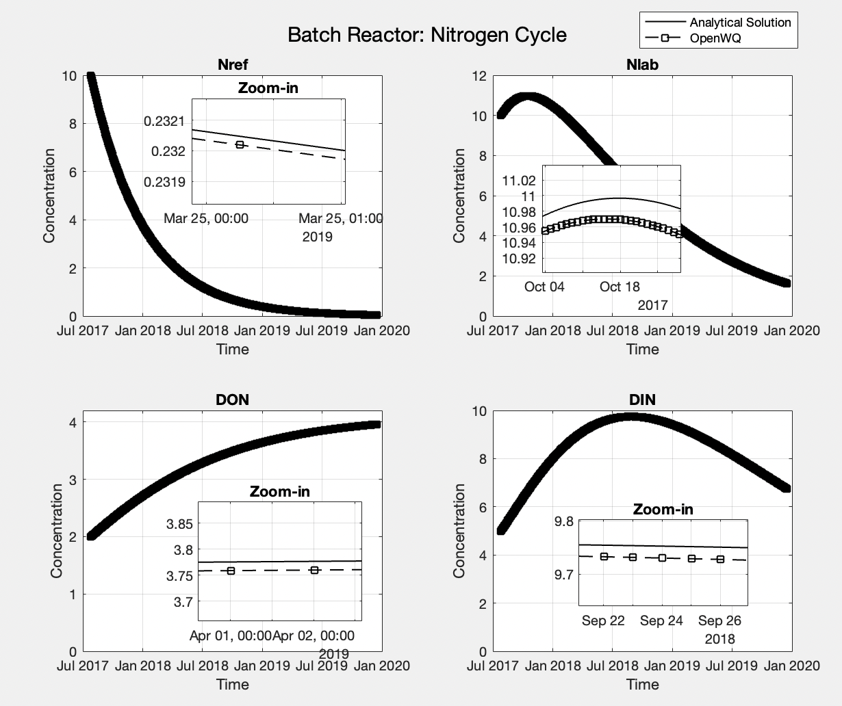
Results BATCH REACTOR: 12_batch_nitrogencycle
GOOD!

Slide 17
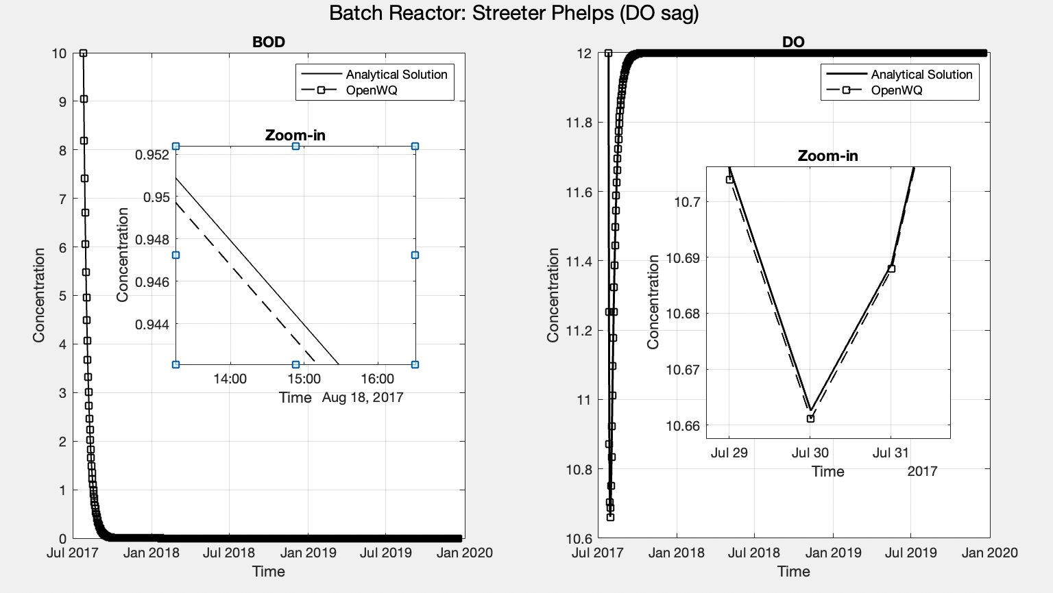
Results BATCH REACTOR: 13_batch_oxygenBODcycle
GOOD!

