Slide 1
Project 1 Sign-Language MNIST and Classification FAA 2024/25
Diogo Marto 108546
Pedro Azevedo 102567

Slide 2
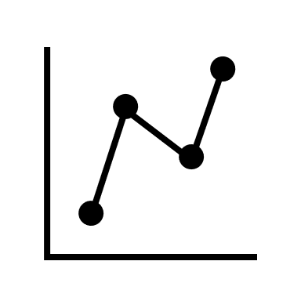



Content
01
03
04
Dataset Description
Models
Comparison
02
State of the Art
2

Slide 3
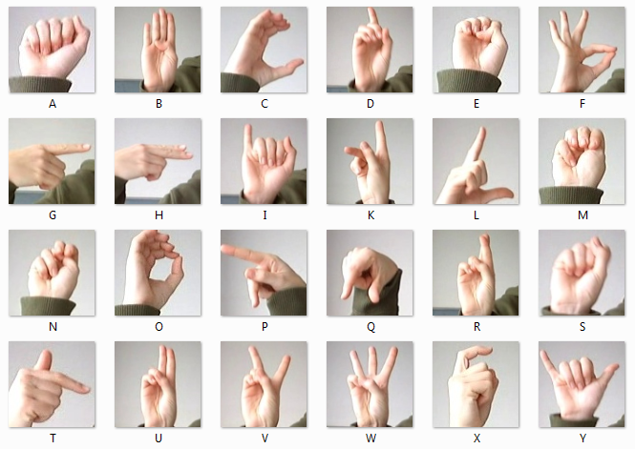
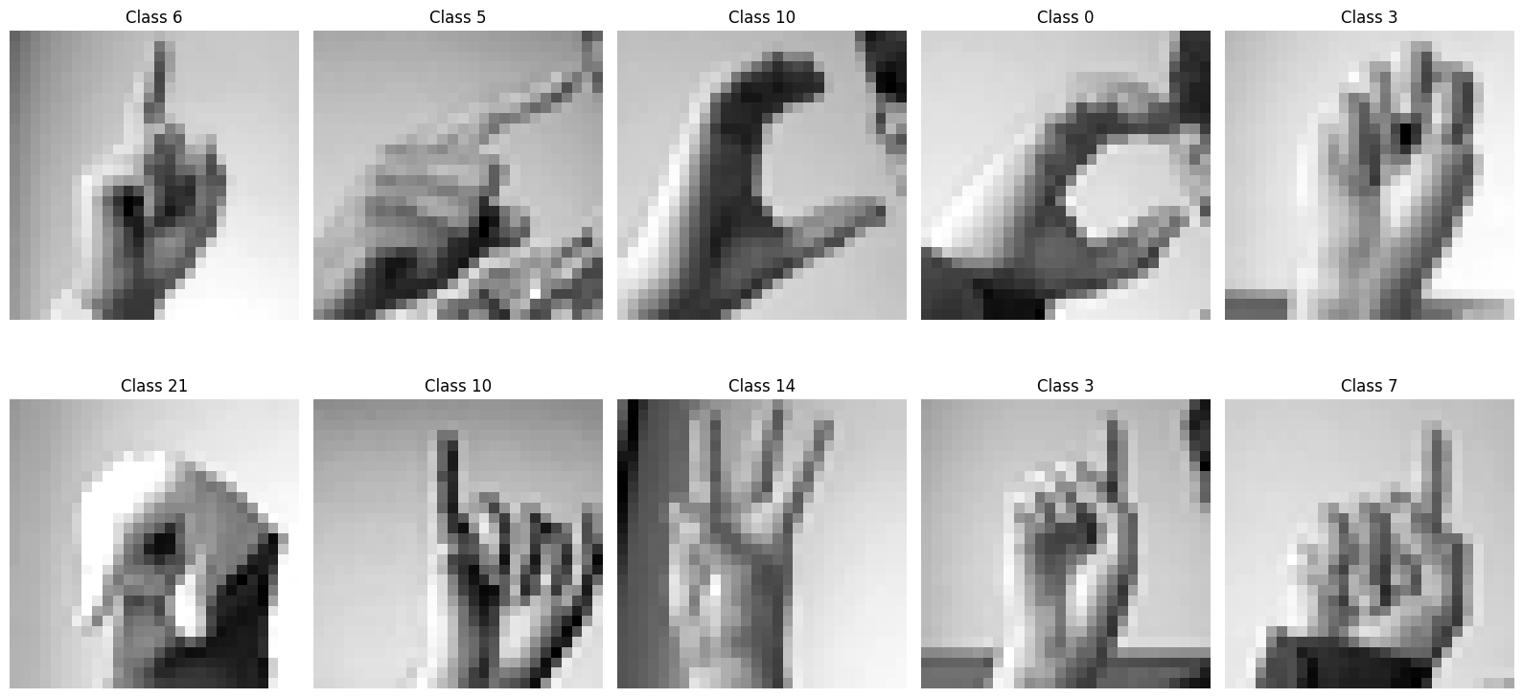
01 Dataset Description
Dataset is a transformation of another dataset
Data was presplit into 2 files:
Train: 27455 examples
Test: 7172 examples
24 classes more or less evenly distributed
3

Slide 4
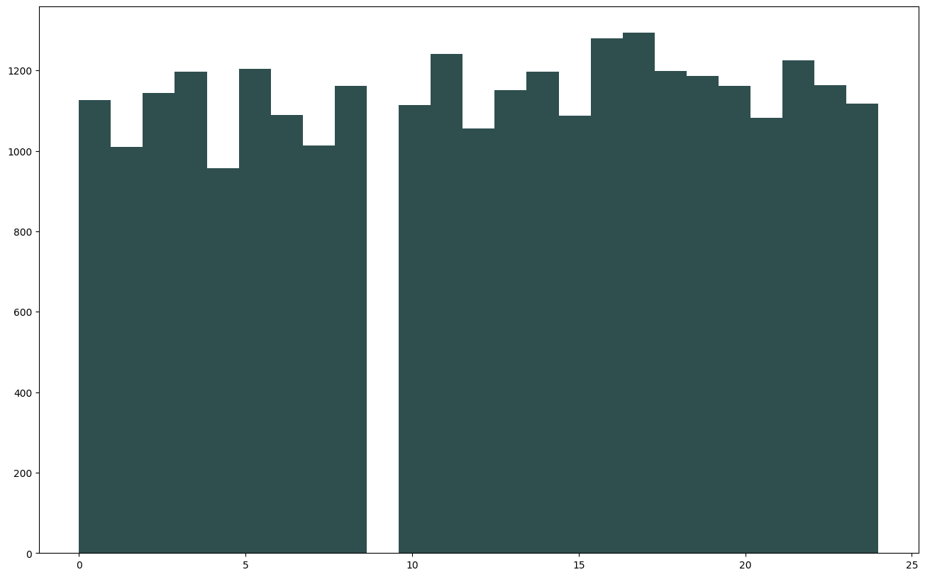
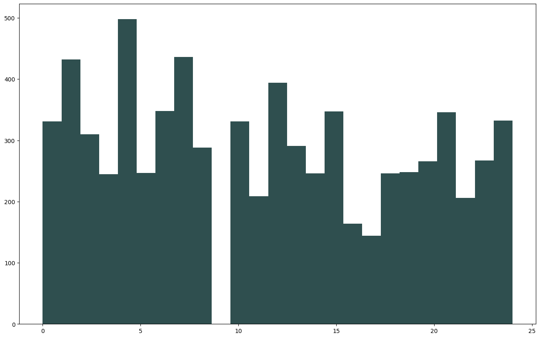
01 Dataset Description
Train
Test
4

Slide 5
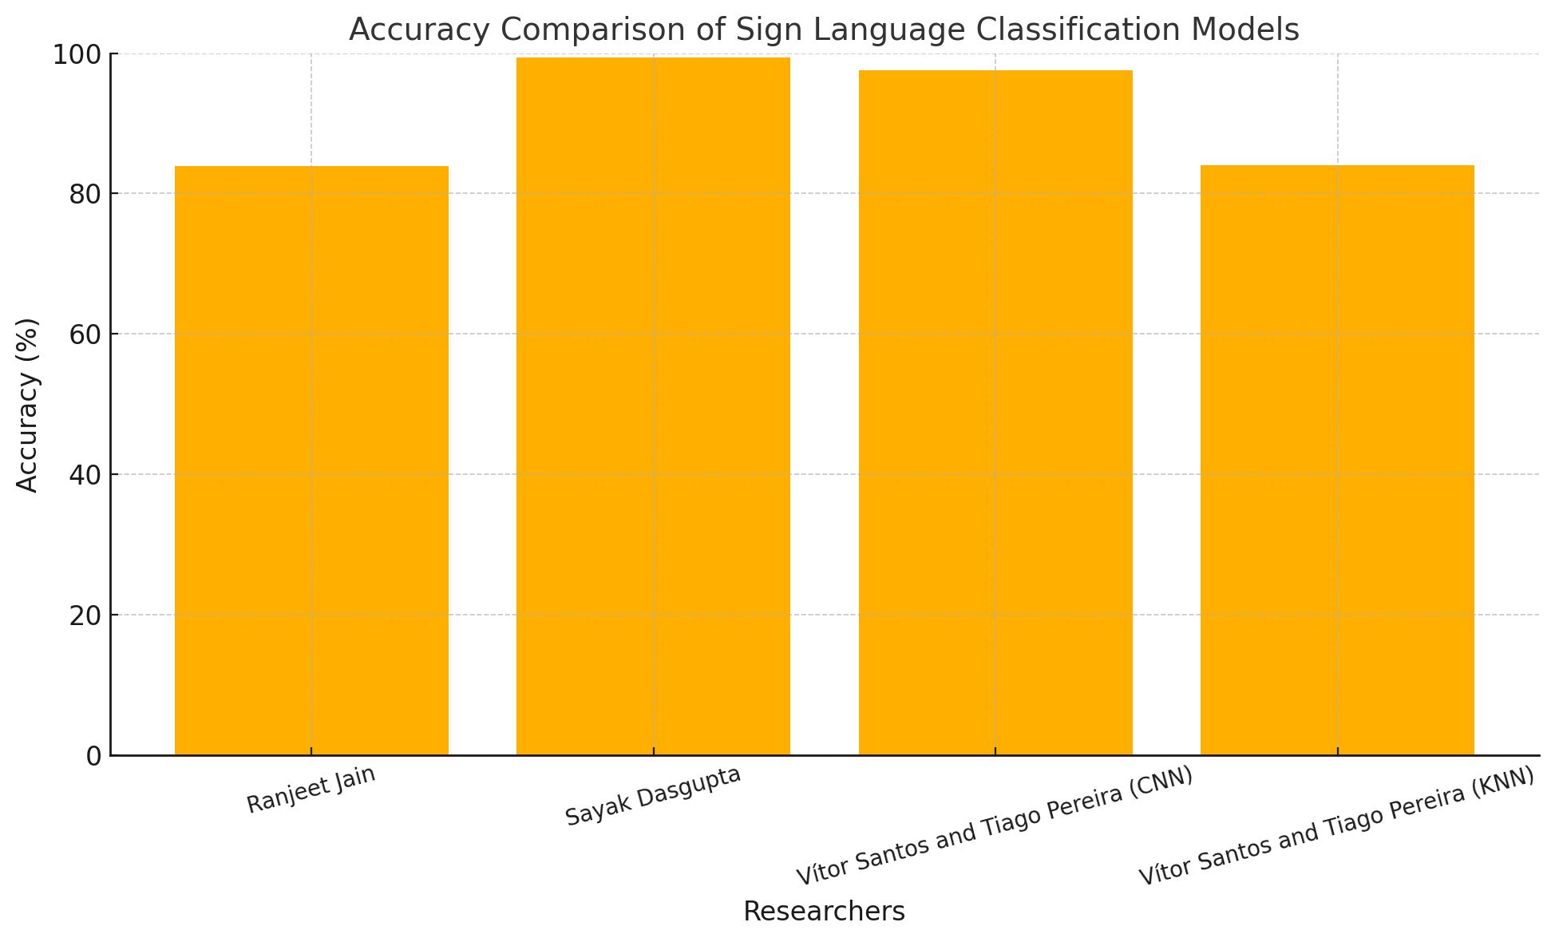
02 State of the art
Ranjeet Jain using CNN has able to achieve 83.87% accuracy
Sayak Dasgupta using CNN has able to achieve 99.40% accuracy but using data augmentation
Vitor Santos and Tiago Pereira were able achieve 84% accuracy using a KNN and 97% using a CNN
5

Slide 6
Models

Slide 7
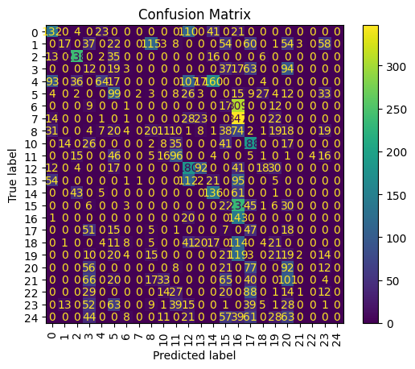
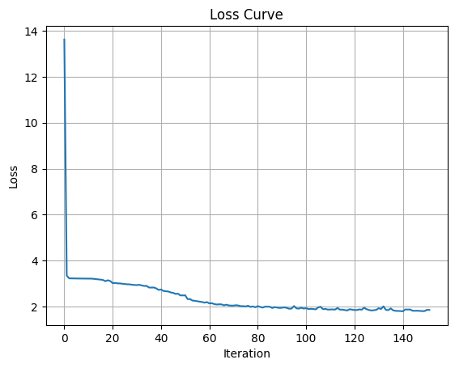
03 Models – NN 1
Model built using most basic parameters, to understand how a simple model will perform
No data normalization
No L2 regularization term
Accuracy 18,61% F1-Score 0.156
7

Slide 8
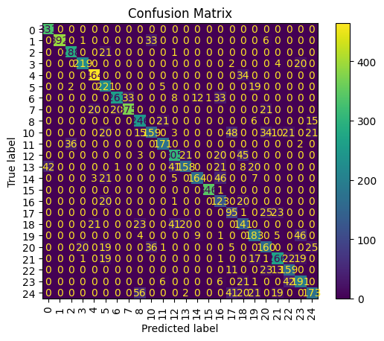
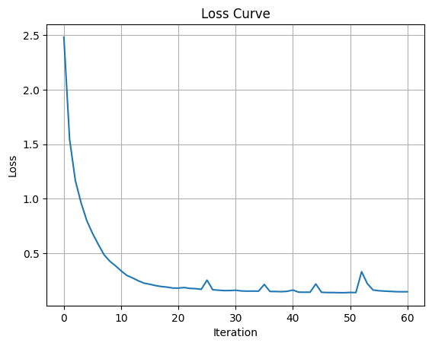
03 Models – NN 2
Added data normalization
Ran simulations to learn best hidden layer structure
(1st 256 , 2nd 128)
Shows clear improvements comparing to Model 1
Accuracy 77.96% F1-Score 0.7577
8

Slide 9
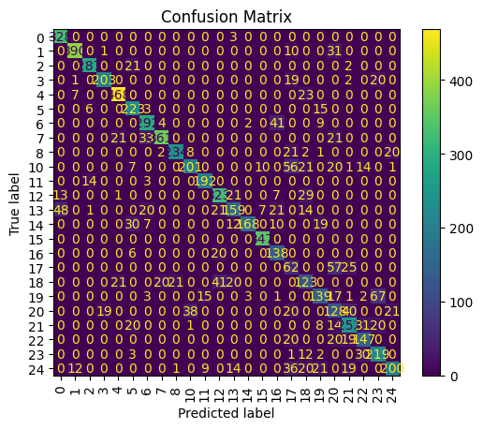
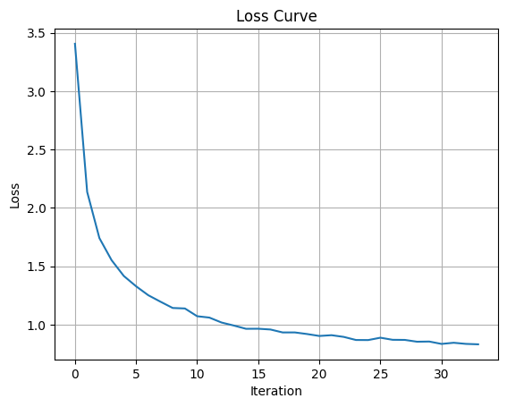
03 Models – NN 3
Added L2 regularization term (alpha)
Ran simulations to get the best alpha value (0.1)
Accuracy 77.86% F1-Score 0.7559
Overfitting still present
9

Slide 10
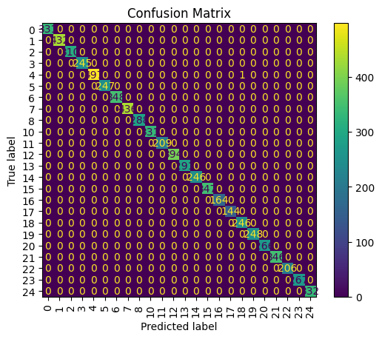
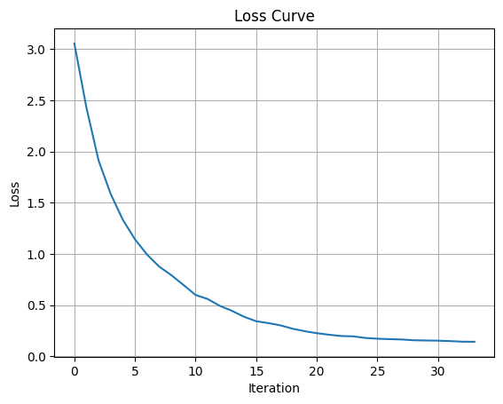
03 Models – NN 4
Added data augmentation in both training and testing
Model performance shows clear improvement
Accuracy 99.48%
F1-Score 0.9979
10

Slide 11
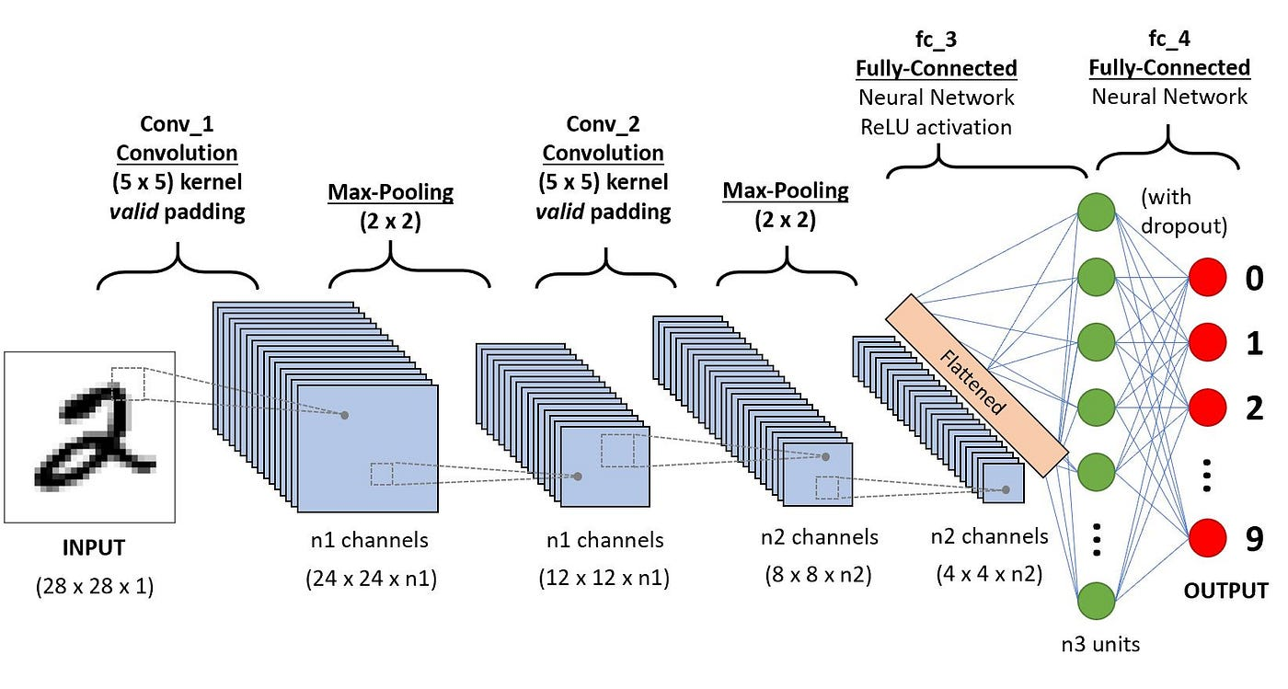
03 Models – CNN What is ?
Very Good at dealing with images as it makes use of convolutions.
From the references we know that they perform well on this problem
11

Slide 12
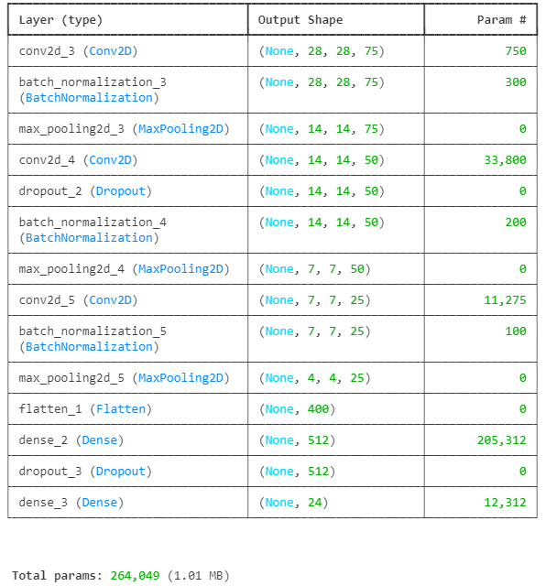
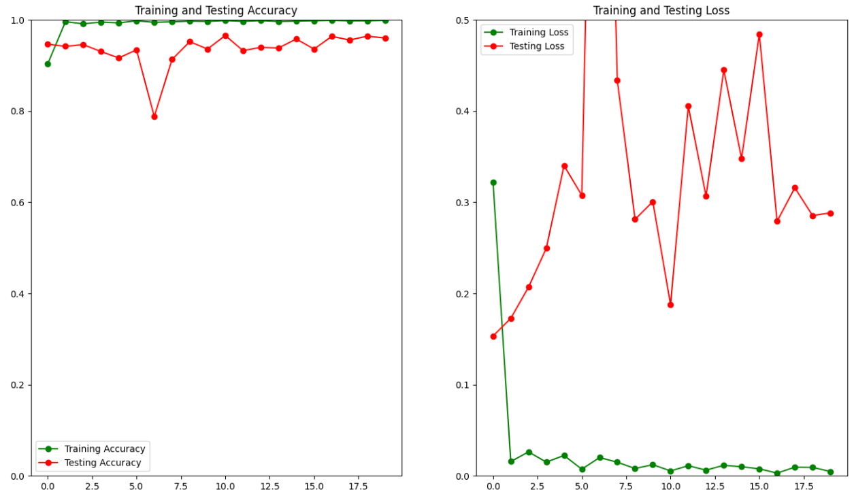
03 Models – CNN 1
Based on references we built the architecture
Trained without Data Augmentation and Adaptive learning rate
Accuracy 90.90%
F1-score 0.9019
12

Slide 13
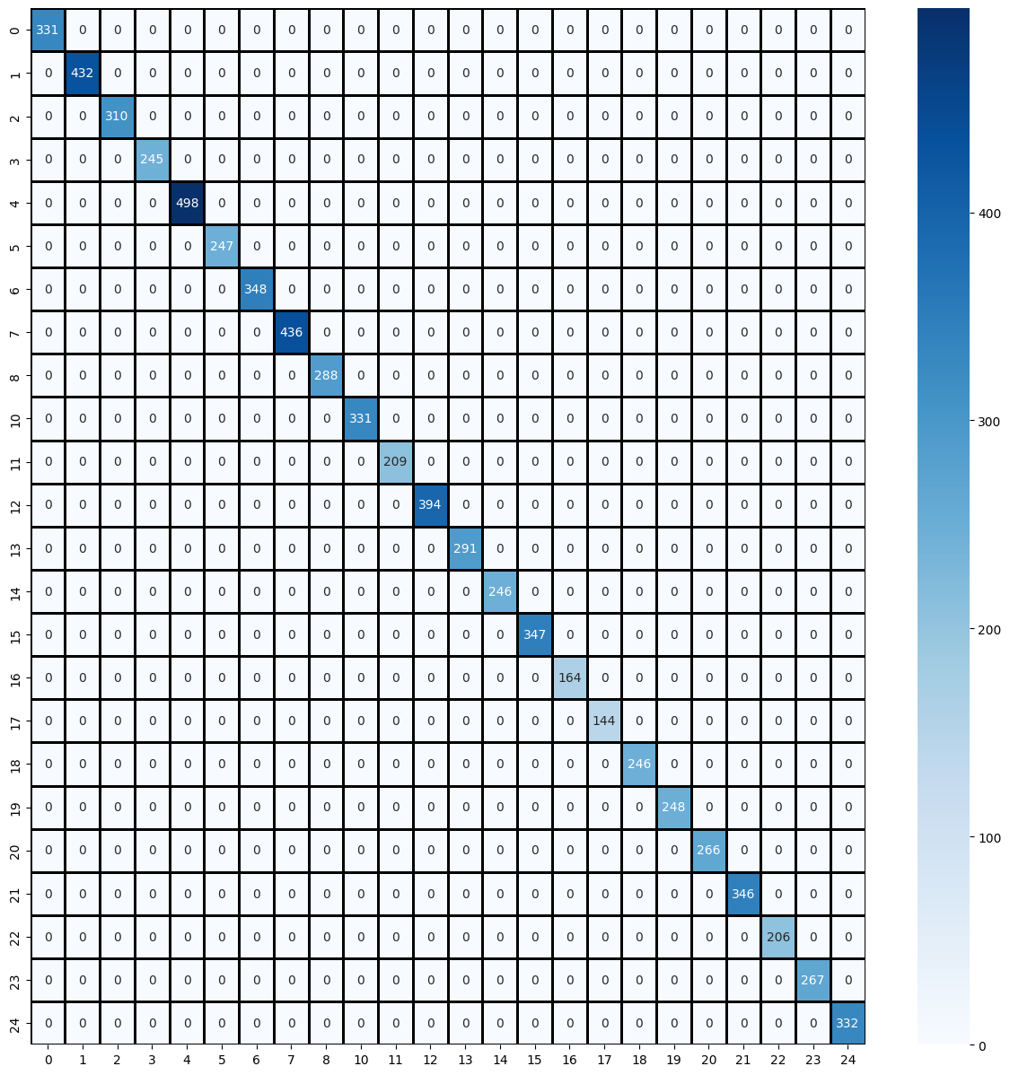
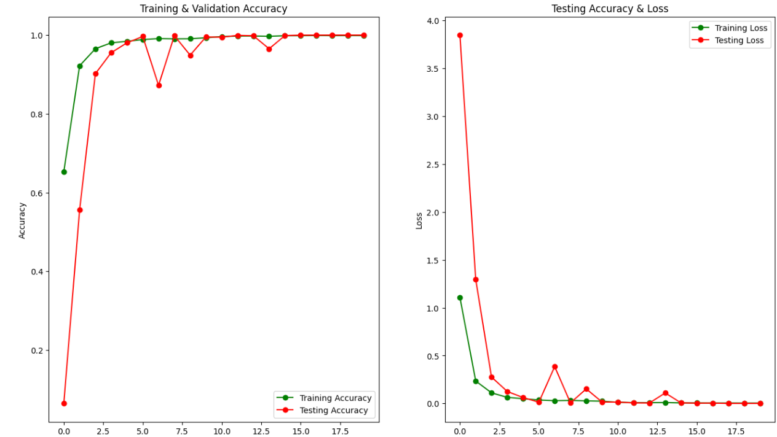
03 Models – CNN 1
Same Architecture
But using data augmentation and adaptive learning rate
Accuracy 100%
F1-score 1
13

Slide 14
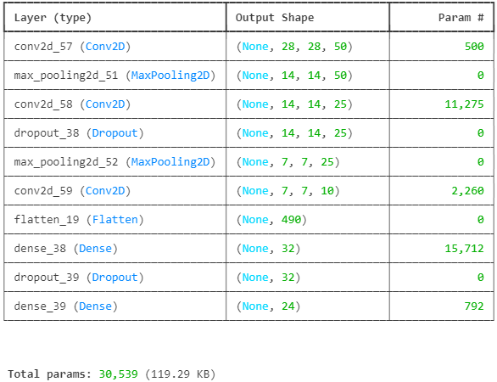
03 Models – CNN 2
Smaller model to not overfit without data augmentation
L2 regularization on dense layers and strength 0.01
Architecture based on iterations where we adjusted model size and alpha strength
14

Slide 15
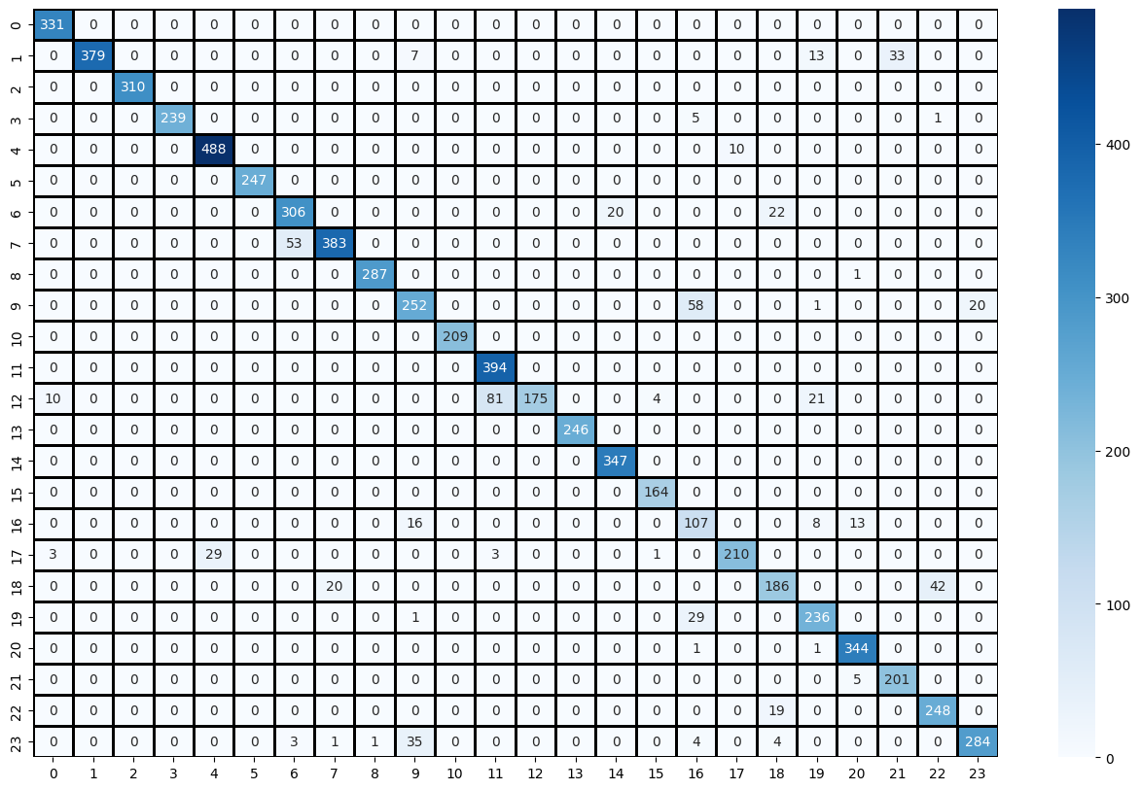
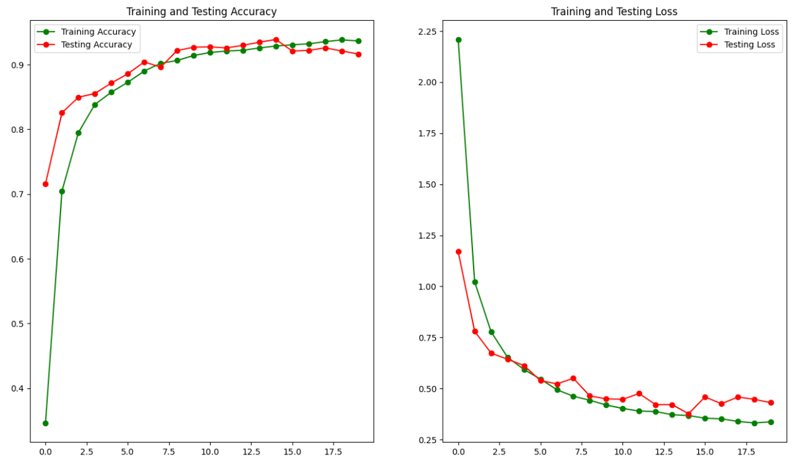
03 Models – CNN 2
Loss curve shows that the model didn’t overfit
Accuracy is less than model 1 with data augmentation
Hardest classes are 11 and 16
Accuracy 91.64%
F1-score 0.9106
15

Slide 16
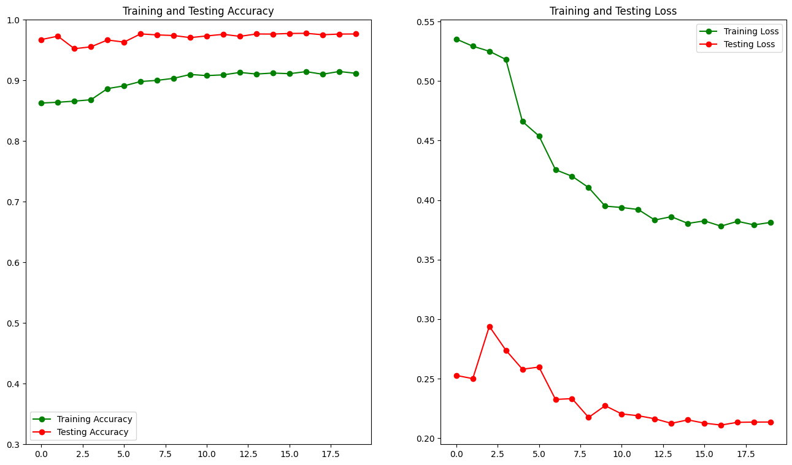
03 Models – CNN 2
Using data augmentation on this model gives an interesting result where train loss > test loss
Data augmentation introduced patterns than don’t occur on test.
Accuracy 97.65%
F1-score 0.9737
16

Slide 17
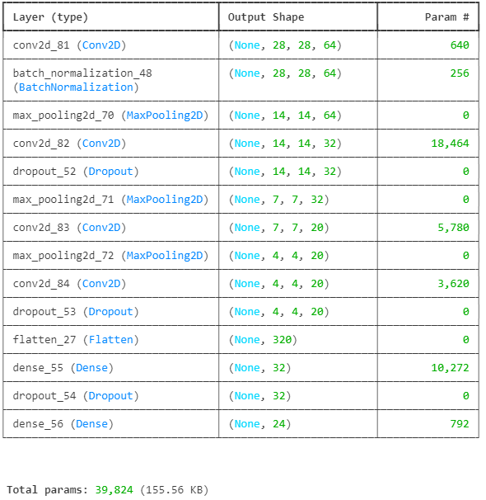
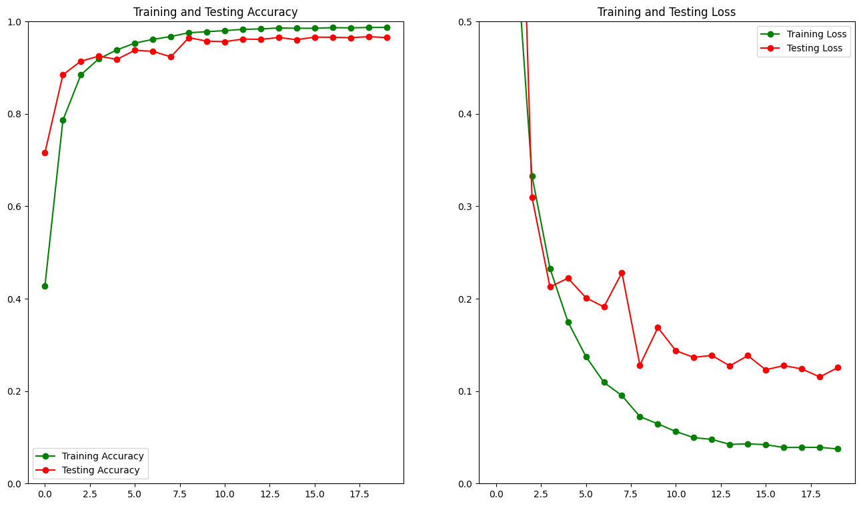
03 Models – CNN3
Final model meant to be small and precise and with data augmentation in mind
Needed 3 layers of convolution
Accuracy 96.52%
F1-score 0.9660
17

Slide 18
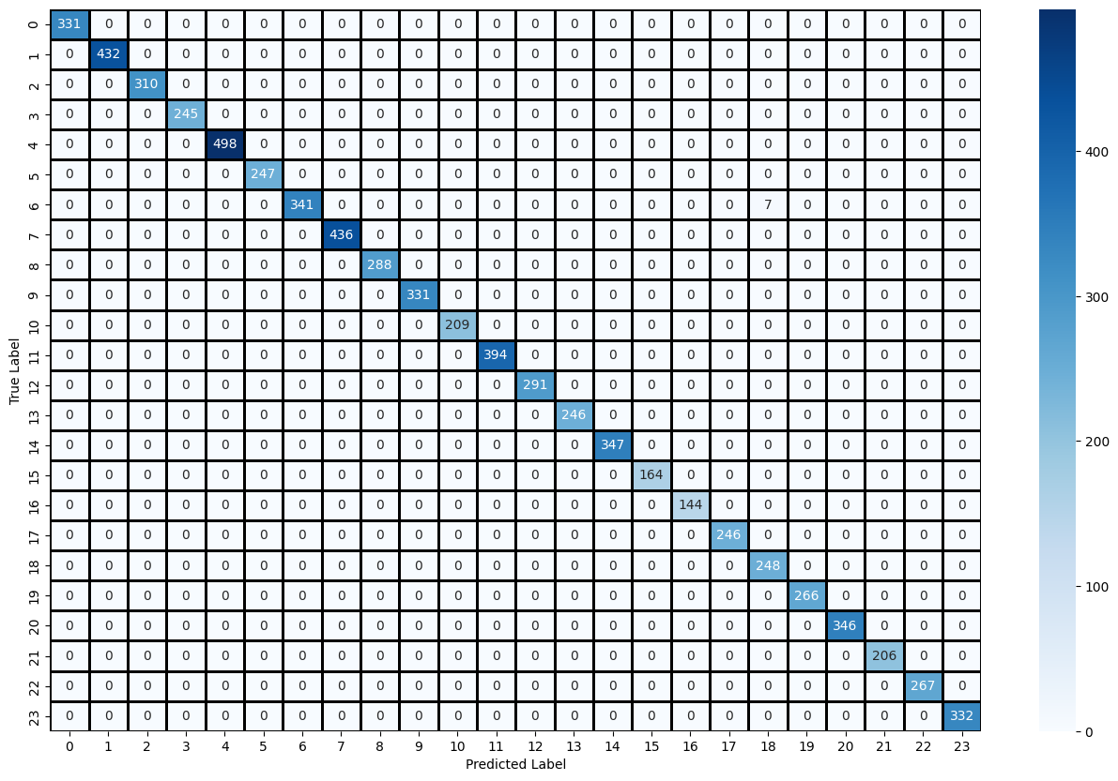
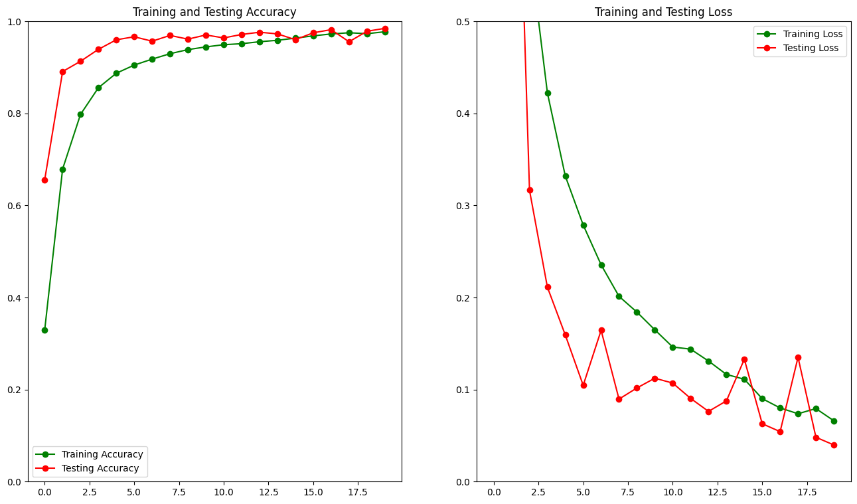
03 Models – CNN3
Accuracy:99.90% F1-score:0.9989
18

Slide 19
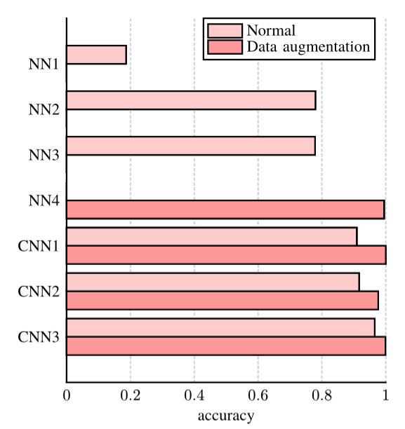
04 Comparison
Without data augmentation the CNNs performed much better
Data augmentation had a big effect on this problem
19

Slide 20
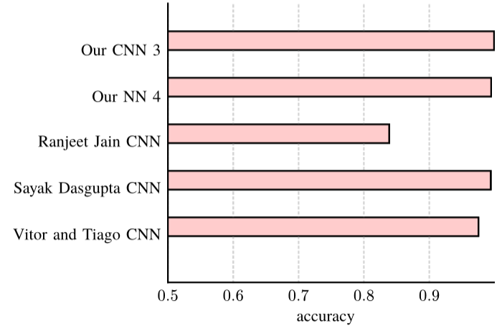
04 Comparison
Our CNN 3 has 8x less parameters than the best model
Our NN 4 performed better than we expected
20

Slide 21
Conclusion
Data augmentation had a large impact both in CNN and ANN.
Both approaches produced very good models.
For further improvements we could experiment with PCA and ensemble of small models.
21

Slide 22
References:
[1] R. Jain, “Deep Learning Using Sign Language.” [Online]. Available: https://www.kaggle.com/code/ranjeetjain3/deep-learning-usingsign-langugage
[2] S. Dasgupta, “Sign Language Classification - CNN (99.40% Accuracy).” [Online]. Available: https://www.kaggle.com/code/sayakdasgupta/ sign-language-classification-cnn-99-40-accuracy
[3] V. Santos and T. Pereira, “Exploring Models for Sign Language Classification.” Aveiro, Portugal, 2023.
22

Slide 23
THANK YOU

