Slide 1

Machine Learning
Session 17 - T
Support Vector Machines – Part 1
Ciência de Dados Aplicada
2023/2024

Slide 2
Support Vector Machines (SVMs) - Basics
Supervised machine learning algorithm suitable for both classification and regression.
Objective: Find the optimal hyperplane or decision boundary in the feature space.
How? By maximizing the margin or distance between data points of different classes or regression targets.
Support Vector Machines
Session 17

Slide 3
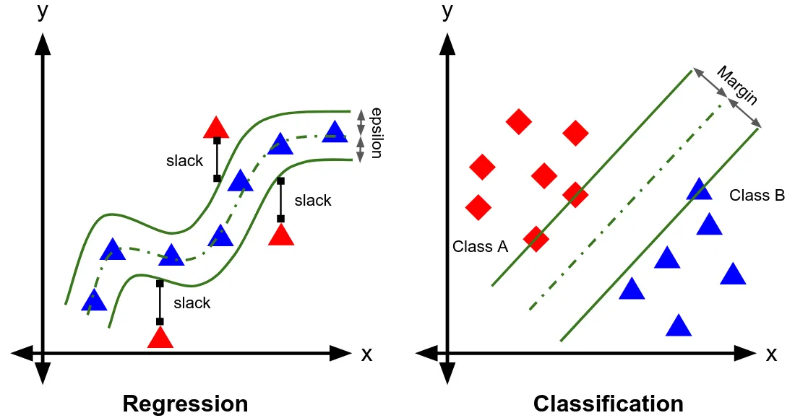
SVMs - Basics
Support Vector Machines
Session 17

Slide 4
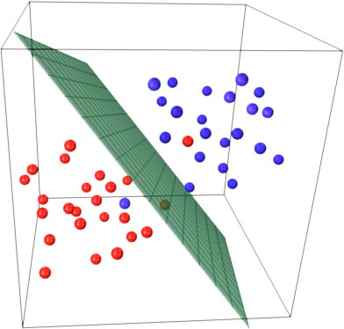
SVMs - Hyperplanes
A hyperplane is a subspace with one dimension less than the number of variables in the dataset (n-1).
For a 3-dimensional dataset, a 2-dimensional plane can be used to separate the data into two distinct groups.
Multiple hyperplanes can separate the data. The goal is to find the hyperplane with the maximum margin.
Support Vector Machines
Session 17

Slide 5
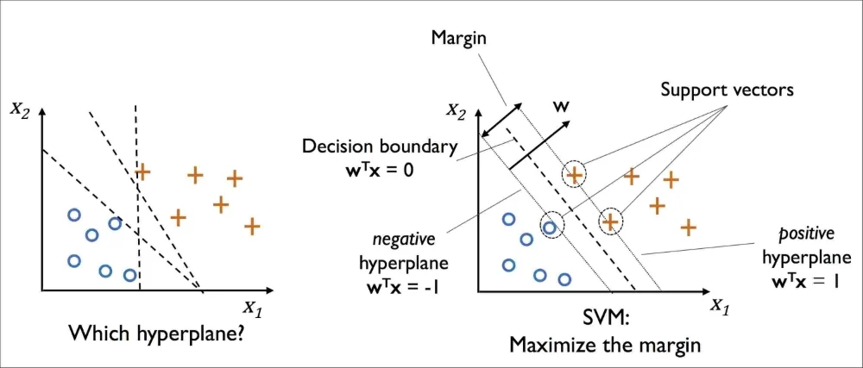
Maximum Margin Classifier
A Margin Classifier is a type of classifier that provides a distance to the discriminant.
The hyperplane serves as the boundary separating classes in a linear classifier.
A Maximum Margin Classifier seeks the discriminant with the maximum margin, maximizing the distance to the nearest points (support vectors) for separating classes.
Support Vector Machines
Session 17

Slide 6
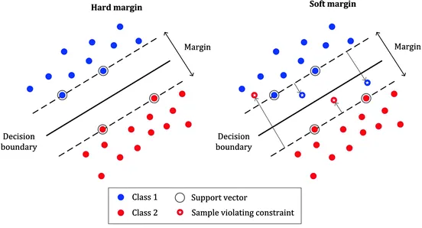
Maximum Margin Classifier
Uses cross validation to find the best support vectors.
Hard vs Soft Margin
Very sensitive to outliers.
All training instances need to be correctly classified.
Only for linearly separable data.
Support Vector Machines
Session 17

Slide 7
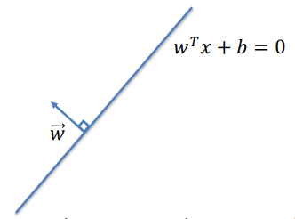
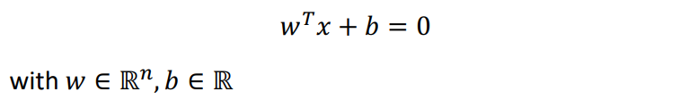
Some Geometry
In n dimensions, a hyperplane is a solution to the equation:
The vector is called the normal vector of the hyperplane.
Support Vector Machines
Session 17

Slide 8

Some Geometry
In n dimensions, a hyperplane is a solution to the equation:
Note that this equation is scale invariante for any scalar
Support Vector Machines
Session 17

Slide 9
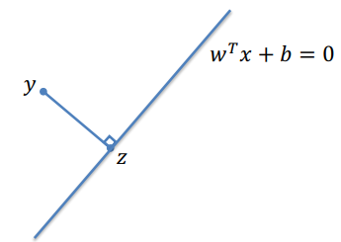
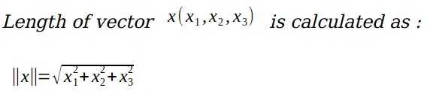

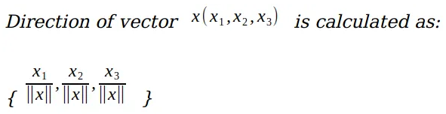
Some Geometry
The distance between a point y and a hyperplane
is the length of the segment perpendicular to the line to the point y
The vector from y to z is given by:
Note that:
Support Vector Machines
Session 17

Slide 10
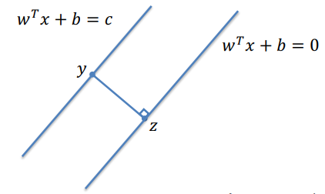
Scale Invariance
By scale invariance, we can assume that c = 1
The maximum margin is always obtained by choosing
so that it is equidistant from the closest data point from each class.
Support Vector Machines
Session 17

Slide 11
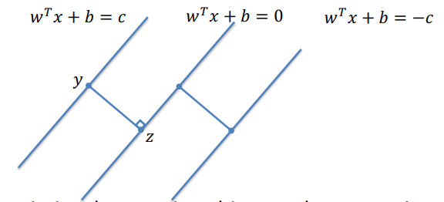

Scale Invariance
We want to maximize the margin subject to the constraints that
But how do we compute the size of the margin?
Support Vector Machines
Session 17

Slide 12
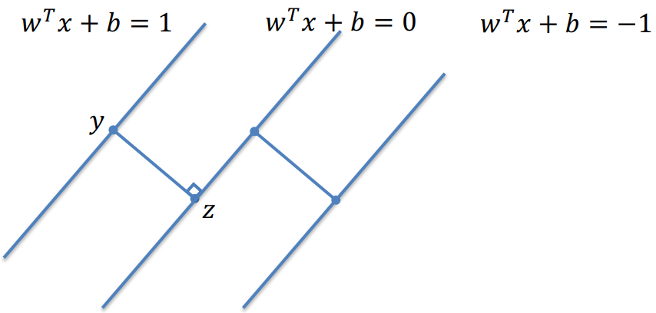

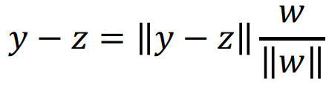

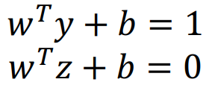

Some Geometry
Putting it all together:
and
and
which gives:
Support Vector Machines
Session 17

Slide 13
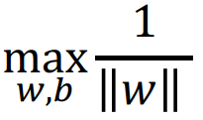


SVMs
From the previous analysis we get the following optimization problem:
such that:
OR
Support Vector Machines
Session 17

Slide 14
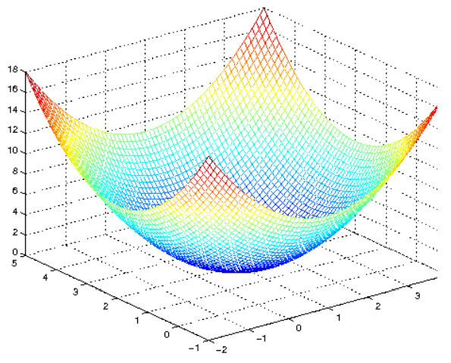
SVMs
such that:
This is a standard quadratic programming problem!
Convex optimization problems
Support Vector Machines
Session 17

Slide 15
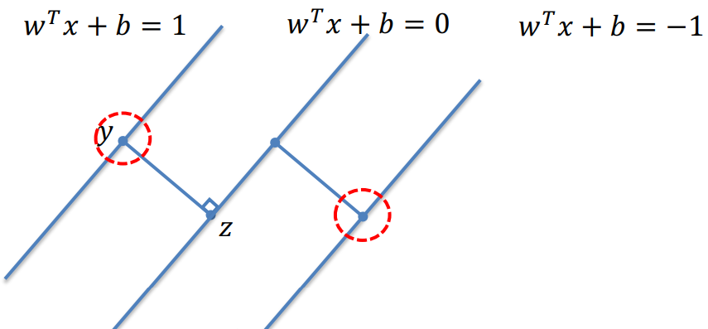

SVMs
Where does the name come from?
The set of data points such that:
are called support vectors.
The SVM classifier is completely determined by the support vectors (the other data points dont influence the algorithm).
Support Vector Machines
Session 17

Slide 16
SVMs
Assumptions made so far:
The data is linearly separable!
We are dealing with binary classification tasks!
Support Vector Machines
Session 17

Slide 17

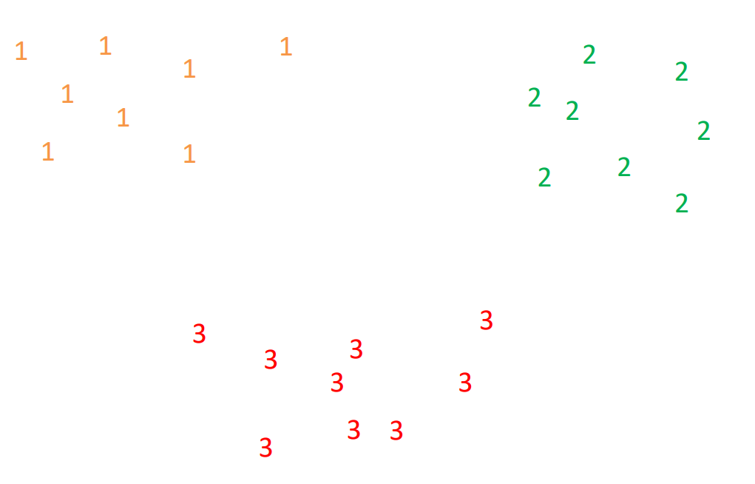
SVMs – Multiclass Classification
What if we want to do more than just binary classification
for instance if
Support Vector Machines
Session 17

Slide 18
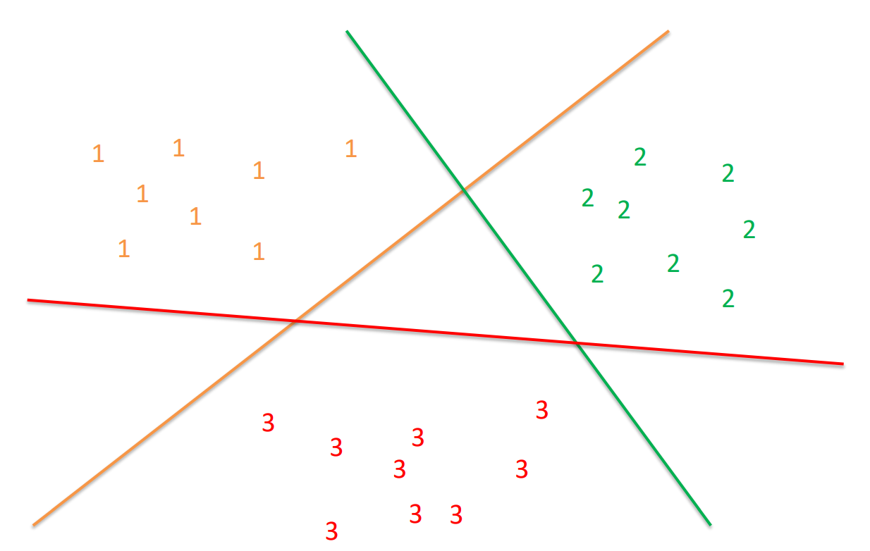
One-Versus-All SVMs
What if we want to do more than just binary classification
for instance if
Support Vector Machines
Session 17

Slide 19
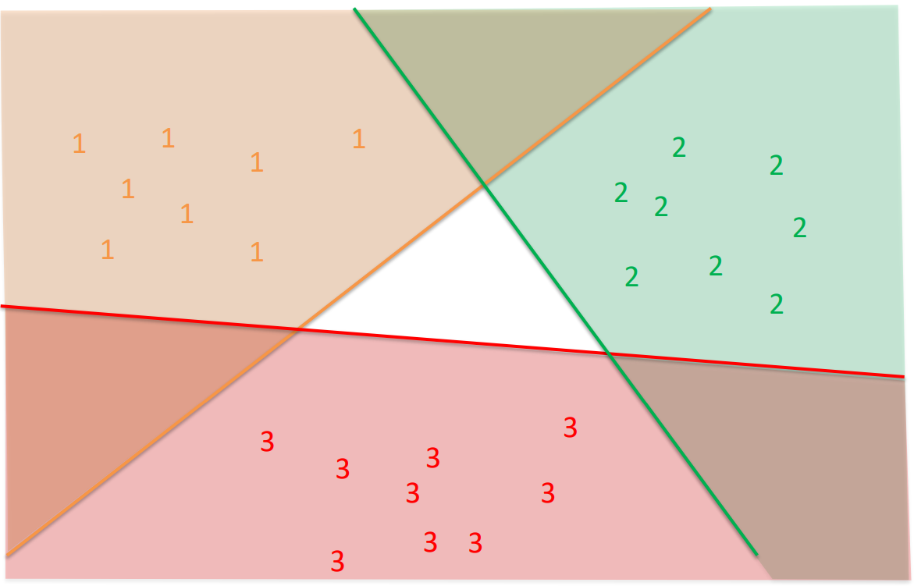
One-Versus-All SVMs
What if we want to do more than just binary classification
for instance if
Regions correctly classified by exactly one classifier.
Support Vector Machines
Session 17

Slide 20


One-Versus-All SVMs
Compute a classifier for each label versus all other labels;
Let be the classifier for the k^{th} label
For a new datapoint x, classify it as:
Drawbacks:
If there are L possible labels, requires learning L classsifiers over the entire dataset.
Support Vector Machines
Session 17

Slide 21
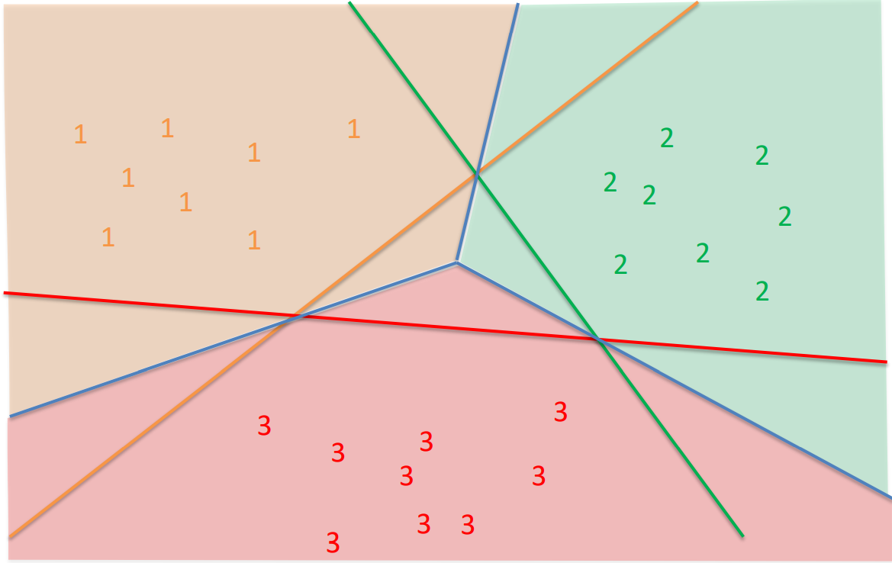

One-Versus-All SVMs
Regions in which points are classified by the highest value of:
Support Vector Machines
Session 17

Slide 22
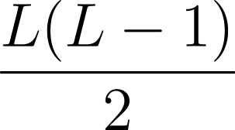
One-Versus-One SVMs
Alternatively, it is possible to learn a classifier for all possible pairs of labels;
Given a new data point, it will be classified by majority vote (by finding the most common lable among all possible classifiers);
If there are L labels, requires learning different classifiers using different fractions of the data.
Drawbacks:
Can overfit some pairs of labels;
Computationaly expensive.
Support Vector Machines
Session 17

Slide 23
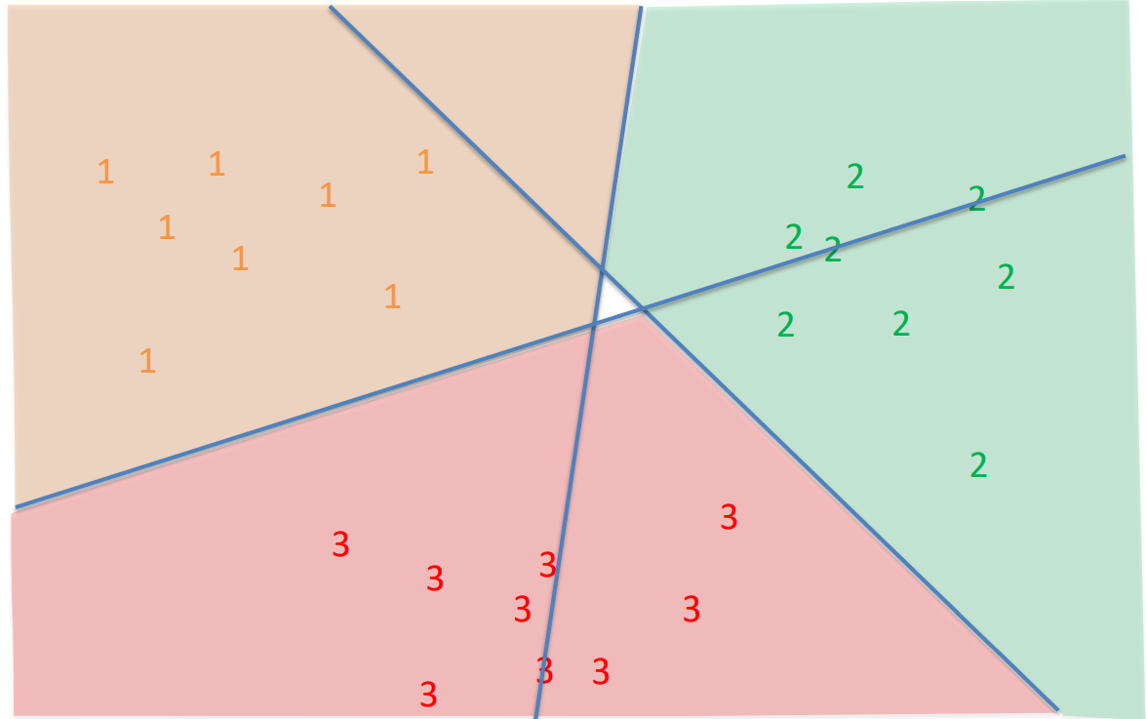
One-Versus-All SVMs
Regions determined by majority vote over all classifiers
Support Vector Machines
Session 17

Slide 24
Resources
https://www.youtube.com/watch?v=efR1C6CvhmE
Support Vector Machines
Session 17

