Slide 1

Machine Learning
Session 1 - T​
Introduction to Machine Learning
Ciência de Dados Aplicada
2023/2024

Slide 2
Objectives
Learn the theoretical foundations of advanced machine learning concepts;
Implement advanced machine learning algorithms using Python;
Apply machine learning techniques to real-world problems.
Introduction to Machine Learning
Session 1

Slide 3
Classes
Typically, classes will be divided in two parts:
Foundations of Data Science and Machine Learning (1 hour).
Hands-on Implementation in Python (1 hour).
Introduction to Machine Learning
Session 1

Slide 4
Evaluation
Test 1 (40%) + Test 2 (40%)
Minimum passing grade of 9.5
Group project (20%)
Groups of 2 or 3 students;
Divided into two phases:
intermediate presentation;
final submission.
Minimum passing grade of 9.5
Introduction to Machine Learning
Session 1

Slide 5
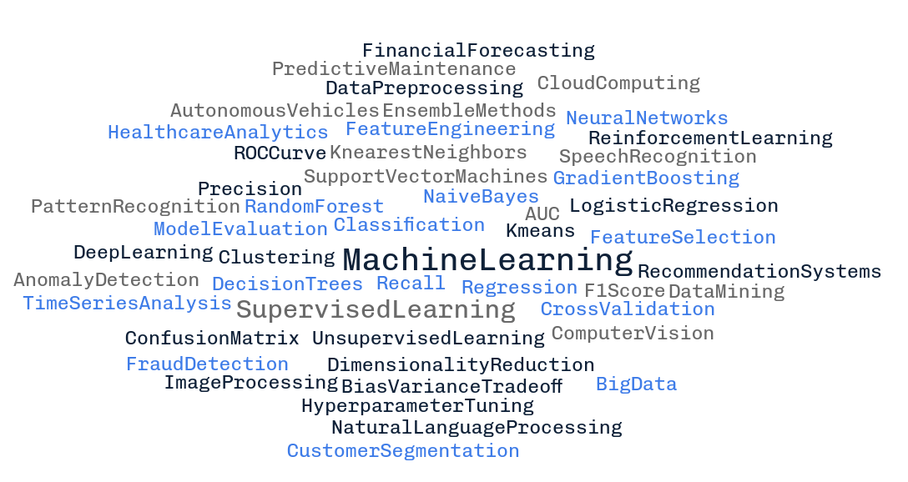
Terminology
Introduction to Machine Learning
Session 1

Slide 6
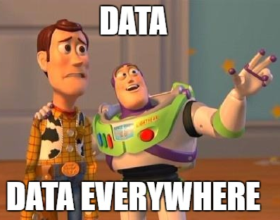
Data everywhere!
Daily creation of 328.77 million terabytes of data.
This year's projection (2024): 120 zettabytes of data.
Last two years alone, account for 90% of the world's data.
Introduction to Machine Learning
Session 1

Slide 7
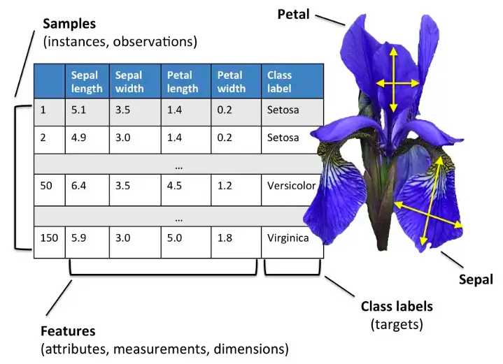
Data types
Tabular data:
https://eminebozkus.medium.com/exploring-the-iris-flower-dataset-4e000bcc266c
Introduction to Machine Learning
Session 1

Slide 8
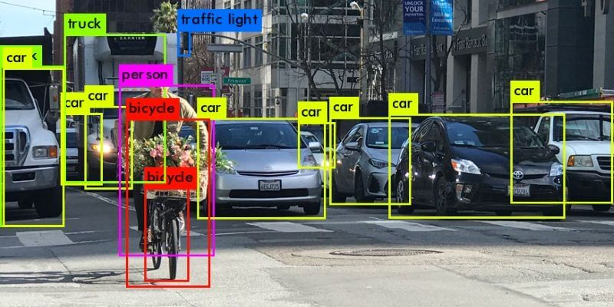
Data types
Image data:
Introduction to Machine Learning
Session 1

Slide 9
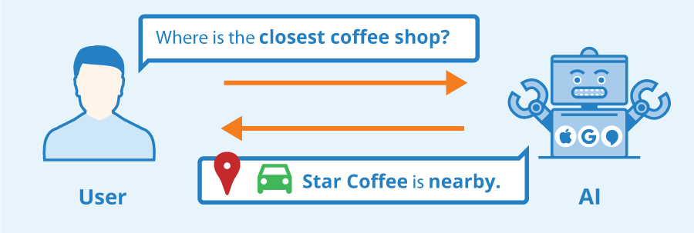
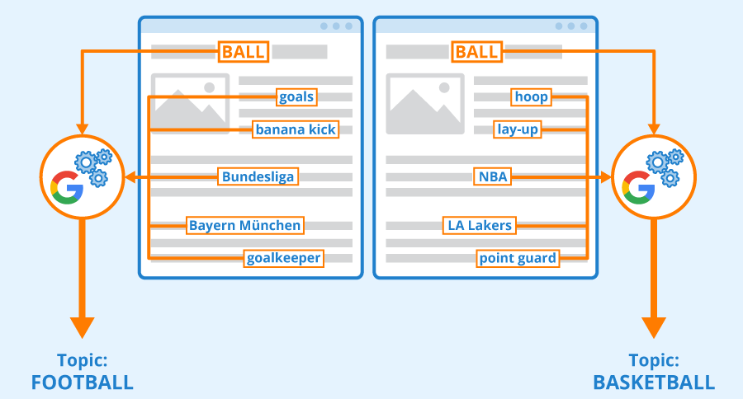
Data types
Text data:
Introduction to Machine Learning
Session 1

Slide 10

Data types
Audio data:
Introduction to Machine Learning
Session 1

Slide 11
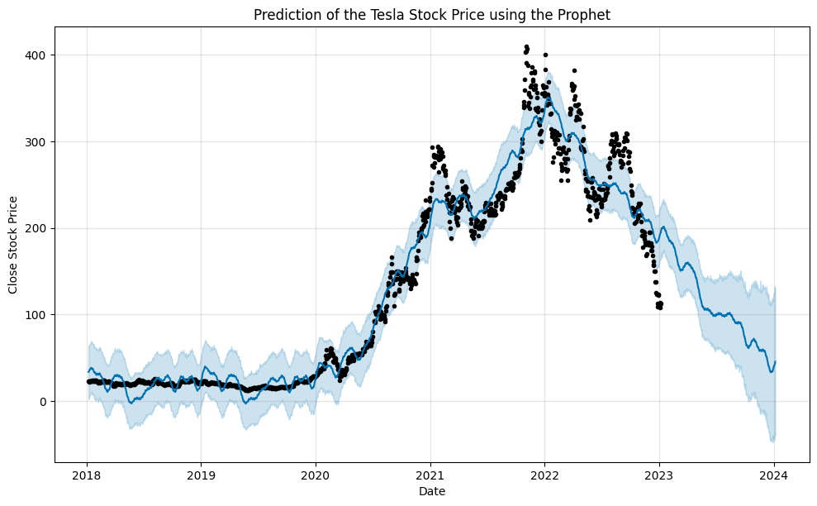
Data types
Time series data:
Introduction to Machine Learning
Session 1

Slide 12
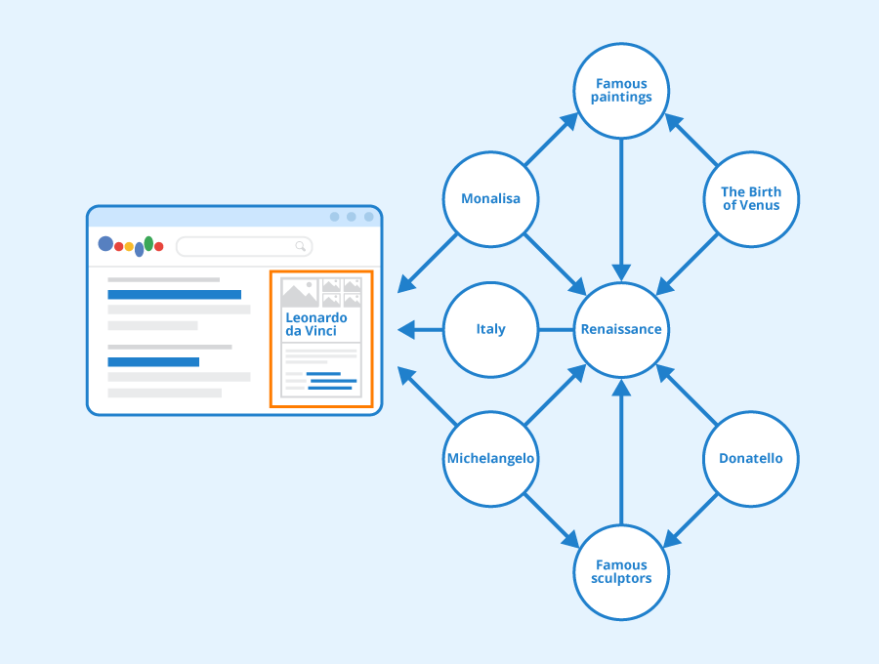
Data types
Graph data:
Introduction to Machine Learning
Session 1

Slide 13



The Components of Learning
Inferences
Data storage: every learning process starts with data. Both humans and computers rely on data storage as a fundamental basis for more advanced reasoning..
Abstraction: involves extracting knowledge from stored data by forming general concepts that represent the data as a whole.
Generalization involves leveraging abstracted data to generate knowledge and inferences, which subsequently inform actions in novel situations.
Evaluation: serves as a feedback mechanism, measuring the effectiveness of acquired knowledge and offering insights for possible enhancements.
Data
Concepts
Data Storage
Abstraction
Generalization
Evaluation
Introduction to Machine Learning
Session 1

Slide 14
Machine Learning
“A computer program is said to learn from experience E with respect to some class of tasks T and performance measure P, if its performance at tasks in T, as measured by P, improves with experience E. ”
Tom Mitchell. Machine Learning 1997.
Introduction to Machine Learning
Session 1

Slide 15
Machine Learning Paradigms
Supervised: the algorithm is trained on a labeled dataset, where the input data is paired with corresponding output labels. The goal is to learn a mapping from inputs to outputs, allowing the algorithm to make predictions on new, unseen data.
Unsupervised: involves working with unlabeled data, where the algorithm explores the inherent structure and patterns within the input without explicit output guidance.
Semi-supervised: combines labeled and unlabeled data for training. It aims to leverage the benefits of both supervised and unsupervised learning, often useful when obtaining labeled data is costly or time-consuming.
Introduction to Machine Learning
Session 1

Slide 16
Machine Learning Paradigms
Generative: the focus is on learning the underlying probability distribution of the input data. It can generate new, synthetic samples that resemble the training data.
Reinforcement Learning: an agent learns to make decisions by interacting with an environment. The agent receives feedback in the form of rewards or penalties, enabling it to learn optimal strategies over time.
Introduction to Machine Learning
Session 1

Slide 17
Machine Learning Applications
Spam filtering;
Fraud detection;
Disease detection;
Drug discovery;
Recommendation systems;
Forecasting;
Autonomous Vehicles;
Chatbots;
Object detection;
Anomaly detection;
...
Introduction to Machine Learning
Session 1

Slide 18
Resources
Kelleher, J. D., Namee, B. M., & D’Arcy, A. (2015). Fundamentals of machine learning for predictive data analytics. London, England: MIT Press.
Guido, S., & Mueller, A. C. (2016). Introduction to machine learning with python. Sebastopol, CA: O’Reilly Media.
Introduction to Machine Learning
Session 1

