Slide 1

Machine Learning
Session 3 - PL
Data Scaling and Feature Selection
Ciência de Dados Aplicada
2023/2024

Slide 2
scikit-learn
Scikit-learn is a powerful library in Python for machine learning tasks, including data scaling and feature selection.
Documentation: https://devdocs.io/scikit_learn/
Tutorials: https://scikit-learn.org/stable/tutorial/index.html
Data Scaling and Feature Selection
Session 3

Slide 3
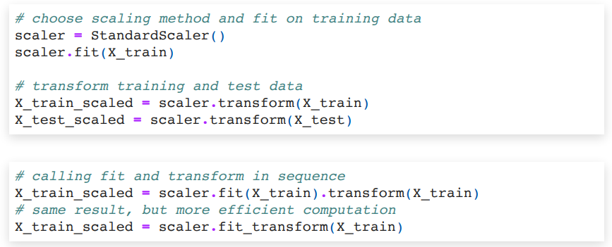
Data scaling in Python (scikit-learn)
In scikit-learn all scalers follow the fit-transform methods:
"fit" prepares the scaler by learning from the data;
"transform" actually scales the data.
Data Scaling and Feature Selection
Session 3

Slide 4
Data scaling in Python (scikit-learn)
StandardScaler:
https://scikit-learn.org/stable/modules/generated/sklearn.preprocessing.StandardScaler.html
MinMaxScaler:
https://scikit-learn.org/stable/modules/generated/sklearn.preprocessing.MinMaxScaler.html
Normalizer:
https://scikit-learn.org/stable/modules/generated/sklearn.preprocessing.Normalizer.html
RobustScaler:
https://scikit-learn.org/stable/modules/generated/sklearn.preprocessing.RobustScaler.html
Others:
https://scikit-learn.org/stable/auto_examples/preprocessing/plot_all_scaling.html
Data Scaling and Feature Selection
Session 3

Slide 5
Feature Selection in Python (scikit-learn)
Feature selectors also follow the "fit" "transform" convention.
Scikit-learn includes several feature selectors:
https://scikit-learn.org/stable/modules/feature_selection.html
Data Scaling and Feature Selection
Session 3

Slide 6
Statistical tests in Python (scipy.stats)
scipy.stats is a module within the SciPy library that provides a wide range of statistical functions and distributions for various statistical analyses.
https://docs.scipy.org/doc/scipy/reference/stats.html
Functions:
T-test: ttest_1samp, ttest_ind
ANOVA: f_oneway
Non-parametric: wilcoxon and kruskal
Chi-square: chisquare
Data Scaling and Feature Selection
Session 3

Slide 7
Exercises:
Notebooks on the github repository:
Notebook with examples:
notebooks/session3/examples.ipynb
Notebook with exercises:
notebooks/session3/exercises.ipynb
Data Scaling and Feature Selection
Session 3

