Slide 1

Machine Learning
Session 3 - T
Data Scaling and Feature Selection
Ciência de Dados Aplicada
2023/2024

Slide 2
Data Scaling
Data scaling refers to the procedure of adjusting the range of features within a dataset to a comparable scale;
Real-world datasets often contain features with different orders of magnitude, ranges, and measurement units.
Car | Model | Volume | Weight | CO2
Toyota | Aygo | 1.0 | 790 | 99
Skoda | Citigo | 1.0 | 929 | 95
Fiat | 500 | 0.9 | 865 | 90
Mini | Cooper | 1.5 | 1140 | 105
Skoda | Fabia | 1.4 | 1109 | 90
... | ... | ... | ... | ...
Data Scaling and Feature Selection
Session 3

Slide 3
Why do we need scaling?
Some machine learning models are sensitive to feature scale;
Features with larger scales may dominate the learning process;
Models may converge faster;
Model performance may improve (specially for models that rely on distance metrics);
Data Scaling and Feature Selection
Session 3

Slide 4
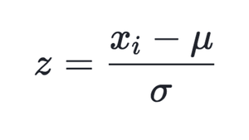

Data Scaling Methods
Standardization (Z-score notmalization): centers the data around mean 0 and standar deviation 1;
Normalization: scales the data between 0 and 1;
Min-Max Scaling: scales data betwenn a maximum and minimum value;
Data Scaling and Feature Selection
Session 3

Slide 5

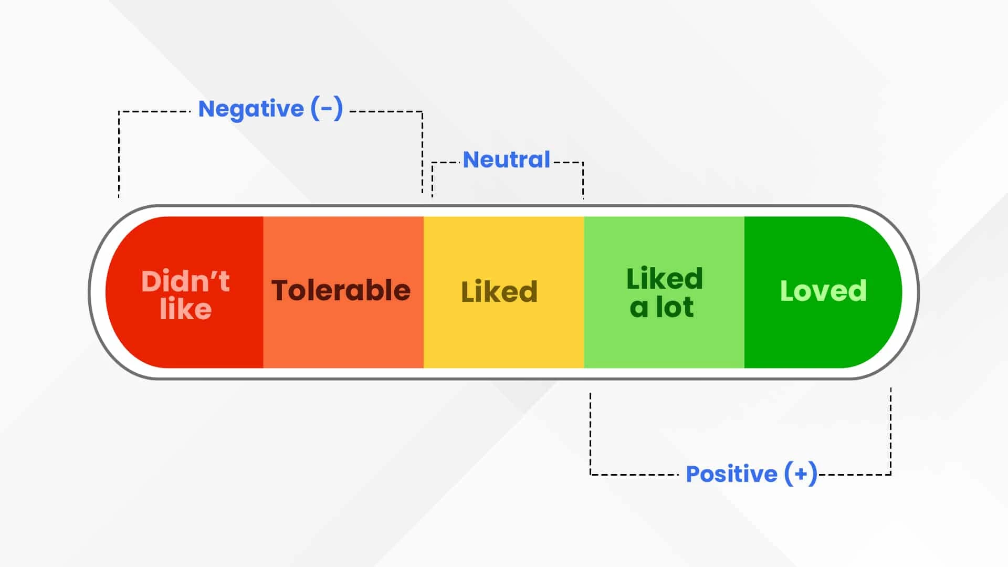
Data Scaling Methods
Robust Scaling: Scales data based on the interquartile range, making it robust to outliers;
Log transformation: scales data by applying the natural logarithm function;
Ordinal scaling: assign integer values to categories with a meaningful order.
Data Scaling and Feature Selection
Session 3

Slide 6
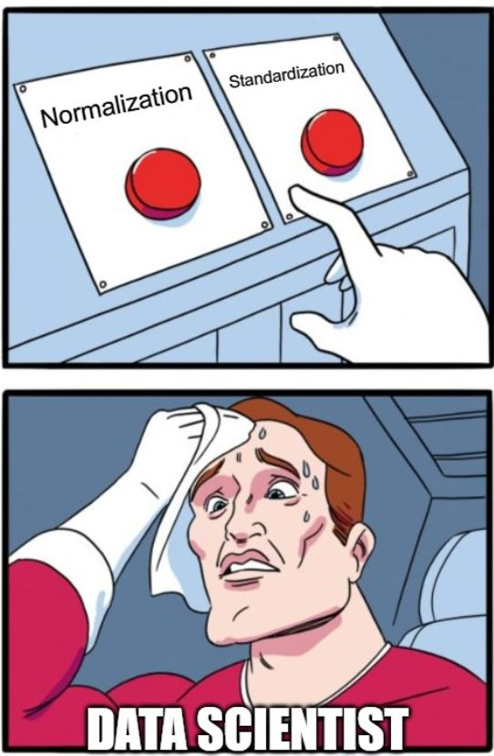
Which Scaling Method to Choose?
Choose the method that aligns with your data type, distribution, and Machine Learning model to use;
Methods to use:
Continuous data:
Uniform distribution: Min-Max scaling / normalization;
Normally distributed: Z-score standardization;
Data with outliers: Robust scaling;
Skewed or exponential distribution: Log transformation.
Categorical data:
Ordinal: Ordinal scaling;
Nominal: other strattegies like one-hot encoding and frequency encoding.
Data Scaling and Feature Selection
Session 3

Slide 7
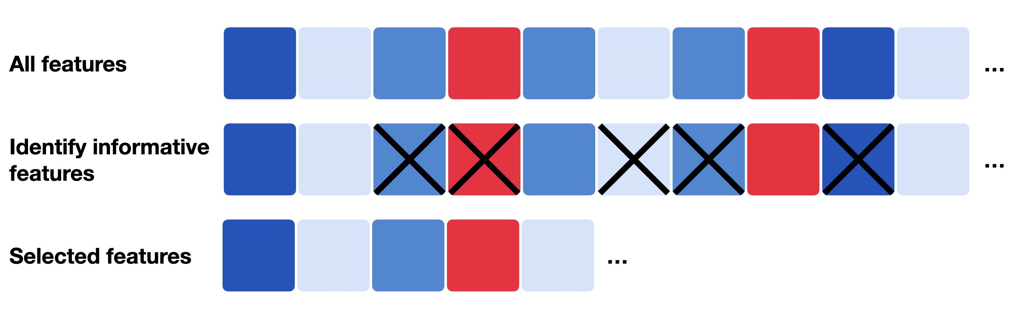
Feature Selection
Feature selection is a process of selecting a subset of the initial features while minimizing the loss of information related to the final task (classification, regression, etc);
Data Scaling and Feature Selection
Session 3

Slide 8

Why Feature Selection?
In many cases, there are multiple advantages in reducing the number of input features used in a model.
This is especially important when:
Dealing with noisy data;
Handling numerous low-frequency features;
Data has too many features compared to samples;
Managing complex models;
...
https://medium.com/barnbridge/barnbridge-dao-built-for-the-future-3735fbd671c5
Data Scaling and Feature Selection
Session 3

Slide 9

Why Feature Selection?
The reduction of the number of features can:
Improve the model's performance;
Enhance optimization stability by removing multicollinearity;
Increase computational eficiency;
Reduce cost of future data collection;
Simplify the model, making it easier to understand and interpret;
…
However, it is not always a necessary step:
Some models have implicit feature selection
Tree-based models;
Models with regularization
LASSO;
RIDGE.
https://www.kaggle.com/code/heyspaceturtle/feature-selection-is-all-u-need
Data Scaling and Feature Selection
Session 3

Slide 10
Feature Selection Algorithms
From the label perspective they can be:
Supervised;
Unsupervised.
From the selection strategy perspective they can be:
Filter methods;
Wrapper methods;
Embbeded methods.
Data Scaling and Feature Selection
Session 3

Slide 11
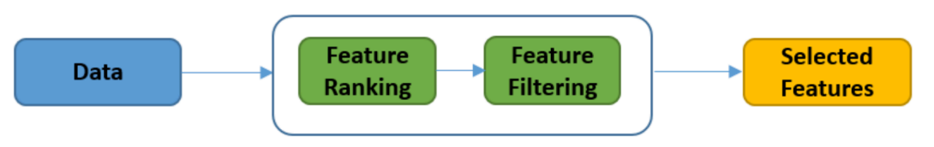
Feature Selection: Filter Methods
Filters methods evaluate feature relevance based on intrinsic data characteristics:
First, features are individually ranked based on specific criteria such as distance, correlation, or entropy;
Second, the best-ranked features are selected using a predetermined threshold.
Data Scaling and Feature Selection
Session 3

Slide 12
Feature Selection: Filter Methods
Unsupervised:
Unsupervised filters compute a metric for each feature based solely on its values;
Metrics include those measuring variability, such as variance (continuous variables) and entropy (discrete variables);
Selection can occur through ranking (e.g., percentile) or by absolute value, by keeping all features with a value below/above a specified threshold.
Supervised:
Supervised filters use a metric calculated for each input feature, comparing its values to those of the output;
Metrics include mutual information (discrete variables) and correlations (continuous variables);
Scores may also rely on univariate statistical tests applied to the paired sets of values;
Different tests may be applied depending on the type of features.
Data Scaling and Feature Selection
Session 3

Slide 13
Feature Selection: Filter Methods
Supervised:
For classification problems (discrete output):
T-test may be used for continuous and binary output; for multiclass output, one-way ANOVA may be used;
Chi-square is used for counts/frequencies or binary variables.
For regression problems (continuous output):
Correlation is an option for continuous inputs (Pearson or Spearman);
Kendall’s rank correlation for discrete inputs (ordinal).
In both cases, mutual information can be used as a non-parametric alternative.
Data Scaling and Feature Selection
Session 3

Slide 14
Feature Selection: Filter Methods
Advantages:
Independent of a learning model;
Computationally efficient;
Suitable for high dimensional data;
Disadvantages:
Interactions between features are ignored;
May fail to handle redundant features;
No interaction with the learning algorithm.
Data Scaling and Feature Selection
Session 3

Slide 15
Feature Selection: Filter Methods
Examples:
VarianceThreshold: keeps only features whose variance exceeds a specified threshold;
SelectKBest: selects the top k (user-defined parameter) features based on a scoring function (mutual information, chi2, ANOVA, etc);
SelectPercentile: selects the top percentage (percentile) of features based on a scoring function (mutual information, chi2, ANOVA, etc).
SelectFpr, SelectFdr, and SelectFwe: sseatures are selected based on their significance according to statistical tests. SelectFpr controls the false positive rate, SelectFdr controls the false discovery rate, and SelectFwe controls the family-wise error rate.
Data Scaling and Feature Selection
Session 3

Slide 16
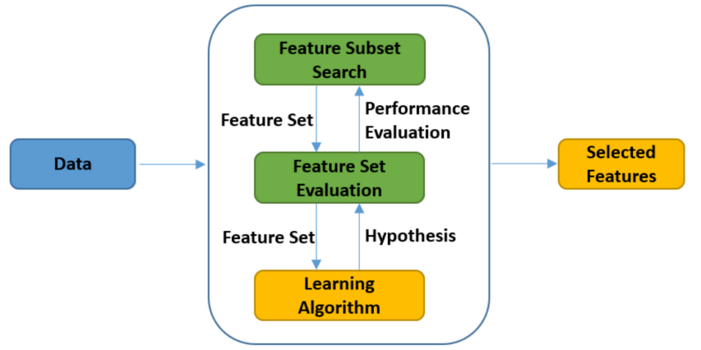
Feature Selection: Wrapper Methods
Wrapper methods directly involve a learning algorithm in the feature selection process.
Subsets of features are used to train and test a model iteratively, selecting the subset that optimizes a performance metric.
Data Scaling and Feature Selection
Session 3

Slide 17
Feature Selection: Wrapper Methods
Subset selection method:
Forward search:
Start with no features;
Greedily include the most relevant feature;
Stop when the desired number of features is selected.
Backward search:
Start with all the features;
Greedily remove the least relevant feature;
Stop when the desired number of features is reached.
Data Scaling and Feature Selection
Session 3

Slide 18
Feature Selection: Wrapper Methods
Advantages:
Better performance attainability;
Take into account interaction between features;
Identify feature interactions of higher order.
Disadvantages:
Computationally expensive;
Prone to overfitting;
The learning algorithm is built from scratch for each subset.
Data Scaling and Feature Selection
Session 3

Slide 19
Feature Selection: Wrapper Methods
Examples:
RFE: recursively selects features by training a model, removing the least important features, and repeating until the desired number of features is reached;
SequentialFeatureSelector: evaluates different combinations of features by adding or removing features iteratively based on model performance;
SelectFromModel: selects features based on importance weights provided by a pre-trained model.
Boruta: all-relevant feature selection method that identifies important features by comparing their importance with that of random shadow features.
Data Scaling and Feature Selection
Session 3

Slide 20
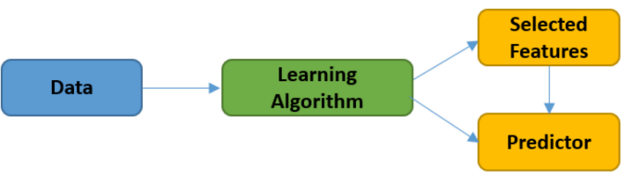
Feature Selection: Embedded Methods
Feature selection is integrated directly into the model training process;
Features are selected or discarded based on their importance to the model's performance during training;
Some examples include tree-based models and models with regularization (L1/L2).
Data Scaling and Feature Selection
Session 3

Slide 21
Feature Selection: Embedded Methods
Advantages:
Faster that wrapper methods;
Take into account interactions between features;
Identify feature dependencies;
Disadvantages:
Specific to the learning algorithm;
Selection dependent on the learning algorithm.
Data Scaling and Feature Selection
Session 3

Slide 22
Feature Selection: Embedded Methods
Examples:
Lasso Regression: performs feature selection by penalizing the absolute size of the regression coefficients, effectively shrinking some coefficients to zero and eliminating corresponding features.
Ridge Regression: performs feature selection by penalizing the square of the regression coefficients, which encourages smaller coefficients and effectively shrinks the impact of less important features.
Random Forests: ensemble learning method that naturally performs feature selection by assessing the importance of features based on how much they decrease node impurity across multiple decision trees.
Gradient Boosting Machines: ensemble learning method that builds decision trees sequentially, each focusing on the residuals of the previous trees, effectively performing feature selection by giving more importance to relevant features.
Data Scaling and Feature Selection
Session 3

Slide 23
Resources:
Zheng, A. (2018). Feature Engineering for Machine Learning. Sebastopol, CA: O’Reilly Media.
Kuhn, M., & Johnson, K. (2019). Feature engineering and selection. Philadelphia, PA: Chapman & Hall/CRC.
Data Scaling and Feature Selection
Session 3

