Slide 1

Machine Learning
Session 2 - T
Data Preprocessing
Ciência de Dados Aplicada
2023/2024

Slide 2
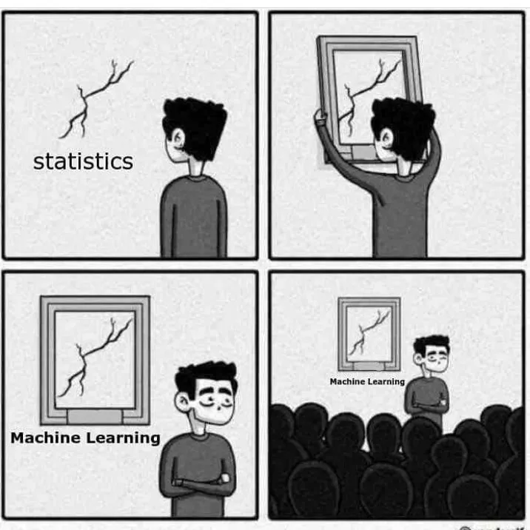
What is Machine Learning?
It’s similar to statistics...
Both aim to uncover patterns within data.
Both heavily rely on calculus, probability, and linear algebra, and share many common algorithms.
But it's not statistics!
Statistics primarily helps drawing reliable conclusions; ML focuses on building autonomous agents.
Statistics gives greater importance on interpretability and mathematical rigor; ML prioritizes predictive performance, scalability, and autonomy.
https://medium.com/nybles/understanding-machine-learning-through-memes-4580b67527bf
Data Preprocessing
Session 2

Slide 3
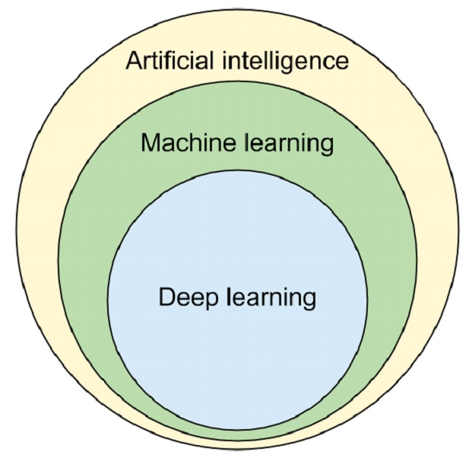
Machine Learning and Artificial Intelligence
Machine Learning is a subset of Artificial Intelligence (AI).
AI encompasses various approaches beyond learning-based systems:
Symbolic reasoning;
Rule-based systems;
Tree search;
Learning-based systems, such as Machine Learning, are more flexible and proficient in solving problems through data-driven learning processes.
Data Preprocessing
Session 2

Slide 4
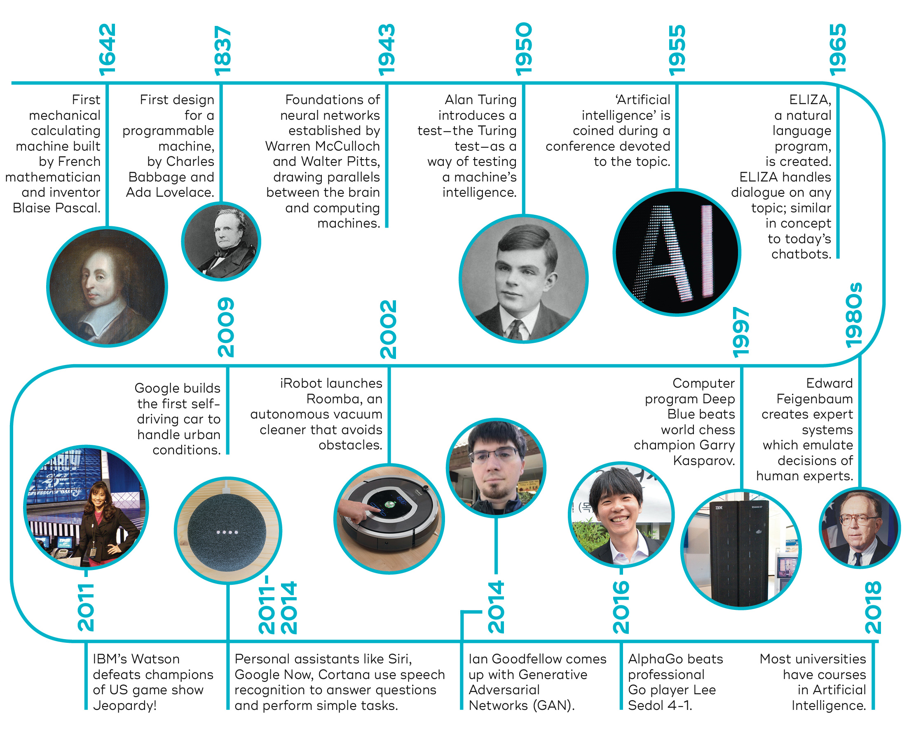
Brief History of Machine Learning
https://qbi.uq.edu.au/brain/intelligent-machines/history-artificial-intelligence
Data Preprocessing
Session 2

Slide 5
The importance of data
Most Machine Learning courses primarily focus on algorithms, operating under the assumption of high-quality and sufficient data to create robust models;
Real-world data often contains errors, highlighting the need for data curation. Even widely-used benchmark datasets frequently contain errors in assigned labels (labelerrors.com/);
The quality of the output is determined by the quality of the input (garbage-in, garbage-out);
The emerging trend of "data-centric AI" focuses on enhancing datasets to improve model outcomes.
Data Preprocessing
Session 2

Slide 6
Data Representation
We will assume datasets to be organized in the following way:
Data is organized in a tabular format;
Rows represent samples (aka records, entities, or examples) and columns variables (aka attributes or features);
Variables can be categorized as either numerical (or continuous) or discrete (or nominal).
Player | Minutes | Points | Rebounds | Assists
A | 39 | 20 | 6 | 150
B | 30 | 29 | 7 | 6
C | 22 | 7 | 7 | 2
D | 20 | 3 | 3 | 14
E | 9 | 19 | 5 | 5
... | ... | ... | ... | ...
Data Preprocessing
Session 2

Slide 7
Raw vs Processed Data
Raw data:
The original source of the data;
Often challenging for direct analysis;
Preprocessing needs:
Handling missing values;
Rescaling variables;
Detecting and managing outliers;
Correcting errors;
…
May come from different sources:
Data integration from multiple sources;
Data cleaning;
Data transformations;
Data selection;
Data enrichment;
…
Player | Minutes | Points | Rebounds | Assists
A | 39 | 20 | 6 | 150
B | 30 | 29 | 7 | 6
C | 22 | 7 | 7 | 2
D | 20 | three | 3 | 14
E | -9 | 19 | ? | 5
F | 14 | 6 | 1 | 3
G | 22 |  | 4
Data Preprocessing
Session 2

Slide 8
Raw vs Processed Data
Processed data:
Data is in a structure ready for analysis;
Usually represented in a matrix or vector format.
Player | Minutes | Points | Rebounds | Assists
A | 39 | 20 | 6 | 14
B | 30 | 29 | 7 | 6
C | 22 | 7 | 7 | 2
D | 20 | 3 | 3 | 14
E | 9 | 19 | 5 | 5
F | 14 | 6 | 1 | 3
G | 22 | 14 | 4 | 7
Data Preprocessing
Session 2

Slide 9
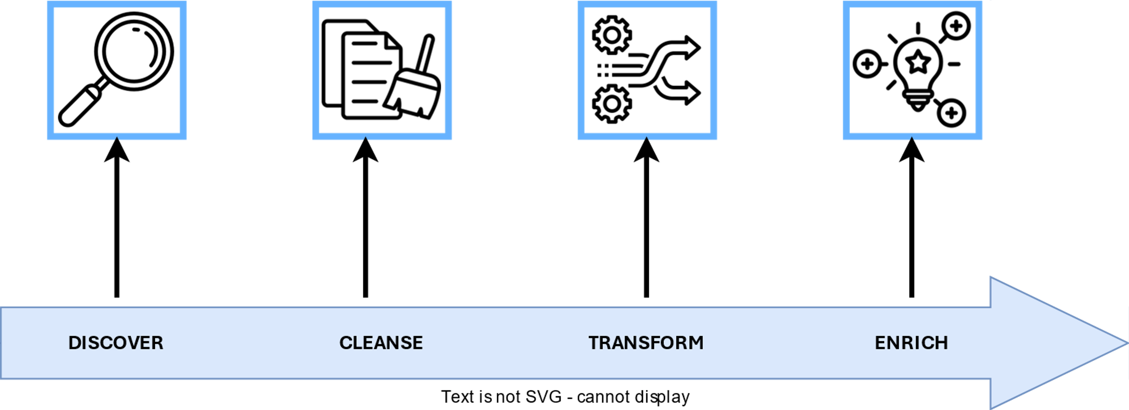
Data Preparation
The differnet stages involved in data preparation, leading from raw to processed data, heavily rely on the domain of the data and the unique characteristics of the datasets.
Data Preprocessing
Session 2

Slide 10
Data Structure and Content Verification
Exploring the structure and content of data involves various tasks, including:
Checking the number of samples and variables;
Verifying data types (numerical, discrete);
Checking value ranges for numerical variables or the set of possible values for discrete variables;
Identifying missing or unknown values;
Identifying duplicates;
...
Data Preprocessing
Session 2

Slide 11
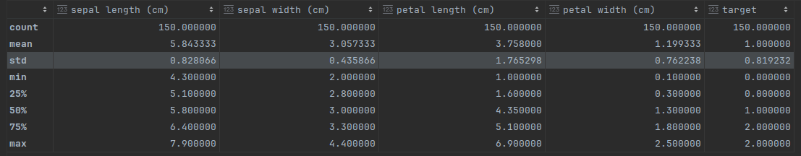
Data Sumarization
Characterization of large datasets using global metrics;
Aims to identify preprocessing needs like handling outliers, missing values, and errors;
Tasks include checking value distributions and applying summary statistics to variables.
Data Preprocessing
Session 2

Slide 12
Data Transformation
Data transformation can play a crucial role in preparing datasets for effective use in machine learning applications.
Typical operations:
Feature engineering: Creating new features from existing ones to enhance the predictive power of the model;
Imputation: Handling missing values by filling them in with estimated or imputed values;
Feature Scaling/Normalization: Rescaling features to a similar scale to ensure that no single feature dominates the learning process.
Feature Encoding: Converting categorical variables into numerical representations that machine learning algorithms can interpret;
Dimensionality Reduction: Reducing the number of features in the dataset while preserving important information.
Data Preprocessing
Session 2

Slide 13
Missing Values
Missing values refers to values or information that are not stored or absent for certain variables within a given dataset.
In Pandas, missing values are typically represented by NaN, which stands for "Not a Number."
Why is data missing from the dataset?
Past data can become corrupted due to inadequate maintenance practices;
Recording failures from human error;
Intentional omission;
...
Data Preprocessing
Session 2

Slide 14
Missing Values
Why do I need to care about missing values?
Some machine learning algorithms fail with missing values;
Failure to handle missing values can lead to biased models and inaccurate results;
Missing data can reduce precision in statistical analysis;
...
Data Preprocessing
Session 2

Slide 15
Missing Values
Addressing missing values involves various approaches that can be specific to different data types and analysis scenarios:
Keep missing values in the data if the analysis methods can handle them;
Disregarding missing values by removing rows and/or columns containing them.
Substituting missing values with other values, which can be achieved through methods such as:
Imputation with a constant value (specific value, mean, median, mode) per column (or row).
Utilizing more sophisticated techniques like k-nearest neighbors, leveraging information from neighboring data points.
Data Preprocessing
Session 2

Slide 16
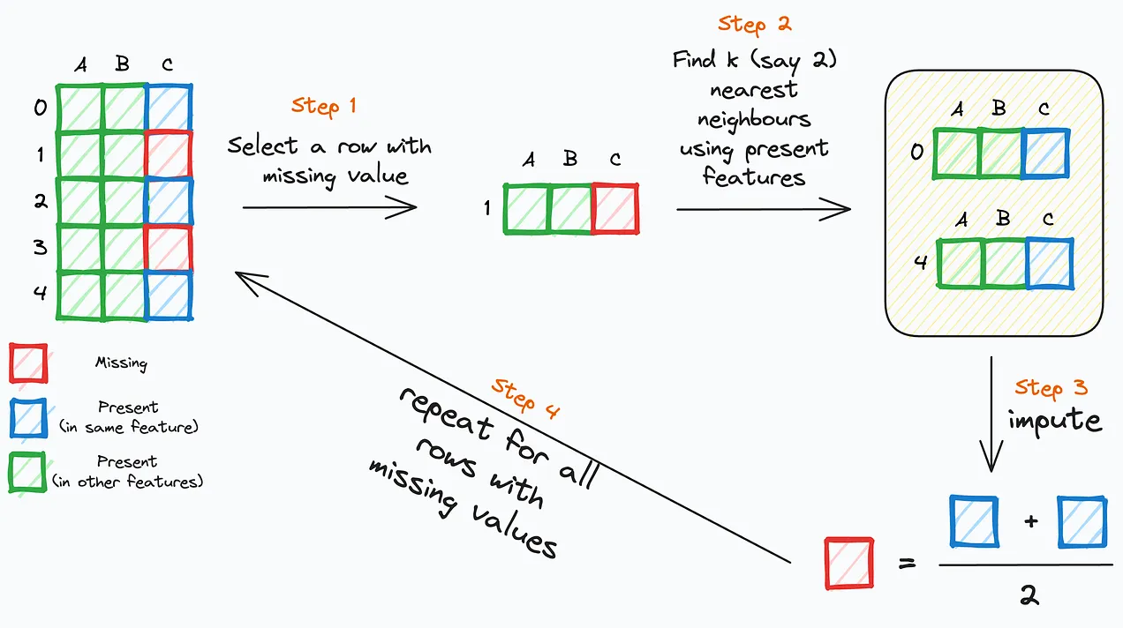
Missing Values
Handling missing values with the k-nearest neighbor algorithm:
https://www.blog.dailydoseofds.com/p/the-most-overlooked-problem-with-768
Data Preprocessing
Session 2

Slide 17
Resources
McCallum, Q. E. (2013). Bad Data Handbook Mapping the World of Data Problems. O’Reilly.
Rattenbury, T., Hellerstein, J. M., Heer, J. M., Kandel, S., & Carreras, C. (2017). Principles of data wrangling: Practical Techniques for Data Preparation. O’Reilly.
https://www.blog.dailydoseofds.com/p/the-most-overlooked-problem-with-768
Data Preprocessing
Session 2

