Slide 1
MetaData262: Computing and Visualizing Test262 Metadata
Diogo Reis
ist187526

Slide 2
Summary
Introduction
Related Work
MetaData262 Improvements
MetaData262Viz
Evaluation and Planning
Conclusions

Slide 3
Introduction

Slide 4
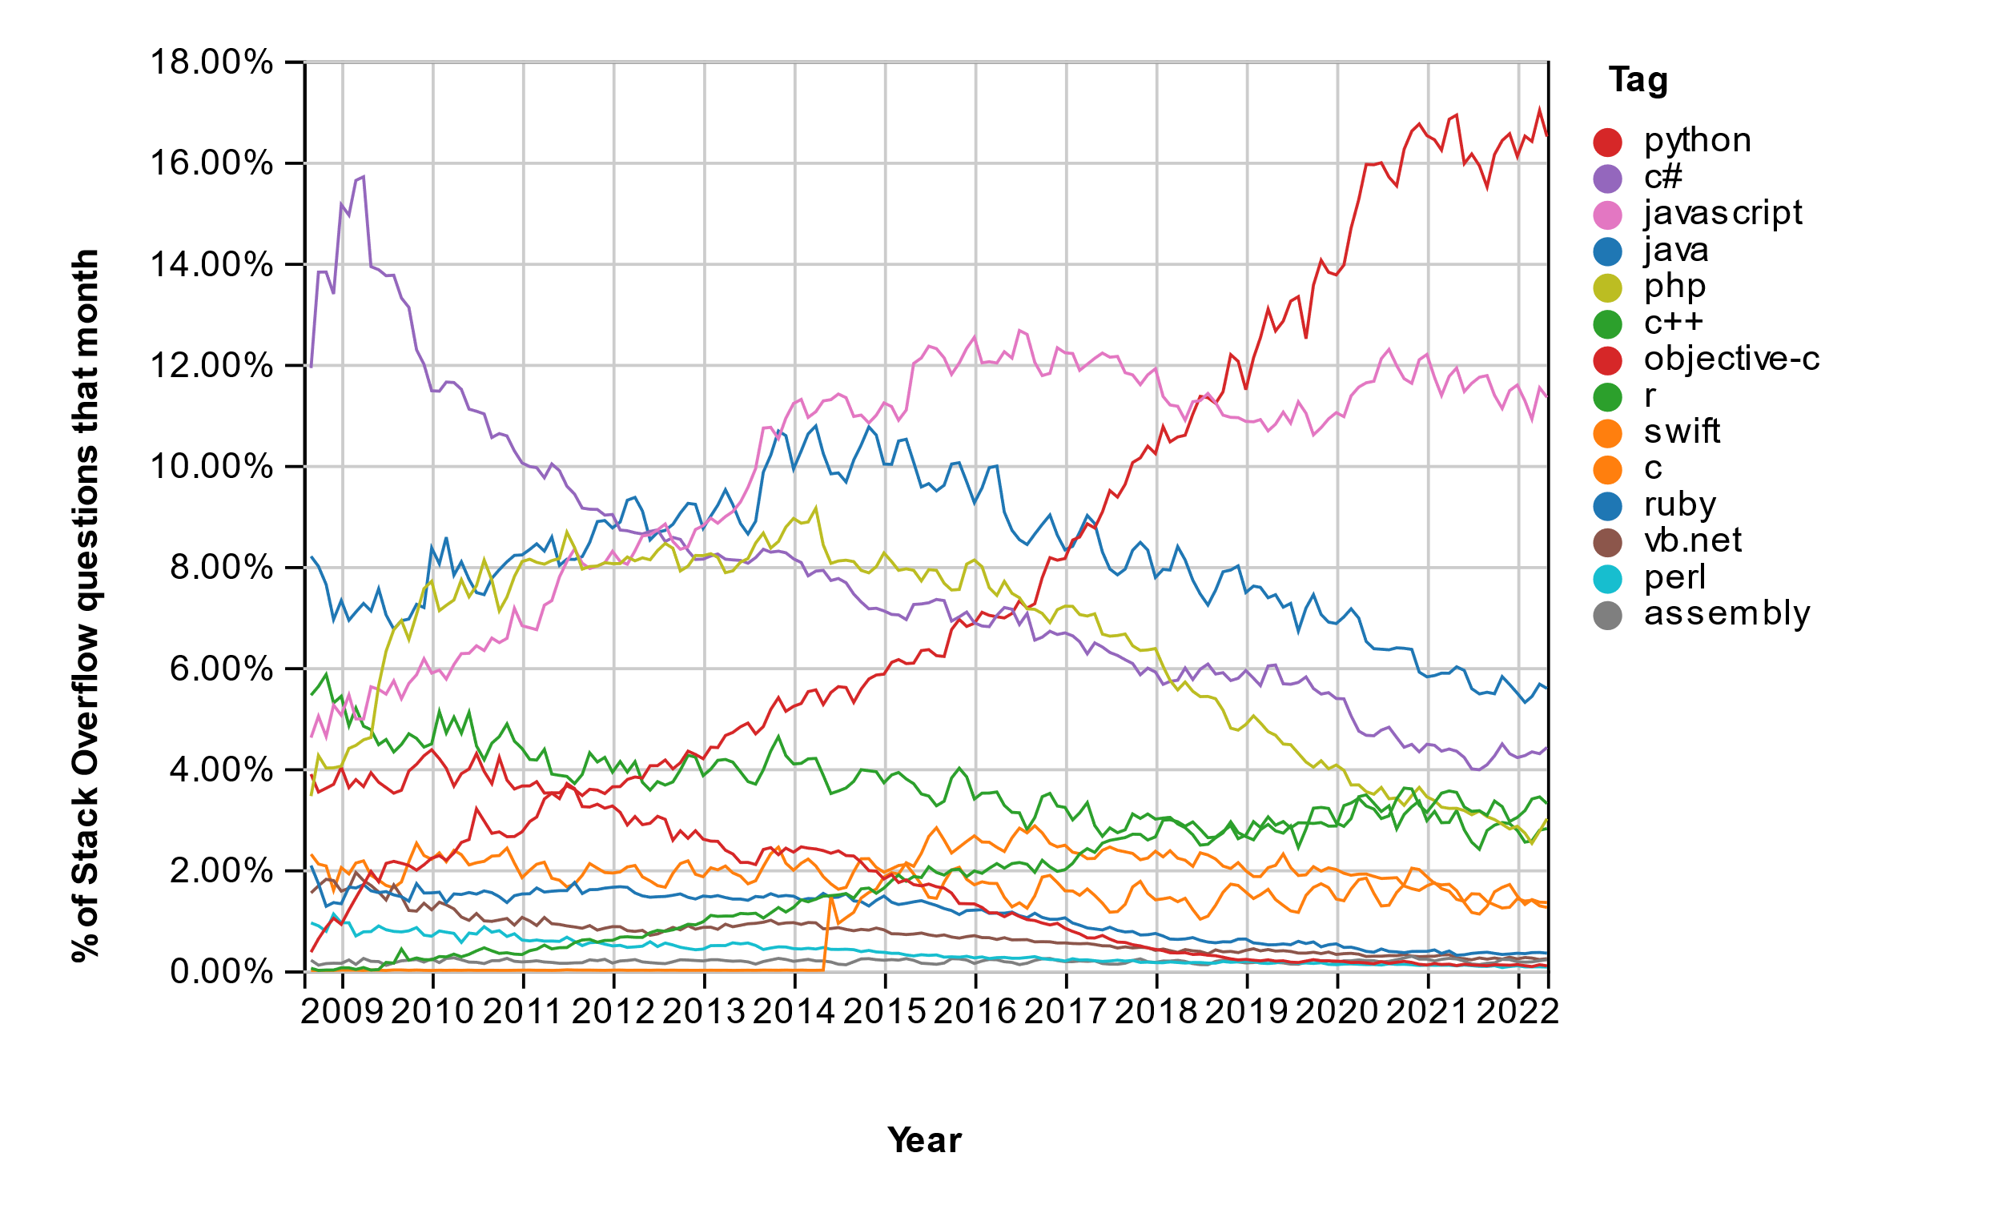
Stack Overflow
Notes:
Stack Overflow Trends

Slide 5
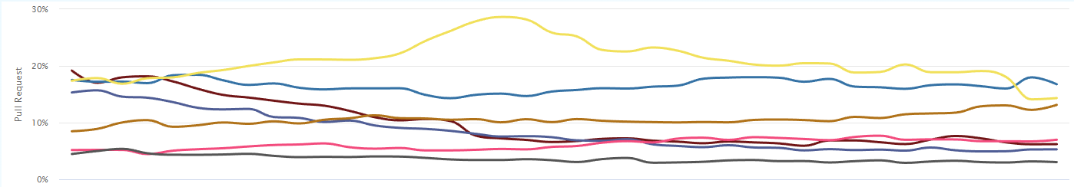
GitHub Pull Requests
Notes:
Github Language Stats (madnight.github.io)

Slide 6
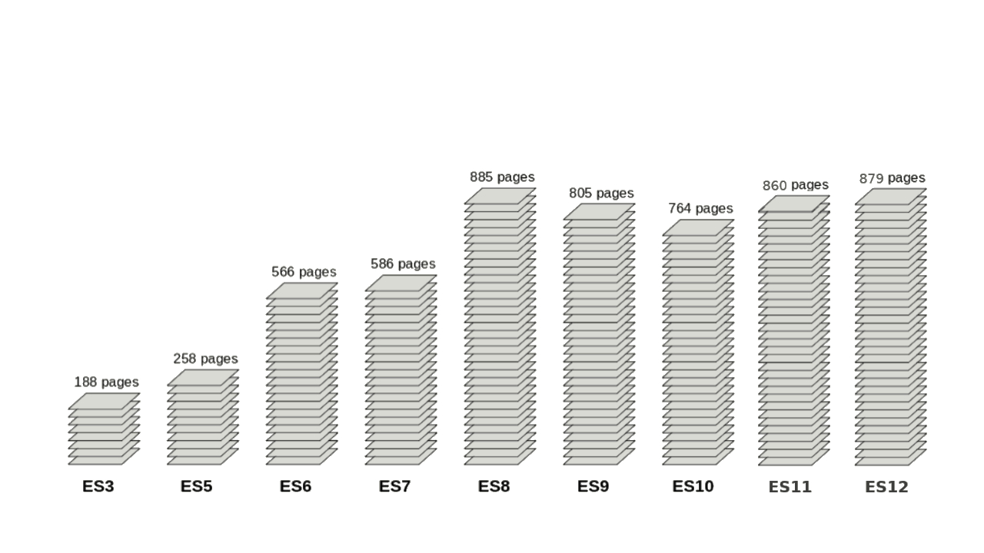
ECMAScript Standard
Long and Complex
JS Engine Consistency
Notes:
What ECMAScript -> All JS engines need to implement the standard
Long complex -> Constant evolution (Backwards compatible)
JS Engines consistent standard -> How check consistency?

Slide 7
Test262
ECMAScript Standard Conformance Test Suite that JS Engines Aim to Pass
Test262 Metrics
40 000 Tests (Approx)
87 Subfolders
Notes:
What is Test262

Slide 8
Problem
Partial Implementations of the Standard
Select Applicable Tests
Test262
?
Partial JS Engine
Notes:
Partial Implementations –> academic ; ongoing industrial engines
From 40k tests -> select Applicable

Slide 9
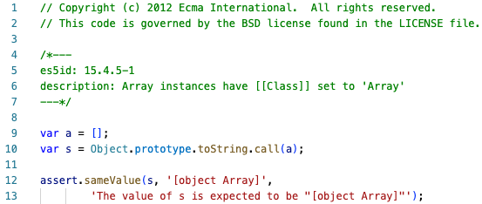
Test

Slide 10
Test
Copyright section

Slide 11
Test
Body section

Slide 12
Test
Frontmatter section

Slide 13
Test
ECMAScript Section

Slide 14
Test
Description of the Test

Slide 15
Frontmatter - Limitations
Not Structured
Typically Incomplete
Lack Important Attributes for Test Filtering
Version
Built-Ins
Notes:
?”Hidden” in code?

Slide 16
MetaData262
Objectives of MetaData262 System
Test262 Metadata Computation
Test262 Metadata Inspection

Slide 17
MetaData262 - Contributions
Structured JSON for Representing Test Metadata
New Metadata Attributes
Version
Built-Ins
Syntactic Constructs
Console Application for Filtering and Inspecting Tests

Slide 18
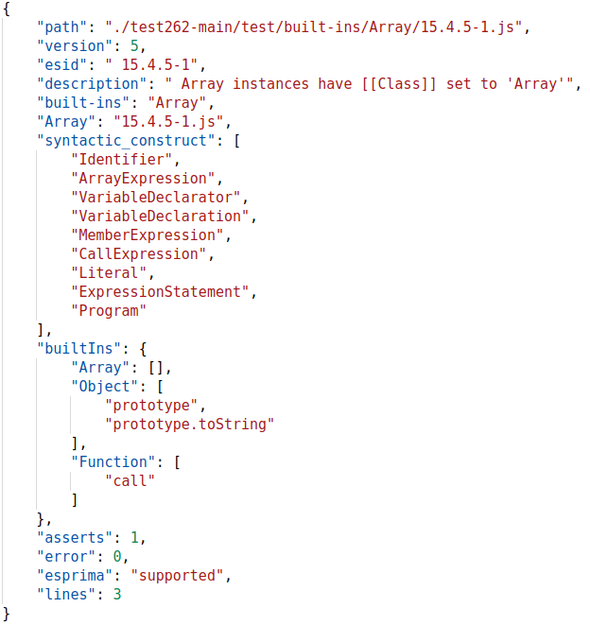
MetaData262 - Example
Test262 Test
MetaData262 Equivalent
…

Slide 19
MetaData262 - Example
Test262 Test
MetaData262 Equivalent
Equivalent Frontmatter
…
Original Frontmatter

Slide 20
MetaData262 - Example
Test262 Test
MetaData262 Equivalent
Relative Path
…

Slide 21
MetaData262 - Example
Test262 Test
MetaData262 Equivalent
New field – version
New field – Syntactic Constructs
…
New field – Built-ins

Slide 22
Goals
Improve MetaData262
Precision
Performance
Additional Information
Create MetaData262Viz – Web application
Filtering Tests
Visualizing Statistics about the filtered tests

Slide 23
Related Work

Slide 24
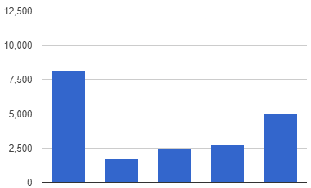
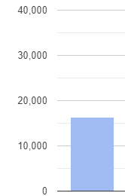
Related Work
Academic Implementations of the ECMAScript Standard
ES5
ES10
8,157
(≈68%)
> 5,000
(≈41%)
16355
(≈45%)
2,440
(≈20%)
2,782
(≈23%)
1,796
(≈15%)
S5
(DLS’12)
JSRef
(POPL’14)
JSRef+V8
(CAV’15)
KJS
(PLDI’15)
JSExplain
(WWW’18)
JISET
(ASE’20)
Passing Tests out of 12,074
Passing Tests out of 35,990

Slide 25
Related Work
Academic Implementations are Partial
Manual Test Selection
No Trust in the Test Selection Process
Notes:
Manual Test Selection -> bad (40k tests)
-> Dangerous Assumption -> Tests failed because not Implemented

Slide 26
Improve MetaData262

Slide 27
Improve MetaData262
Additional Information
Includes
Harness Functions
Precision
Version Computation
Built-Ins Computation
Performance
Parallelize Computation

Slide 28
Improve MetaData262 – Add Harness
Harness
Set of Files Containing Auxiliar Functions used by Test262 Tests
7290 Lines
32 Files
96 Tests
Harness Function

Slide 29
Improve MetaData262 – Add Harness
Harness
Set of Files Containing Auxiliar Functions used by Test262 Tests
7290 Lines
32 Files
96 Tests
Extend the Metadata with Harness Functions and Files used by the Test

Slide 30
Improve MetaData262 - Precision
Additional Information
Includes
Harness Functions
Precision
Version Computation
Built-Ins Computation
Performance
Parallelize Computation

Slide 31
Dynamic Version Computation
Run Tests
Node.js
SpiderMonkey
ECMAScript | Node.js | SpiderMonkey
5 | 0.10.48 | js24
6 | 6.17.1 | js38
8 | 8.17.0 | js52
9 | 10.9.0 | js60
10 | 12.11.0 | js68
11 | 14.5.0 | js78
Notes:
Run Tests on JS Engines

Slide 32
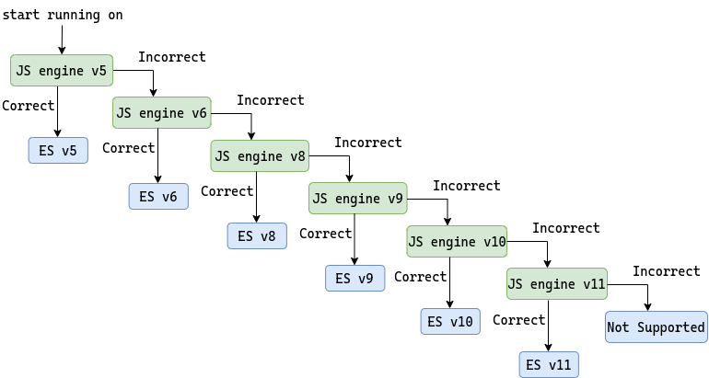
Dynamic Version Computation

Slide 33
Dynamic Version Computation

Slide 34
Dynamic Version Computation

Slide 35
Dynamic Version Computation

Slide 36
Dynamic Version Computation

Slide 37
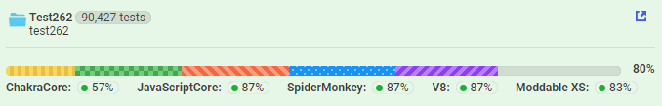
Dynamic Version Computation
No engine supports one and only one version exactly
Notes:
Inherently flawed -> no engine one & only one version
Moddable Microcontrollers
More engines -> reduce error induced each engine

Slide 38


Dynamic Version Computation
No engine supports one and only one version exactly
More Engines to Increase Precision
JavaScriptCore Engine
XS Engine
Notes:
Inherently flawed -> no engine one & only one version
More engines -> reduce error induced each engine

Slide 39
MetaData262Viz

Slide 40
MetaData262Viz
Web Platform
Filtering Tests
Visualizing Statistics about the filtered tests

Slide 41
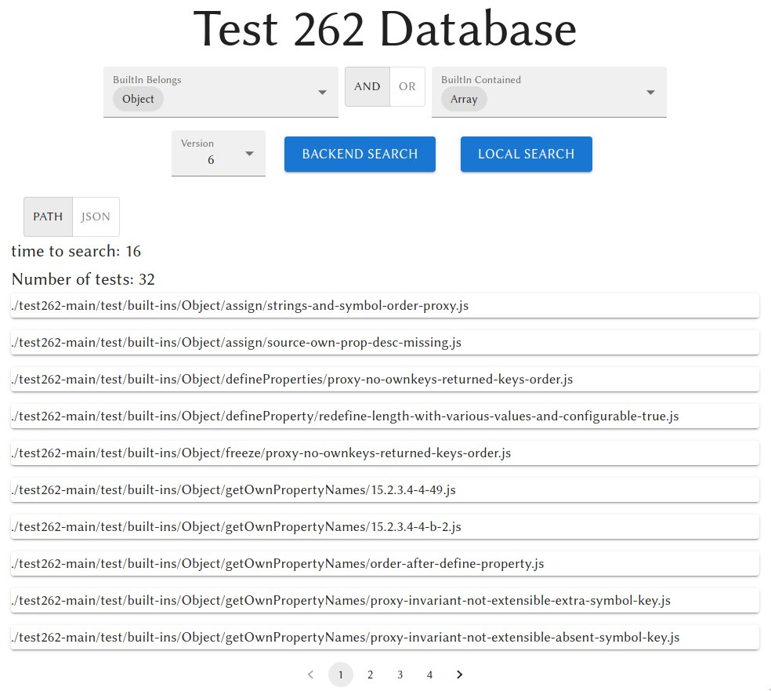
MetaData262Viz

Slide 42
MetaData262Viz
Filters Section

Slide 43
MetaData262Viz
Results Section

Slide 44
MetaData262Viz - Filters
Sub Path

Slide 45
MetaData262Viz - Filters
Built-Ins Used

Slide 46
MetaData262Viz - Filters
Relation Between fields

Slide 47
MetaData262Viz - Filters
Version

Slide 48
MetaData262Viz - Results
Viewing options

Slide 49
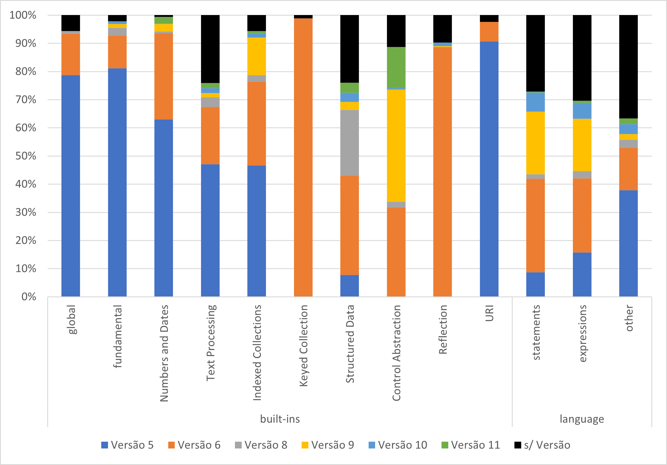
MetaData262Viz - Statistics
Version Distribution
Notes:
! Create charts using Victory library !

Slide 50
MetaData262Viz - Statistics
Notes:
! Create charts using Victory library !

Slide 51
Evaluation and Planning

Slide 52
Evaluation
Improved MetaData262
Has no Ground Truth
Manual Validation of Computations
Random Test Selection
Heuristic Test Selection
Notes:
Ground truth

Slide 53


Evaluation
MetaData262Viz
Unit Tests – for Testing Correct Implementation
Load Tests – for Testing the Amount of Users Able to Serve

Slide 54
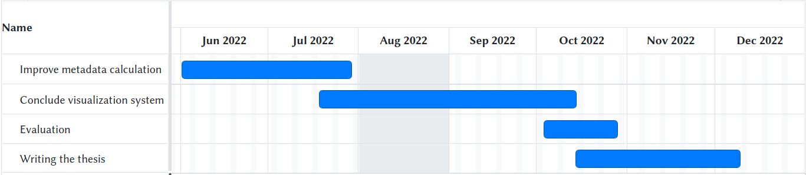
Planning

Slide 55
Conclusion

Slide 56
Conclusion
Standardizing Test Selection for JS Implementations
Improve MetaData262
Create MetaData262Viz

Slide 57
MetaData262: Computing and Visualizing Test262 Metadata
Diogo Reis
ist187526
Notes:
Thank you!

