Slide 1
DA2
-Diogo santos (up202009291) – 50%
-Rafael Valquaresma (up202104805) – 50%

Slide 2
Problem Description
Routing Algorithm for Ocean Shipping and Urban Deliveries
Developing and analyzing a set of approximate solutions to the TSP

Slide 3
Solution Description
Creation of the Menu class to interact with the user
Creation of the Data class that receives the provided data
Creation of the Graph class, alongside the Edge and Node structs inside it, to implement the main functions

Slide 4
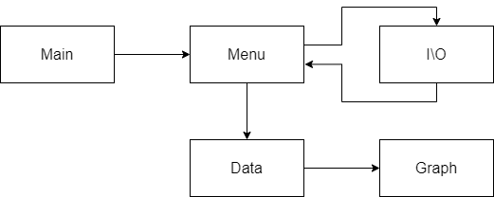
Class diagram

Slide 5
Implemented Functionalities
Menu.h:
Menus:
SelectGraphMenu – First menu to appear where the user selects the graph desired
MainMenu – Main menu where user can select the main functionalities implemented
InfoMenu – Menu used to print information about the graph
Auxiliary functions:
printTitle – Function that prints this project’s title
getUserInput – Function that receives the user’s input
clearScreen – Function that clears the terminal
print – Functions used to print certain data as a table or as a path

Slide 6
Implemented Functionalities
Data.h:
Data Reading functions:
readRealGraphs – Reads one of the 3 real graphs in the datasets folder
readToyGraphs – Reads one of the 3 toy graphs in the datasets folder
readExtraGraphs – Reads one of the 12 extra graphs in the datasets folder
Variable getters:
getGraph – Returns the Graph graph
getRealGraph – Returns the Boolean realGraph
getExtraGraph – Returns the Boolean extraGraph
getHasName – Returns the Boolean hasName

Slide 7
Implemented Functionalities
Graph.h:
Graph builders:
addNode – Adds nodes to the graph
addEdge – Adds edges to the nodes
Variable getters:
getNodes – Returns the object nodes
getEdgesOut – Returns the vector edgesOut of a node
Auxiliary functions:
convertToRad – Returns the radian equivalent of a degree
distanceBetweenNodes – Returns the calculated distance between two nodes
getTourDistance – Returns the total distance travelled in the cycle provided for the real graphs
toyAndExtraComputeDistance – Returns the total distance travelled in the cycle provided for the other graphs

Slide 8
Implemented Functionalities
Graph.h:
Algorithms:
hamiltonianCycle – Calls the hamiltonianCycleUtil function after initializing the needed variables
hamiltonianCycleUtil – Backtracking approach to the TSP problem
triangularApproximationHeur – Triangular Approximation approach to the TSP problem
triangularApproximationHeurToy – Triangular Approximation approach to the TSP problem for the Toy graphs
sosACO – Self-Organizing System based Ant Colony Optimization approach to the TSP
primMST – Finds the minimum spanning tree of a graph using Prim's algorithm

Slide 9
Highlights
Menu:
Visually clean and elegant user interface
Easy and perceptible results
Graph:
Reasonably fast algorithms with good-ish results

Slide 10
problems
Graph:
The distance values obtained through our algorithms vary and sometimes are quite ridiculous and outright wrong

