Slide 1

Tango: Distributed Data Structures over a Shared Log
Group 10
André Matos 92420
Diogo Ribeiro 102484
Luís Calado 103883

Slide 2
Index
Introduction
Shared Log
Tango objects
Transactions
Layered partitions
Transactions over streams
Evaluation
Conclusion

Slide 3
Shared Log
Tango builds on the CORFU shared log abstraction
Log uses chain replication ​
CORFU operations:
append(b) -> append entry b to the shared log, obtaining an offset/position l in return
check() -> check the current tail of the log
read(l) -> read the entry at log position l
trim(l) -> trim a particular offset in the log for garbage collection
No communication between clients.
CORFU Sequencer is used.

Slide 4
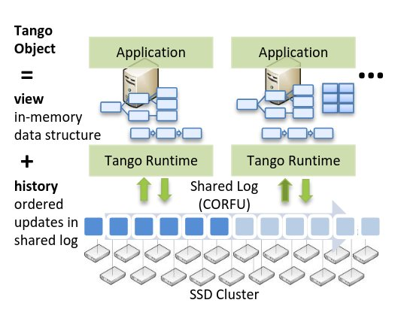
The Tango Object = View + History
Structure: Historical log of updates + multiple views (tree, map).
Client Interaction: Append updates to log, sync views with apply upcall.
Custom Views: Different views (tree, set) from same log.
Consistency & Durability: Linearizability, recovery via log history, checkpoints.

Slide 5
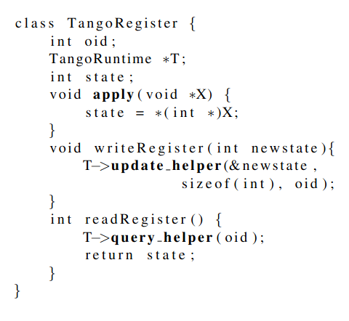
TangoRegister
update helper: this accepts an opaque buffer from the object and appends it to the shared log.
query helper: this reads new entries from the shared log and provides them to the object via an apply upcall.

Slide 6
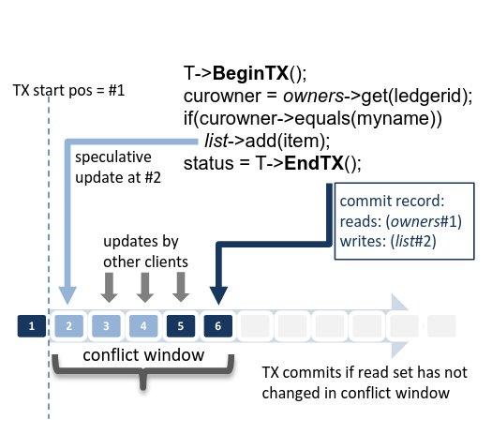
Transactions
Concurrency: Speculative commit, decision after log check.
Commit Record: Tracks readset (objects/versions), checks for changes.
Atomicity/Isolation: Single log ensures multi-object transactions.
Transaction Flow: BeginTX sets context, EndTX commits or aborts.

Slide 7
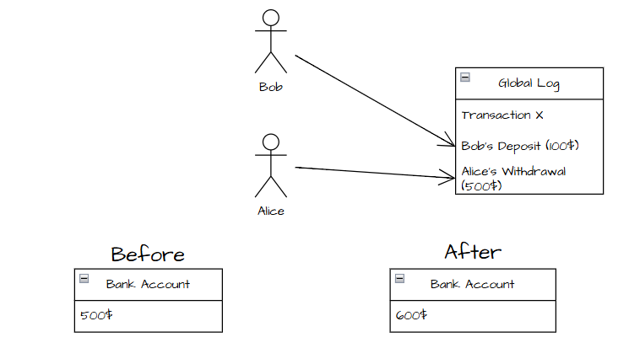
Transactions
Read/Write: Read-only skips commit; write-only skips log traversal.
BeginTX
Read(x)
Write(x + 100)
EndTX
speculative update
commits if read set has not
changed in conflict window
BeginTX
Read(x)
Write(x - 500)
EndTX
speculative update
can't commit, read set isn't updated

Slide 8
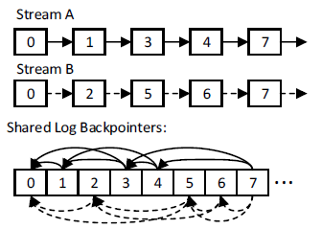
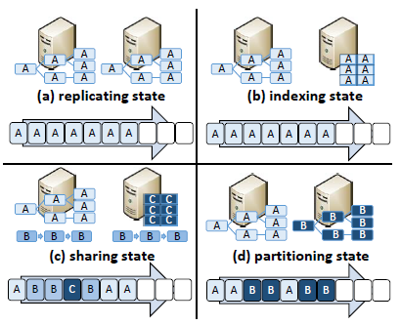
Layered Partitions
Partitioning: Objects mapped to streams; clients read relevant streams.
Streams: Linked lists built through backpointers.
Append: Stream IDs sent to sequencer, respond with backpointers.
Failure Handling: Reverse log traversal, junk values fill gaps.

Slide 9
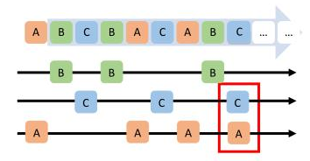
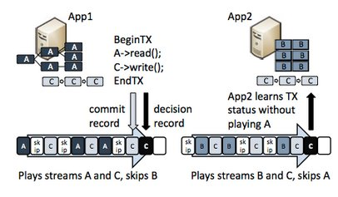
Transactions Over Streams
Multiappend: Transactions affect multiple streams, single commit in shared log.
Limitation: Can't involve reads from objects without local copies.
Commit Decision: Client adds commit decision to log; other clients can add if needed.
Failure Handling: If commit fails, any client can reconstruct objects from the log after a timeout.

Slide 10
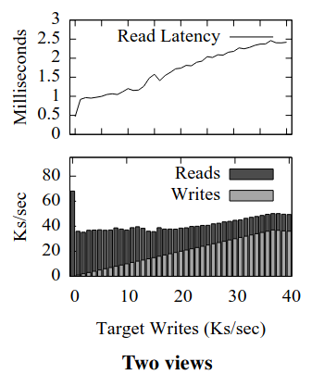
Evaluation

Slide 11
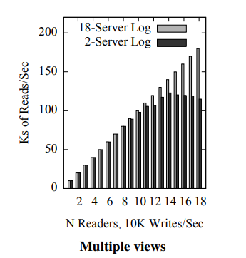
Evaluation

Slide 12
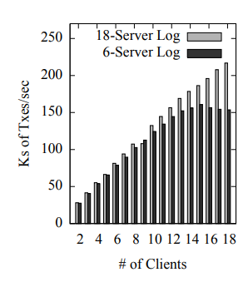
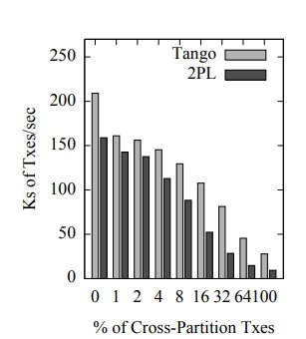
Evaluation

Slide 13
Conclusion
Main Contributions:
Different structures, same log
Clients with different views
Clients choose views

