Slide 1
What help define the Internet
I will provide a brief explanation of what made the Internet what it is today from past to present.
My goal is to present this information to group of people who are constant users of the Internet but do not truly understand the architecture behind it.

Slide 2
The Concept
As with everything it all started out as a vision a concept for some people.
For one person in particular it was something he wanted to achieve.
It would take several years for that concept to become a reality.
With the help of the US government and the military many scientist were able to get the funding they need.
From this researching and funding ARPANet is created which becomes the precursor the Internet we know today.

Slide 3
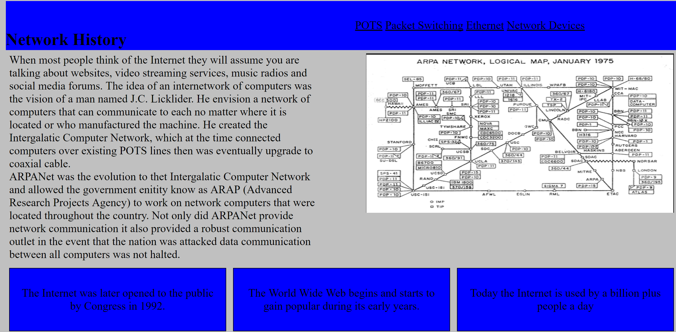

Slide 4
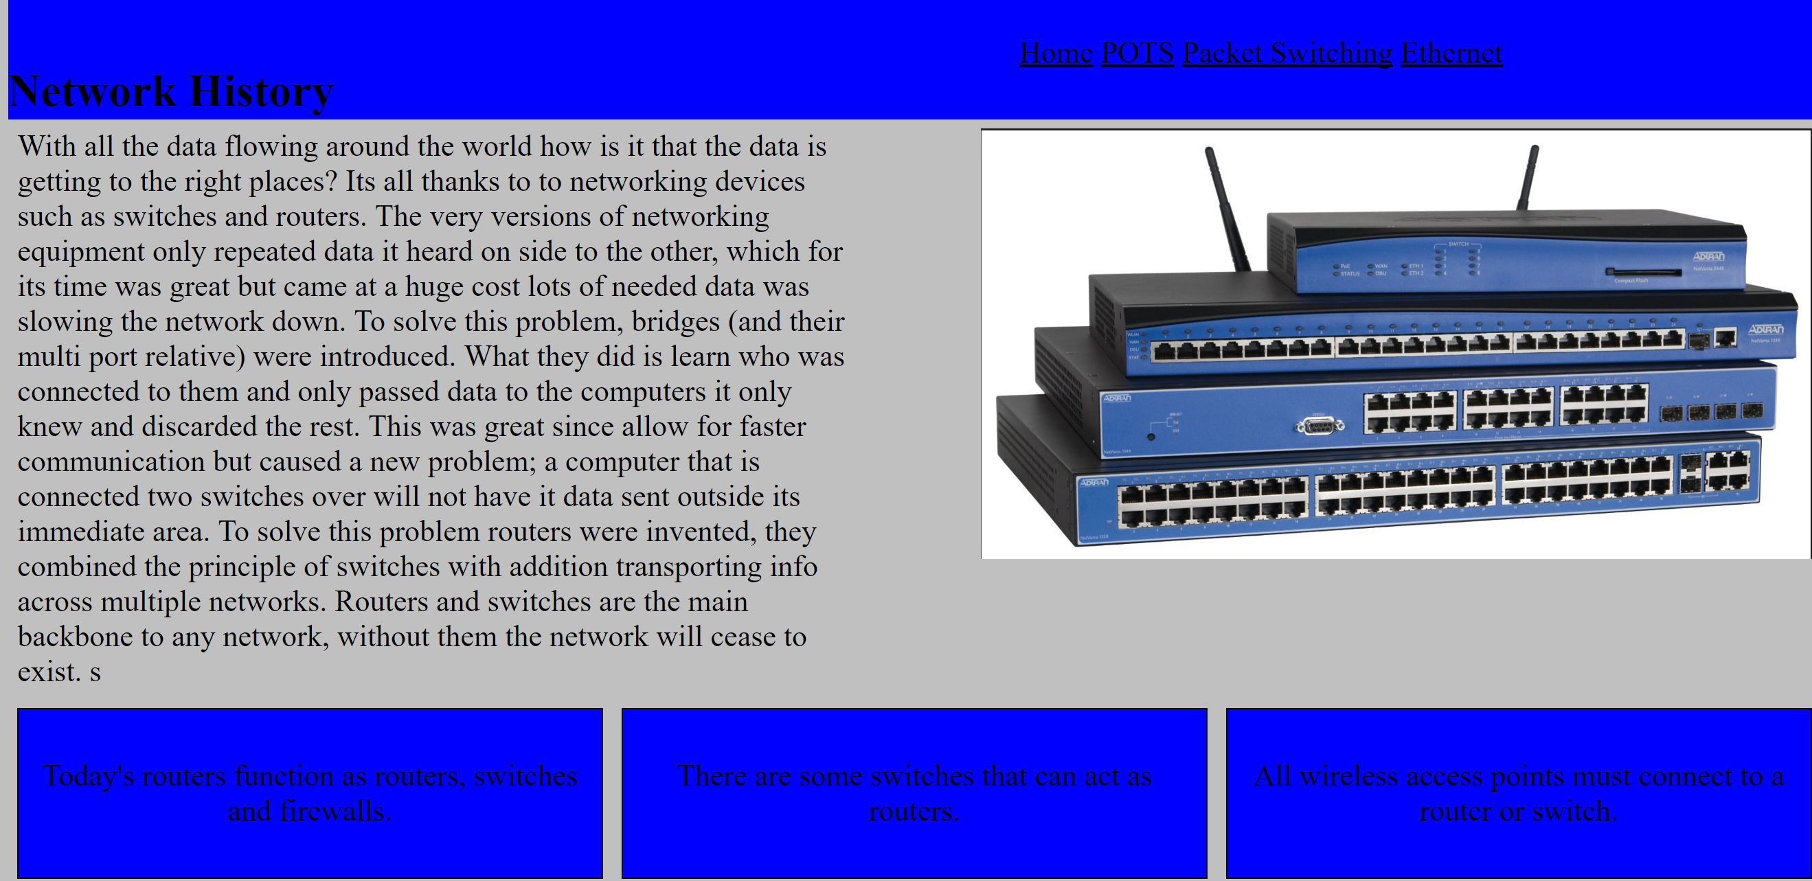
The Networking Hardware
To connect computers to the Internet backbone network consisting of routers and switches are used.

Slide 5
How does data move around the Internet
Well I am happy that you asked. All data is transmitted as packets.
Packets are then routed throughout the series of switches and routers which are interconnected to each other. This is called packet switching.

Slide 6
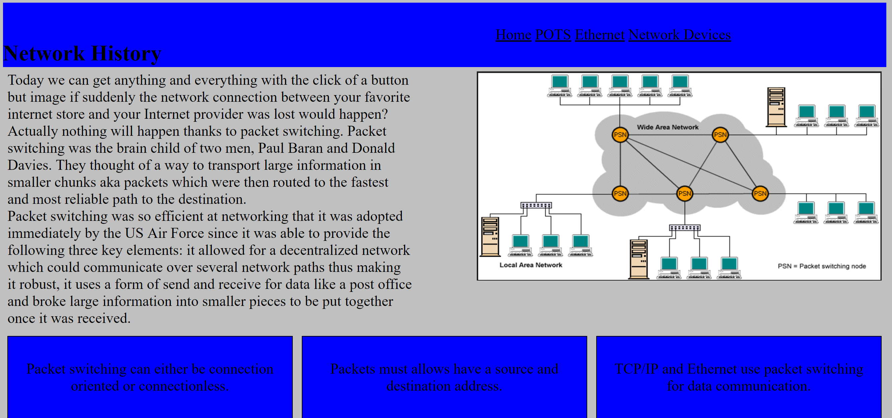

Slide 7
Data Communication: Before & After
In the beginning the only way to connect to another computer was through direct connection and usually it would have to be computer of the same model. This caused lots of problems between schools, organizations and agencies.
So they began use the current telephone infrastructure for data communication and POTS became the de facto medium for transmitting data but it came with huge inconvenience, it was slow and could not provide reliability.
Thus Ethernet was created and has become the industry standard for network communication between devices.

Slide 8
