Slide 1
Sentiment Analysis using Deep Learning methods
Author : Dionysios Karamouzas
Supervisor : Ioannis Pitas
Co-Supervisor : Ioannis Mademlis

Slide 2
Contents
Natural Language Processing
Sentiment Analysis
Public Opinion Monitoring in Twitter
Knowledge Distillation for improved Sentiment Analysis on Figurative Language

Slide 3
Public Opinion Monitoring in Twitter

Slide 4
Proposed Mechanism
By utilizing DNN-based classifiers, a four-dimensional vector, i.e., an instance of the proposed semantic descriptor, is first extracted for each tweet independently.
This descriptor quantifies text polarity, offensiveness, bias and figurativeness.
Our mechanism is concluded in three basic steps.

Slide 5
Step 1 - Selecting the desired pool of tweets
The user has to choose a set of tweets on which the proposed mechanism will be applied.
This can be done by passing some filtering criteria (keywords, hashtags, dates) to the Twitter API.
Monitoring public opinion concerning an issue requires smart adjustment of these criteria.

Slide 6
Step 2 - Individual descriptor extraction per tweet
Semantically describe each tweet from the selected message pool as a 4D real-valued opinion vector/descriptor.
Descriptor = [offensiveness, bias, polarity, figurativeness]
A set of 4 DNN models are employed to this end.

Slide 7
Descriptor examples

Slide 8
Step 2 – Training Datasets
S19-T6: 14,100 tweets annotated as offensive/non-offensive
PSMP: 5,000 messages from Twitter and Facebook annotated as neutral/partisan
TSI: 76,000 tweets annotated as ironic/sarcastic/figurative/literal. The first three classes were grouped in a single “figurative” class
YTC: 12,559 YouTube comments annotated as positive/negative

Slide 9
Step 2 – Text preprocessing
Stopwords, hashtags, mentions and URLs were removed
Lemmatization was applied to avoid having multiple words with same meaning
All words were converted into lower-case

Slide 10
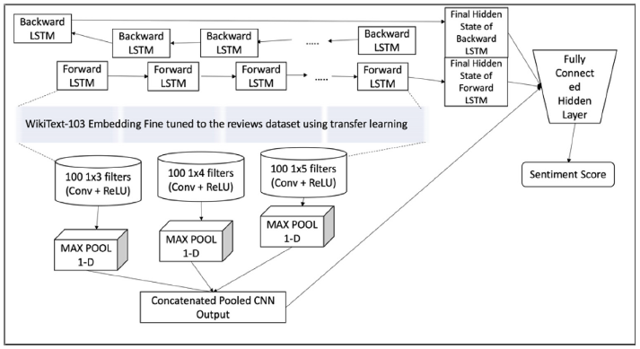
Step 2 – Neural Models

Slide 11
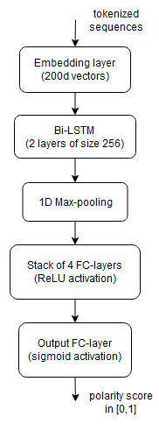
Step 2 – Neural Models

Slide 12
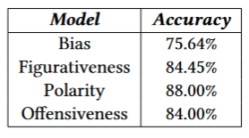
Testing Accuracies of the 4 classifiers

Slide 13
Step 3 - Aggregation
Aggregation Target
Aggregation Strategy
Complete aggregation (outcome is a single 4D vector)
Temporally segmented aggregation (outcome is a 4D timeseries, day-by-day or week-by-week aggregation).
Element-wise vector mean
Element-wise vector median
Element-wise vector trimmed mean

Slide 14
Evaluation
The proposed mechanism was evaluated on Tweets datasets of 2016 and 2020 United States Presidential Elections
Day-by-day temporally segmented aggregation target was selected
All three aggregation strategies (mean, median, trimmean) were separately followed
Analysis 1: Timeseries Forecasting
Analysis 2: Visualizations and Qualitative Evaluation

Slide 15
Evaluation datasets – US 2016
2016 US Presidential Election tweet dataset:
Size : 61 million rows
Τime range : 2016-08-30 to 2017-02-28
32 million tweets were kept after applying the cleaning process
The keywords “Clinton”, “Obama” and “Trump” were used to categorize the messages into Democrats and Republicans

Slide 16
Evaluation datasets – US 2020
2020 US Presidential Election tweet dataset:
Size : 1.72 million rows
Time range : 2020-10-15 to 2020-11-08
720 thousand tweets were kept after applying the cleaning process
Tweets were pre-separated in two partisan groups (Democrats and Republicans).

Slide 17
Data cleaning
Removal of:
Empty rows
Non-English text
Duplicate tweets
Tweets that contained less than 5 words after text preprocessing

Slide 18
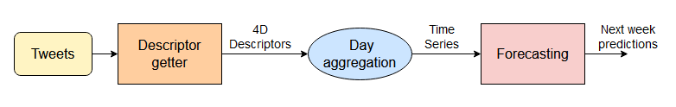
Evaluation Analysis 1 – Timeseries Forecasting
The first type of evaluation performed on the derived timeseries was to assess their predictability using AI-enabled forecasting.
Forecasting has obvious political usefulness: it may allow an interested organization to predict near-future changes in its public image, using only Twitter data.

Slide 19
TSF Implementation - Model
A neural architecture of an LSTM followed by a fully connected layer was adopted.
The model was trained separately for each timeseries, using Back-Propagation Through Time (BPTT) and a Continuous Coin Betting (COCOB) optimizer.

Slide 20
TSF Implementation – train/test data
Only the 2016 dataset was used for training the forecasting model
A segment was withheld for test purposes from the end of each timeseries, with a length equal to the forecasting horizon
A moderate 7-day forecasting horizon was selected, since this allows for rather reliable predictions while still being practically useful.
This pretrained model was also separately tested on the 2020 dataset.

Slide 21
TSF Implementation - preprocessing
Deseasonalisation (NNs are weak at modelling seasonality) : Decomposed each timeseries into seasonal, trend, and remainder components and removed the seasonality component
Sliding window schemes were adopted for feeding inputs to the NN and deriving the outputs :
Output window size n = forecasting horizon H = 7
The input window size m was empirically set to 9 = n*1.25
Each training timeseries was broken down into blocks of size m + n, thus forming the input–output pairs used to train the forecasting model

Slide 22

TSF -Metrics and results
Symmetric Mean Absolute Percentage Error (SMAPE) is defined as follows:
where H, Fk, and Yk indicate the size of the horizon, the forecast of the DNN and the ground-truth forecast, respectively.

Slide 23
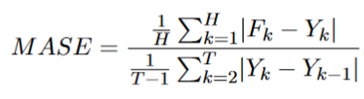
TSF -Metrics and results
Mean Absolute Scaled Error (MASE) is defined as follows:
The numerator is the same as in SMAPE, but normalised by the average in-sample one-step naive forecast error.
MASE > 1 -> tested model is worse on average than the naive benchmark

Slide 24
TSF -Metrics and results
Since these metrics are computed for univariate timeseries forecasting, we employed mean and median aggregation across the four descriptor channels for each of the six timeseries.

Slide 25
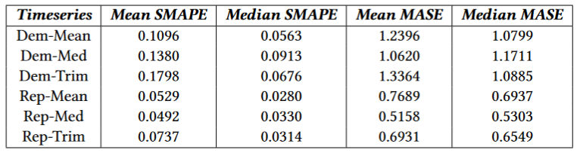
Forecasting results for the 2016 dataset

Slide 26
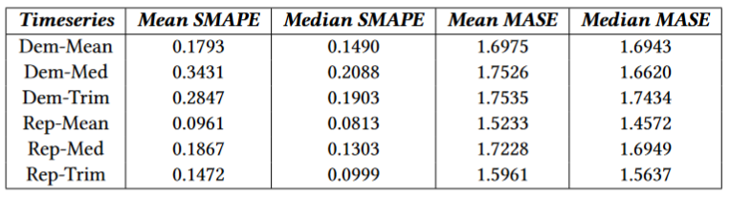
Forecasting results for the 2020 dataset

Slide 27
TSF - Conclusions
The timeseries constructed using the proposed mechanism seem to be predictable to an acceptable degree by using the employed NN.
The mean aggregation strategy resulted in the timeseries with the best overall forecasting behaviour.
Based on both metrics, it is clear that forecasting performs worse for the Democrats than for the Republicans, implying that public opinion concerning them (as expressed in Twitter) was less stable and predictable during the examined period.
Finally, we notice a drop in accuracy when testing on the 2020 dataset (small in absolute terms), compared to the 2016 one. This was expected, since the forecasting model was pretrained only on the training set of the 2016 dataset

Slide 28
Evaluation Analysis 2 – Visualizations
A set of visualizations were computed from the 4D timeseries constructed using the proposed mechanism, in order to facilitate manual inspection of the outcome.

Slide 29
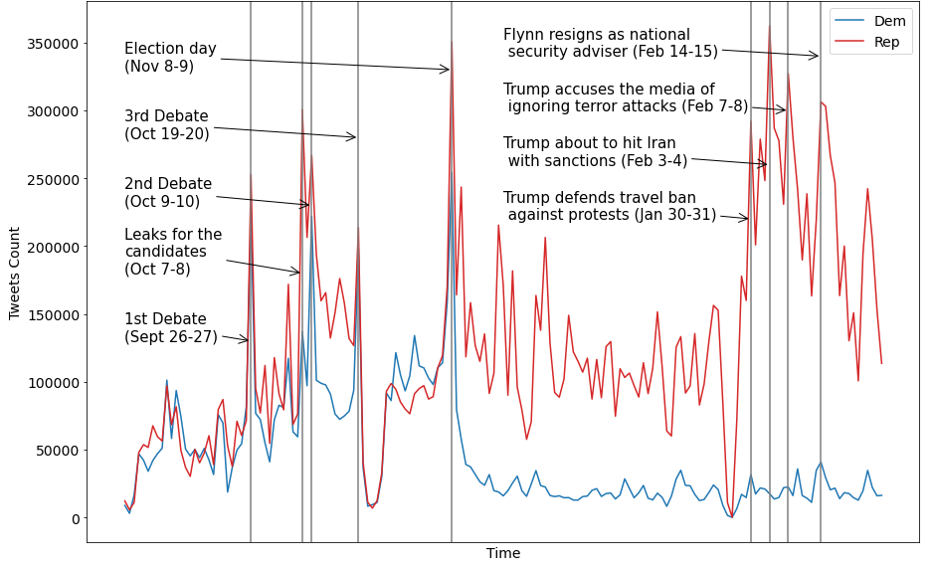
Tweets daily count - 2016

Slide 30
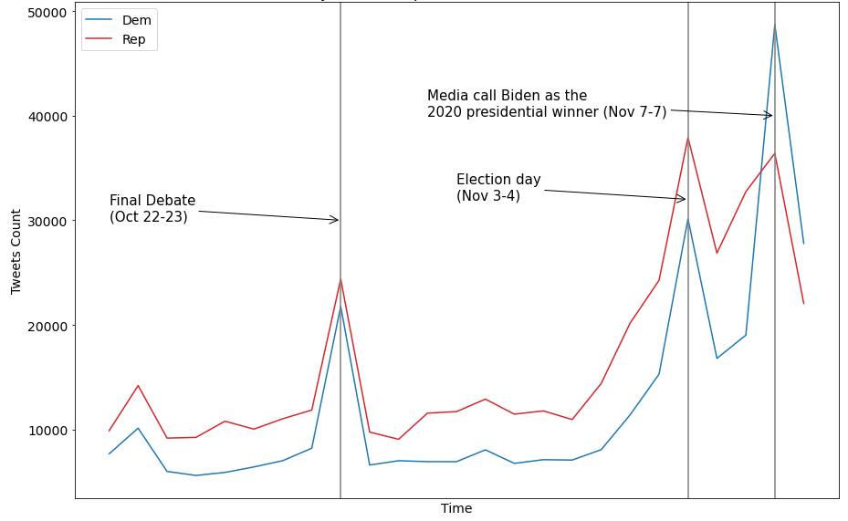
Tweets daily count - 2020

Slide 31
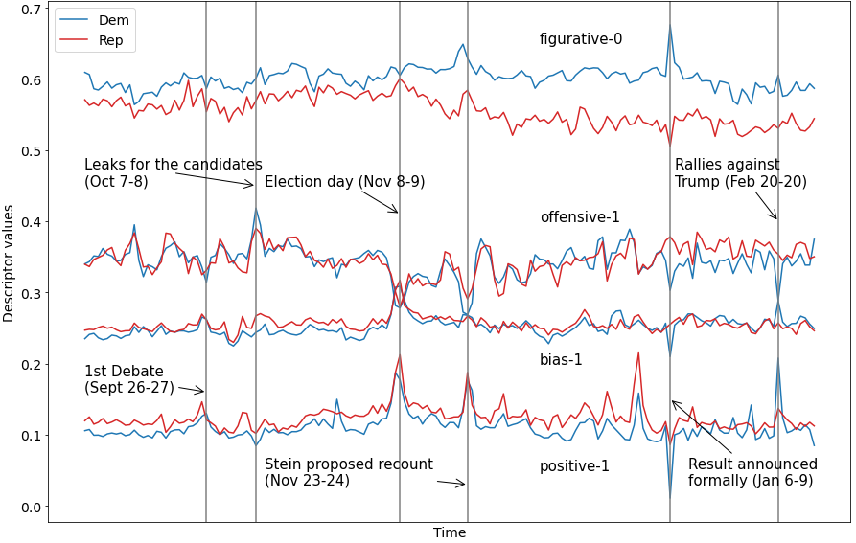
Mean daily descriptor - 2016

Slide 32
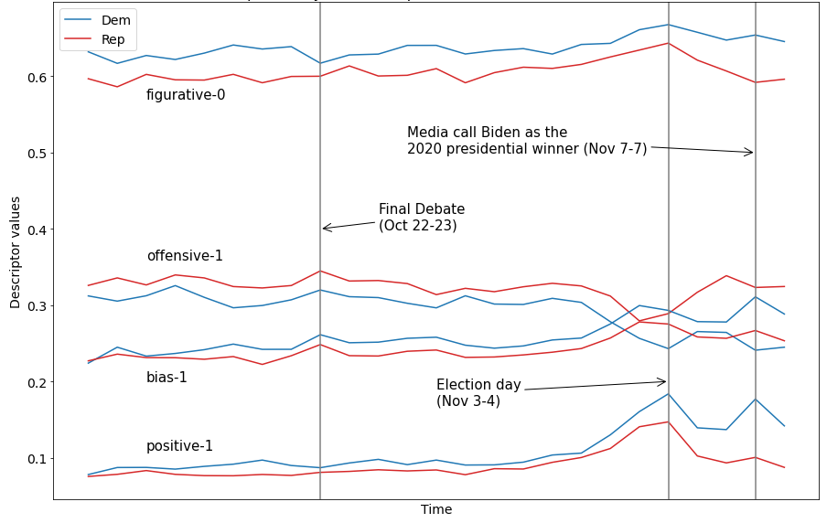
Mean daily descriptor - 2020

Slide 33
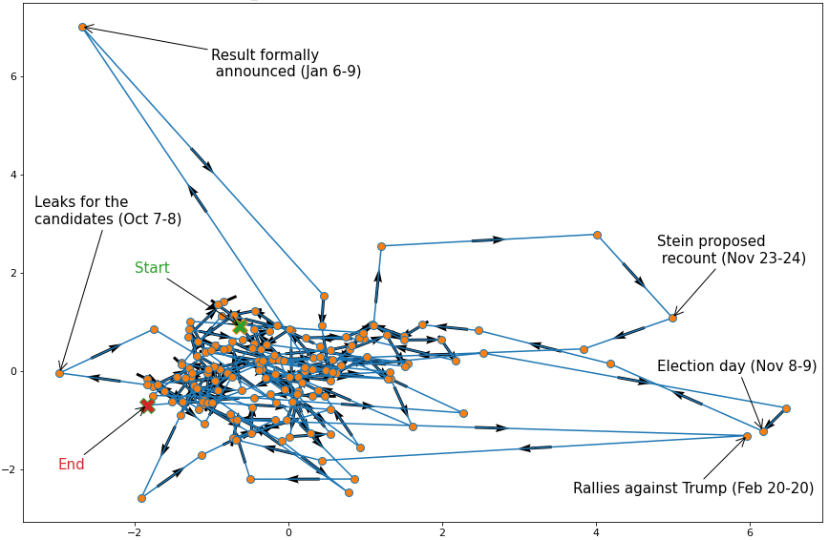
PCA plot of mean descriptor for Democrats - 2016

Slide 34
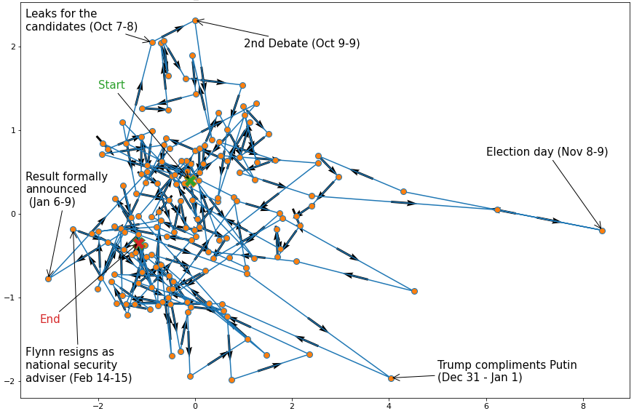
PCA plot of mean descriptor for Republicans - 2016

Slide 35
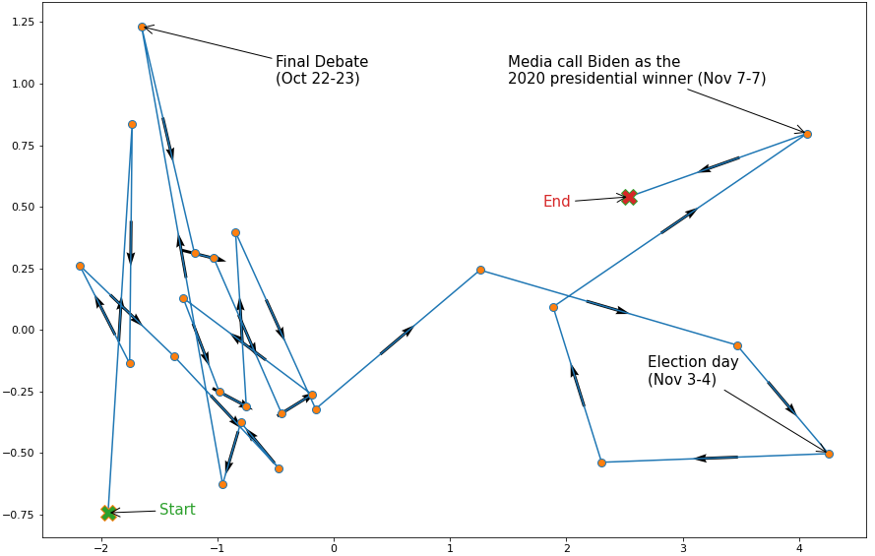
PCA plot of mean descriptor for Democrats - 2020

Slide 36
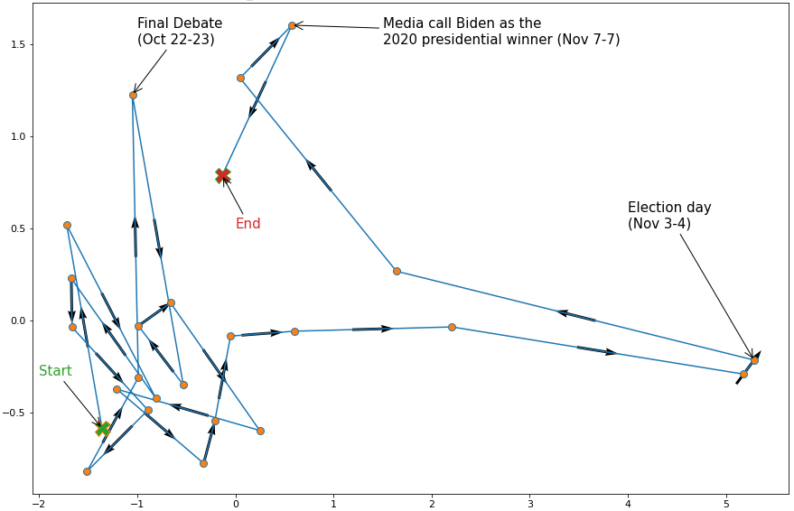
PCA plot of mean descriptor for Republicans - 2020

Slide 37
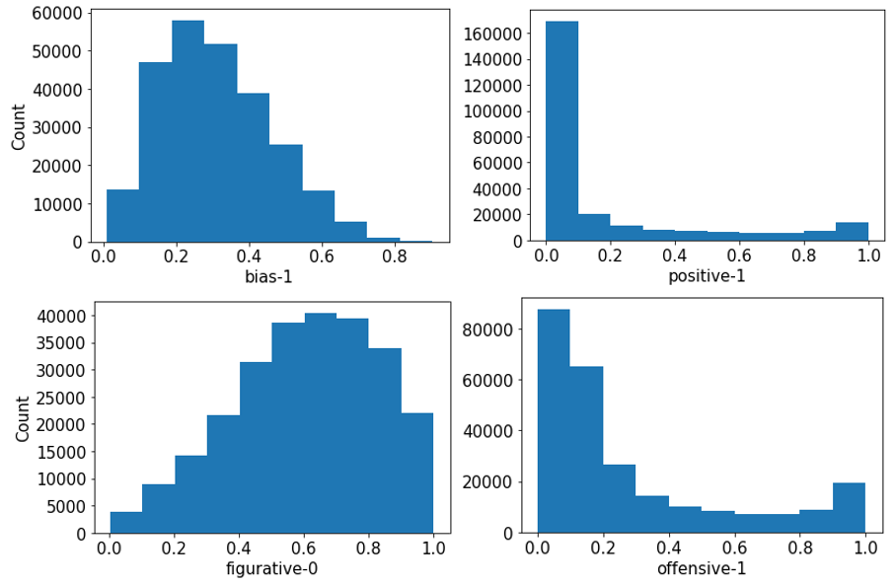
Histograms (tweets count) of the four descriptor dimensions about Democrats – Nov 9, 2016

Slide 38
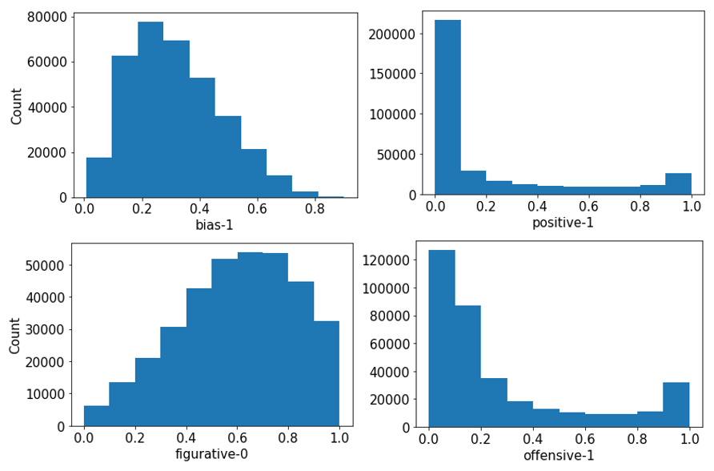
Histograms (tweets count) of the four descriptor dimensions about Republicans - Nov 9, 2016

Slide 39
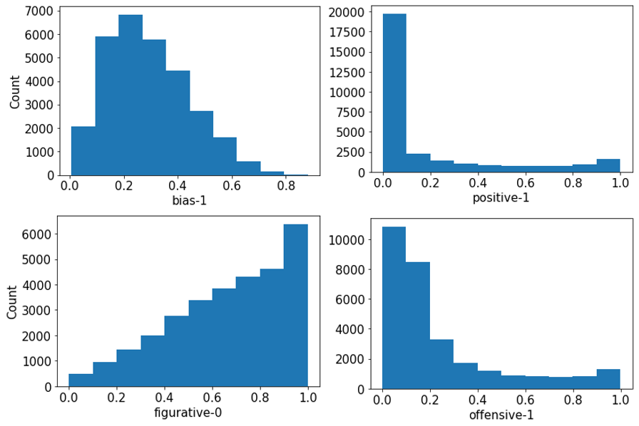
Histograms (tweets count) of the four descriptor dimensions about Democrats - Nov 4, 2020

Slide 40
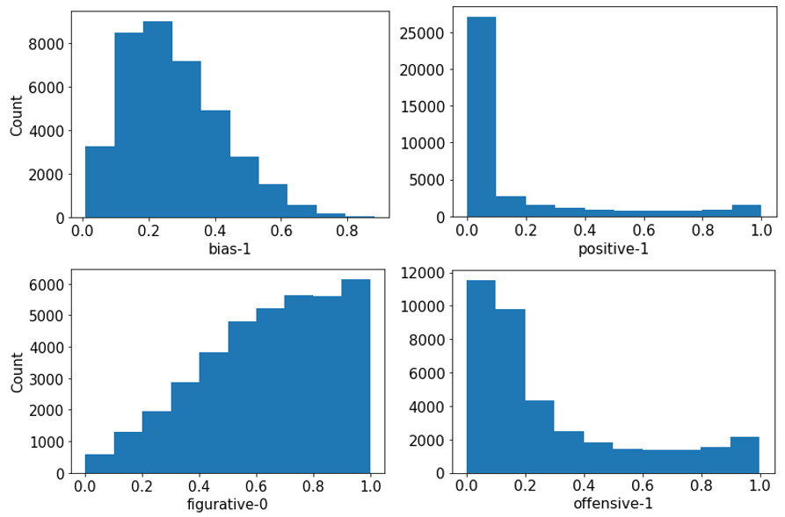
Histograms (tweets count) of the four descriptor dimensions about Republicans - Nov 4, 2020

Slide 41
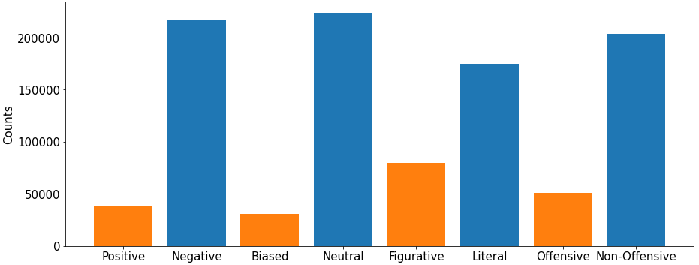
Tweets distribution for each class of the descriptor dimensions about Democrats - Nov 9, 2016

Slide 42
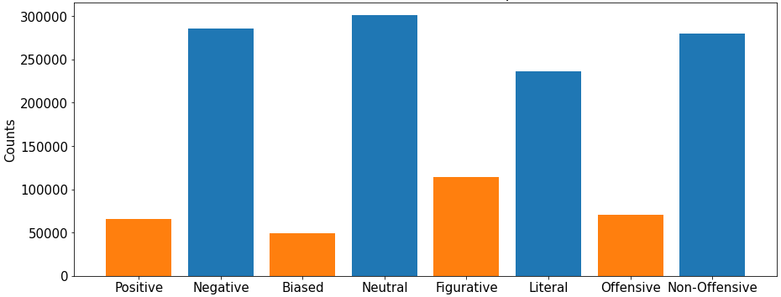
Tweets distribution for each class of the descriptor dimensions about Republicans - Nov 9, 2016

Slide 43
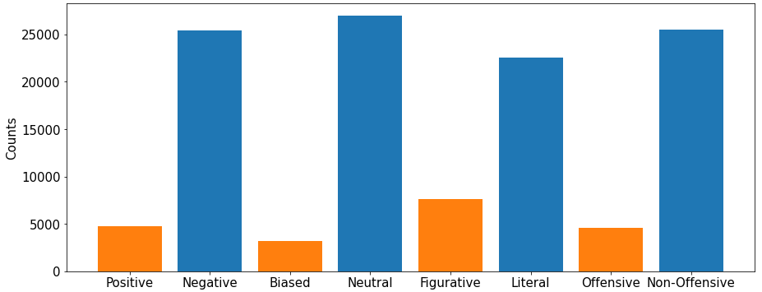
Tweets distribution for each class of the descriptor dimensions about Democrats - Nov 4, 2020

Slide 44
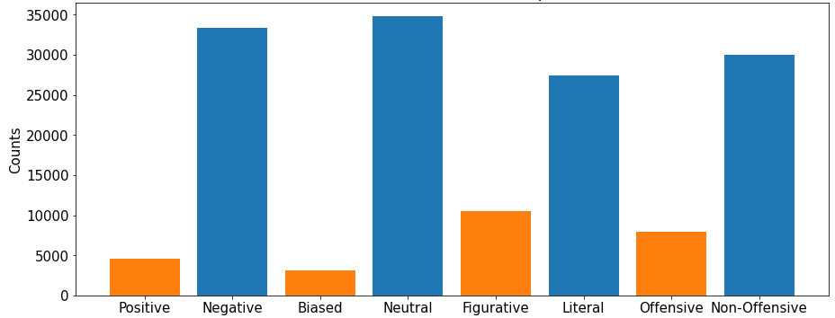
Tweets distribution for each class of the descriptor dimensions about Republicans - Nov 4, 2020

Slide 45
Discussion - Novelty
Unlike previously published methods our mechanism has:
Multidimensional descriptor which conveys rich insights
State-of-the-art DNN-based NLP tools, a fact which guarantees enhanced accuracy
Generic nature that allows interested users to easily extract similar insights for any event by applying the described mechanism

Slide 46
Discussion - Findings
Public opinion concerning Democrats was less stable and less predictable, in comparison to public opinion about Republicans.
In general, the public has an overall relatively stable stance towards the competing politicians: judgmental and indignant (negative + literal) but simultaneously educated (unbiased + non-offensive).
The timeseries derived through the proposed mechanism paint a rather accurate picture of the favored candidate.
The winning party is referenced during the pre-election period in tweets that are jointly less negative + less offensive + more biased. Strong partisan presence in Twitter seems to be heavily correlated with high vote percentages.
Crucial events do directly lead to abrupt changes in the daily number of tweets but also in public opinion.

Slide 47
Conclusions
Automated public opinion monitoring using social media is a very powerful tool, able to provide interested parties with valuable insights for more fruitful decision-making.
Our novel, generic, automated, proposed mechanism allows the user to monitor the public opinion related to whatever desired topic through Twitter.

Slide 48
Knowledge Distillation for improved Sentiment Analysis on Figurative Language

Slide 49
Proposed method
A teacher-student architecture is utilized to enrich the student model with the knowledge of a pre-trained figurative language (sarcasm, irony and/or metaphor) recognizer - teacher.
The proposed method consists in a novel setup of knowledge distillation from a pre-trained binary recognizer of figurative language, employed as an auxilliary task while training a multiclass sentiment analysis neural model under a multitask setting.

Slide 50
Teacher - F
A DNN-based binary text classifier F has been pre-trained under a regular supervised setting on a database containing two classes: “figurative”, “literal/non-figurative”.
The teacher’s output F(x) for a respective input data point x would lie in the interval [0, 1] with 0/1 being interpreted as figurative/literal respectively.

Slide 51
Student - S
The student S is the neural model we actually want to optimize; on a different, sentiment-annotated dataset.
Typically, N ≥ 3 classes are employed for the sentiment analysis/opinion mining task (“positive”, “neutral”, “negative”, etc.)
S is trained by a regular, suitable loss function LS , such as Cross-Entropy (CE).

Slide 52

Multi-task loss function
The proposed method consists in training S with the following multitask loss function:
To compute this loss term, a parallel output layer Sb serving as an auxiliary binary classification head is architecturally plugged onto the penultimate layer of S, while F(x) serves as real-valued/continuous substitute “ground-truth” for LD.
To avoid confusion, the normal softmax-based multiclass classification head of S is denoted below by Sm. Thus, assuming N sentiment classes, Sm/Sb is an output neural layer consisting of N /1 neuron(s), respectively.

Slide 53

Multi-task loss function
By employing the Mean Squared Error cost (MSE) for LD, the proposed complete multitask loss function is:
Where ̃x is the actual, sentiment ground-truth class label corresponding to x, in the context of multiclass classification.

Slide 54
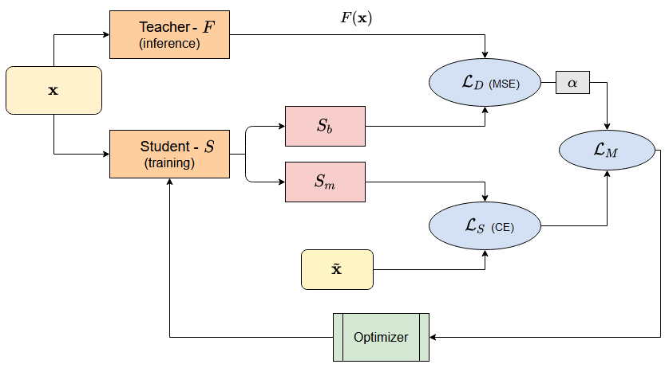
Distillation schema

Slide 55
Noteworthy points
No actual/real ground-truth annotation concerning the presence or type of FL is required while training S for sentiment analysis.
After S has been fully trained, both the entire F model and the auxiliary output layer/binary classification head Sb can be safely discarded.
Knowledge distillation from binary classifiers with sigmoidal output, in order to aid a multiclass classifier on a different task, has not been previously presented for regular DNNs.

Slide 56
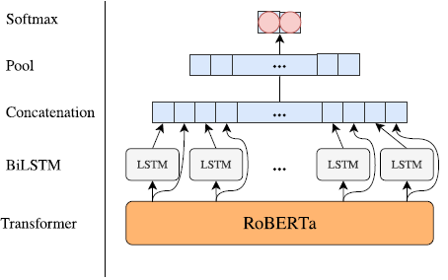
Evaluation – Student architecture
Put a reference here for potamias

Slide 57
Evaluation – Teacher architecture
Put a reference here for kiran

Slide 58
Evaluation setup - datasets
TSI: 76,000 tweets annotated as ironic/sarcastic/figurative/literal. The first three classes were grouped in a single “figurative” class, in order to train F as a binary figurative text classifier.
S15-T11 : 8000/4000 tweets for training/test, respectively, including tweets with ironic, sarcastic and metaphorical language. The 12000 data points are grouped under 11 classes annotated with integers in an 11-point scale, ranging from -5 to +5, that denote the polarity of each tweet, from “very negative” to “very positive”.

Slide 59
Evaluation setup - Metrics
Two evaluation metrics were employed:
Cosine similarity (COS, higher is better)
Mean Squared Error (MSE, lower is better).
Assuming a test set of T data points, both are computed by comparing two T -dimensional integer vectors, respectively containing the predicted and the ground-truth class labels.

Slide 60
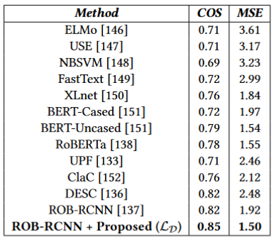
Performance comparison

Slide 61
Conclusions
Figurative language (sarcasm, metaphor, irony) significantly increases the difficulty of the sentiment analysis task.
This study exploits the intuition that estimations about the existence of figurative language in an input text can boost the accuracy of a sentiment classifier, by helping it to internally resolve semantic ambiguities.
Evaluation on a relevant public dataset indicates that the proposed method leads to state-of-the-art performance, surpassing all competing approaches and confirming the validity of our underlying intuition

Slide 62
Bibliography

Slide 63
References
Turing, Alan M. "Computing machinery and intelligence." Parsing the turing test. Springer, Dordrecht, 2009. 23-65.
Mikolov, Tomas, et al. "Efficient estimation of word representations in vector space." arXiv preprint arXiv:1301.3781 (2013).
Zhang, Ye, and Byron Wallace. "A sensitivity analysis of (and practitioners' guide to) convolutional neural networks for sentence classification." arXiv preprint arXiv:1510.03820 (2015).
Vaswani, Ashish, et al. "Attention is all you need." Advances in neural information processing systems 30 (2017).
McCann, Bryan, et al. "Learned in translation: Contextualized word vectors." Advances in neural information processing systems 30 (2017).
Matthew E. Peters, Mark Neumann, Mohit Iyyer, Matt Gardner, Christopher Clark, Kenton Lee, and Luke Zettlemoyer. 2018. Deep Contextualized Word Representations. In Proceedings of the 2018 Conference of the North American Chapter of the Association for Computational Linguistics: Human Language Technologies, Volume 1 (Long Papers), pages 2227–2237, New Orleans, Louisiana. Association for Computational Linguistics.

Slide 64
References
Radford, Alec, et al. "Improving language understanding by generative pre-training." (2018).
Devlin, Jacob, et al. "Bert: Pre-training of deep bidirectional transformers for language understanding." arXiv preprint arXiv:1810.04805 (2018).
Rumelhart, David E., Geoffrey E. Hinton, and Ronald J. Williams. "Learning representations by back-propagating errors." nature 323.6088 (1986): 533-536.
Hochreiter, Sepp, and Jürgen Schmidhuber. "Long short-term memory." Neural computation 9.8 (1997): 1735-1780.
Pennington, Jeffrey, Richard Socher, and Christopher D. Manning. "Glove: Global vectors for word representation." Proceedings of the 2014 conference on empirical methods in natural language processing (EMNLP). 2014.
Bojanowski, Piotr, et al. "Enriching word vectors with subword information." Transactions of the association for computational linguistics 5 (2017): 135-146.

Slide 65
References
Hochreiter, Sepp, and Jürgen Schmidhuber. "Long short-term memory." Neural computation 9.8 (1997): 1735-1780.
Zhang, Ye, and Byron Wallace. "A sensitivity analysis of (and practitioners' guide to) convolutional neural networks for sentence classification." arXiv preprint arXiv:1510.03820 (2015).
Umer, Muhammad, et al. "Sentiment analysis of tweets using a unified convolutional neural network‐long short‐term memory network model." Computational Intelligence 37.1 (2021): 409-434.
Minaee, Shervin, Elham Azimi, and AmirAli Abdolrashidi. "Deep-sentiment: Sentiment analysis using ensemble of cnn and bi-lstm models." arXiv preprint arXiv:1904.04206 (2019).
Abid, Fazeel, et al. "Sentiment analysis through recurrent variants latterly on convolutional neural network of Twitter." Future Generation Computer Systems 95 (2019): 292-308.
Ling, Mingjie, et al. "Hybrid neural network for Sina Weibo sentiment analysis." IEEE Transactions on Computational Social Systems 7.4 (2020): 983-990.

Slide 66
Q & A
Thank you very much for your attention!
Contact: Dionysios Karamouzas
dionkara@ece.auth.gr

