Slide 1

Sentiment Analysis
Dionisios Karamouzas
Aristotle University of Thessaloniki
dionkara@ece.auth.gr
Version 1.2

Slide 2
Contents
About SA
Sentiment Analysis - A text classification task
Baseline algorithms
Rule-based methods
Supervised ML methods
Text pre-processing
Common pre-processing steps
Word embeddings
Neural Networks
RNN
LSTM
CNN
Hybrid
BERT (classifier)

Slide 3
About SA
What ? : Sentiment analysis (belongs to NLP) is the interpretation and classification of emotions (positive, negative and neutral) within text data using text analysis techniques
Where ? : Reviews (products, movies), social media (Twitter, Facebook), articles, etc.
Why ? : Get a feel of public opinion behind certain topics adapt strategies to win customers/voters preference

Slide 4
Sentiment analysis other names
Opinion extraction
Opinion mining
Sentiment mining
Subjectivity analysis

Slide 5
A Text Classification Task
Sentiment Analysis

Slide 6
Three levels of granularity
Sentence level
Paragraph level
Document level

Slide 7
Baseline algorithms
Sentiment Analysis

Slide 8
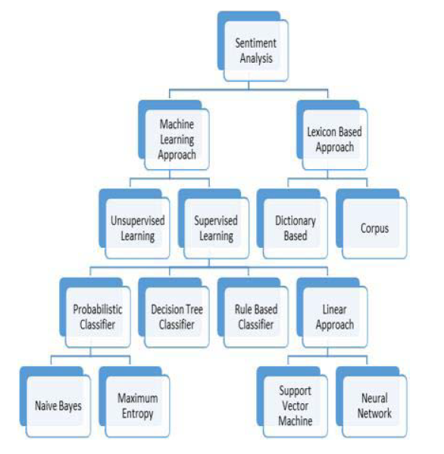
Algorithm tree for SA

Slide 9
Rule-based methods
A set of rules based on which the text is labeled as positive/negative/neutral.
These rules are also known as lexicons -> lexicon-based methods.
Popular example methods are TextBlob, VADER and SentiWordNet.

Slide 10
TextBlob
TextBlob scores each word in the lexicon with a numeric value between -1 (negative) and +1 (positive).
A score of 0 is interpreted as neutral.
Averages the polarity scores of all the words in a sequence to compute a combined polarity score for the whole sequence.

Slide 11
VADER
VADER also relies on a dictionary which maps words to sentiment scores -> -4 (most negative) to +4 (most positive).
The sentiment score of a sentence can be obtained by summing up the scores of each word in the text and is between -1 to 1.
This is achieved by applying a normalization technique to the total score (since single words scores are in [-4,4]).

Slide 12
SentiWordNet
It operates on the database provided by WordNet -> English words, grouped as synonyms (synsets).
SentiWordNet assigns a positivity, negativity and objectivity score to every synset. These three values are in [0,1] and add up to 1.
To calculate the sentiment of a sentence it uses the scores of the synsets each word belongs to.

Slide 13
Supervised ML methods
In this approach, machine learning is utilized to train models with labeled data (supervised learning).
Given the data, the only remaining thing is to choose the proper model and specify its hyper-parameters in order to obtain high prediction accuracies while avoiding overfitting.

Slide 14
ML classifiers
Naïve Bayes Classifier
Maximum Entropy
Support Vector Machine (SVM)
Decision Tree
Random Forest
K-nearest Neighbors
Neural Networks

Slide 15
Text Pre-processing

Slide 16
Common pre-processing steps
Text cleaning: Remove all unnecessary words/characters (URL, hashtags, stopwords)
Lowercase all words
Stemming/Lemmatization
Tokenization
Vectorization

Slide 17
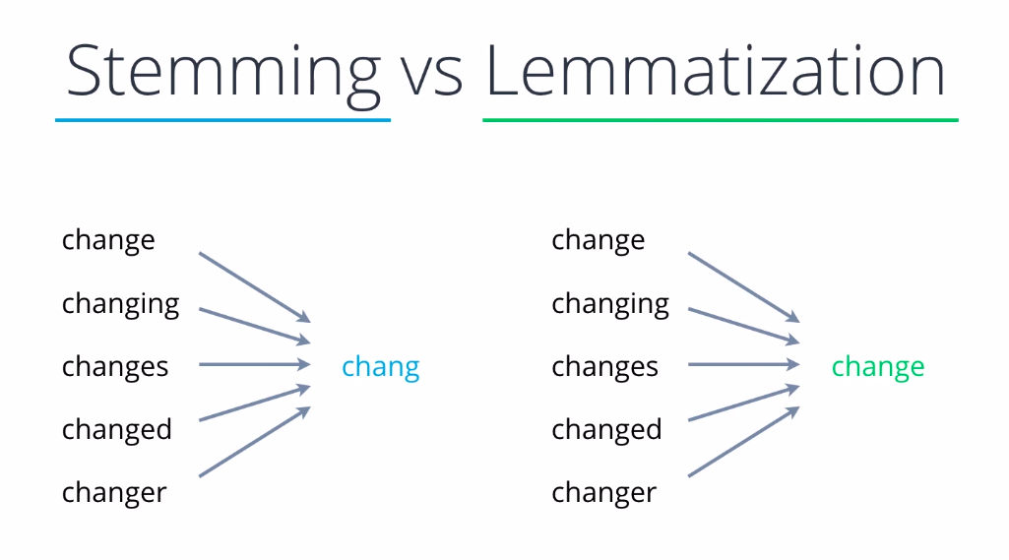

Slide 18
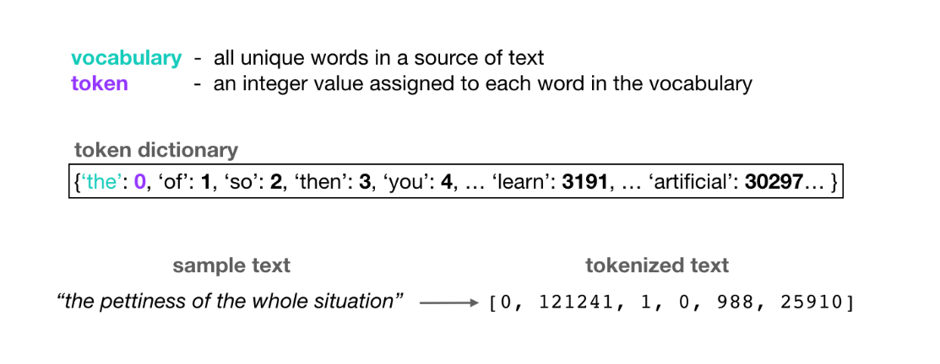
Tokenization
Usually, most frequent words appear higher in the token dictionary (“the”, “of”, “so”)

Slide 19
Text Vectorization
We cannot work with text directly when using machine learning algorithms.
Bag-of-Words
focuses on the occurrence of words in a document
Words Counts
count for the number of times each word appeared in the document
Word Frequencies with TF-IDF
Term Frequency: summarizes how often a given word appears within a document.
Inverse Document Frequency: downscales words that appear a lot across documents.
PROBLEM: cannot account for the similarity between words

Slide 20
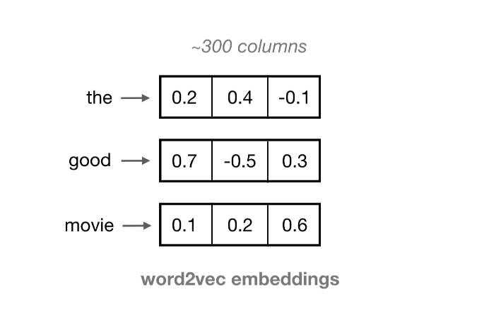
Solution: Word Embeddings
Words are represented with real-valued vectors that are learned in an unsupervised training process
Words with same meaning have similar representations
We can represent a sentence as a list of word embeddings and use it as input to a recurrent or convolutional neural network

Slide 21
Sentiment Analysis with Neural Networks
(RNN, CNN, BERT)

Slide 22
Main idea
Input: real valued vectors that represent a piece of text. Sentence = 2D matrix where rows are word embeddings
Output: A probability distribution across sentiment classes
In a neural architecture, the embeddings are output by the embedding layer or a language model (Word2Vec, GloVe, BERT)
After getting the embeddings, text and image classification are almost the same.

Slide 23
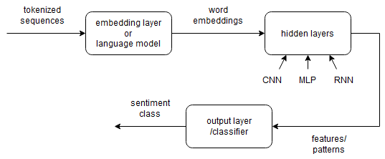
Classification schema
Take the matrix representation of a sentence as input and extract high level features with hidden layers.
Feed these features to the output layer/classifier (fully-connected layer) to classify the input sample into one of the sentiment classes.
Binary classification -> sigmoid output , Multiclass classification -> softmax output

Slide 24
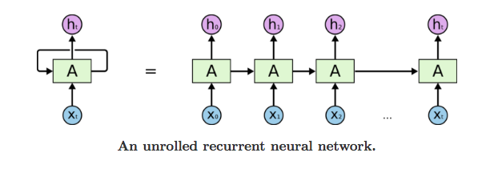
Recurrent Neural Networks (RNNs)
RNNs are designed to handle sequential data like text.
They take into account the order of words.
The repeating module consists of a single tanh fully connected layer.

Slide 25
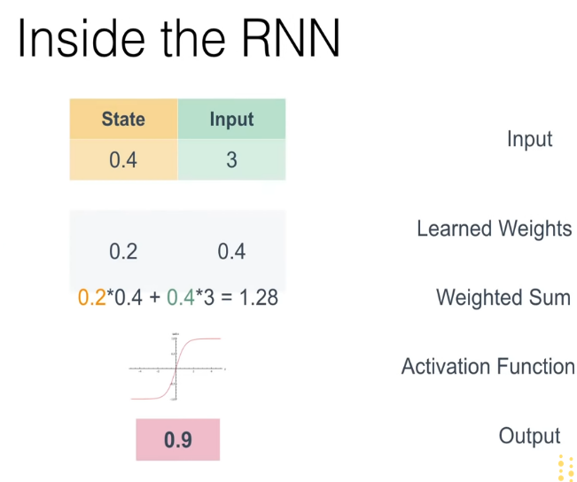
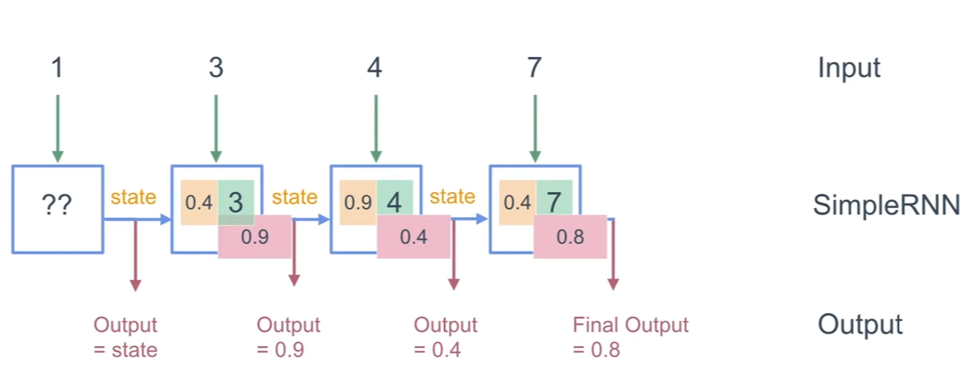
Simple RNN

Slide 26
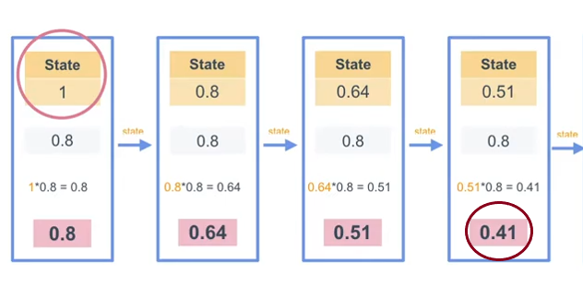
RNN problem – short memory
The input state at each time step is multiplied by a weight.
After many consecutive multiplications (time steps) the original state becomes a lot smaller -> network forgets.

Slide 27
LSTM
LSTMs were invented to solve that short memory problem and be able to encode both long and short term state (memory).
Here the repeating module has four fully connected layers -> 3 sigmoid + 1 tanh.

Slide 28
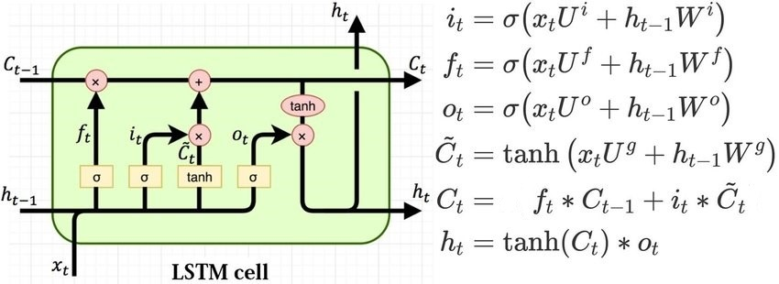
LSTM cell
All four layers (U, W) look at ht−1 (previous output) and xt (current input), and output a vector (it, ft, ot, c~t) with same size as the cell state Ct−1. All red colored operations are element-wise.

Slide 29
LSTM components
Forget gate layer decides what information we’re going to throw away from the cell state.
The tanh layer creates a vector of new candidate values C~t, that could be added to the cell state.
Input gate layer decides which candidate values will be added to the cell state (it∗C~t).
Output gate layer decides what parts of the slightly modified new cell state tanh(Ct) we will output (ht).
All three gates (forget, input, output) have sigmoid activations in order to output values between 0 and 1 and control the data flow from cell state.

Slide 30
Text classification example with LSTM
For a sentiment analysis application of LSTM, we consider as input vectors xt the word embeddings of a sentence
The aforementioned calculations will be performed as many times as the number of words in the sentence.
The final output of LSTM is produced at the final time step (end of input sequence) and then is fed to the output/dense layer which gives us the final classification result.

Slide 31
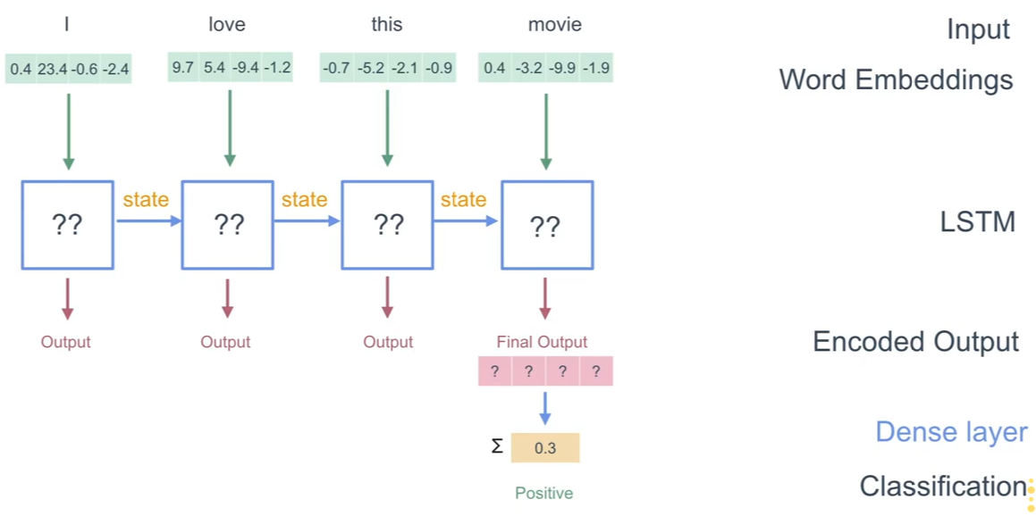
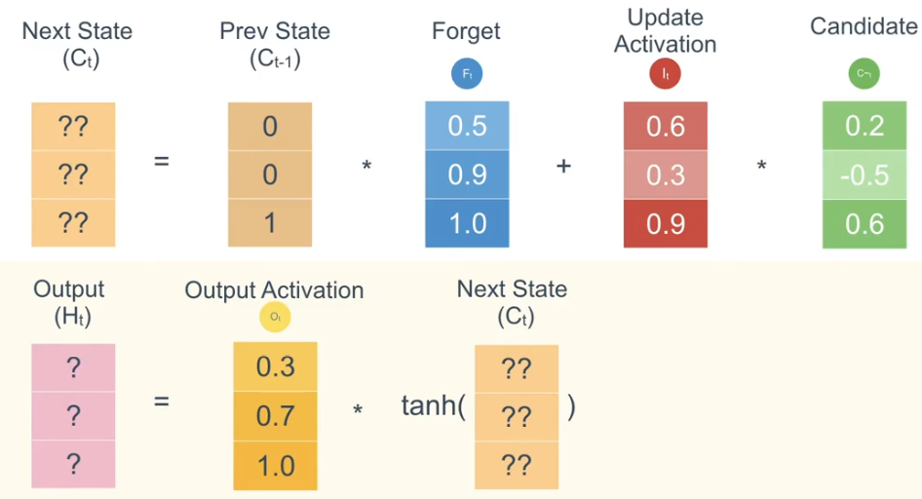
Text classification example with LSTM

Slide 32
Stacked LSTM
Higher LSTM cells pass their outputs to the lower LSTMs as inputs.
The lowest LSTM layer in the architecture produces at the final time step (end of input sequence) the final output.
The rest classification steps are the same as with a single LSTM architecture.

Slide 33
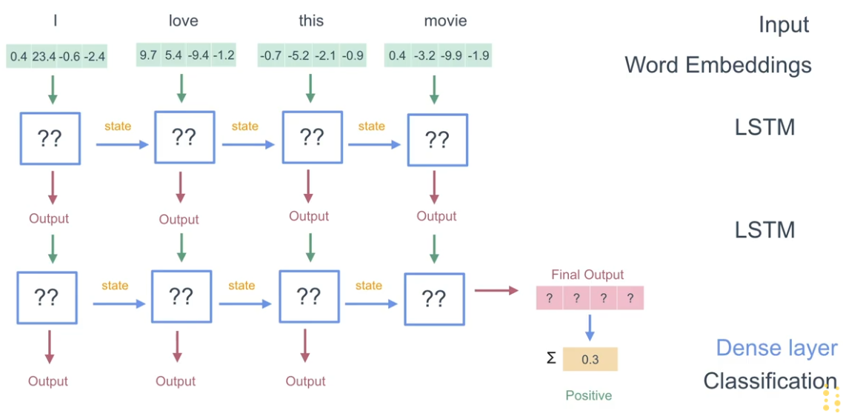
Stacked LSTM

Slide 34
Why increase depth?
The network can be seen as a processing pipeline, in which each layer solves a part of the task (easier than the whole task) before passing it on to the next layer, until finally the last layer provides the output.
The additional layers are understood to recombine the learned representations from prior layers and create new representations at high levels of abstraction. For example, from lines to shapes to objects (computer vision).

Slide 35
Bidirectional LSTM
Forward and backward LSTMs are combined.
The forward one ‘sees’ the words in their normal reading order. The backward one ‘sees’ them in reverse.
The final outputs from these two LSTMs are concatenated to form the final output of the whole bidirectional LSTM.
This vector is again fed to the output layer which gives us the sentiment score.

Slide 36
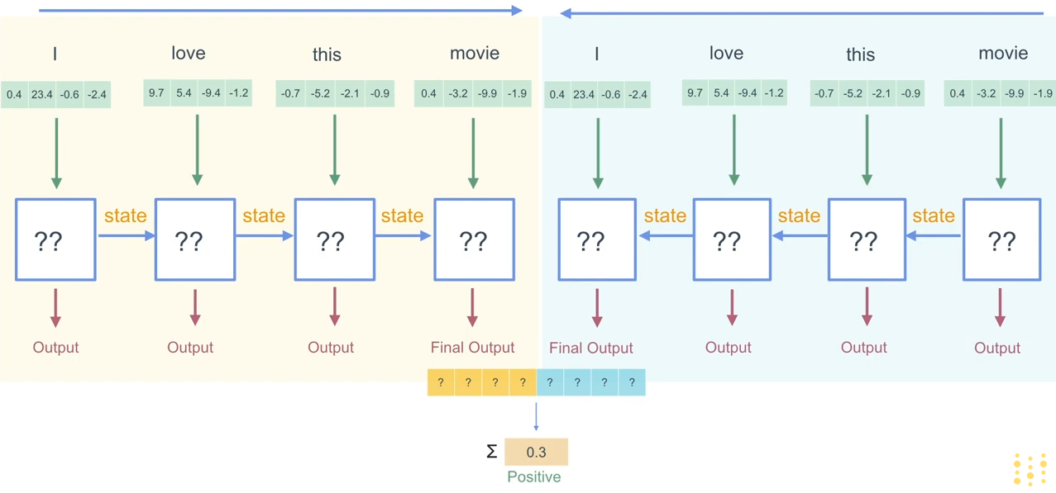
Bi-LSTM

Slide 37
Why use Bidirectional LSTM?
Bidirectional LSTM (Bi-LSTM) preserves information from both past (forward LSTM) and future (backward LSTM).
In sequence classification tasks (sentiment analysis) they usually perform better than unidirectional LSTMs as they can understand context better.

Slide 38
Convolution Neural Networks (CNNs)
Traditionally used in image processing
Can be also used for text
Easily parallelized for GPUs
Good classification results

Slide 39
Convolution over text
Convolution : window-based feature extraction, where the features are patterns in sequential word groupings that indicate traits like the sentiment of a text
1D convolution : kernel moves in only one dimension: time (whereas in images the kernel moved in two dimensions -2D convolution)
Many kernels - different heights : learn different kinds of relationships between words
Kernel weights are learned in training

Slide 40
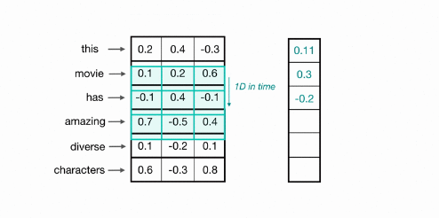
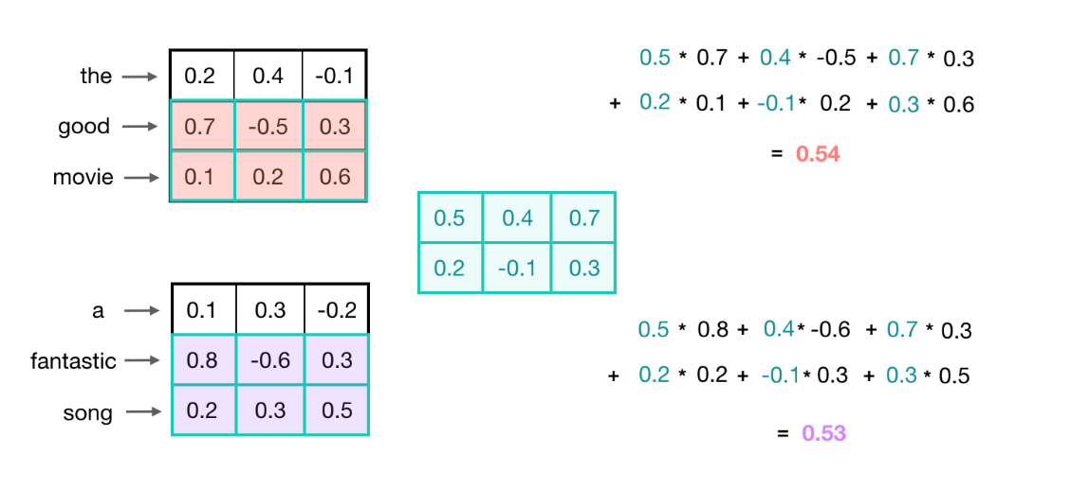
1D Convolution example

Slide 41
CNNs shared-weights
The fact that the filters weights are shared by the entire input (image/text) allows CNN to:
Identify spatially local input patterns/features no matter where they are located on the input – location invariant
Have much less parameters (efficiency) than a fully connected network since the former will learn the same feature extractor (the convolution) for every location in the input while the latter would have to relearn the same feature extractor for each location

Slide 42
CNNs pooling
The learned kernels produce the strongest response to a spatially local input pattern -> Max pooling:
Captures/Isolates the patterns detected by the kernels
Reduces the sizes of feature maps
Makes CNN more robust to variations in features’ positions (translational invariance)
Fully connected layers do not take into account the spatial structure of data and are not invariant to shifts of the input

Slide 43
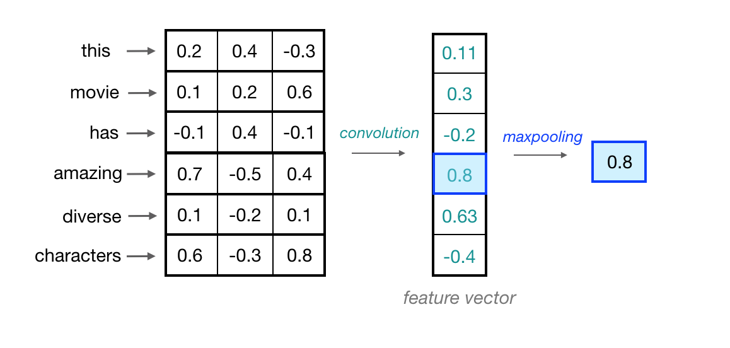
Pooling example

Slide 44
Classification flow
Single kernel convolution : outputs a feature vector about the size of input embeddings number
Convolutional layer : outputs the feature vectors that were produced by every kernel of the layer
The max-values from the different convolutional layers outputs (different kernel heights) are concatenated and passed to the output layer
Output/classification layer : Fully connected layer with sigmoid/softmax activation outputs the sentiment class our input text piece belongs to

Slide 45
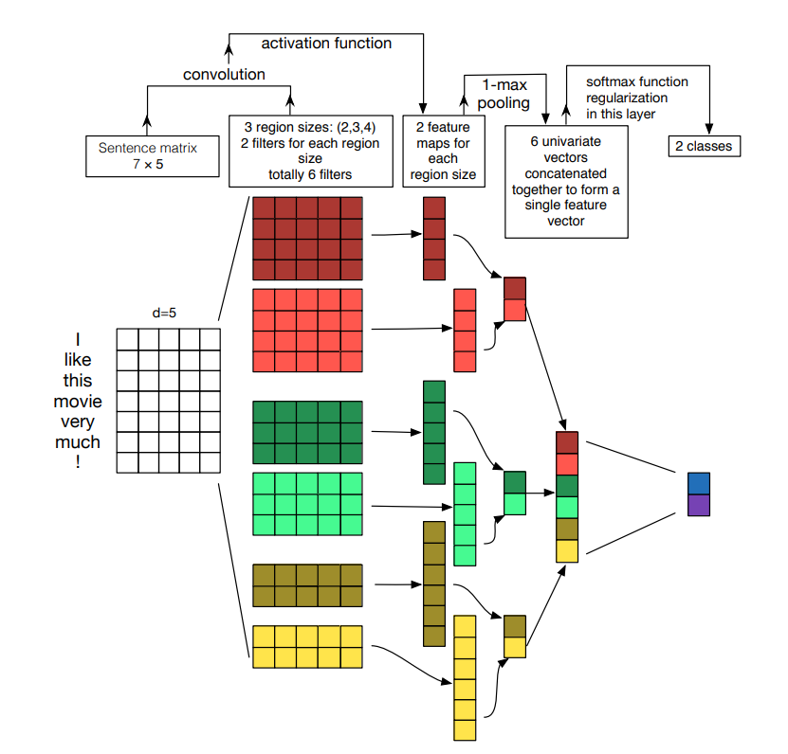
Complete CNN architecture

Slide 46
CNN/LSTM Hybrid
CNN will detect local features (word groupings) and LSTM will model long-distance temporal relationships in the input sequence of embeddings.
CNN is usually used first to reduce the dimensionality of the input by producing the feature vectors. These vectors are input to the LSTM.
Therefore, the LSTM will have to process smaller inputs than the full input representations, making its training a lot faster and efficient.
As always, a fully-connected output layer is needed at the end of the model for the classification result.

Slide 47
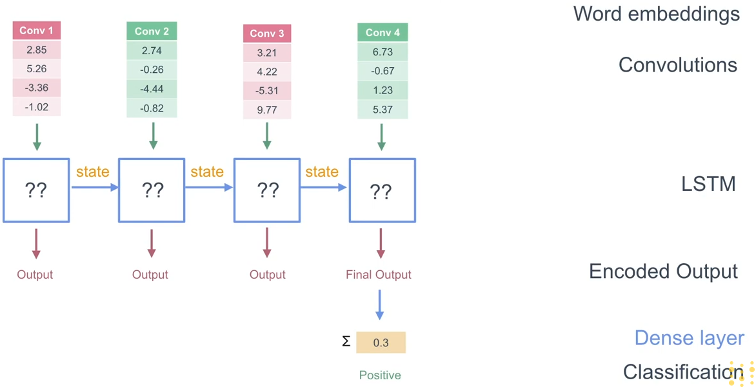
CNN/LSTM Hybrid

Slide 48

BERT
Text classification with BERT

Slide 49
Text classification with BERT
A language model can be used instead of the embedding layer to produce the word embeddings from the tokenized sequences.
BERT is a state-of-the-art language model that leads to top results due to its high quality contextualized embeddings.

Slide 50
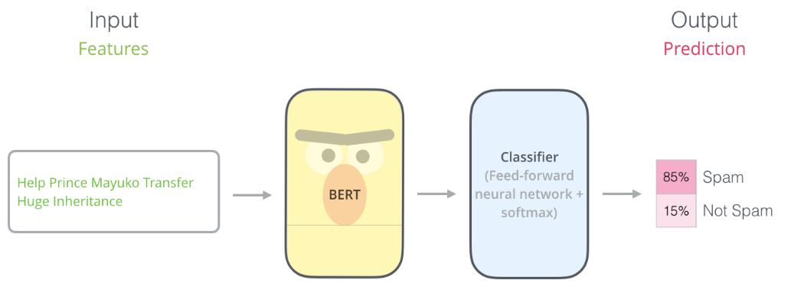
Text classification with BERT

Slide 51
Text classification with BERT
Load the pre-trained BERT and add a classifier on top of it.
The classifier can be a CNN, LSTM, MLP or just a single fully connected layer.
BERT feeds the classifier with the word embeddings to produce the final output.
Since BERT is pre-trained, we just need to train the classifier for the classification task using our labeled dataset.
We can fine-tune BERT along with the classifier on the specific task but this is computationally expensive and usually brings small benefit.

Slide 52
References-papers
Hutto, Clayton, and Eric Gilbert. "Vader: A parsimonious rule-based model for sentiment analysis of social media text." Proceedings of the international AAAI conference on web and social media. Vol. 8. No. 1. 2014.
Esuli, Andrea, and Fabrizio Sebastiani. "Sentiwordnet: A publicly available lexical resource for opinion mining." Proceedings of the Fifth International Conference on Language Resources and Evaluation (LREC’06). 2006.
Hochreiter, Sepp, and Jürgen Schmidhuber. "Long short-term memory." Neural computation 9.8 (1997): 1735-1780.
Ansari, Mohd Zeeshan, et al. "Analysis of political sentiment orientations on twitter." Procedia Computer Science 167 (2020): 1821-1828.
Kurniasari, L. I. L. I. S., and A. R. I. E. F. Setyanto. "Sentiment analysis using recurrent neural network-lstm in bahasa Indonesia." J. Eng. Sci. Technol 15.5 (2020): 3242-3256.
Cai, Yi, et al. "Recurrent neural network with pooling operation and attention mechanism for sentiment analysis: A multi-task learning approach." Knowledge-Based Systems 203 (2020): 105856.

Slide 53
References-papers
Gaikar, Dipak, et al. "Twitter Sentimental Analysis for Predicting Election Result using LSTM Neural Network." IRJET (2019).
Saha, Baidya Nath, Apurbalal Senapati, and Anmol Mahajan. "LSTM based deep RNN architecture for election sentiment analysis from Bengali newspaper." 2020 International Conference on Computational Performance Evaluation (ComPE). IEEE, 2020.
Wang, Mei, et al. "Sentiment analysis based on attention mechanisms and Bi-Directional LSTM fusion model." 2019 IEEE SmartWorld, Ubiquitous Intelligence & Computing, Advanced & Trusted Computing, Scalable Computing & Communications, Cloud & Big Data Computing, Internet of People and Smart City Innovation (SmartWorld/SCALCOM/UIC/ATC/CBDCom/IOP/SCI). IEEE, 2019.
Pascanu, Razvan, et al. "How to construct deep recurrent neural networks." arXiv preprint arXiv:1312.6026 (2013).
Schuster, Mike, and Kuldip K. Paliwal. "Bidirectional recurrent neural networks." IEEE transactions on Signal Processing 45.11 (1997): 2673-2681.

Slide 54
References-papers
Zhang, Ye, and Byron Wallace. "A sensitivity analysis of (and practitioners' guide to) convolutional neural networks for sentence classification." arXiv preprint arXiv:1510.03820 (2015).
Gan, Chenquan, et al. "Sparse attention based separable dilated convolutional neural network for targeted sentiment analysis." Knowledge-Based Systems 188 (2020): 104827.
Pota, Marco, et al. "A subword-based deep learning approach for sentiment analysis of political tweets." 2018 32nd International Conference on Advanced Information Networking and Applications Workshops (WAINA). IEEE, 2018.
Rehman, Anwar Ur, et al. "A hybrid CNN-LSTM model for improving accuracy of movie reviews sentiment analysis." Multimedia Tools and Applications 78.18 (2019): 26597-26613.
Kaladevi, P., and K. Thyagarajah. "RETRACTED ARTICLE: Integrated CNN-and LSTM-DNN-based sentiment analysis over big social data for opinion mining." Behaviour & Information Technology 40.9 (2021): XI-XIX.

Slide 55
References-papers
Umer, Muhammad, et al. "Sentiment analysis of tweets using a unified convolutional neural network‐long short‐term memory network model." Computational Intelligence 37.1 (2021): 409-434.
Minaee, Shervin, Elham Azimi, and AmirAli Abdolrashidi. "Deep-sentiment: Sentiment analysis using ensemble of cnn and bi-lstm models." arXiv preprint arXiv:1904.04206 (2019).
Abid, Fazeel, et al. "Sentiment analysis through recurrent variants latterly on convolutional neural network of Twitter." Future Generation Computer Systems 95 (2019): 292-308.
Ling, Mingjie, et al. "Hybrid neural network for Sina Weibo sentiment analysis." IEEE Transactions on Computational Social Systems 7.4 (2020): 983-990.

Slide 56
References-sites
https://en.wikipedia.org/wiki/Sentiment_analysis
https://www.analyticsvidhya.com/blog/2021/06/rule-based-sentiment-analysis-in-python/
https://textblob.readthedocs.io/en/dev/
https://www.analyticsvidhya.com/blog/2021/08/why-must-text-data-be-pre-processed/
https://towardsdatascience.com/text-preprocessing-in-natural-language-processing-using-python-6113ff5decd8
https://nlp.stanford.edu/IR-book/html/htmledition/stemming-and-lemmatization-1.html
https://machinelearningmastery.com/stacked-long-short-term-memory-networks/
https://machinelearningmastery.com/develop-bidirectional-lstm-sequence-classification-python-keras/
https://cezannec.github.io/CNN_Text_Classification/
https://jalammar.github.io/illustrated-bert/

Slide 57
Q & A
Thank you very much for your attention!
Contact: Dionisios Karamouzas
dionkara@ece.auth.gr

