Slide 1
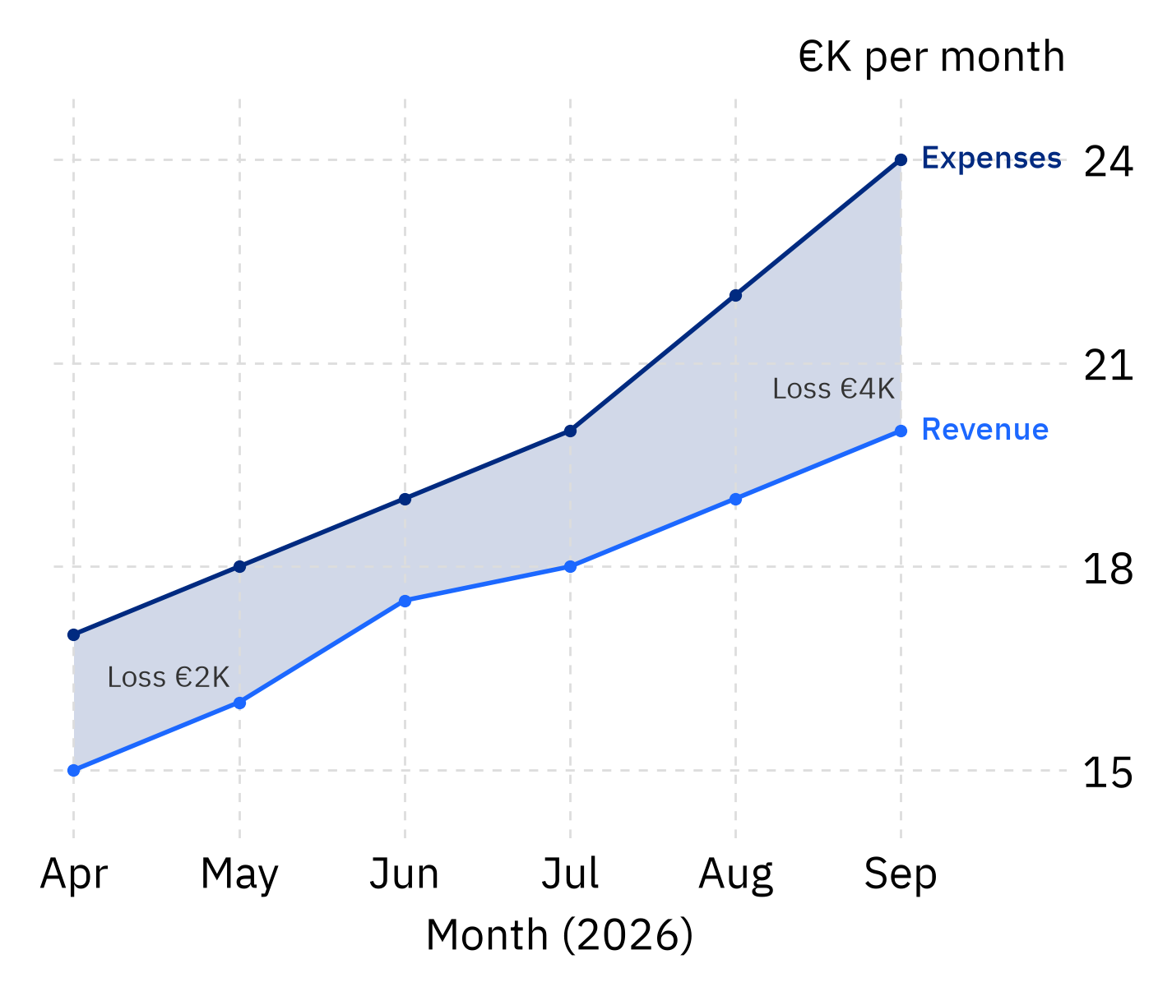
Dashboard
Financials
AI Insights
Runway
Cash balance
30 mo
€120K
INVESTOR OVERVIEW
StartupGuard AI
See business risk before it hits
Founders discover problems too late:
Financial data is scattered across different tools
Competitor moves often go unnoticed
Important decisions are made without seeing their impact on runway

Slide 2
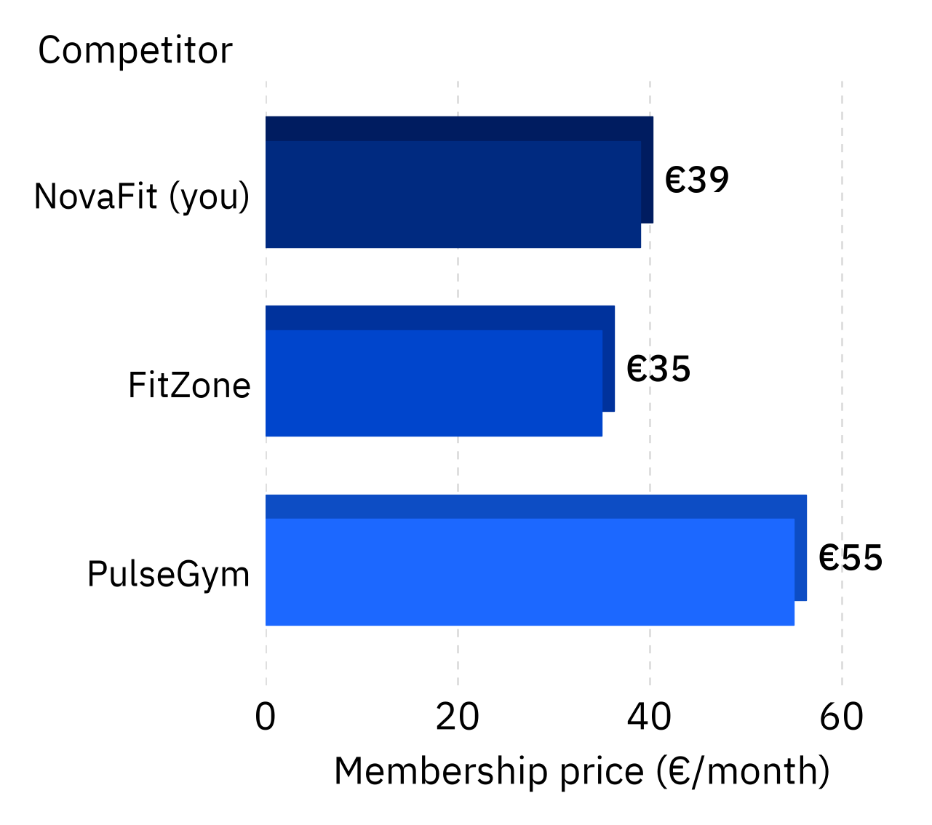
THE SOLUTION
One AI platform combines your business data with local market intelligence
Competitors
Market Analysis
Internal
External
Revenue, expenses, cash, burn rate, runway, growth
Competitors, pricing, price history, partnerships, launches, local market activity
01
02
03
Simulate
Compare
Act
See how decisions impact burn rate and runway
Compare pricing, trends, and competitor activity
Get clear AI recommendations on what to do next

Slide 3

THE OUTCOME
Founders detect risks earlier and make better-informed decisions.
Earlier warnings on financial and competitive risks
Simulate important decisions before committing
Turn business and market data into actionable AI guidance

