Slide 1

Real Estate Market Insights Dashboard
Trends in Price, Size & Value from 10,000+ Property Listings
BY: DIONTE CAPLETON

Slide 2
Project Overview
Objective: To uncover pricing patterns and property value trends across U.S. real estate listings using Power BI.
Data Source: Cleaned dataset of 10,000+ real estate listings across multiple states.
Business Question:
What are the key trends in listing price, price per square foot, and value concentration across different locations and home layouts?

Slide 3
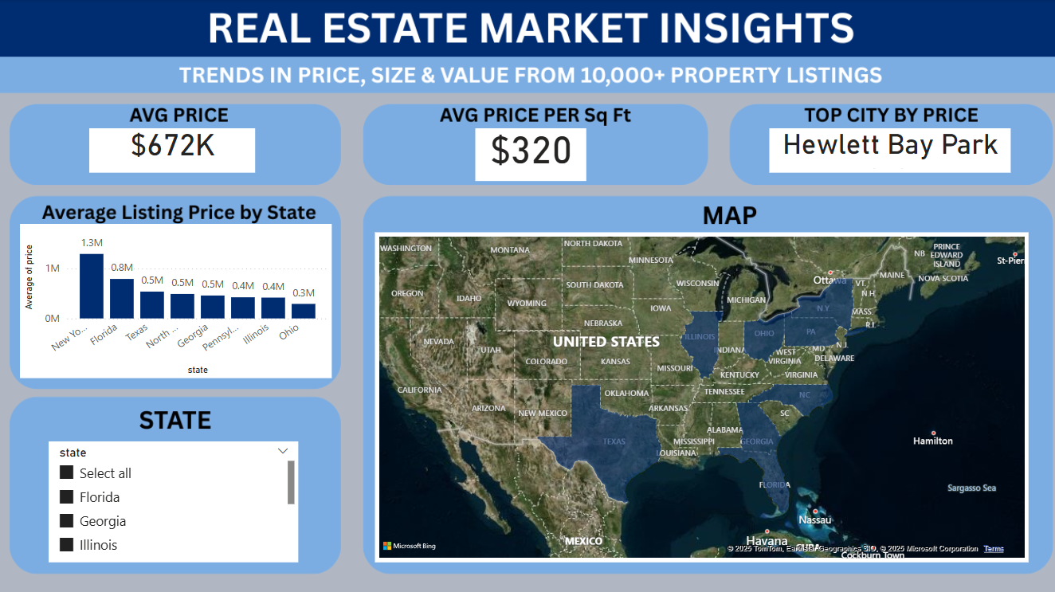
Nationwide Market Snapshot
Avg Price: $672K
Avg Price per Sq Ft: $320
Top City by Price: Hewlett Bay Park
Insights:
High-value clusters exist in specific cities, often coastal or luxury zones.
Visuals include:
• Map showing price distribution across states
• Avg Listing Price by State bar chart
• State filter

Slide 4
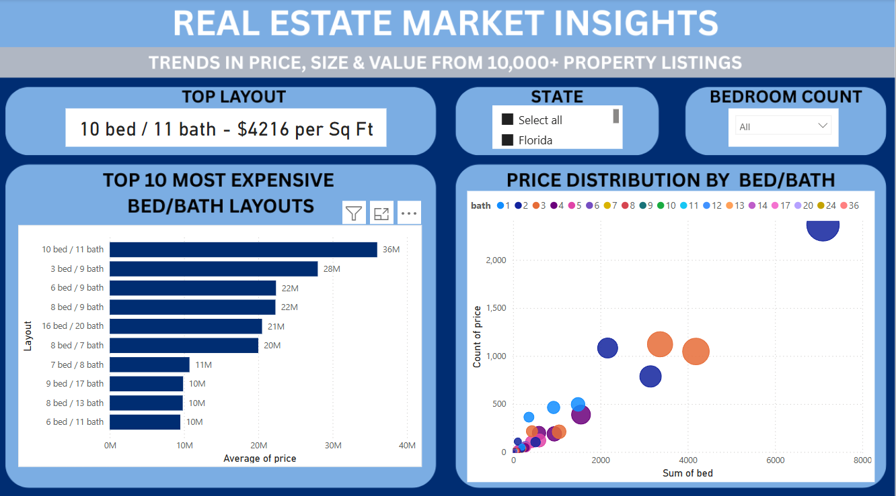
Home Layout Insights
Top Layout (by $/Sq Ft): 10 bed / 11 bath – $4216 per Sq Ft
Insights:
Luxury layouts have exponential pricing, skewing market averages.
Visuals include:
• Top 10 most expensive bed/bath layouts
• Price distribution scatter plot by bed & bath
• Filters: State and Bedroom Count

Slide 5
Key Findings & Applications
• Coastal cities and luxury layouts dominate price per square foot.
• Price premiums are driven by both layout complexity and geography.
These insights support:
• Broker targeting of high-value regions
• Investor decisions on property type and location
• Builders optimizing popular layout combinations

Slide 6
Recommendation
The company can enhance its premium analytics offerings by highlighting micro-market insights that reveal luxury layout demand and hyperlocal pricing trends.
For example, layouts like 10 bed / 11 bath have the highest price per Sq Ft ($4,216), while regions like Hewlett Bay Park and Palm Beach significantly outpace state averages.
I recommend the company incorporate bed/bath-level segmentation dashboards across its platform to help clients:
Identify underpriced high-value markets
Forecast luxury inventory trends
Advise brokers and investors with layout-specific ROI predictions
This analysis strengthens the company’s value proposition as the go-to platform for targeted investment insights and real estate intelligence.

Slide 7

Thank You / Let’s Connect
Questions or Feedback?
LinkedIn: https://www.linkedin.com/in/dionte-capleton-54074524a/
GitHub: https://github.com/Dionte18Cape
Let’s connect and talk data!

