Slide 1

Retail Sales Forecast Dashboard
Data Analysis & Forecasting for Strategic Retail Decisions
Dionte Capleton • DC Analytics
March 2025

Slide 2
Business Problem
A national retail company wants to understand its revenue drivers, track monthly performance, and use sales forecasts to make proactive decisions.
Key Question:
How can we identify revenue trends, customer segments, and future projections to inform inventory and marketing strategy?

Slide 3
Project Overview
• Performed sales data analysis using Python, SQL, and Tableau
• Forecasted monthly revenue using Facebook Prophet
• Built an interactive dashboard to explore trends by state, category, month, and gender
Links:
Tableau Dashboard: [Dionte18Cape]
LinkedIn: [Dionte Capleton]

Slide 4
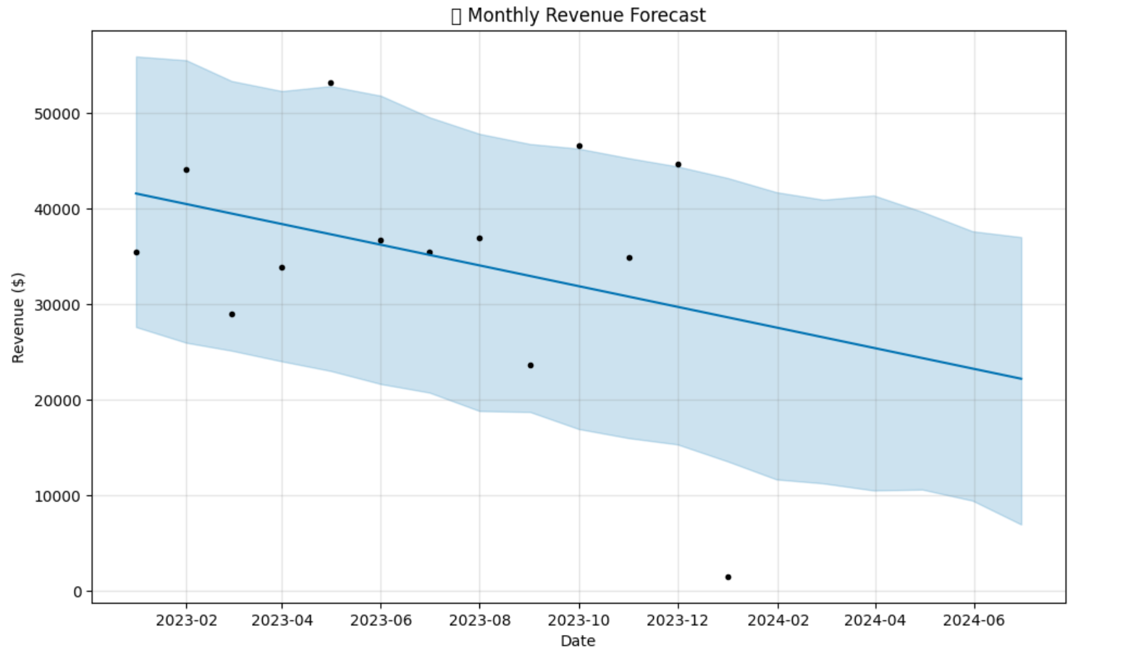
Forecast Model
Forecast indicates a declining revenue trend unless action is taken. Confidence intervals highlight the importance of monitoring state and category segments.
Key Fields:
• Date
• State
• Gender
• Product Category
• Quantity
• Price
• Total Amount

Slide 5
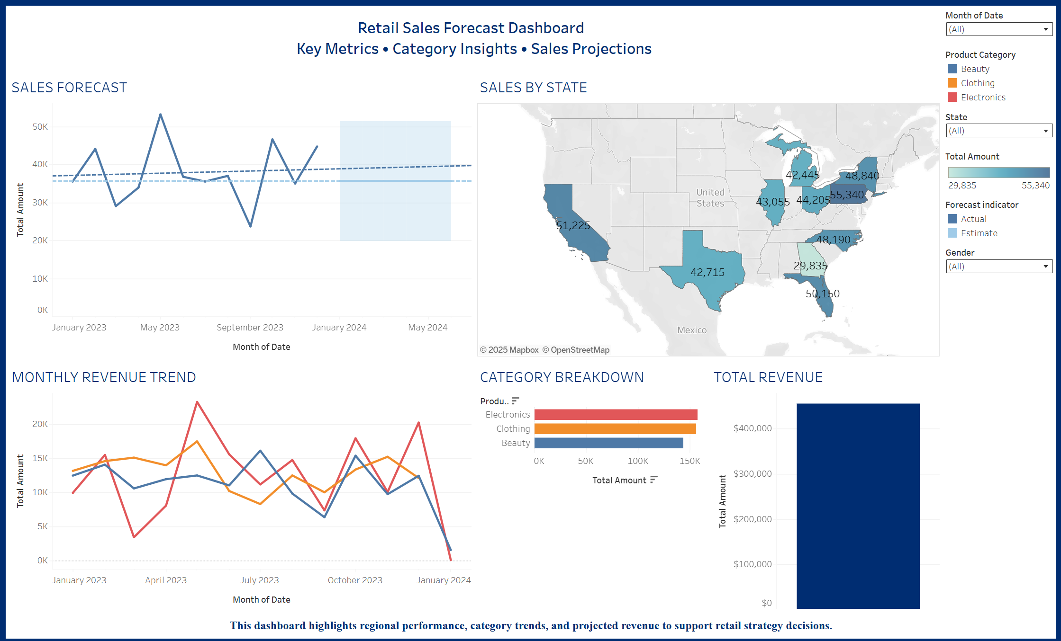
Tableau Dashboard

Slide 6
Business Recommendations
• Focus marketing in top-performing states (CA, NY, TX)
• Optimize inventory allocation based on forecasts
• Use gender-based promotion strategies
• Invest in high-margin categories like Electronics

Slide 7
Tools & Skills Used
Tools:
• Python (Pandas, Prophet, SQLite)
• SQL (via pandasql or sqlite3)
• Tableau Public
Skills:
• Data Cleaning
• Time Series Forecasting
• Dashboard Design
• SQL Analysis

Slide 8

Thank You
Dionte Capleton
Portfolio: https://github.com/Dionte18Cape
LinkedIn: https://www.linkedin.com/in/dionte-capleton-54074524a/
Atlanta, GA

