Slide 1

Diploma Thesis
Multi-Wavelength Dynamic Imaging
of the Pupillary Photomotor Reflex
Karimpidis Dionisios
Committee:
Professor Balas Constantinos (Supervisor)
Professor Kalaitzakis Constantinos
Associate professor Bucher Mattias

Slide 2
Multi-Wavelength Dynamic Imaging of the Pupillary Photomotor Reflex
Outline
1. Biological View
2. Pupillography till today
3. Device instrumentation
4. Software Development
5. Conclusion and future work

Slide 3
1. Biological view
Human Eye Anatomy
Nervous System
Pupillary light reflex
Multicolor eye excitation

Slide 4
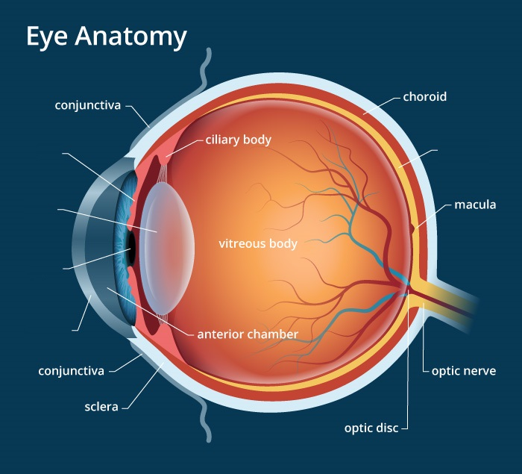
Human Eye Anatomy
Τhe human eye can be considered as an camera type eye
with many similar working parts
cornea acts like camera lens
Iris like diaphragm
Lens like autofocus camera lens
Retina like electronic image sensor
Pupil like opening through which
light enters

Slide 5
1. Biological view
Human Eye Anatomy
Nervous System
Pupillary light reflex
Multicolor eye excitation

Slide 6
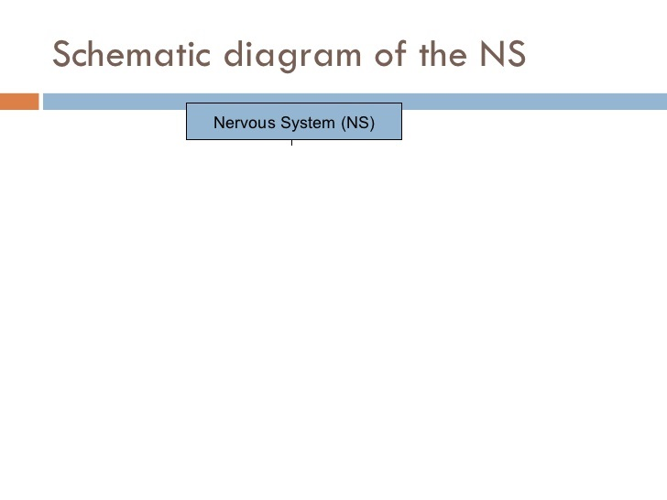

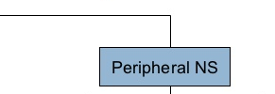

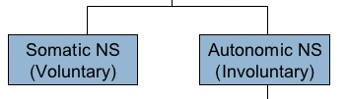
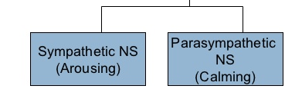
Nervous System

Slide 7
Nervous System
Sympathetic Nervous System (SNS)
responsible for the "fight or flight" response to a perceived threat
Consists of two kind of neurons
    preganglionic neuron, relatively short and stem from thoracolumbar region
    Postganglionic neuron, extend across most of the body
sympathetic neuron pathway is composed from very short neurons so it’s a faster system

Slide 8
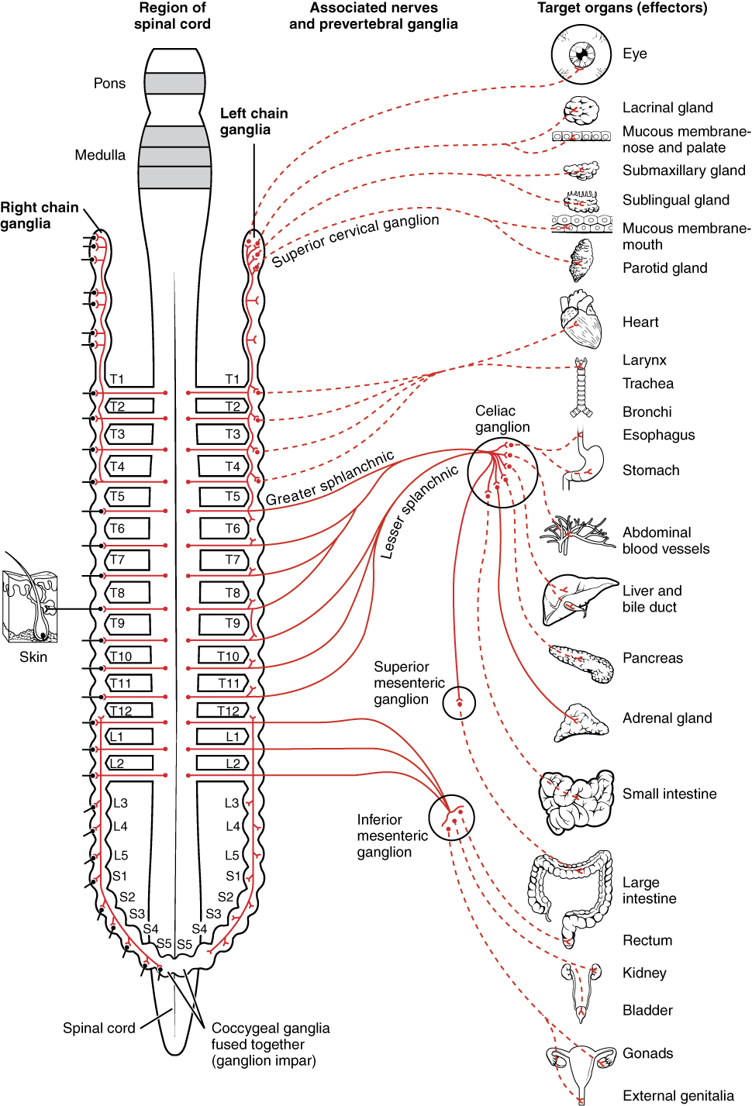
Sympathetic Nervous System (SNS)

Slide 9
Nervous System
Parasympathetic Nervous System (PSNS)
responsible for the body's "rest and digest" function
controls homeostasis, restores the body to a state of calm
its action is complementary to that of the SNS
Neurons stem from craniosacral region
parasympathetic neuron pathway is composed from longer neurons so it’s a slower system

Slide 10
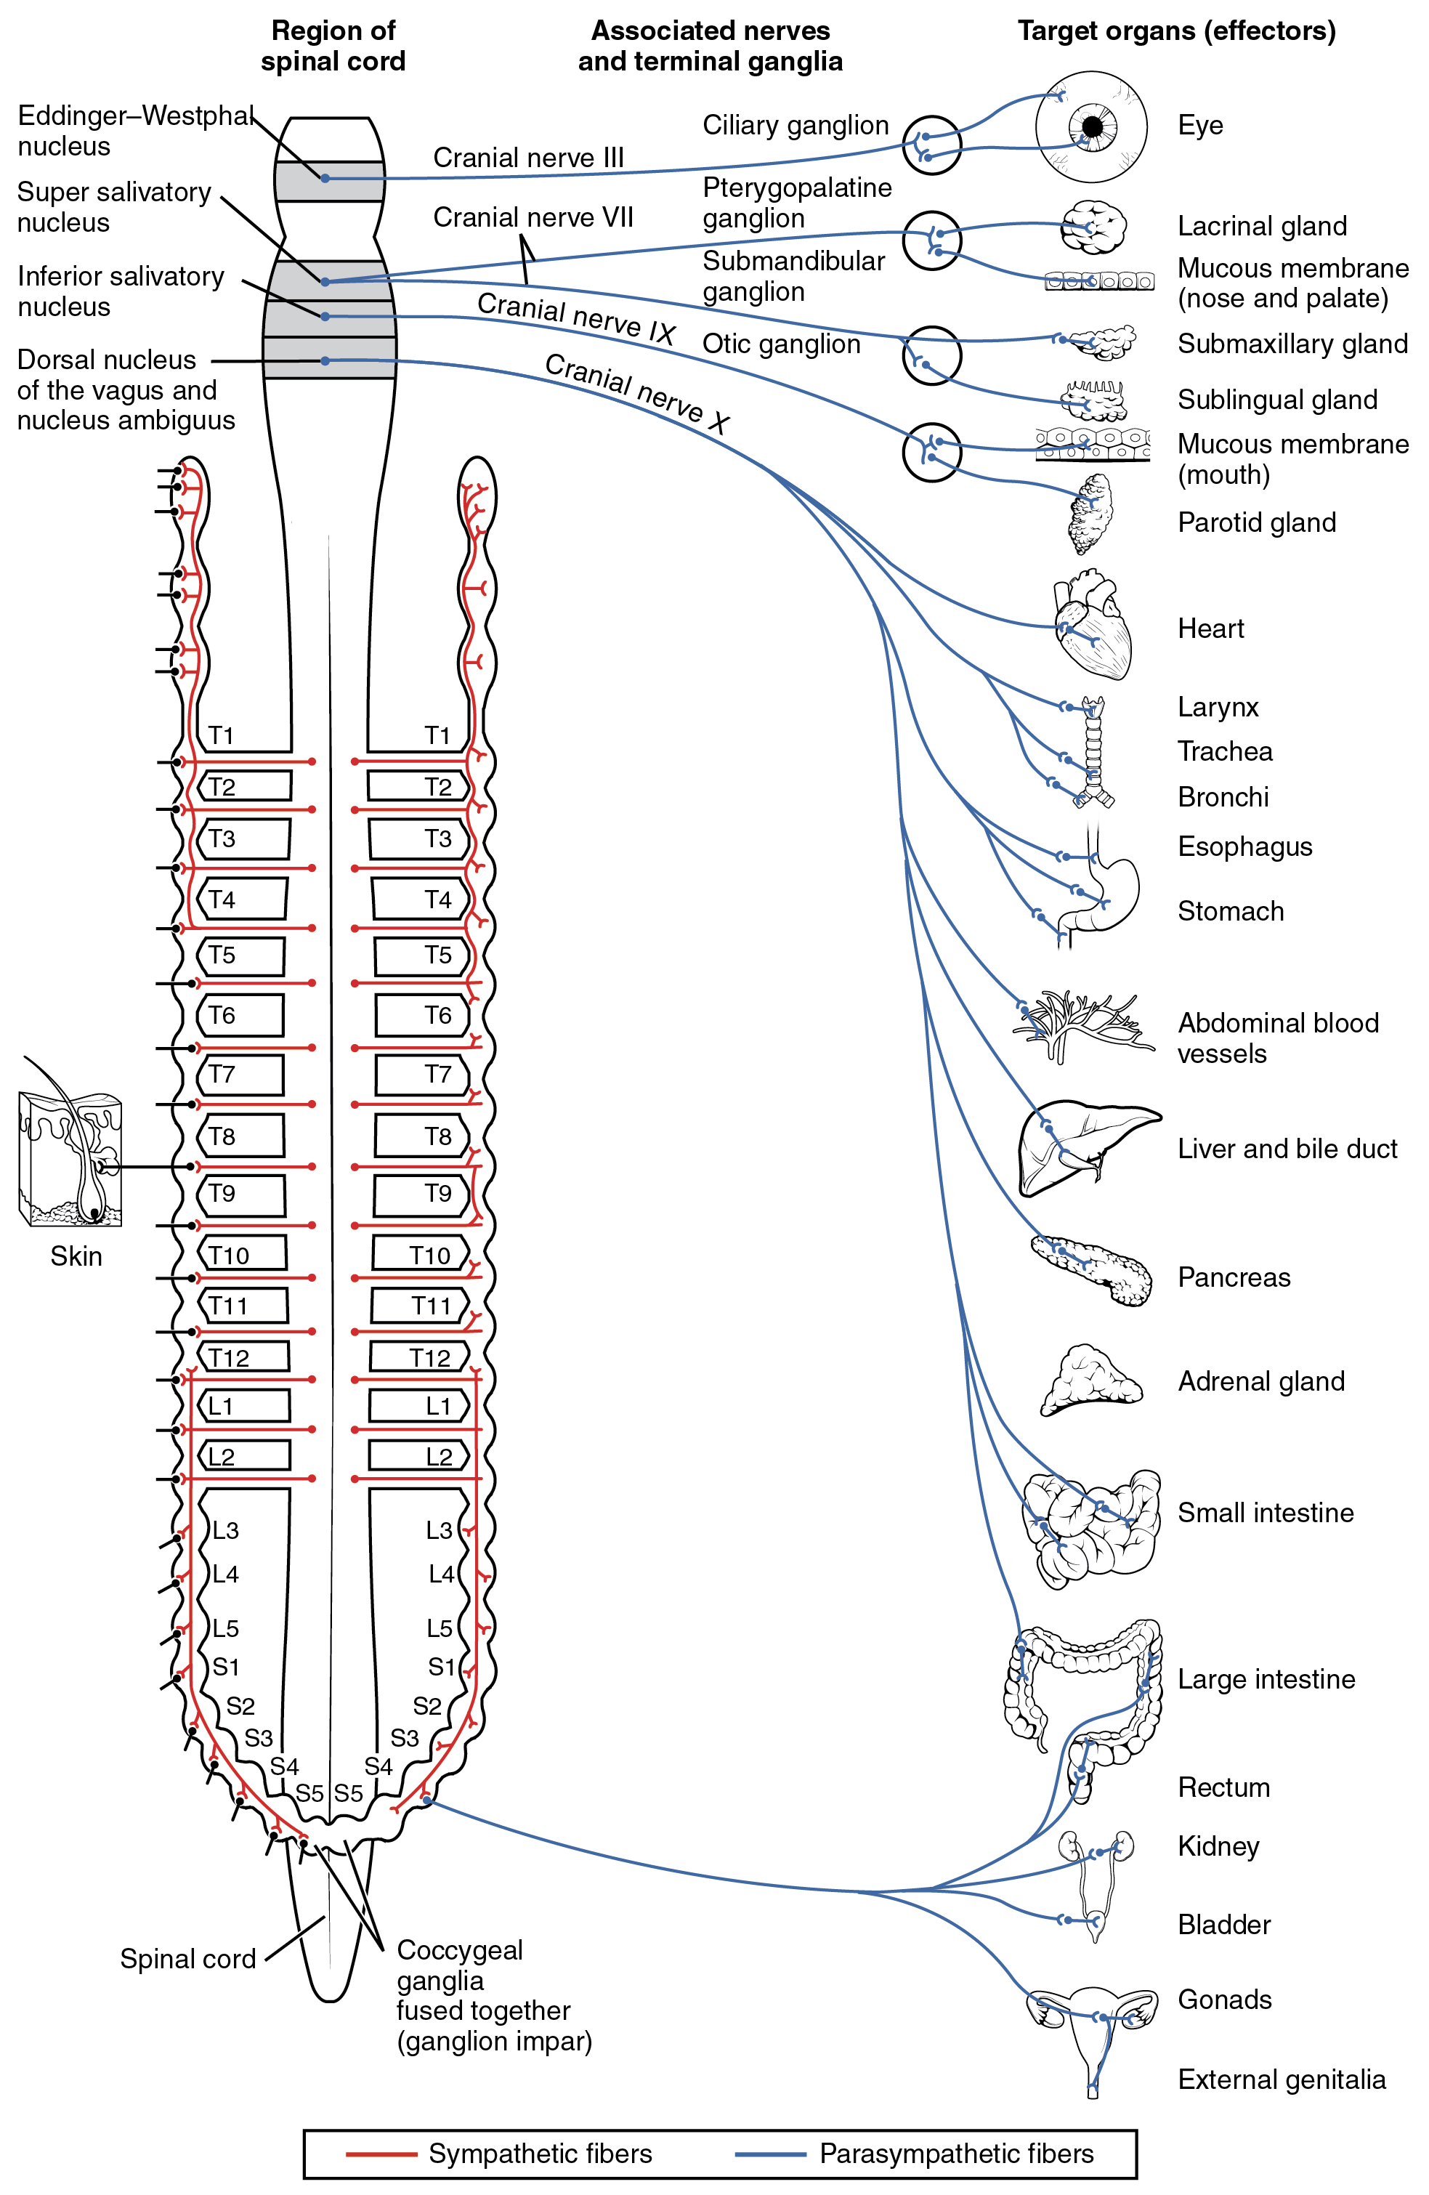
Parasympathetic Nervous System (PSNS)

Slide 11
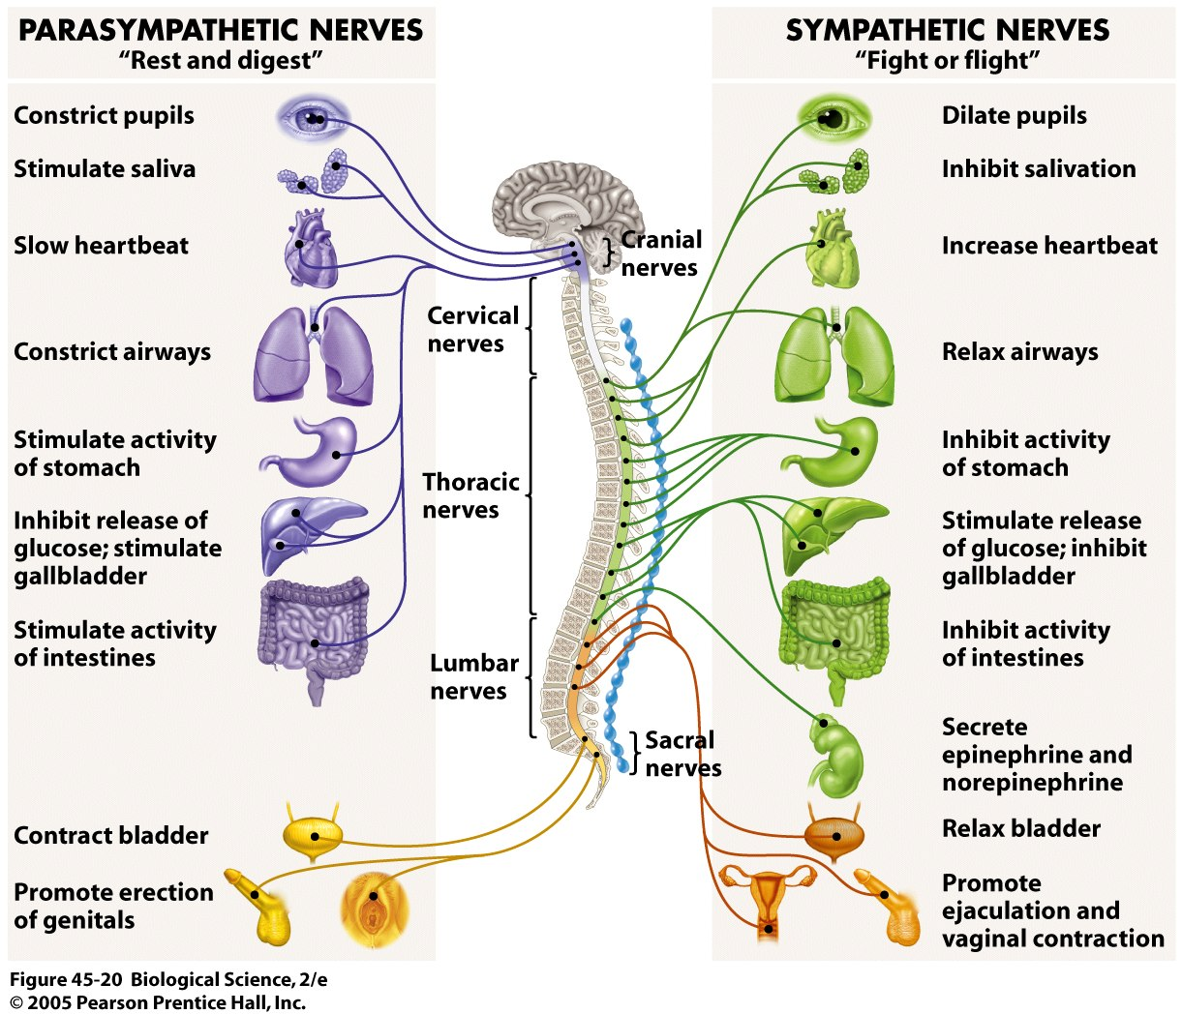
SNS and PSNS correspondence

Slide 12
1. Biological view
Human Eye Anatomy
Nervous System
Pupillary light reflex
Multicolor eye excitation

Slide 13
Pupillary light reflex
The pupillary light reflex involves adjustments in pupil size with changes in light levels
The reflex is consensual
-Direct response is the change in pupil size in the eye to which the light is directed
  -Consensual response is the change in pupil size in the eye opposite to the eye to which the light is directed

Slide 14
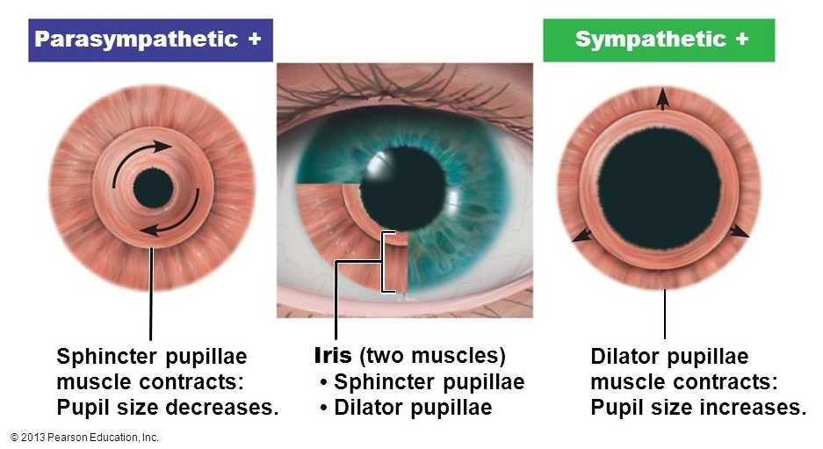
Pupillary light reflex
Iris area is composed of two muscles, sphincter and dilator as shown in the image below

Slide 15
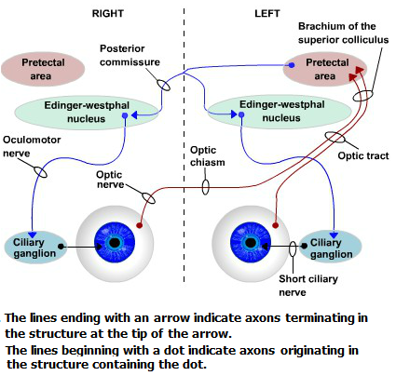
Pupillary light reflex
The pathway controlling pupil constriction neural circuit:

Slide 16
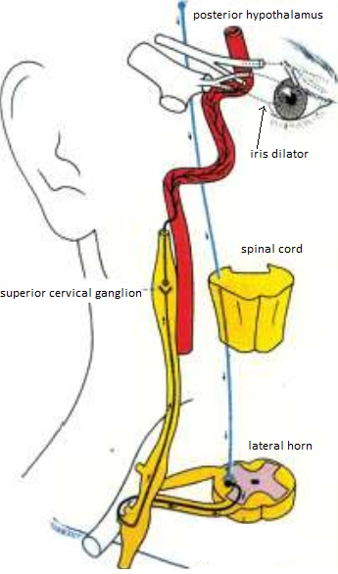
Pupillary light reflex
The pathway controlling pupil dilation neural circuit:

Slide 17
1. Biological view
Human Eye Anatomy
Nervous System
Pupillary light reflex
Multicolor eye excitation

Slide 18
Multicolor eye excitation
Retina is a thin layer of tissue that lines on the back of inner side of eye
Different types of cells are located in this region
Light-sensitive cells are cones and rods that convert incoming light into nerve signals
Human eye can be supposed as an back illuminated system because light is passing through the retinal “circuitry” before reaching the light-sensitive cells

Slide 19
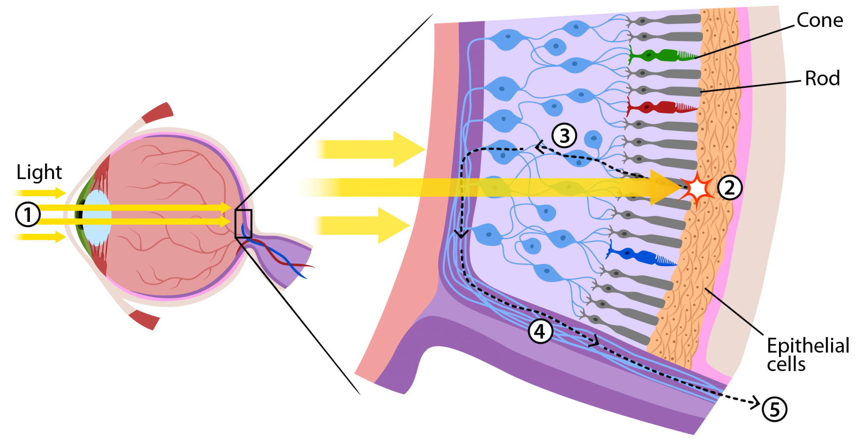
Multicolor eye excitation
"backwards" organization
benefits:
1.Retinal pigmented epithelium
(RPE) can absorb scattered
light
2. Vision becomes clearer
3. Protects the rods and cones
from unnecessary damage

Slide 20
Multicolor eye excitation
Rod cells:
Human eye has over 100 million rod cells in the retina
Great number of them tend to converge to a single ganglion. Almost 600 rods are connected to each nerve fiber
Provide visual capability at low light levels
Are located away from the center of retina called macula so they are responsible for peripheral or “where is it” vision

Slide 21
Multicolor eye excitation
Cone cells:
There are roughly 6 million cone cells in the retina
Perform best at normal light levels, providing the ability to see colorful
Are concentrated towards the center of macula named fovea centralis, area responsible for detailed or “what is it” vision

Slide 22
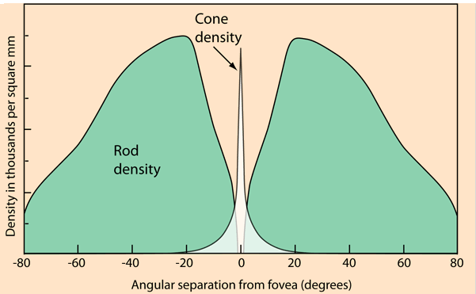
Multicolor eye excitation
The eye has 200° field of view but detailed angle for high resolution images is 15° from fovea region

Slide 23
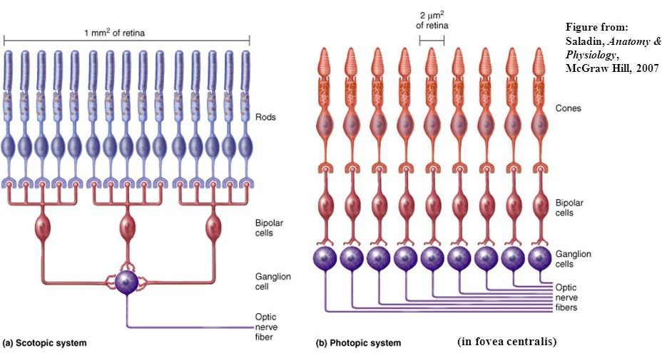
Multicolor eye excitation
connection between rods and cones and optic nerve fibers is varius

Slide 24
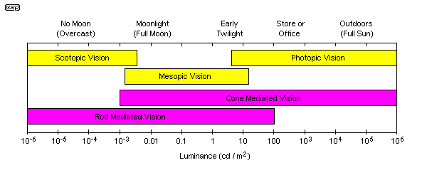
Multicolor eye excitation
We can distinguish 3 different vision regimes (Scotopic, Mesopic and Photopic Vision)

Slide 25
Multi-Wavelength Dynamic Imaging of the Pupillary Photomotor Reflex
Outline
1. Biological View
2. Pupillography till today
3. Device instrumentation
4. Software Development
5. Conclusion and future work

Slide 26
Pupillography till today
Contraction and dilation of pupil is not only associated with changes in light intensity
Several factors, diseases and a wide variety of neurological injuries affect pupil’s behavior
Clinical significance of pupil light reflex is testing:
    integrity of the sensory and motor functions of the eye
    neurological integrity and functionality

Slide 27
Pupillography till today
Eye diseases (e.g. optic neuritis, glaucoma or cataract issues)
Pupillography in psychology
  Hess and Polt experiment
  Hess, Seltzer and Shlien experiment
  study on infants
Drugs and Pharmaceuticals
  PLR in cases of rehabilitation
  parasympatholytic or sympathomimetic drugs and opposite
  antidepressants and pupil reflex in psychopathic medicine

Slide 28
Pupillography till today
Diabetes and Cardiovascular Neuropathy
  Diabetic autonomic neuropathy (DAN)
  PLR used in heart failure
  PLR and cardiovascular reflex
Brain and mental disorders
  Schizophrenia
  Parkinson's and Alzheimer's Disease
  Myasthenia Gravis
  Autism spectrum disorders

Slide 29
Pupillography till today
Psychiatric disorders and anxiety
  Psychosensory pupillary response
  Anxiety and pain responce
Alternative Cures
  Acupuncture
  Kampo
  goshuyuto

Slide 30
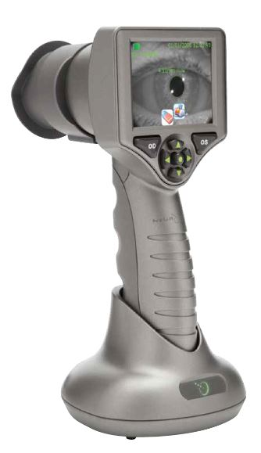
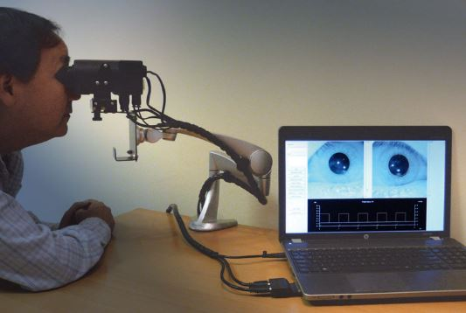
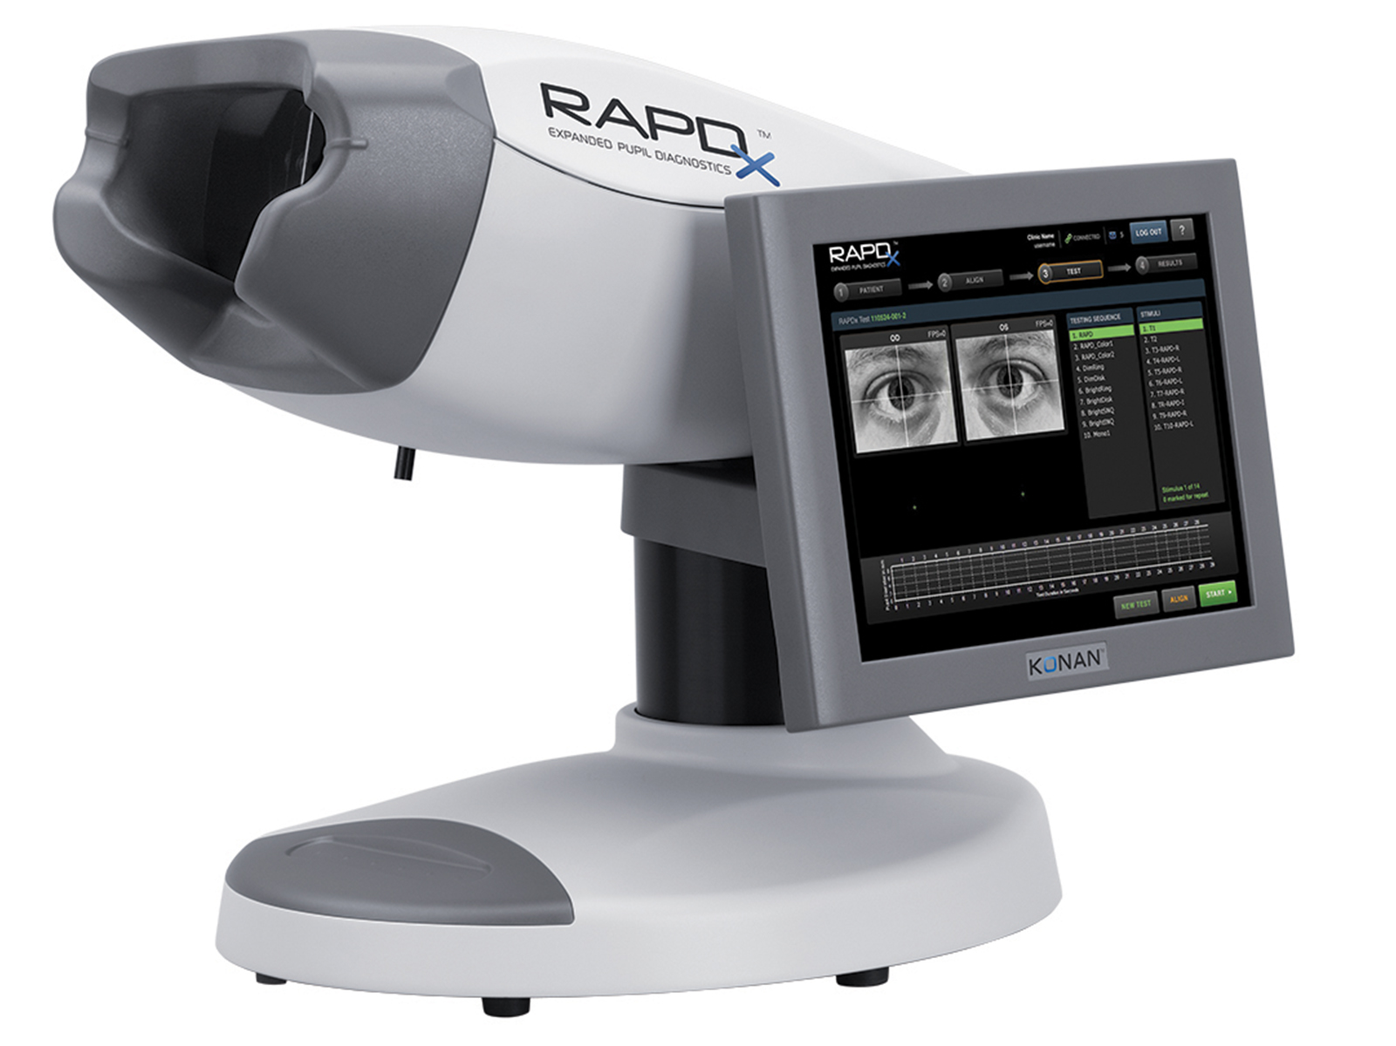

Commercial pupillometry devices

Slide 31
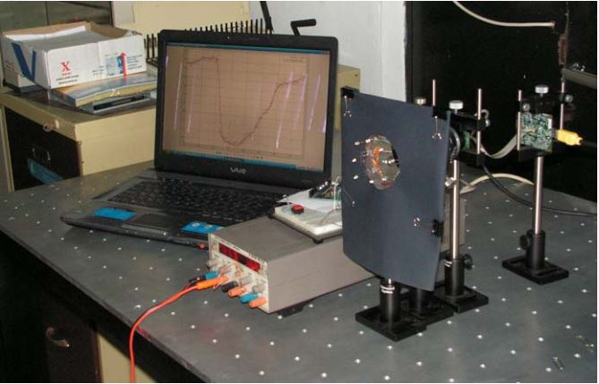
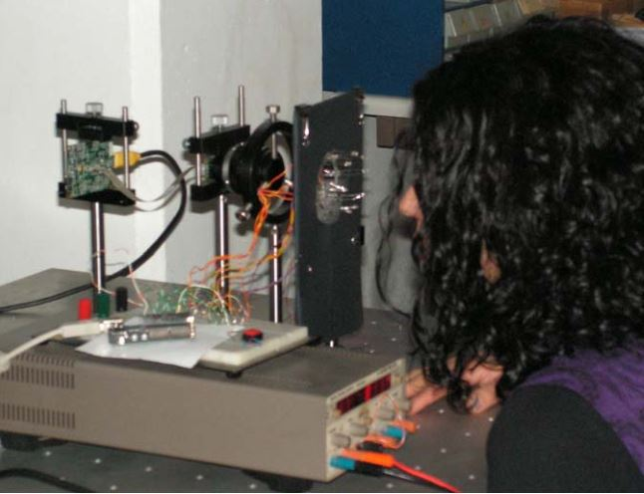
Experimental pupillometry devices (1/2)

Slide 32
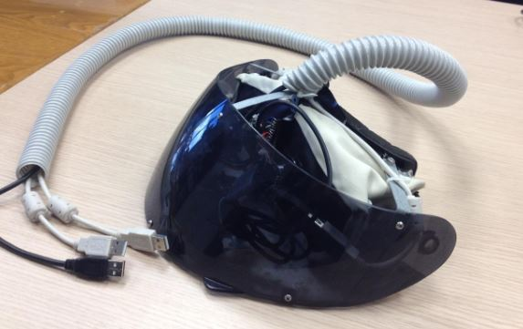
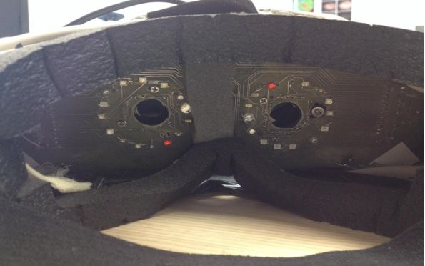
Experimental pupillometry devices (2/2)

Slide 33
Multi-Wavelength Dynamic Imaging of the Pupillary Photomotor Reflex
Outline
1. Biological View
2. Pupillography till today
3. Device instrumentation
4. Software Development
5. Conclusion and future work

Slide 34
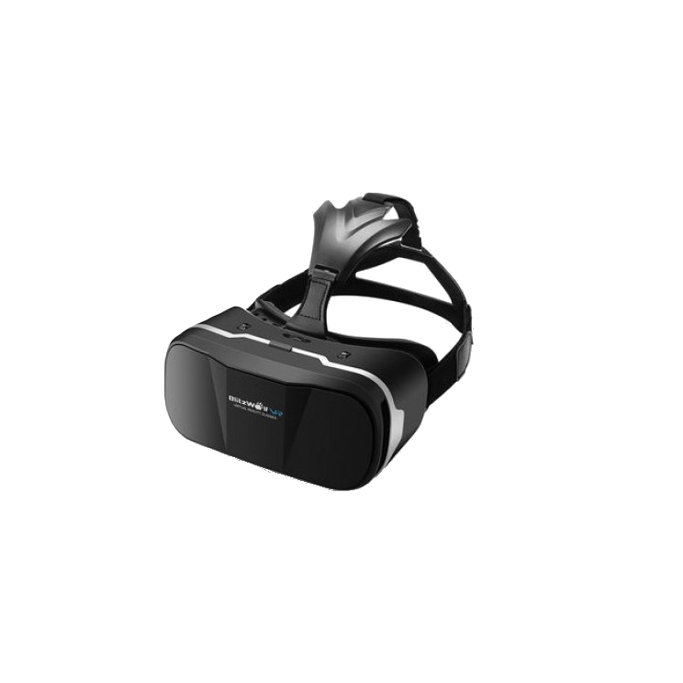
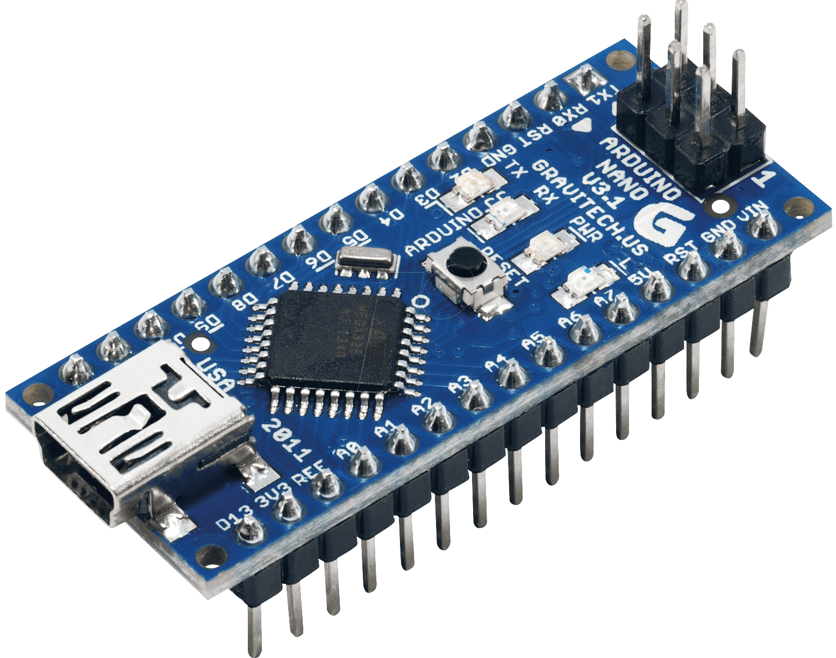
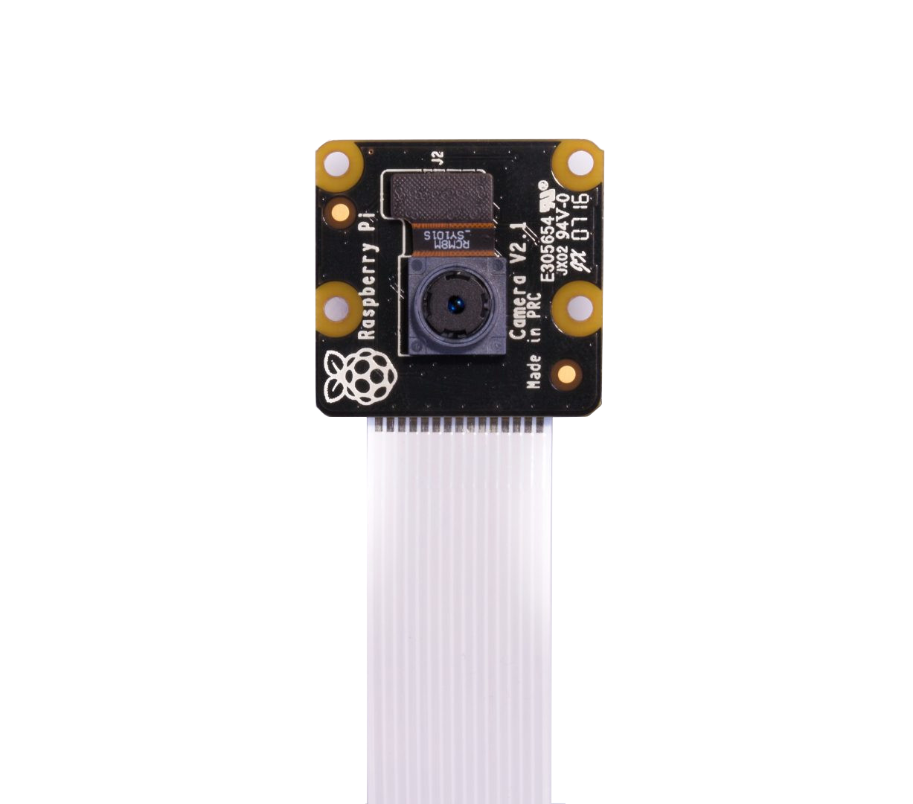
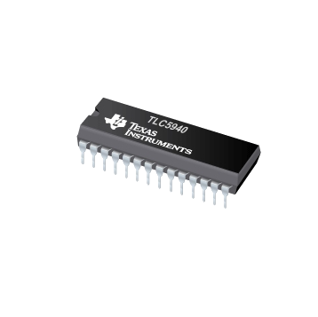
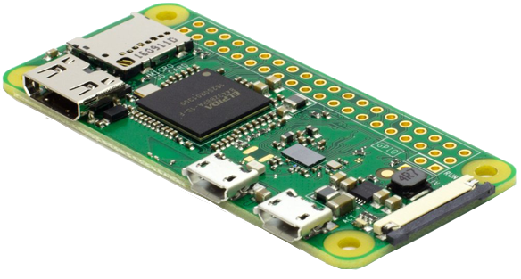
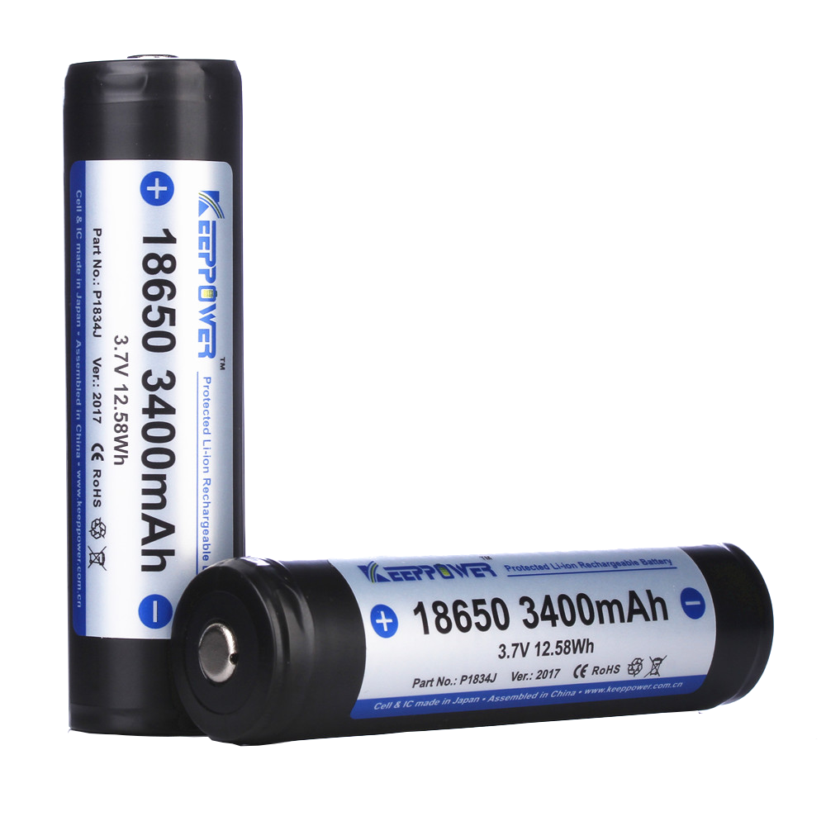
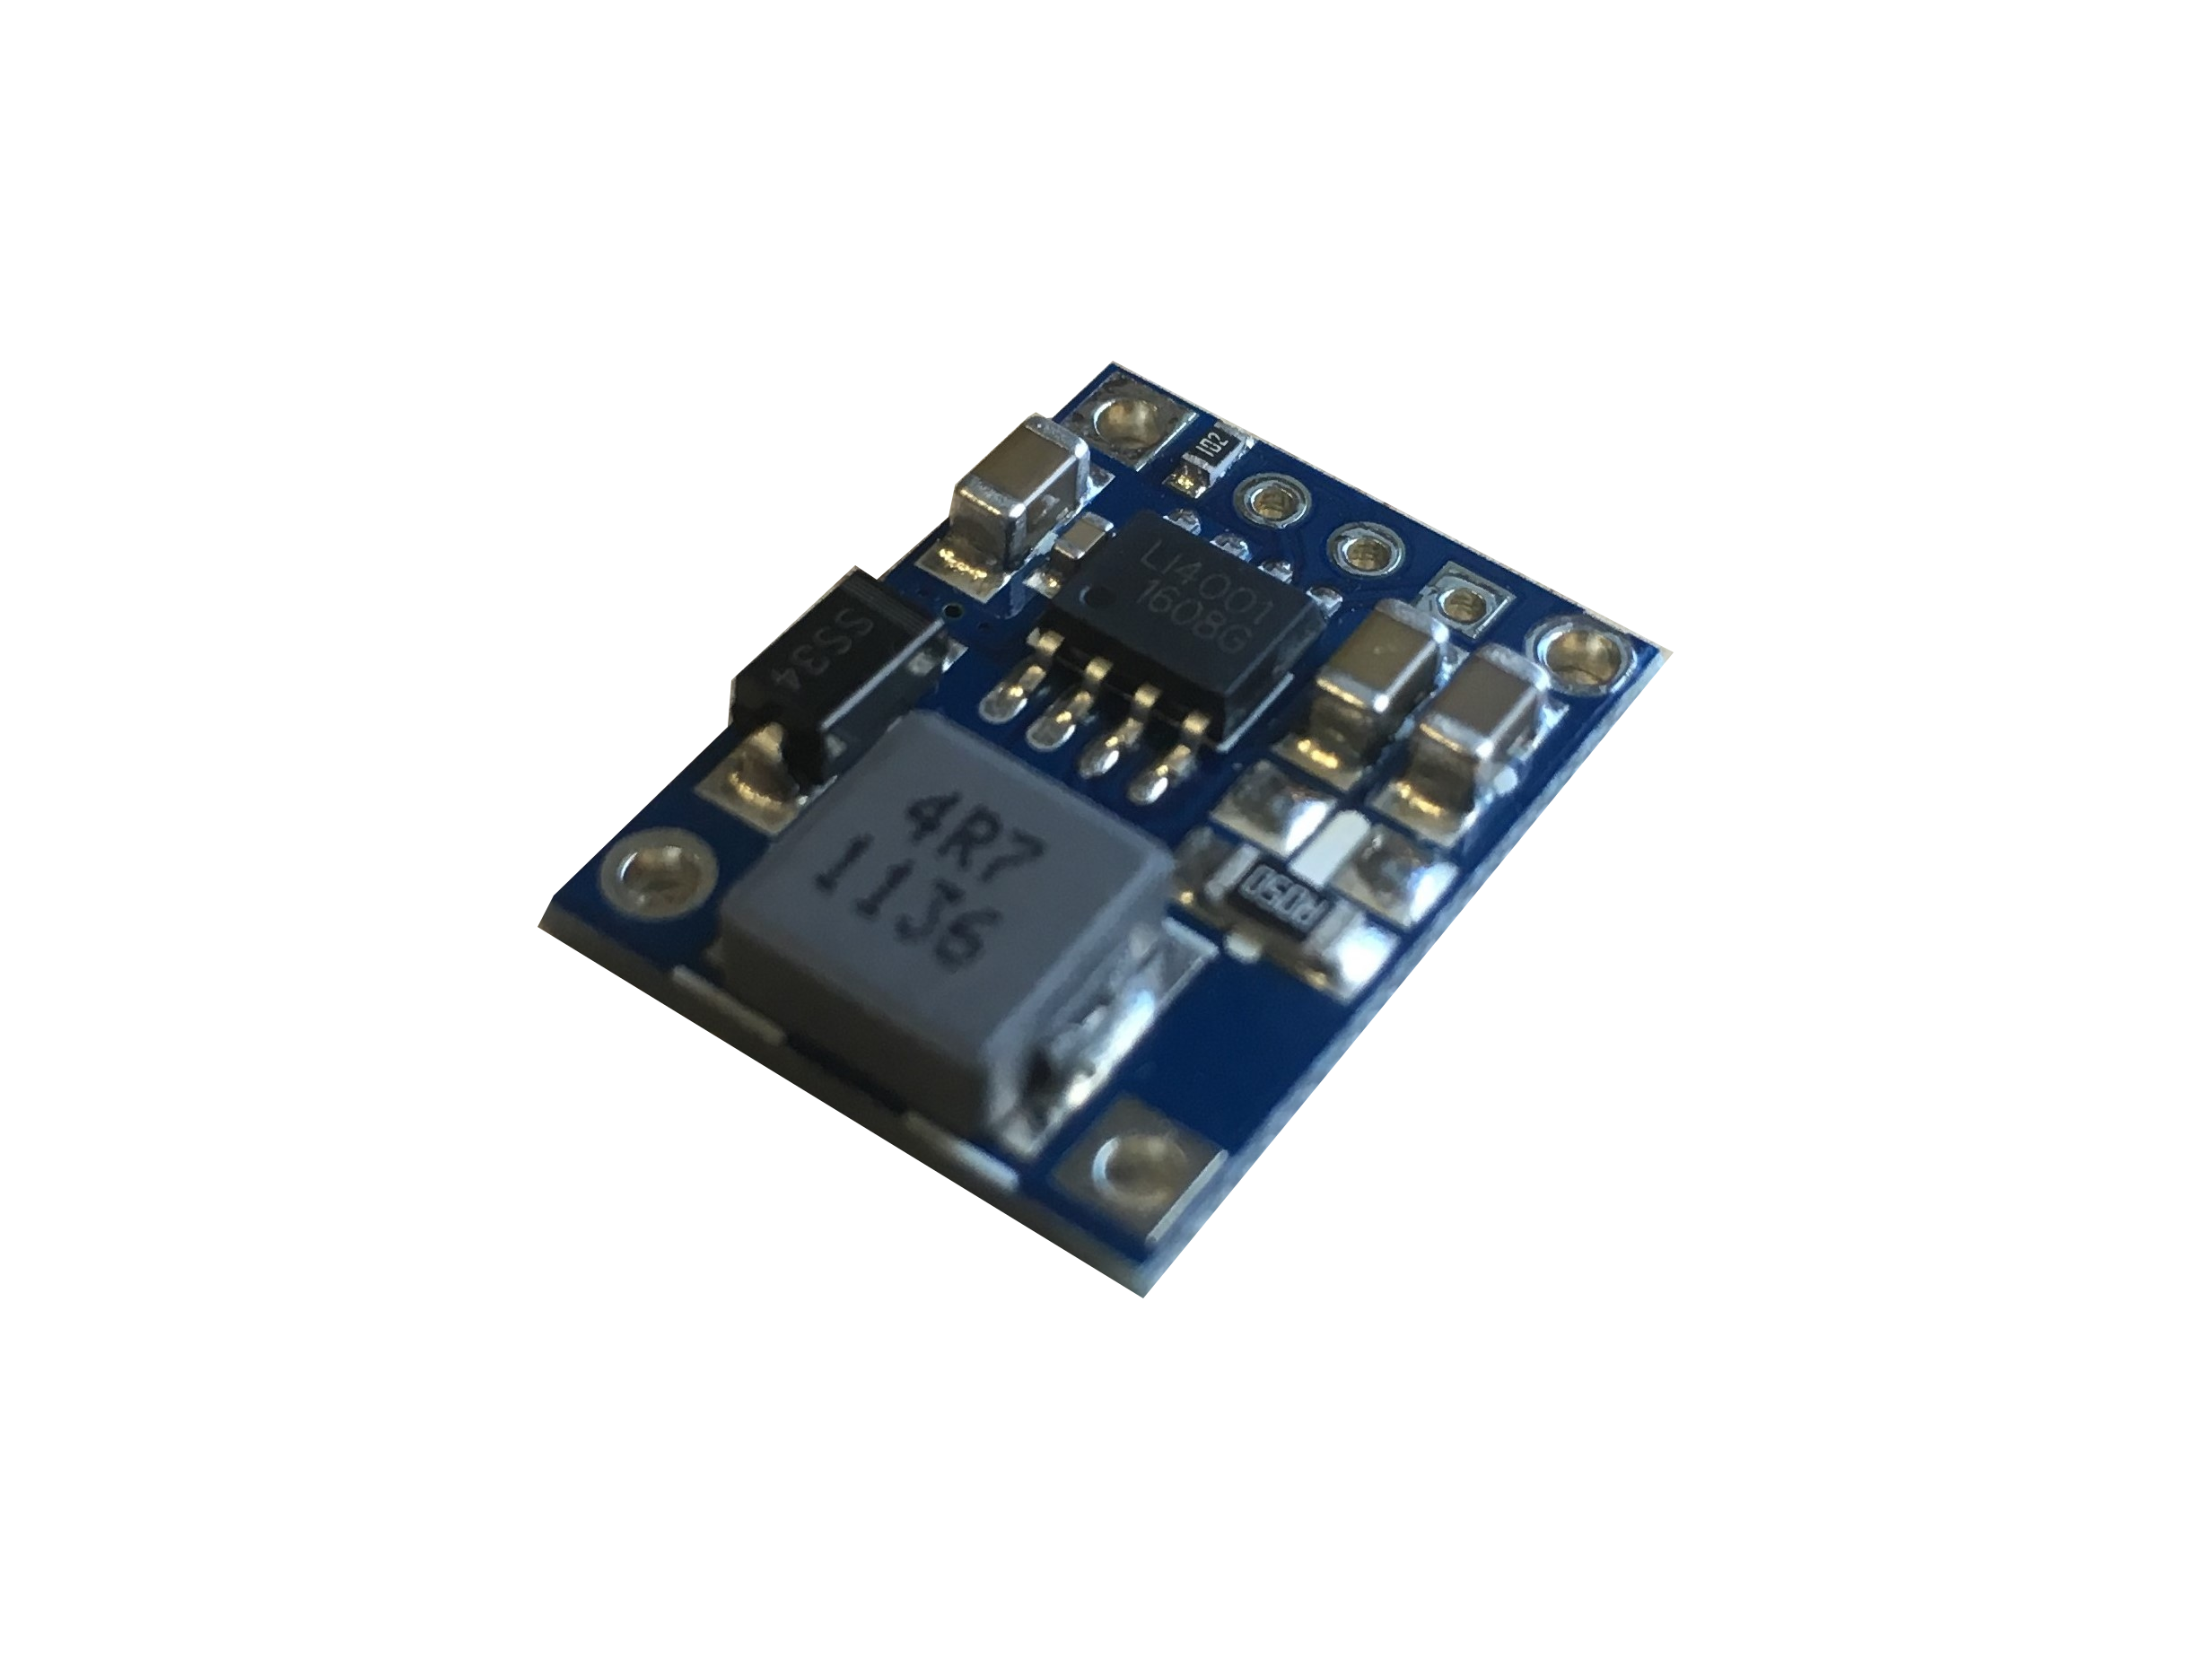
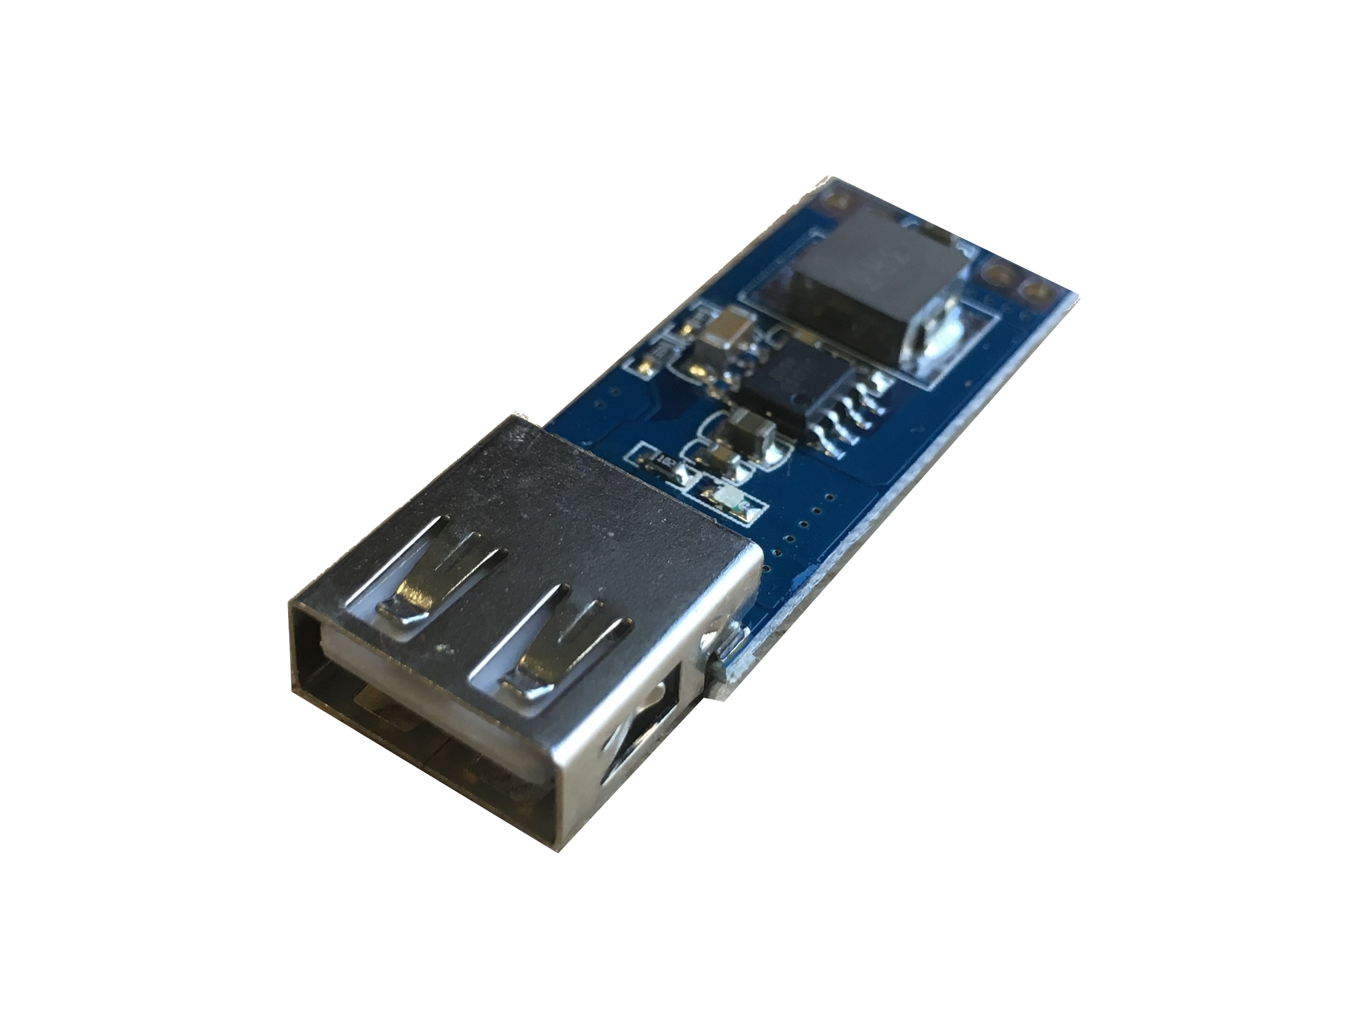
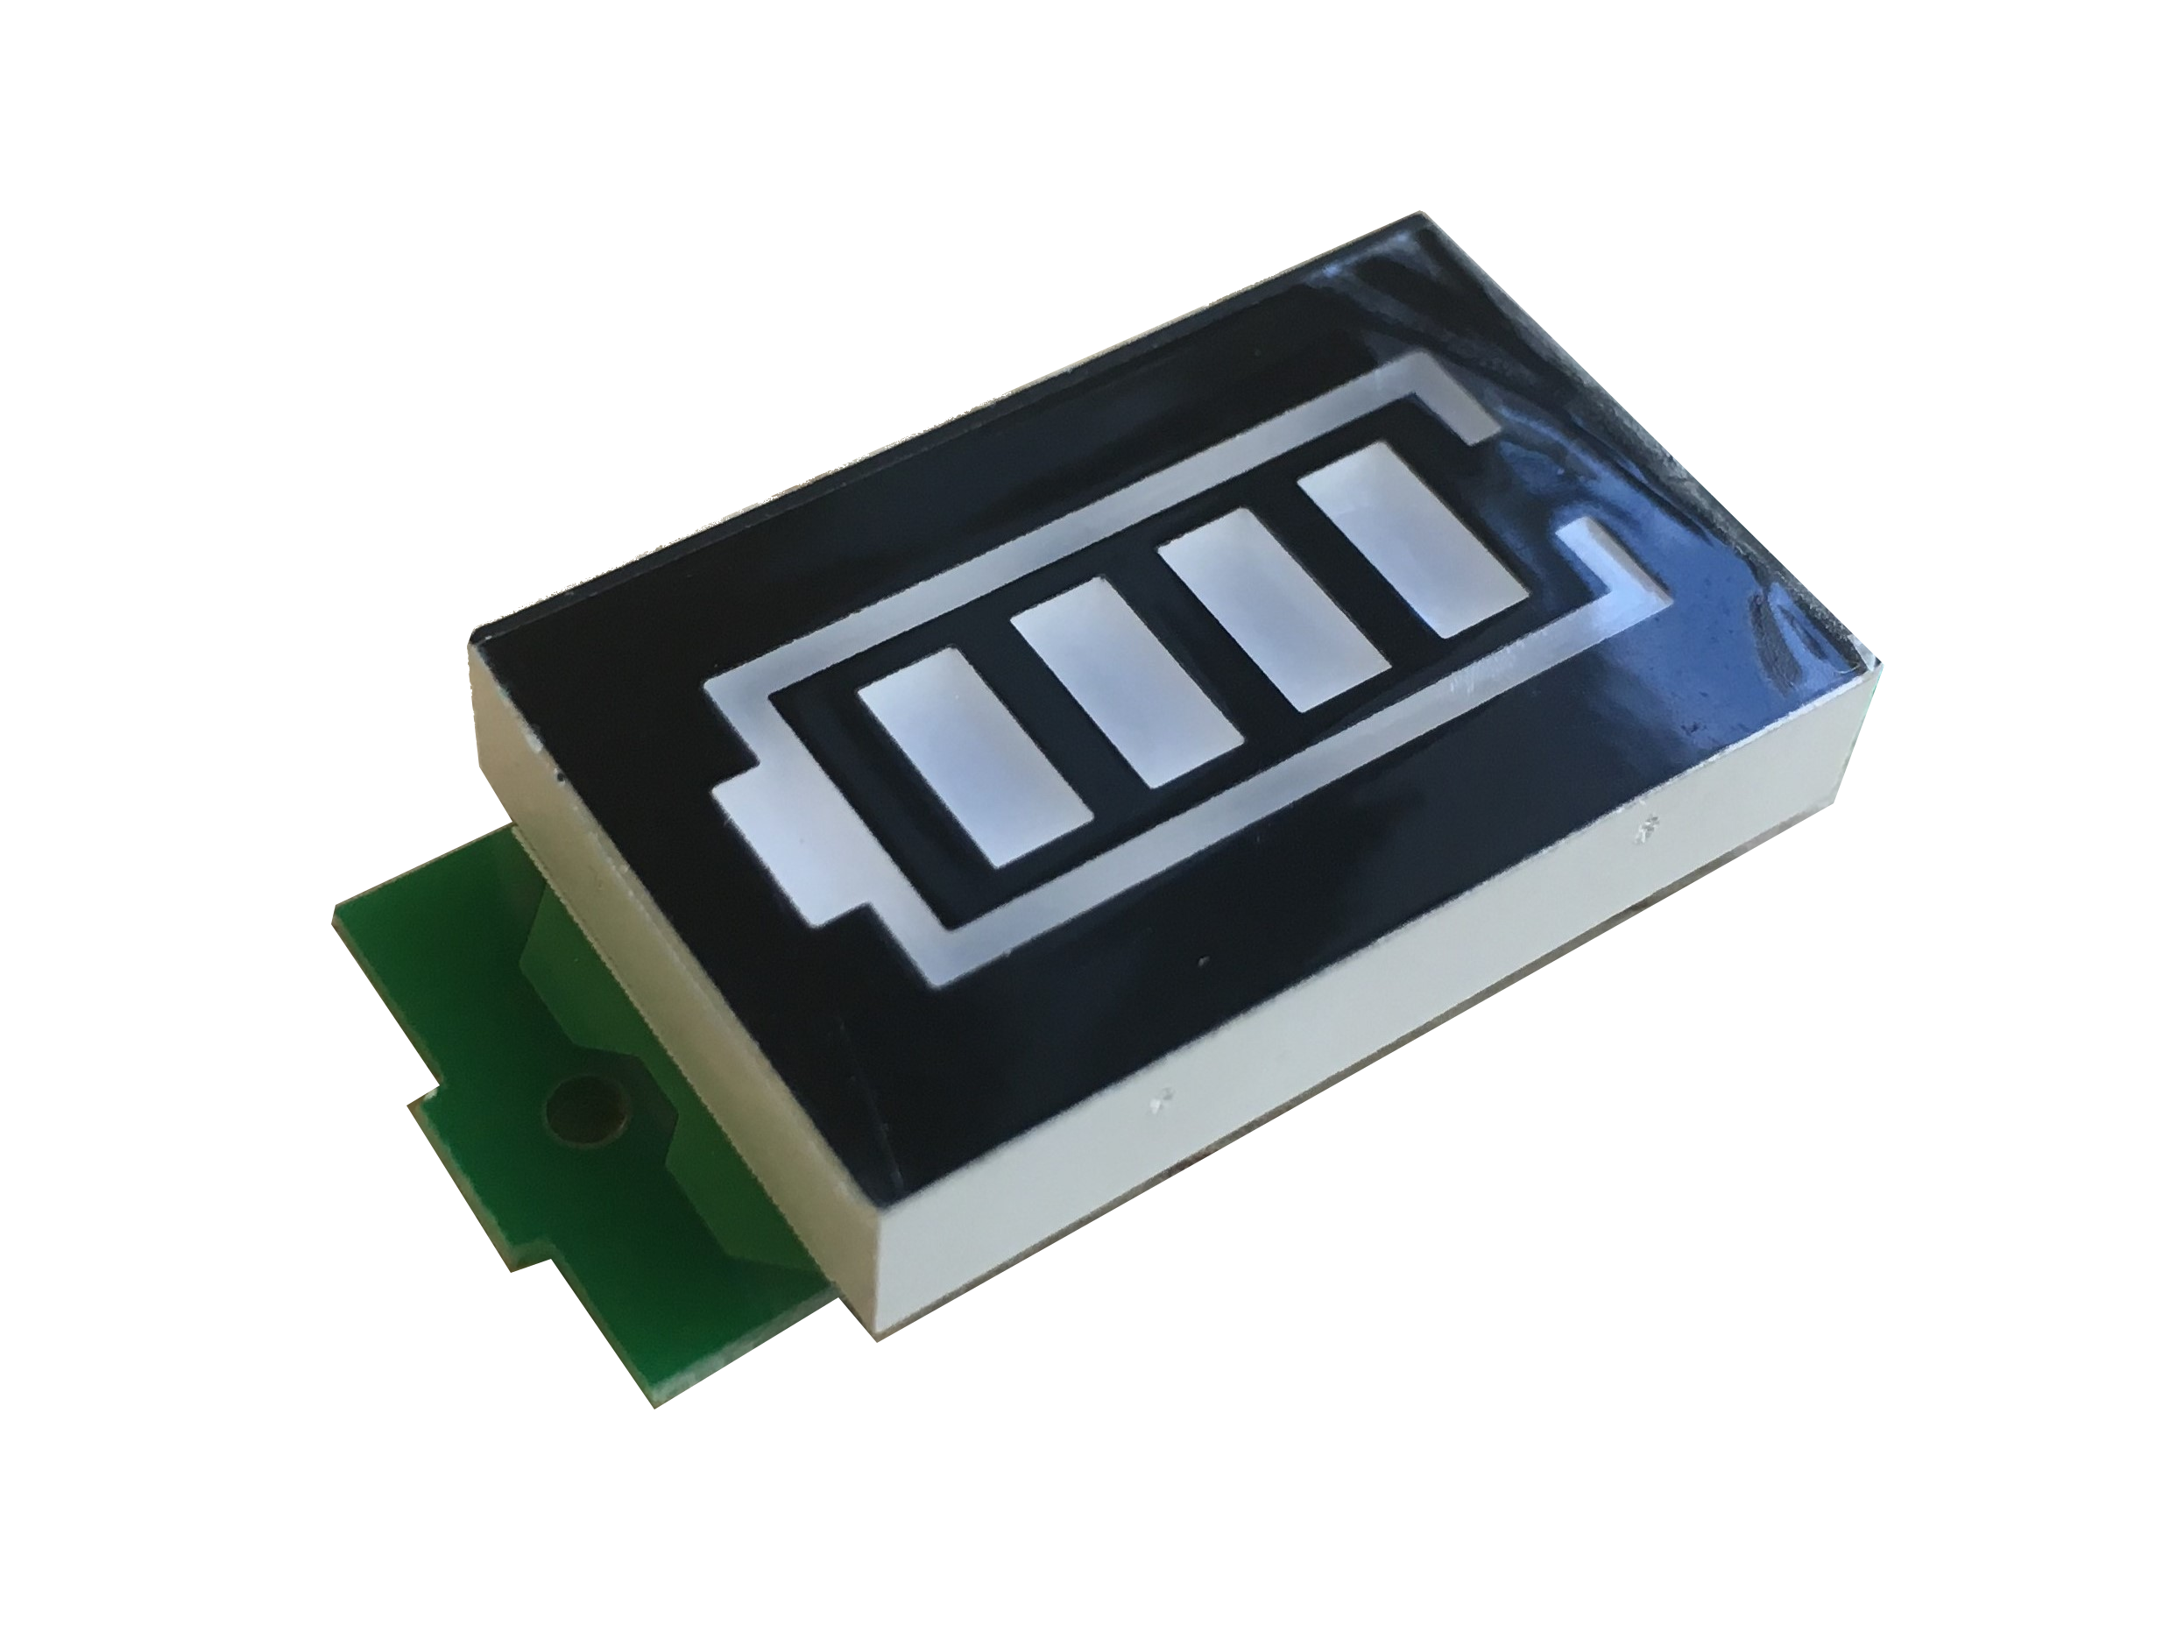
Device instrumentation

Slide 35
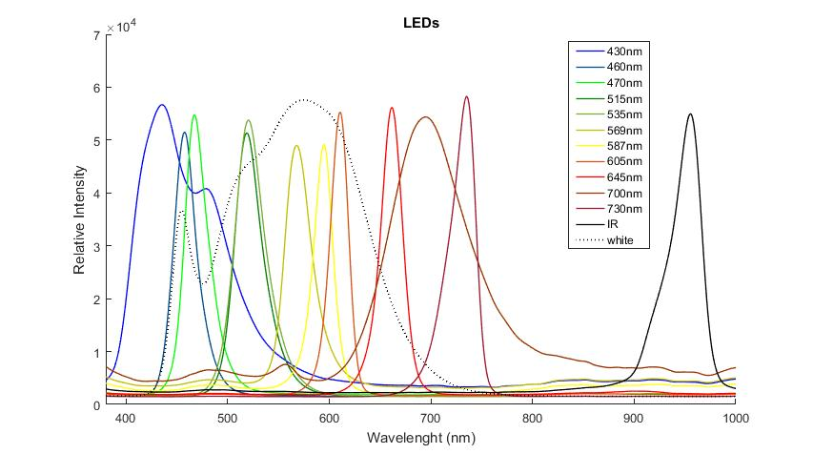
Device instrumentation
Stimulation and IR LEDs

Slide 36
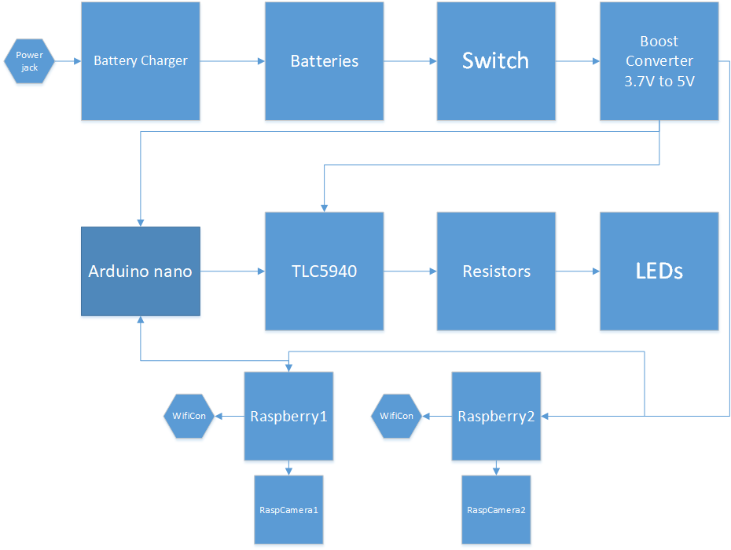
Device instrumentation
Schematic block diagram of all components

Slide 37
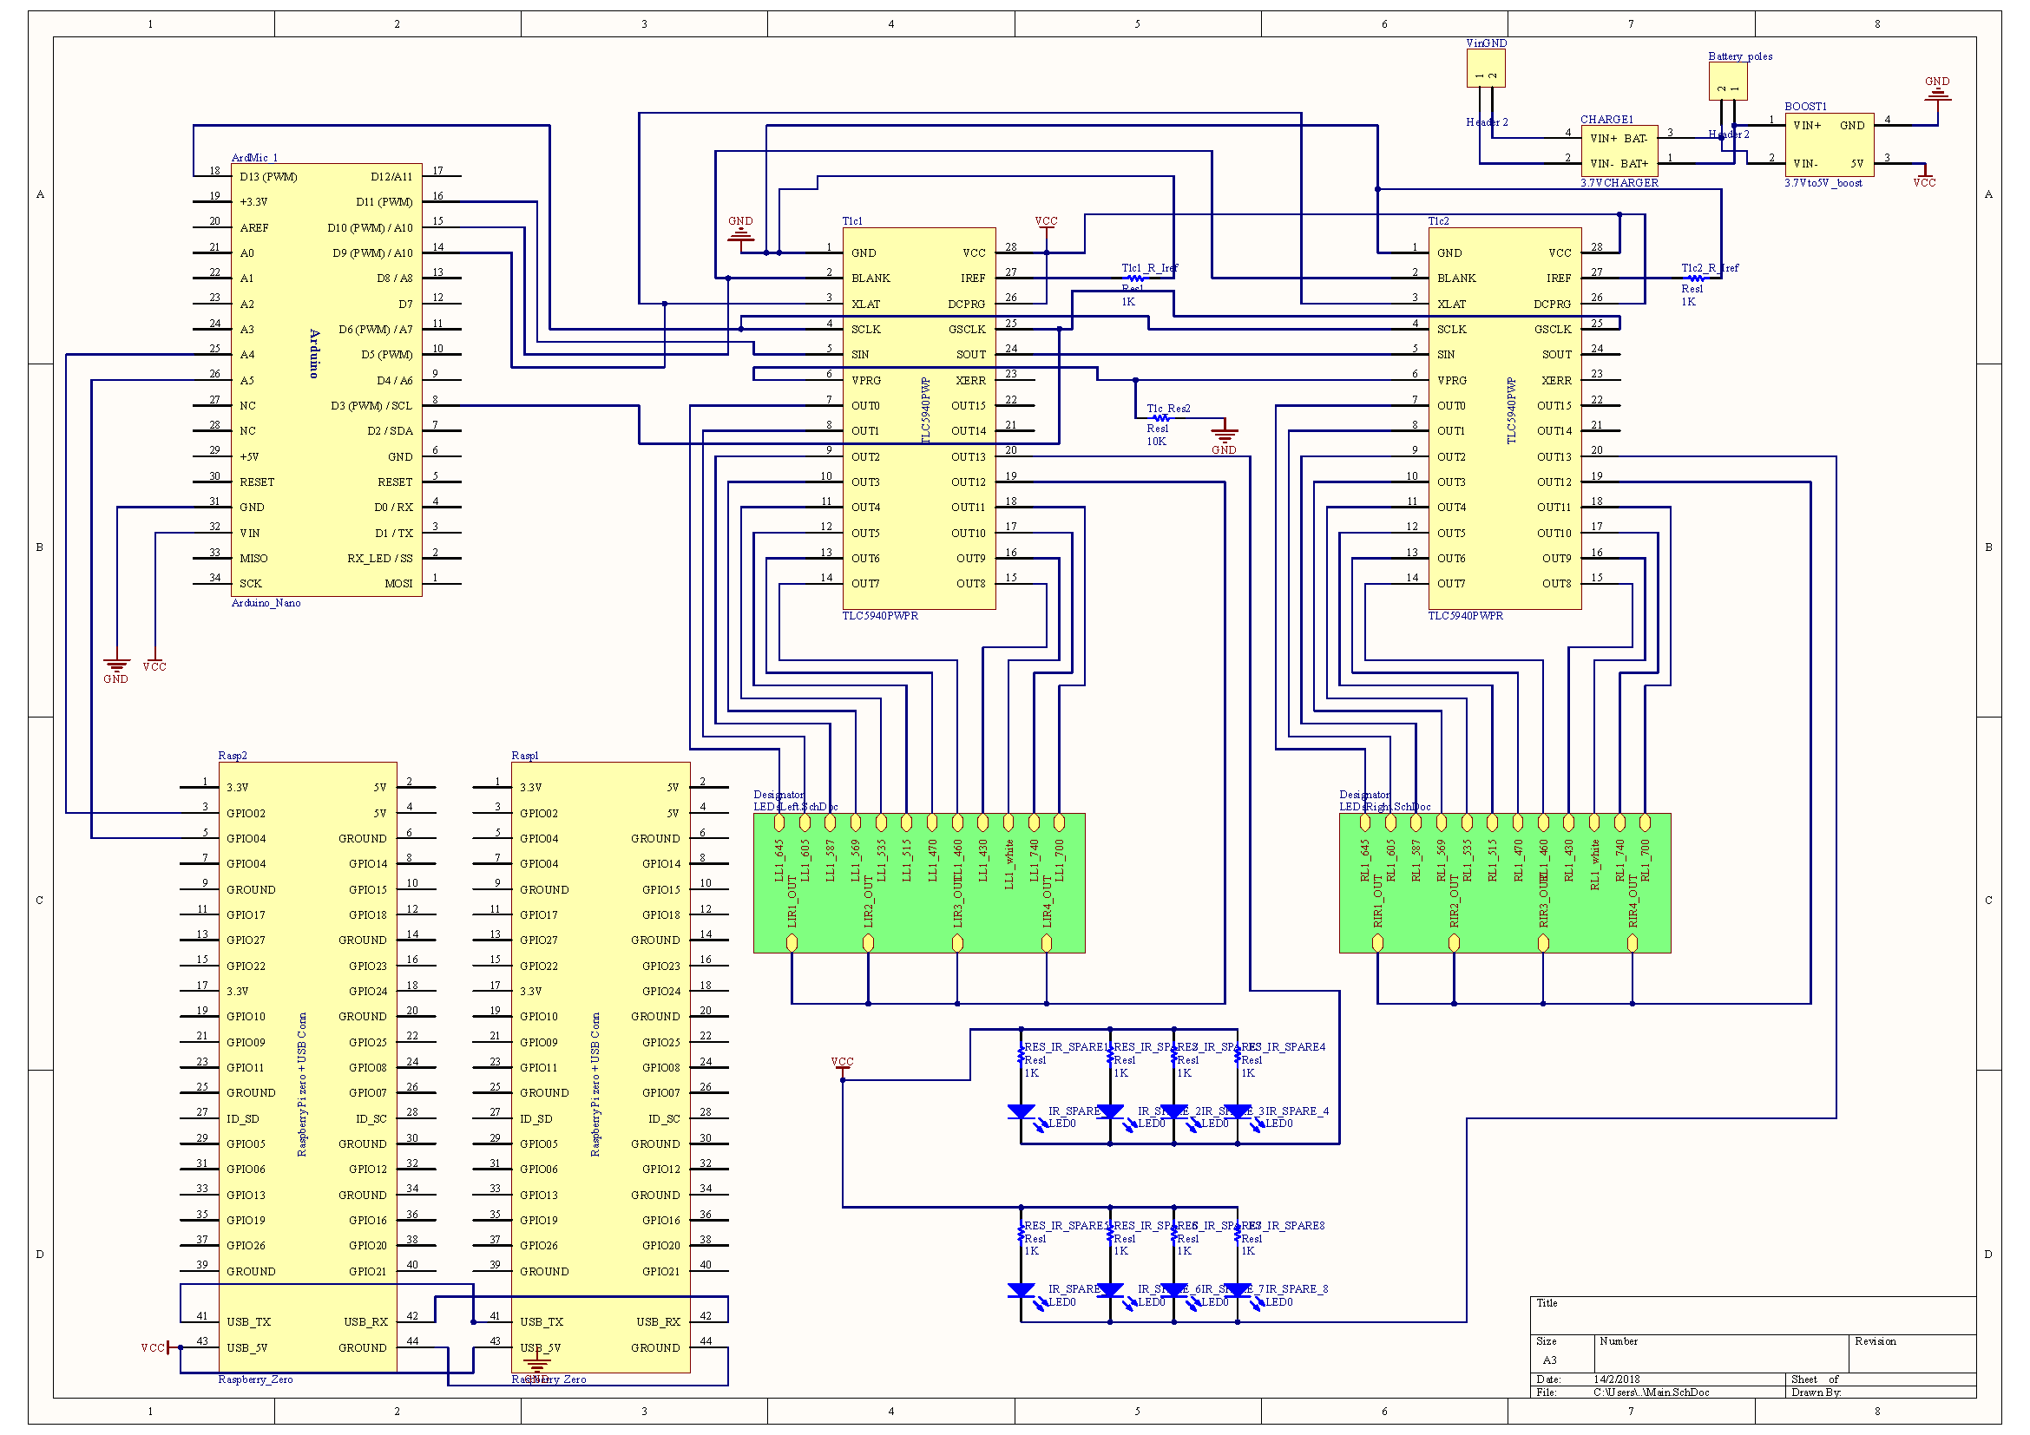
Device instrumentation

Slide 38
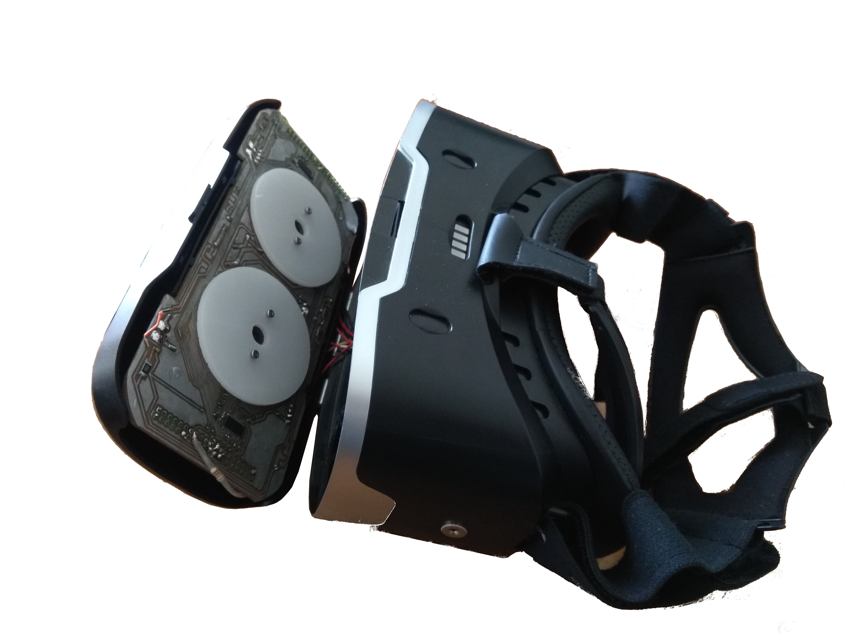
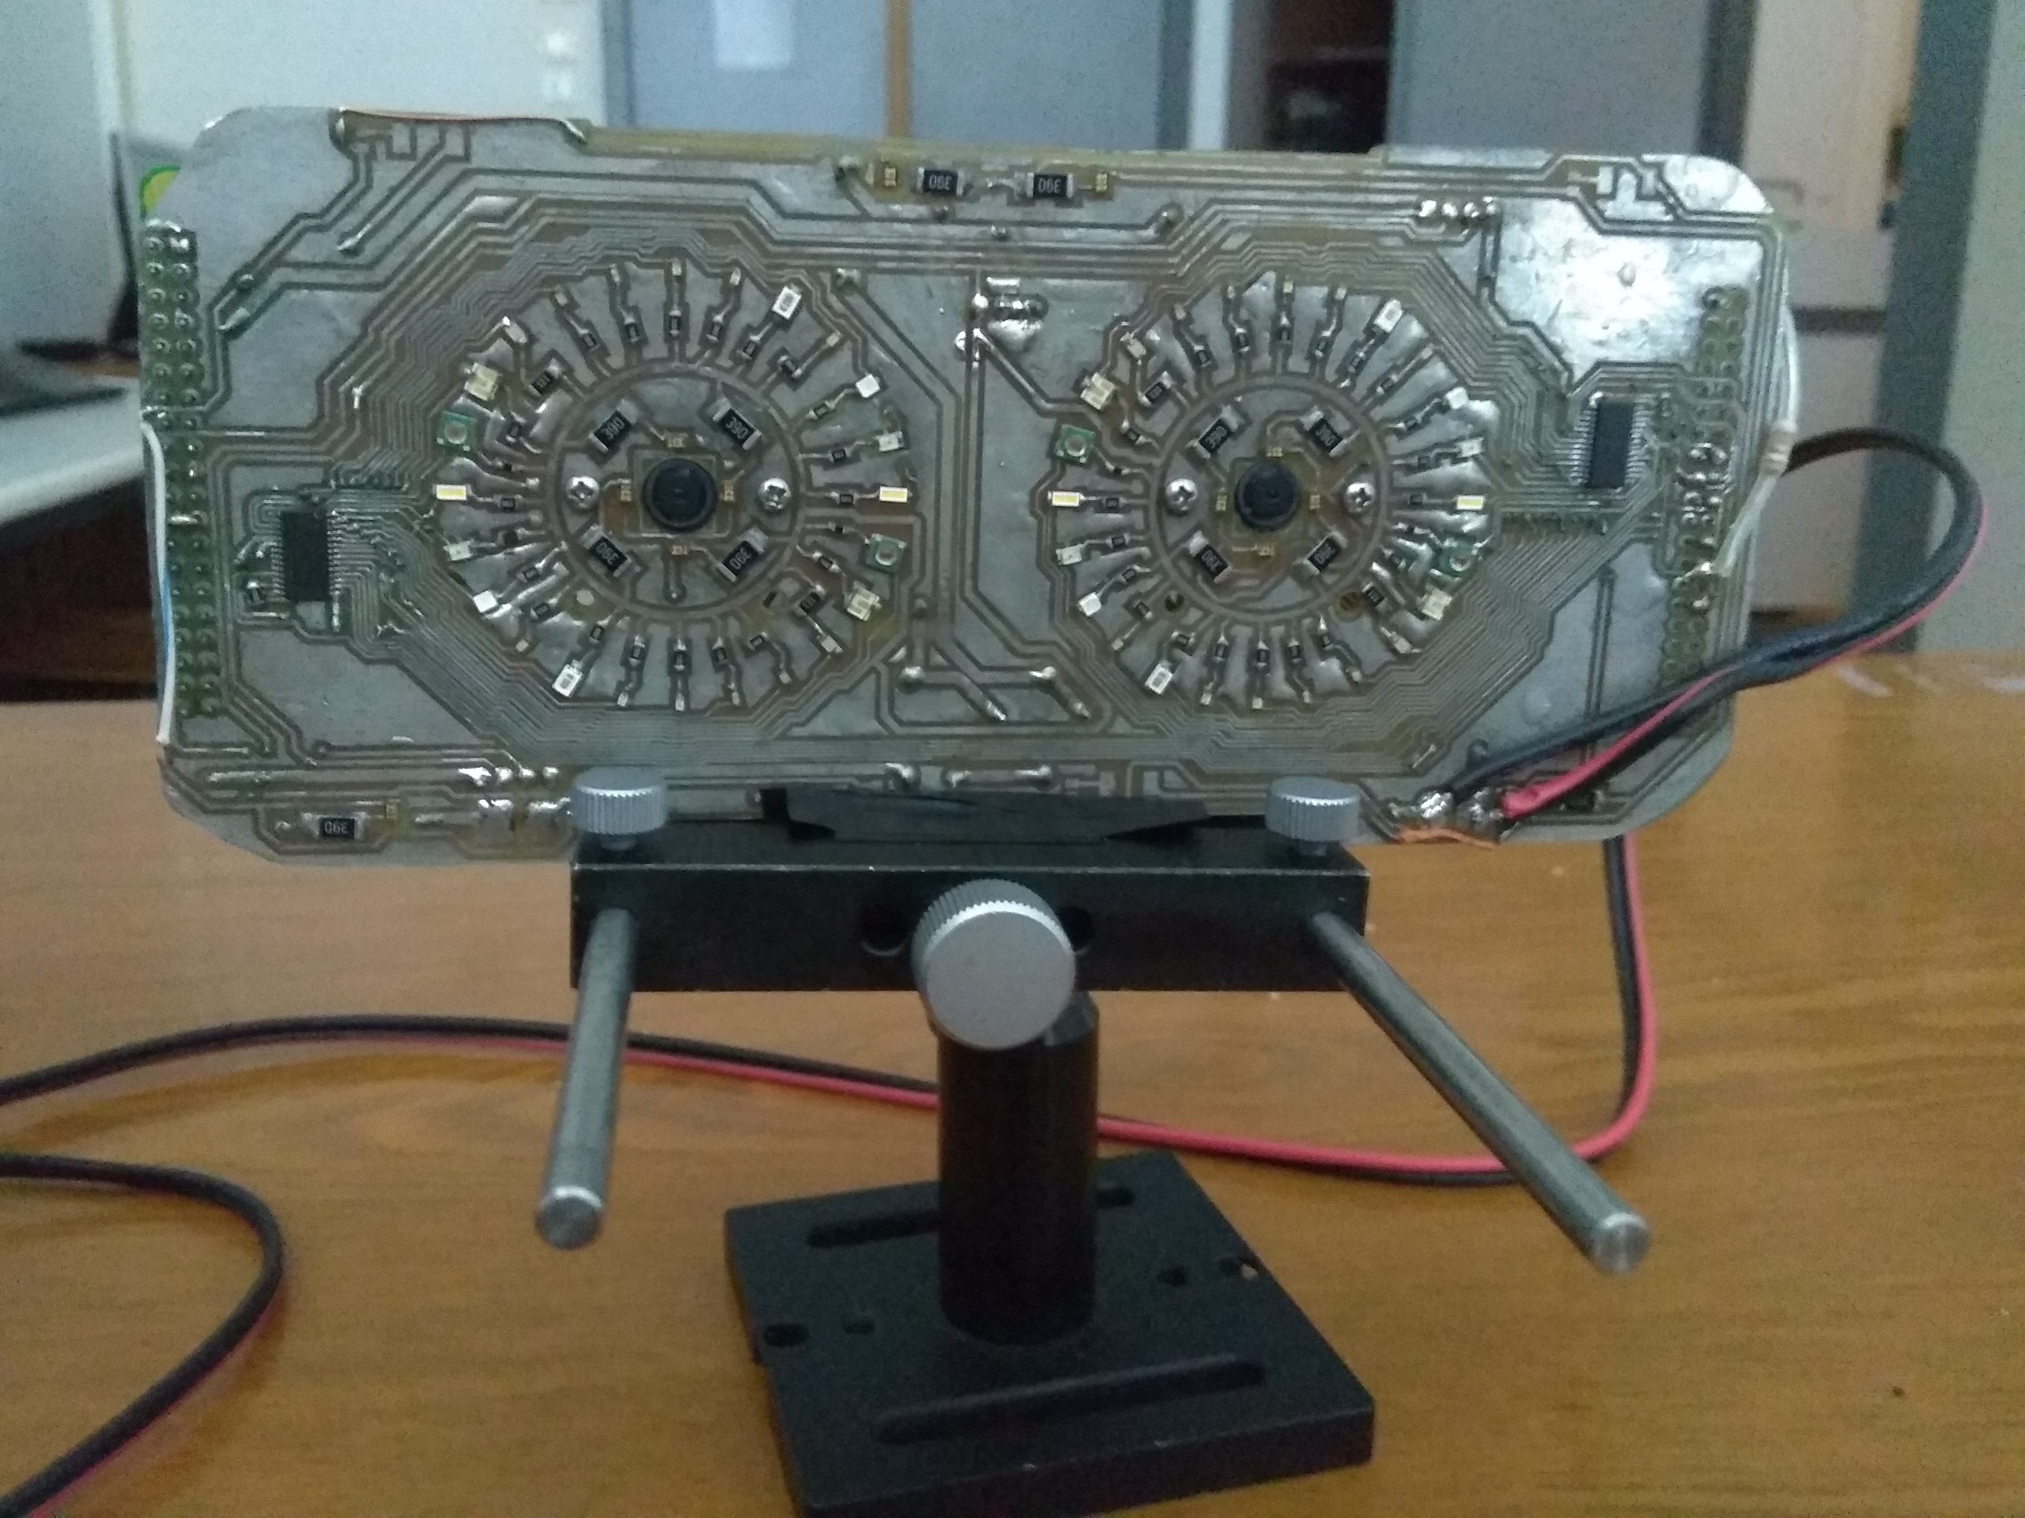
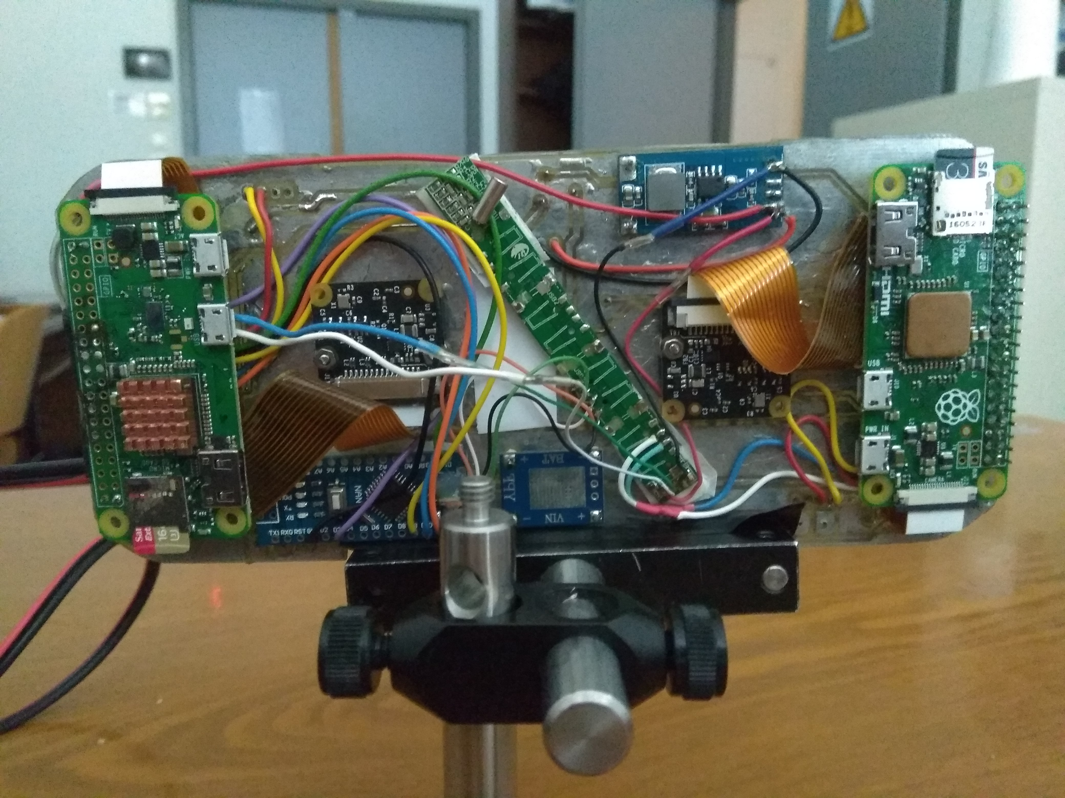


Device instrumentation

Slide 39
Multi-Wavelength Dynamic Imaging of the Pupillary Photomotor Reflex
Outline
1. Biological View
2. Pupillography till today
3. Device instrumentation
4. Software Development
5. Conclusion and future work

Slide 40
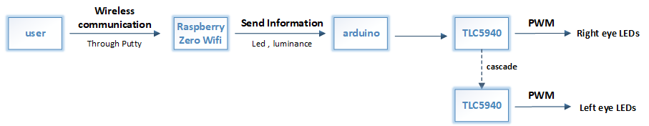
Software Development
LEDs driving algorithm

Slide 41
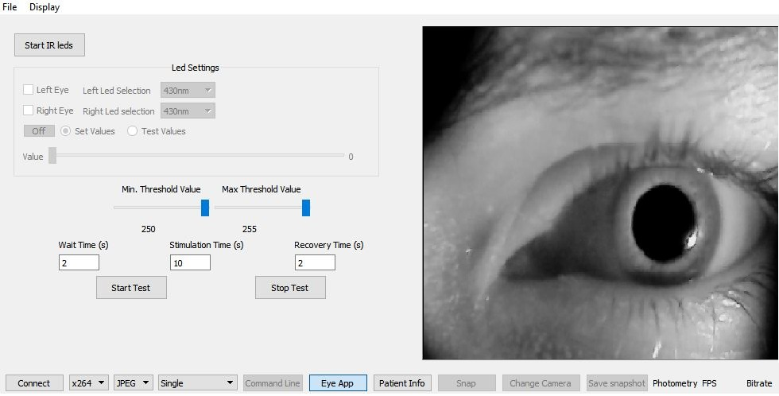
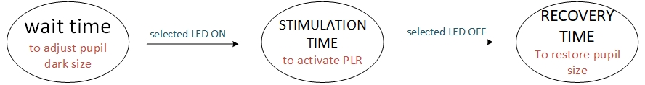

Software Development
Qt GUI and layouts

Slide 42
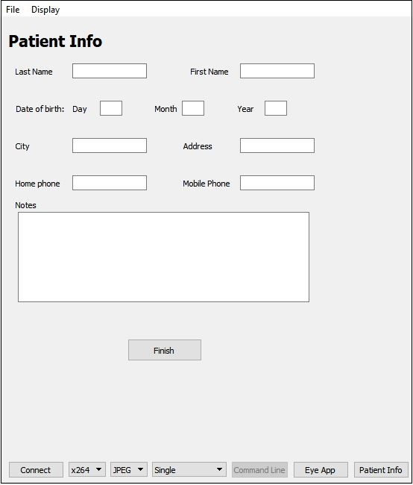
Software Development

Slide 43

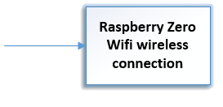
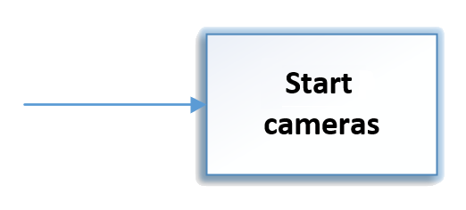
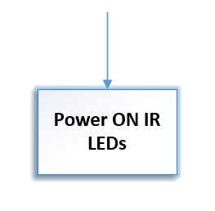
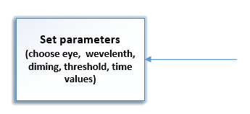
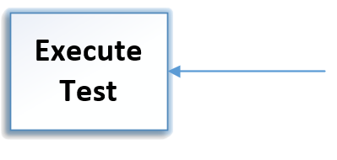



Software Development

Slide 44
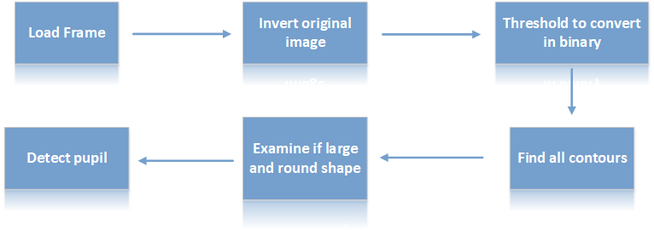
Software Development
Pupil measurement algorithm

Slide 45
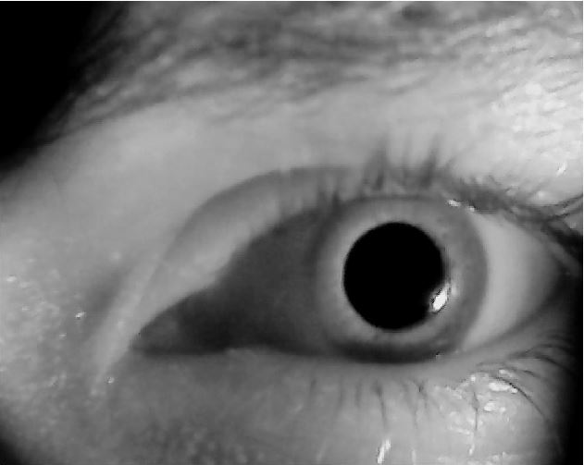
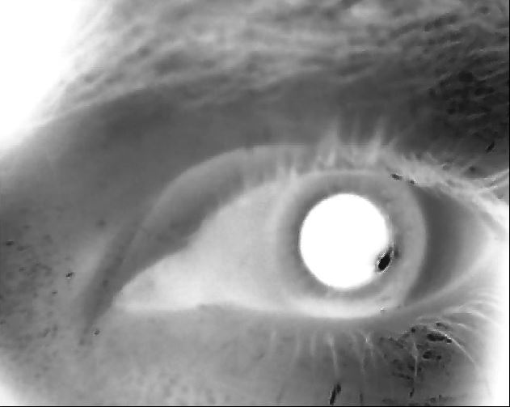


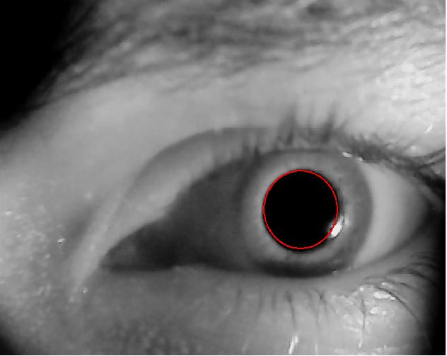
Software Development

Slide 46
Algorithm evaluation

Slide 47
Multi-Wavelength Dynamic Imaging of the Pupillary Photomotor Reflex
Outline
1. Biological View
2. Pupillography till today
3. Device instrumentation
4. Software Development
5. Conclusion and future work

Slide 48
Conclusion
Advantages of the developed system:
  Low cost
  Compact embeded system
  Size minimization
  Lightweight
  Wireless
  Fast examination time

Slide 49
Conclusion
Pupillometry is a non-intrusive method which can expunge the subjective estimation
Provides timely diagnosis of a wide variety of pathologies and psychosomatic cases
Ease of use from a non specialized in engineering user

Slide 50
Future work
Real time localization and pupil estimation
Elicit significant parameters that could determine the behavior of the photomotor reflex
Involve data analysis on larger and more socio-demographically diverse population samples
Connection between pupillary reflexes and awareness, cognitive and sentimental condition of a human

Slide 51

Multi-Wavelength Dynamic Imaging of the Pupillary Photomotor Reflex

