Slide 1
12770 – Predictive Thermal Comfort Management for Dynamically Occupied Spaces
Group 5: Tanghao Chen, Yizhen Xu, Zexi Yin
12770- Special Topics: Autonomous Sustainable Buildings: From Theory to Practice

Slide 2
The problem we are solving
Problem Statement：
Under low-cost, single-point sensor conditions, can historical temperature and humidity time-series characteristics be used to predict thermal discomfort events in semi-public spaces (such as study rooms) where personnel density dynamically changes?
Why it matters:
Discomfort from heat affects concentration and learning efficiency.
Existing conventional solutions (manual adjustments) are slow to respond, inconsistent, and non-quantifiable.
The Sense-Plan-Act Gap:
 | Current Situation | Problem
Sense | Human Perception of Heat/Cold | Lag, subjective
Plan | Make decision based on experience | No prediction, random
Act | Manual adjustment
Objective: We plan to develop a low-cost system (combining low-cost sensors with machine learning technology) that can predict rising temperatures in study rooms before they reach uncomfortable levels—that is, before people even notice—and automatically propose corrective measures

Slide 3
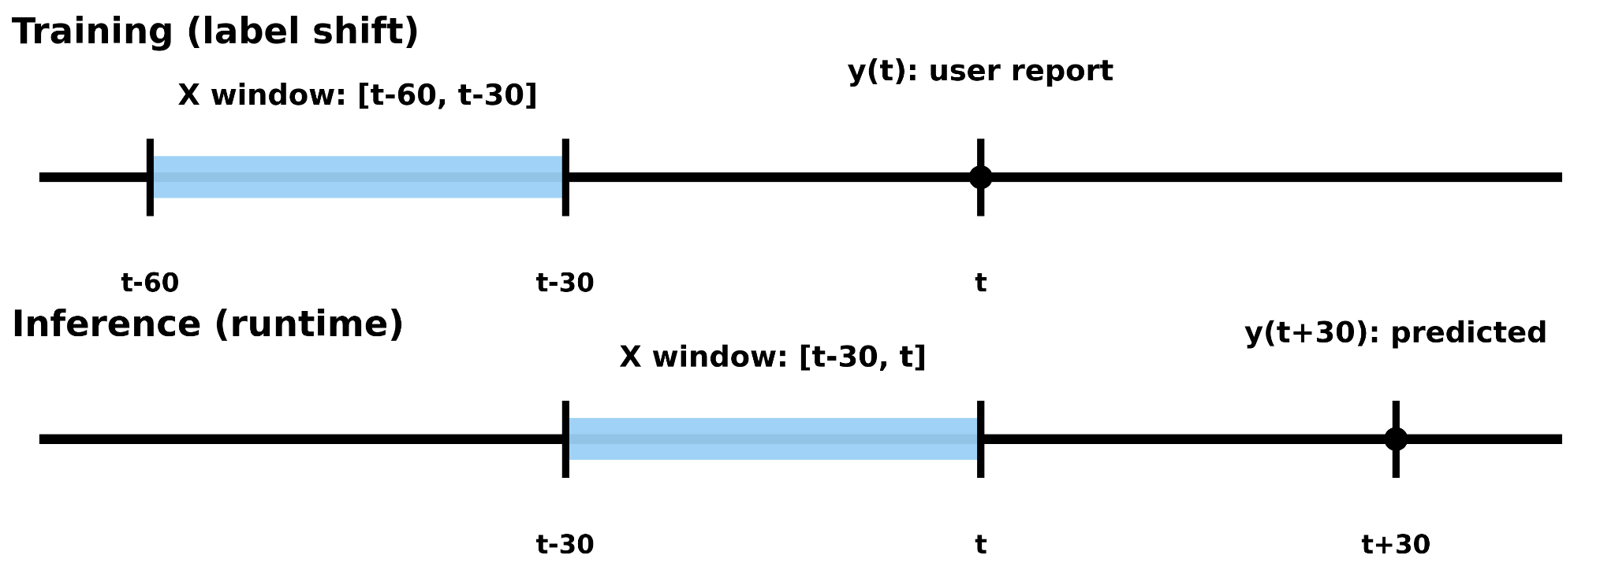
Proposed Solution
ZBT-2
Connect via Matter/Thread
IKEA TIMMERFLOTTE
Sense T, RH
Home Assistant Green
Log time-stamped history
Input (X):
30-min window features
T, RH, t, ΔT_30, ΔRH_30
Data Pipeline:
Output (y):
User report at t
hot/stuffy: y = 1
Otherwise: y = 0
Training Dataset:
Features + Labels
X ([t-60, t-30]) + y (t)
Study Room User Feedback (QR Code)
Model:
Train Logistic Regression / XGBoost
Model Output: p = P ( y (t + 30) = 1 ∣ X ([t-30, t]) ) – discomfort risk in next 30 min
Plan: Map p → Low / Mid / High
Action:
If High risk → Push alert (HA Voice announcement)
Standard guidance: AC strong airflow for 10 mins + avoid frequent window open/close

Slide 4
System Validation & Evaluation Framework
1. Two-Week A/B Testing
Week 1 (Baseline): Logging data only; no system intervention.
Week 2 (Intervention): Active control + proactive AI prompts.
Metric: Reduction in manual adjustments & discomfort duration.
2. Offline Model Validation
Method: Time-series split (Train: first 10 days / Test: last 4 days).
Task: Predict discomfort events 30 minutes in advance.
Goal: High precision and recall in environmental forecasting.
3. Ground Truth Calibration
Sampling: Subjective feedback 3 times daily (Morning/Noon/Night).
Purpose: Verify sensor accuracy vs. human perception
4. Energy Efficiency Analysis
Monitoring: Real-time power tracking via smart plugs.
Metric: Energy saved per "Comfort Hour."
Goal: Optimize HVAC cycles without sacrificing comfort.

Slide 5
Excepted Challenges
Hardwares
The placement of sensor may affects data quality.
Single-point sensors have limited representativeness.
Data Collection
Collect data consistently over a continuous period (e.g., 2 weeks)
The dataset size may be small, which could affect the model's generalization ability.
Modeling
Risk of Overfitting in Small Datasets
On-premises deployment for real-time reasoning
We are developing optimization strategies for each challenge and expect to manage these challenges within the scope of the project.

