Slide 1
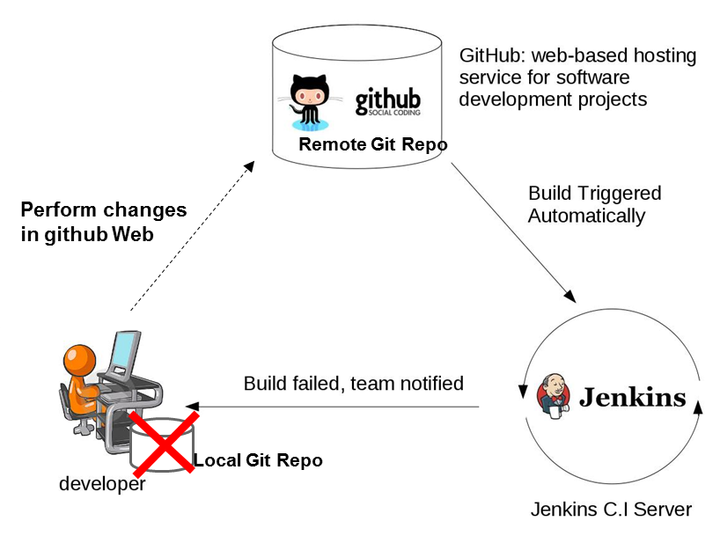
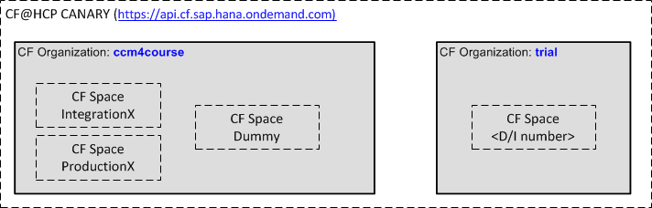

M4 Pilot 1 – Exercises – Supplement Sheet
General Information
Your Jenkins Server: http://localhost:8080/jenkins/
Your CF organisation: ccm4course
Your CF space: IntegrationX, ProductionX
Your App in CF:
http://bulletinboard-ads-integration-<d/i number>.cfapps.sap.hana.ondemand.com/
http://bulletinboard-ads-acceptance-<d/i number>.cfapps.sap.hana.ondemand.com/
http://bulletinboard-ads-production-<d/i number>.cfapps.sap.hana.ondemand.com/
How we work
Overview – CF Organizations and Spaces
CloudFoundry
Advertisement service
push
push
Jenkins TeamX

Slide 2
Appendix

Slide 3
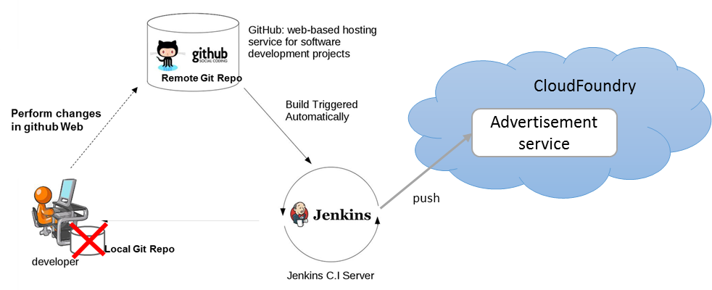
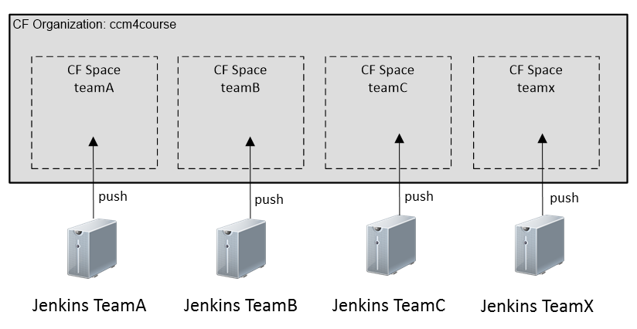
Team A - M4 Pilot – Exercise – Supplement Sheet
General Information
Exercise: https://github.wdf.sap.corp/cc-java-dev/cc-m4-coursematerial/blob/master/M4-Pilot/Exercise.md
Your Jenkins Server: http://veecfseqos001:8080/jenkins/
Your CF organisation: ccm4course
Your CF space: teamA
Your App in CF: http://bulletinboard-ads-teama.cfapps.neo.ondemand.com/api/v1.0/ads/
Exercise Overview
We will create two jobs:
Commit-Job: This job syncs the coding from GitHub, performs the unit tests and build the „war“ file
Deploy-Job: This job deploys the app on CloudFoundry
How we work
Each group:
forks a repository
got its own Jenkins server
works within the same CF organisation
got ist own CF space
will perform coding changes directly on GitHub and not in a local dev environment
will get a common user to deploying the app to CF

Slide 4
Team B - M4 Pilot – Exercise – Supplement Sheet
General Information
Exercise: https://github.wdf.sap.corp/cc-java-dev/cc-m4-coursematerial/blob/master/M4-Pilot/Exercise.md
Your Jenkins Server: http://veecfseqos003:8080/jenkins/
Your CF organisation: ccm4course
Your CF space: teamB
Your App in CF: http://bulletinboard-ads-teamb.cfapps.neo.ondemand.com/api/v1.0/ads/
Exercise Overview
We will create two jobs:
Commit-Job: This job syncs the coding from GitHub, performs the unit tests and build the „war“ file
Deploy-Job: This job deploys the app on CloudFoundry
How we work
Each group:
forks a repository
got its own Jenkins server
works within the same CF organisation
got ist own CF space
will perform coding changes directly on GitHub and not in a local dev environment
will get a common user to deploying the app to CF

Slide 5
Team C - M4 Pilot – Exercise – Supplement Sheet
General Information
Exercise: https://github.wdf.sap.corp/cc-java-dev/cc-m4-coursematerial/blob/master/M4-Pilot/Exercise.md
Your Jenkins Server: http://veecfseqos007:8080/jenkins/
Your CF organisation: ccm4course
Your CF space: teamC
Your App in CF: http://bulletinboard-ads-teamc.cfapps.neo.ondemand.com/api/v1.0/ads/
Exercise Overview
We will create two jobs:
Commit-Job: This job syncs the coding from GitHub, performs the unit tests and build the „war“ file
Deploy-Job: This job deploys the app on CloudFoundry
How we work
Each group:
forks a repository
got its own Jenkins server
works within the same CF organisation
got ist own CF space
will perform coding changes directly on GitHub and not in a local dev environment
will get a common user to deploying the app to CF

Slide 6
Team D - M4 Pilot – Exercise – Supplement Sheet
General Information
Exercise: https://github.wdf.sap.corp/cc-java-dev/cc-m4-coursematerial/blob/master/M4-Pilot/Exercise.md
Your Jenkins Server: http://veecfseqos010:8080/jenkins/
Your CF organisation: ccm4course
Your CF space: teamD
Your App in CF: http://bulletinboard-ads-teamd.cfapps.neo.ondemand.com/api/v1.0/ads/
Exercise Overview
We will create two jobs:
Commit-Job: This job syncs the coding from GitHub, performs the unit tests and build the „war“ file
Deploy-Job: This job deploys the app on CloudFoundry
How we work
Each group:
forks a repository
got its own Jenkins server
works within the same CF organisation
got ist own CF space
will perform coding changes directly on GitHub and not in a local dev environment
will get a common user to deploying the app to CF

Slide 7
Team E - M4 Pilot – Exercise – Supplement Sheet
General Information
Exercise: https://github.wdf.sap.corp/cc-java-dev/cc-m4-coursematerial/blob/master/M4-Pilot/Exercise.md
Your Jenkins Server: http://veecfseqos013:8080/jenkins/
Your CF organisation: ccm4course
Your CF space: teamE
Your App in CF: http://bulletinboard-ads-teame.cfapps.neo.ondemand.com/api/v1.0/ads/
Exercise Overview
We will create two jobs:
Commit-Job: This job syncs the coding from GitHub, performs the unit tests and build the „war“ file
Deploy-Job: This job deploys the app on CloudFoundry
How we work
Each group:
forks a repository
got its own Jenkins server
works within the same CF organisation
got ist own CF space
will perform coding changes directly on GitHub and not in a local dev environment
will get a common user to deploying the app to CF

Slide 8
Team F - M4 Pilot – Exercise – Supplement Sheet
General Information
Exercise: https://github.wdf.sap.corp/cc-java-dev/cc-m4-coursematerial/blob/master/M4-Pilot/Exercise.md
Your Jenkins Server: http://veecfseqos014:8080/jenkins/
Your CF organisation: ccm4course
Your CF space: teamF
Your App in CF: http://bulletinboard-ads-teamf.cfapps.neo.ondemand.com/api/v1.0/ads/
Exercise Overview
We will create two jobs:
Commit-Job: This job syncs the coding from GitHub, performs the unit tests and build the „war“ file
Deploy-Job: This job deploys the app on CloudFoundry
How we work
Each group:
forks a repository
got its own Jenkins server
works within the same CF organisation
got ist own CF space
will perform coding changes directly on GitHub and not in a local dev environment
will get a common user to deploying the app to CF

Slide 9
Team G - M4 Pilot – Exercise – Supplement Sheet
General Information
Exercise: https://github.wdf.sap.corp/cc-java-dev/cc-m4-coursematerial/blob/master/M4-Pilot/Exercise.md
Your Jenkins Server: http://veecfseqos015:8080/jenkins/
Your CF organisation: ccm4course
Your CF space: teamG
Your App in CF: http://bulletinboard-ads-teamg.cfapps.neo.ondemand.com/api/v1.0/ads/
Exercise Overview
We will create two jobs:
Commit-Job: This job syncs the coding from GitHub, performs the unit tests and build the „war“ file
Deploy-Job: This job deploys the app on CloudFoundry
How we work
Each group:
forks a repository
got its own Jenkins server
works within the same CF organisation
got ist own CF space
will perform coding changes directly on GitHub and not in a local dev environment
will get a common user to deploying the app to CF

Slide 10
Team H - M4 Pilot – Exercise – Supplement Sheet
General Information
Exercise: https://github.wdf.sap.corp/cc-java-dev/cc-m4-coursematerial/blob/master/M4-Pilot/Exercise.md
Your Jenkins Server: http://veecfseqos020:8080/jenkins/
Your CF organisation: ccm4course
Your CF space: teamH
Your App in CF: http://bulletinboard-ads-teamh.cfapps.neo.ondemand.com/api/v1.0/ads/
Exercise Overview
We will create two jobs:
Commit-Job: This job syncs the coding from GitHub, performs the unit tests and build the „war“ file
Deploy-Job: This job deploys the app on CloudFoundry
How we work
Each group:
forks a repository
got its own Jenkins server
works within the same CF organisation
got ist own CF space
will perform coding changes directly on GitHub and not in a local dev environment
will get a common user to deploying the app to CF

Slide 11
Team I - M4 Pilot – Exercise – Supplement Sheet
General Information
Exercise: https://github.wdf.sap.corp/cc-java-dev/cc-m4-coursematerial/blob/master/M4-Pilot/Exercise.md
Your Jenkins Server: http://veecfseqos021:8080/jenkins/
Your CF organisation: ccm4course
Your CF space: teamI
Your App in CF: http://bulletinboard-ads-teami.cfapps.neo.ondemand.com/api/v1.0/ads/
Exercise Overview
We will create two jobs:
Commit-Job: This job syncs the coding from GitHub, performs the unit tests and build the „war“ file
Deploy-Job: This job deploys the app on CloudFoundry
How we work
Each group:
forks a repository
got its own Jenkins server
works within the same CF organisation
got ist own CF space
will perform coding changes directly on GitHub and not in a local dev environment
will get a common user to deploying the app to CF

Slide 12
Team J - M4 Pilot – Exercise – Supplement Sheet
General Information
Exercise: https://github.wdf.sap.corp/cc-java-dev/cc-m4-coursematerial/blob/master/M4-Pilot/Exercise.md
Your Jenkins Server: http://veecfseqos022:8080/jenkins/
Your CF organisation: ccm4course
Your CF space: teamJ
Your App in CF: http://bulletinboard-ads-teamj.cfapps.neo.ondemand.com/api/v1.0/ads/
Exercise Overview
We will create two jobs:
Commit-Job: This job syncs the coding from GitHub, performs the unit tests and build the „war“ file
Deploy-Job: This job deploys the app on CloudFoundry
How we work
Each group:
forks a repository
got its own Jenkins server
works within the same CF organisation
got ist own CF space
will perform coding changes directly on GitHub and not in a local dev environment
will get a common user to deploying the app to CF

Slide 13
Team K - M4 Pilot – Exercise – Supplement Sheet
General Information
Exercise: https://github.wdf.sap.corp/cc-java-dev/cc-m4-coursematerial/blob/master/M4-Pilot/Exercise.md
Your Jenkins Server: http://veecfseqos025:8080/jenkins/
Your CF organisation: ccm4course
Your CF space: teamK
Your App in CF: http://bulletinboard-ads-teamk.cfapps.neo.ondemand.com/api/v1.0/ads/
Exercise Overview
We will create two jobs:
Commit-Job: This job syncs the coding from GitHub, performs the unit tests and build the „war“ file
Deploy-Job: This job deploys the app on CloudFoundry
How we work
Each group:
forks a repository
got its own Jenkins server
works within the same CF organisation
got ist own CF space
will perform coding changes directly on GitHub and not in a local dev environment
will get a common user to deploying the app to CF

