Slide 1
Jenkins (Monsoon)
PrivA
GitHub
PubA
PubB
Local pc/laptop
Virtual Mashine
PrivA
PrivB

Slide 2
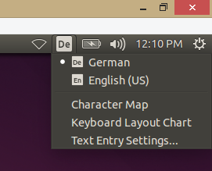
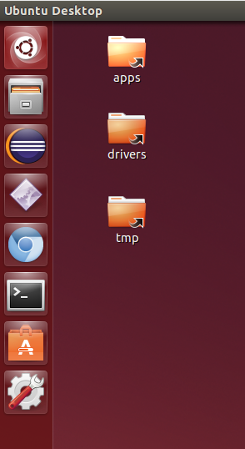
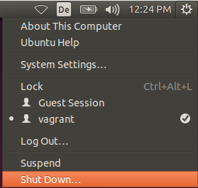
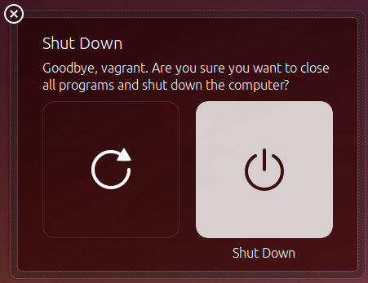

Slide 3
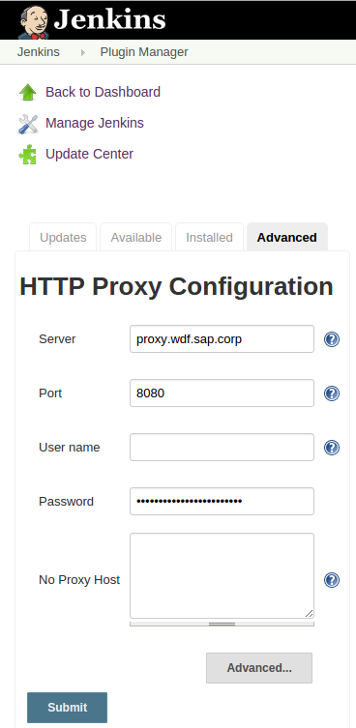


Slide 4
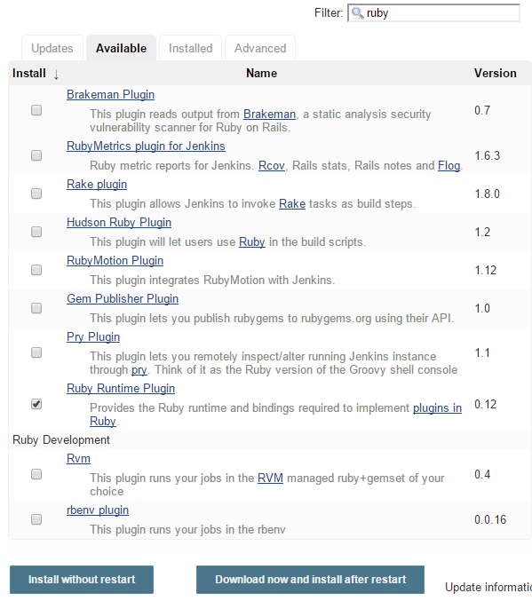

Slide 5
Commit Stage
Integration Stage
Acceptance Stage
Production Stage
Commit
Deploy
System-Test
Manual activity
Upload Nexus
Download from Nexus and push to CF

Slide 6

GitHub
Commit Stage
Integration Stage
Acceptance Stage
Production Stage
Commit
Deploy
System-Test
Deploy
Release
Deploy
Integration Space
Acceptance Space
Production Space
Service @CF
Service @CF
Service @CF
Local storage (Jenkins)
Nexus
Legend
Data flow
Communication
Automatic trigger

Slide 7
GitHub
Commit Stage
Integration Stage
Acceptance Stage
Production Stage
Commit
Deploy
System-Test
Deploy
Release
Deploy
Legend
Data flow
Communication
Integration Space
Acceptance Space
Production Space
Automatic trigger
Service @CF
Service @CF
Service @CF
Local storage (Jenkins)
Nexus

Slide 8
GitHub
Commit Stage
Commit
Local storage (Jenkins)
Legend
Data flow

Slide 9
GitHub
Commit Stage
Integration Stage
Commit
Deploy
Integration Space
Service @CF
Local storage (Jenkins)
Legend
Data flow

Slide 10
GitHub
Commit Stage
Integration Stage
Commit
Deploy
System-Test
Integration Space
Service @CF
Local storage (Jenkins)
Legend
Data flow
Communication

Slide 11
GitHub
Commit Stage
Integration Stage
Commit
Deploy
System-Test
Integration Space
Service @CF
Local storage (Jenkins)
Legend
Data flow
Communication
Automatic trigger

Slide 12
GitHub
Commit Stage
Integration Stage
Commit
Deploy
System-Test
Integration Space
Service @CF
Local storage (Jenkins)
Legend
Data flow
Communication
Automatic trigger

Slide 13
GitHub
Commit Stage
Integration Stage
Acceptance Stage
Commit
Deploy
System-Test
Deploy
Integration Space
Acceptance Space
Service @CF
Service @CF
Local storage (Jenkins)
Legend
Data flow
Communication
Automatic trigger

Slide 15
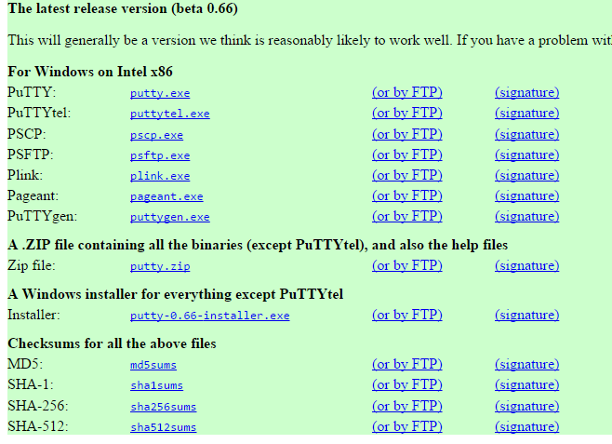

Slide 16
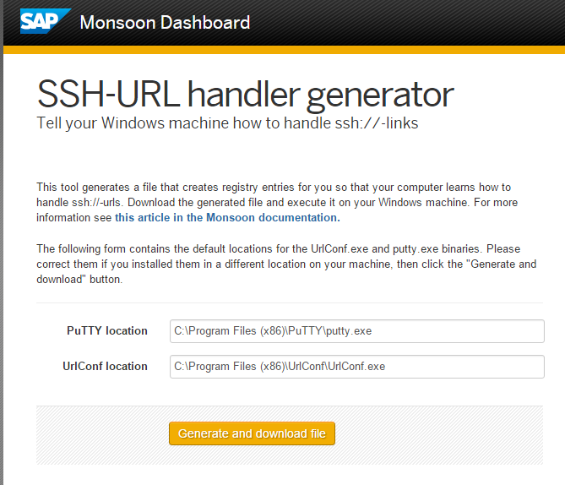

Slide 17
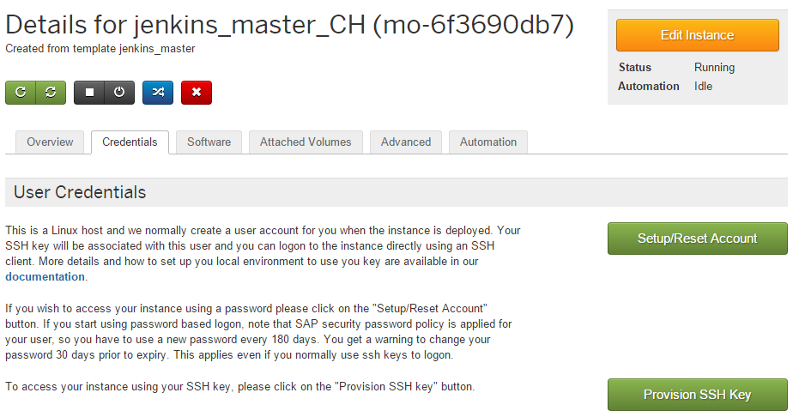

Slide 18
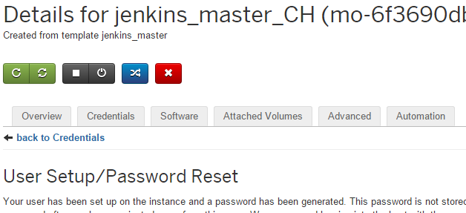

Slide 19
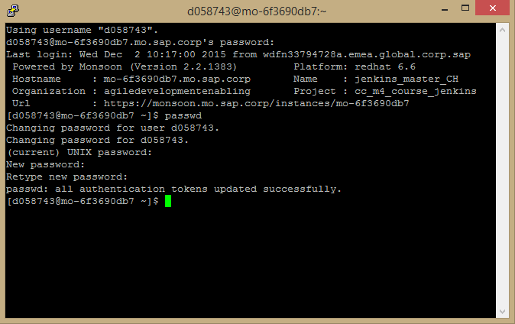

Slide 20
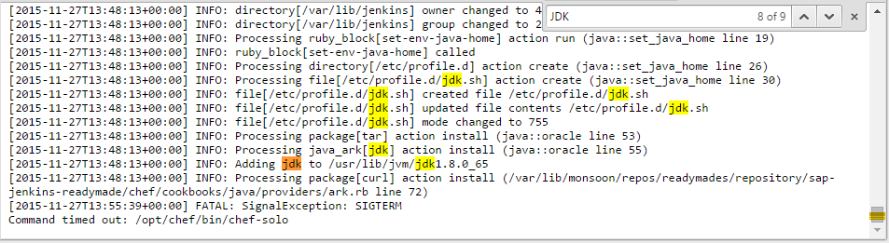

Slide 21
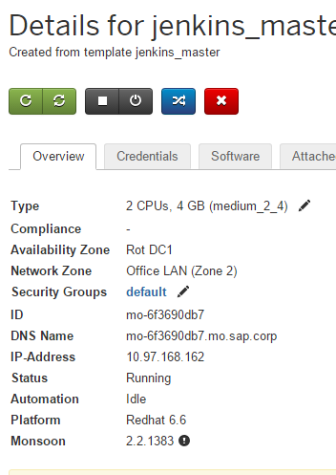

Slide 22
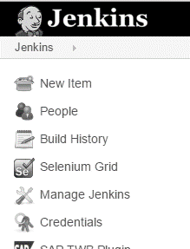
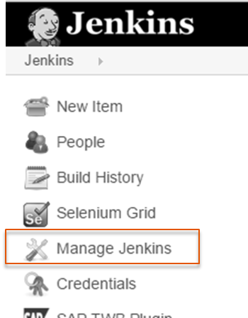
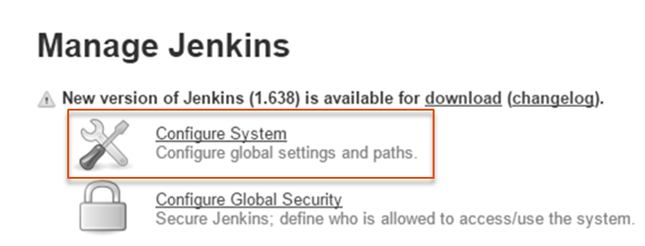
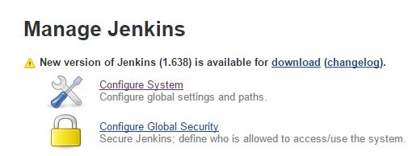
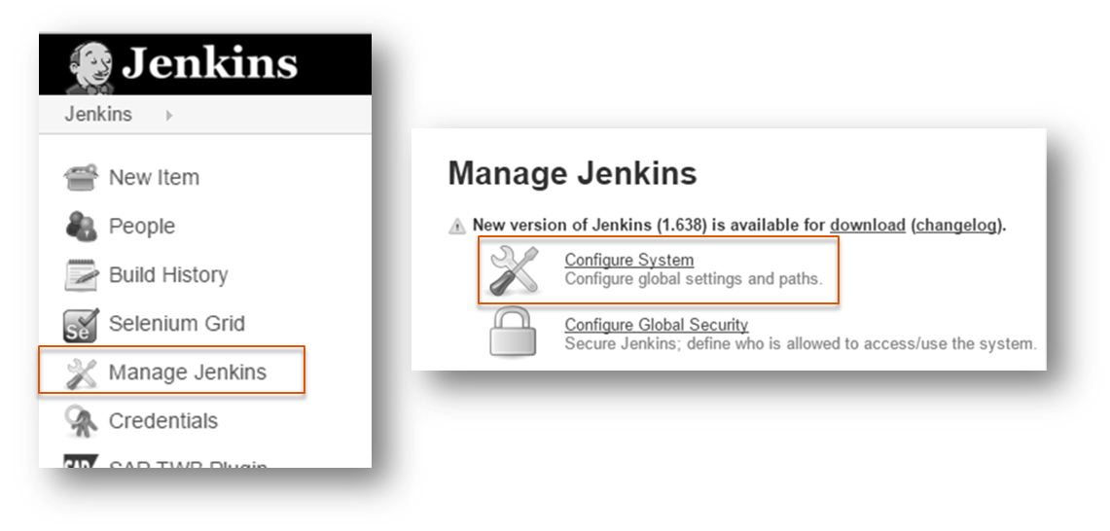

Slide 23
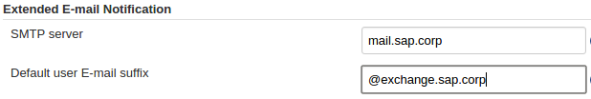
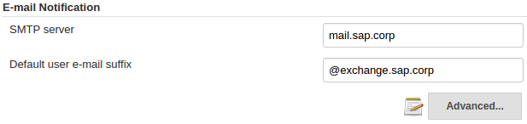

Slide 26
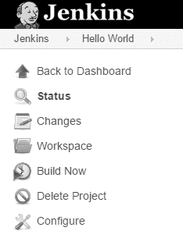

Slide 27
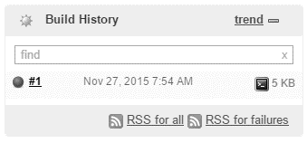

Slide 28
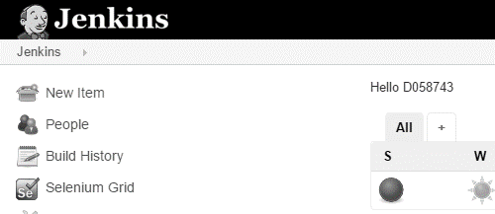

Slide 29
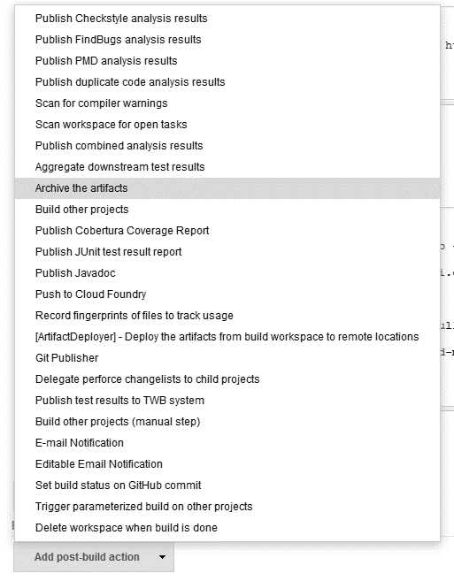

Slide 30
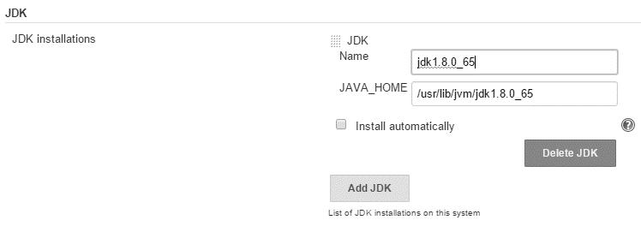

Slide 31
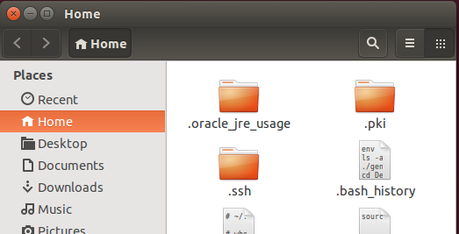

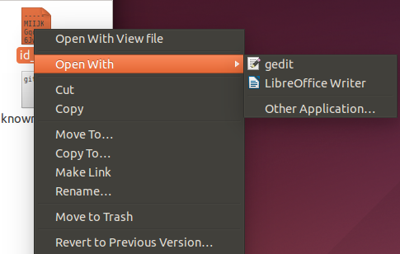

Slide 32
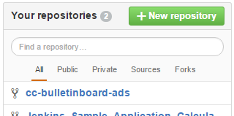

Slide 33
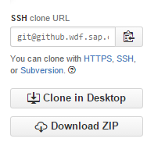
2
1

Slide 34
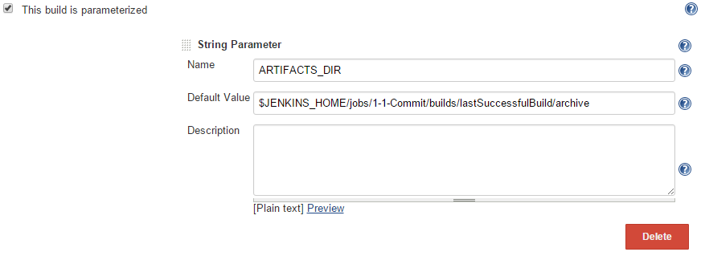

Slide 35
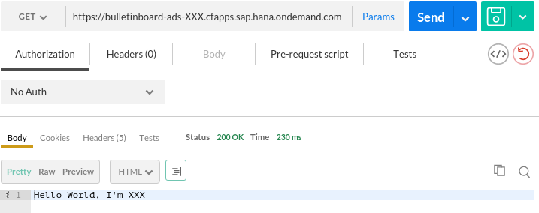

Slide 36
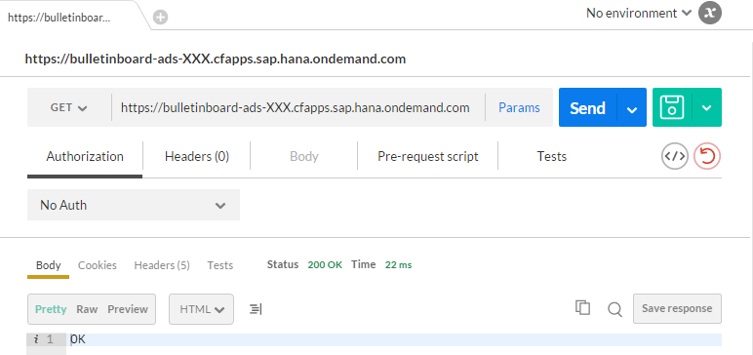

Slide 37
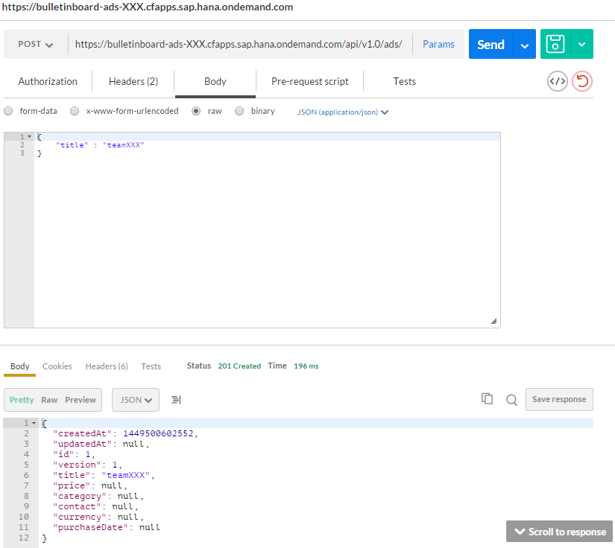
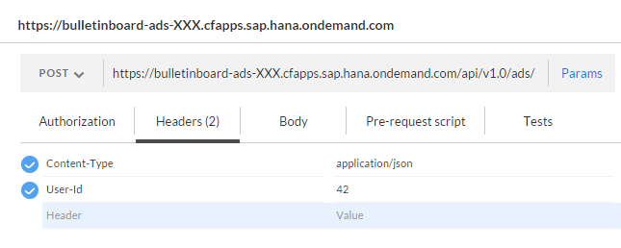

Slide 38
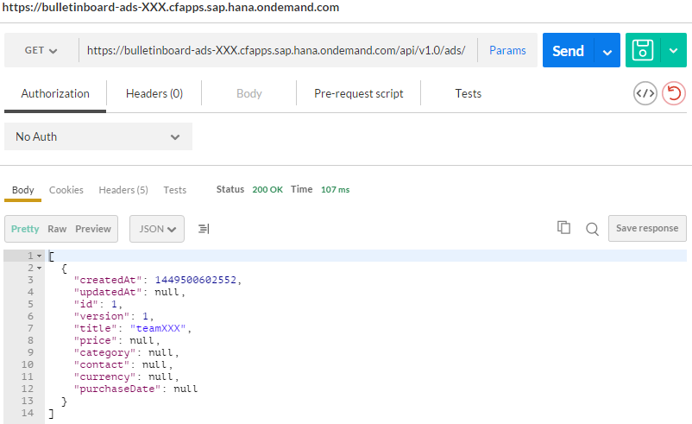

Slide 39
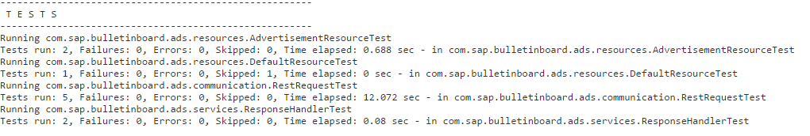

Slide 40
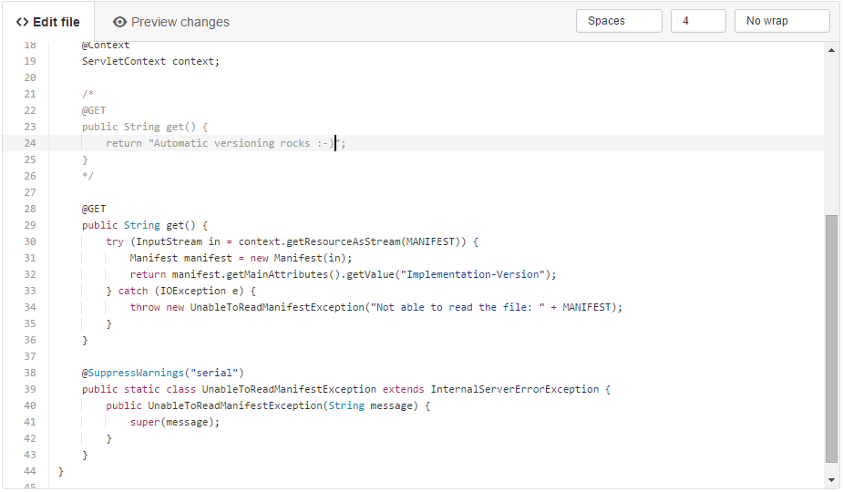

Slide 41
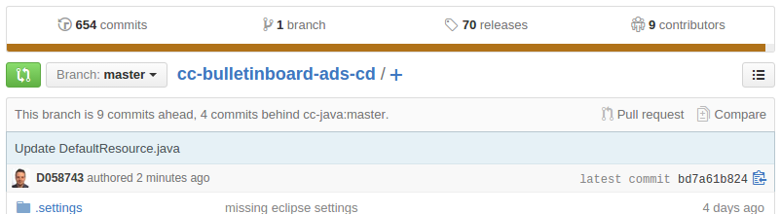
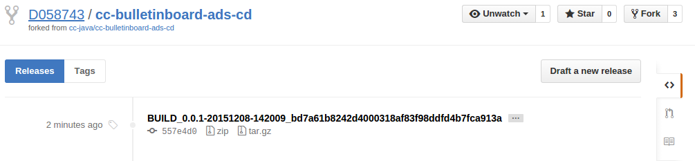

Slide 42
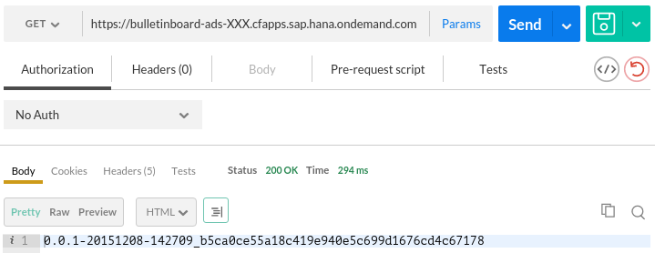

Slide 43
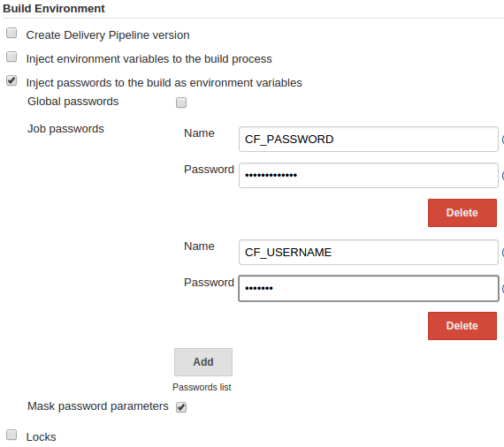

Slide 44
CC M2/M4 Continuous Delivery/ Deployment Pipeline
Version control
Commit
Integration
Performance
Acceptance
Production
Artifact repositories

Slide 45

Commit Stage
Version control
Versioning
Compile
Unit/ IntegrationTests
Codechecks
Archive
1
LOCAL & NEXUS
Artifact repositories

Slide 46
Integration Stage
Version control
4
Deploy
3
System Test
Integration Space
2
5
1
Service @CF
LOCAL & NEXUS
Artifact repositories

Slide 47
Performance Stage
Version control
4
Deploy
3
Performance Test
Performance Space
2
5
1
Service @CF
LOCAL & NEXUS
Artifact repositories

Slide 48
Acceptance Stage
Version control
Deploy
3
Manual Test
5
Release
Acceptance Space
2
4
1
Service @CF
6
LOCAL & NEXUS
Artifact repositories

Slide 49
Production Stage
Version control
Deployment
Production Space
2
Service @CF
1
LOCAL & NEXUS
Artifact repositories

Slide 50
BACKUP

Slide 51
GitHub
Commit Stage
Integration Stage
Acceptance Stage
Production Stage
Commit
Deploy
System-Test
Manual activity
Upload Nexus
Download from Nexus and push to CF
Integration Space
Production Space
Service @CF
Service @CF
Local storage (Jenkins)
Nexus

