Slide 1
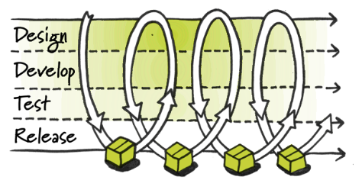

CC: Implement CD & DevOps First Pilot – 09. – 11.02.2016
Ralf Schmitt-Roquette, Jens Keller, Christian Holzwarth, Zeng, Zheng, Thomas Rauner
07.02.2016
BLI
BLI
BLI
BLI

Slide 2
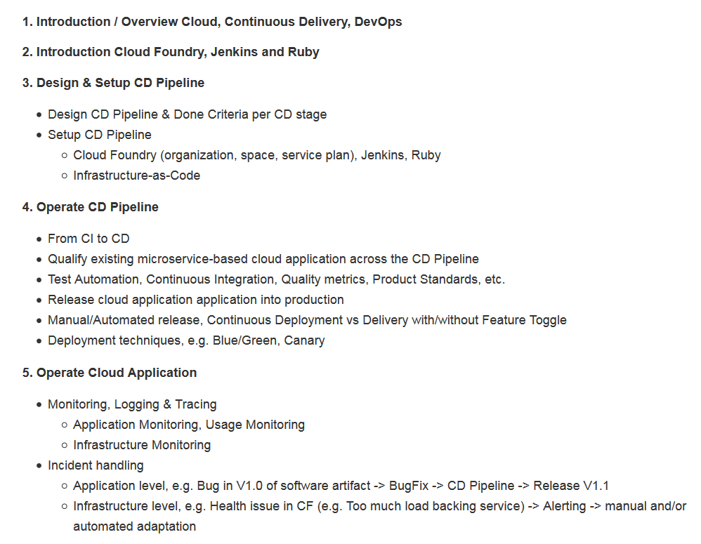
Course Outline
https://github.wdf.sap.corp/cc-java-dev/cc-m4-coursematerial
Introduction / Overview Cloud, Continuous Delivery, DevOps, Cloud Foundry, Jenkins, etc.
Design & Setup CD Pipeline
Operate CD Pipeline
Operate Cloud Application

Slide 3
Course Agenda – Day 1
 | Start | Stop | Duration | Topic
1 | 9:00 | 9:45 | 0:45 | Introduction + Expectations
2 | 9:45 | 10:00 | 0:15 | Overview Continuous Delivery
3 | 10:00 | 10:30 | 0:30 | Overview + Demo CC Continuous Deployment Pipeline
4 | 10:30 | 10:45 | 0:15 | Break
5 | 10:45 | 11:00 | 0:15 | Overview Jenkins, Maven, etc. (+ Demo)
6 | 11:00 | 11:45 | 0:45 | Exercise 2 (Initial steps, Jenkins) + 3 (Commit stage)
7 | 11:45 | 12:45 | 1:00 | Lunch
8 | 12:45 | 13:15 | 0:30 | Overview Cloud Foundry, Test Strategy, System tests
9 | 13:15 | 14:00 | 0:45 | Exercise 4.1 + 4.2 (Integration stage)
10 | 14:00 | 14:15 | 0:15 | Break
11 | 14:15 | 14:30 | 0:15 | Jenkins SCM integration
12 | 14:30 | 15:00 | 0:30 | Exercise 5 (Automate Pipeline)
13 | 15:00 | 15:30 | 0:30 | Automated versioning
14 | 15:30 | 16:00 | 0:30 | Exercise 6 (Automated versioning)
15 | 16:00 | 16:15 | 0:15 | Break
16 | 16:15 | 16:30 | 0:15 | CD Pipeline Execution, Automated vs manual release
17 | 16:30 | 16:45 | 0:15 | Exercise 7.1 + 7.2 (Acceptance stage)
18 | 16:45 | 17:00 | 0:15 | Summary of the day

Slide 4
Course Agenda – Day 2
 | Start | Stop | Duration | Topic
1 | 9:00 | 9:15 | 0:15 | Wrap Up day 1
2 | 9:15 | 9:30 | 0:15 | Blue/ Green Deployment Overview + Demo
3 | 9:30 | 10:30 | 1:00 | Exercise 8.1 + 8.2 ()
4 | 10:30 | 10:45 | 0:15 | Break
5 | 10:45 | 11:00 | 0:15 | Canary Overview + Demo
6 | 11:00 | 11:30 | 0:30 | Automate Pipeline + Ruby
7 | 11:30 | 12:30 | 1:00 | Lunch
8 | 12:30 | 12:45 | 0:15 | Quality Metrics
9 | 12:45 | 13:30 | 0:45 | Exercise 9 ()
10 | 13:30 | 13:45 | 0:15 | Break
11 | 13:45 | 14:00 | 0:15 | Pipeline Visualization + Dashboards
12 | 14:00 | 14:30 | 0:30 | Exercise 10 ()
13 | 14:30 | 14:45 | 0:15 | Microservices and CD
14 | 14:45 | 15:00 | 0:15 | Break
15 | 15:00 | 15:45 | 0:45 | Exercise 11 (Monsoon incl. Introduction)
16 | 15:45 | 16:00 | 0:15 | Infrastructure as Code
17 | 16:00 | 16:45 | 0:45 | Exercise 11 (Environment yml + Ruby)
18 | 16:45 | 17:00 | 0:15 | Summary of the day

Slide 5
Course Agenda – Day 2 (Updated)
 | Start | Stop | Duration | Topic
1 | 9:00 | 9:15 | 0:15 | Wrap Up day 1
2 | 9:15 | 9:45 | 0:30 | Overview Cloud Foundry, Test Strategy, System tests
3 | 9:45 | 10:30 | 0:45 | Exercise 4.1 + 4.2 (Integration stage)
4 | 10:30 | 10:45 | 0:15 | Break
5 | 10:45 | 11:00 | 0:15 | CD Pipeline start triggers , Polling vs Push
6 | 11:00 | 11:30 | 0:30 | Exercise 5 (Automate Pipeline)
7 | 11:30 | 11:45 | 0:15 | Leftover Exercise 6 (Automated versioning)
8 | 11:45 | 12:45 | 1:00 | Lunch
9 | 12:45 | 13:00 | 0:15 | CD Pipeline Execution, Automated vs manual release
10 | 13:00 | 13:15 | 0:15 | Exercise 7.1 + 7.2 (Acceptance stage)
11 | 13:15 | 13:30 | 0:15 | Blue/ Green Deployment Overview + Demo
12 | 13:30 | 14:30 | 1:00 | Exercise 8.1 + 8.2 ()
13 | 14:30 | 14:45 | 0:15 | Break
14 | 14:45 | 15:00 | 0:15 | Canary Overview + Demo
15 | 15:00 | 15:15 | 0:15 | Quality Metrics
16 | 15:15 | 16:00 | 0:45 | Exercise 9 ()
17 | 16:00 | 16:15 | 0:15 | CD Pipeline Visualization + Dashboards
18 | 16:15 | 16:45 | 0:30 | Exercise 10 ()
19 | 16:45 | 17:00 | 0:15 | Summary of the day

Slide 6
Course Agenda – Day 2 (Updated 2)
 | Start | Stop | Duration | Topic
1 | 9:00 | 9:30 | 0:30 | Wrap Up day 1
2 | 9:30 | 10:00 | 0:30 | Overview Cloud Foundry, Test Strategy, System tests
3 | 10:00 | 10:45 | 0:45 | Exercise 4.1 + 4.2 (Integration stage)
4 | 10:45 | 11:00 | 0:15 | Break
5 | 11:00 | 11:30 | 0:30 | CD Pipeline start triggers , Polling vs Push
6 | 11:30 | 12:00 | 0:30 | Exercise 5 (Automate Pipeline)
7 | 12:00 | 12:15 | 0:15 | Leftover Exercise 6 (Automated versioning)
8 | 12:15 | 13:15 | 1:00 | Lunch
9 | 13:15 | 13:30 | 0:15 | CD Pipeline Execution, Automated vs manual release
10 | 13:30 | 14:00 | 0:30 | Exercise 7.1 (Acceptance stage) - no 7.2 (Upload Nexus)
11 | 14:00 | 14:15 | 0:15 | Blue/ Green Deployment Overview + Demo
12 | 14:15 | 15:00 | 0:45 | Exercise 8.2 (Deploy production) - no 8.1 (Download from Nexus)
13 | 15:00 | 15:15 | 0:15 | Break
14 | 15:15 | 15:30 | 0:15 | Canary Overview + Demo
15 | 15:30 | 15:45 | 0:15 | Quality Metrics
16 | 15:45 | 16:30 | 0:45 | Exercise 9 ()
17 | 16:30 | 16:45 | 0:15 | CD Pipeline Visualization + Dashboards
18 | 16:45 | 17:00 | 0:15 | Exercise 10 ()
19 | 17:00 | 17:15 | 0:15 | Summary of the day

Slide 7
Course Agenda – Day 3
 | Start | Stop | Duration | Topic
1 | 9:00 | 9:15 | 0:15 | Wrap up day 2
2 | 9:15 | 9:45 | 0:30 | Monitoring Overview + Demo
3 | 9:45 | 10:15 | 0:30 | Exercise 12 (Uptime Monitor)
4 | 10:15 | 10:30 | 0:15 | Availability Services Demo
5 | 10:30 | 10:45 | 0:15 | Break
6 | 10:45 | 11:15 | 0:30 | ELK, Kibana Overview
7 | 11:15 | 12:00 | 0:45 | Exercise 13.1 (Kibana Dashboards)
8 | 12:00 | 13:00 | 1:00 | Lunch
9 | 13:00 | 13:30 | 0:30 | Exercise 13.2 (Analysis in Kibana)
10 | 13:30 | 14:00 | 0:30 | Scaling microservices in CF
11 | 14:00 | 14:15 | 0:15 | Break
12 | 14:15 | 15:15 | 1:00 | CI-connect Demo
13 | 15:15 | 16:15 | 1:00 | CI Exercises 1-4
14 | 16:15 | 17:00 | 0:45 | Summary

Slide 8
Course Agenda – Day 3
 | Start | Stop | Duration | Topic
1 | 9:00 | 9:30 | 0:30 | Wrap up day 2
2 | 9:30 | 10:00 | 0:30 | Exercise 10 (Dashboard, Trafficlight)
3 | 10:00 | 10:15 | 0:15 | Break
4 | 10:45 | 11:15 | 0:30 | CD and Microservices
5 | 11:15 | 11:30 | 0:15 | Infrastructure as Code (incl. Ruby FW, Pipeline Automation)
6 | 11:30 | 11:45 | 0:15 | Exercise 1 (Monsoon)
7 | 11:45 | 12:30 | 0:45 | Exercise 11 (Cloud Foundry)
8 | 12:30 | 13:30 | 1:00 | Lunch
9 | 13:30 | 14:00 | 0:30 | Monitoring Overview + Demo
10 | 14:00 | 14:30 | 0:30 | Exercise 12 (Uptime Monitor)
11 | 14:30 | 15:00 | 0:30 | ELK, Kibana Overview
12 | 15:00 | 15:45 | 0:45 | Exercise 13.1 (Kibana Dashboards)
13 | 15:45 | 16:00 | 0:15 | Break
14 | 16:00 | 16:30 | 0:30 | Exercise 13.2 (Analysis in Kibana)
15 | 16:30 | 17:00 | 0:30 | Scaling microservices in CF
16 | 17:00 | 17:45 | 0:45 | Q & A, Summary course

Slide 9

Agenda
Summary of the day 1

Slide 10
Agenda
Summary of the day 2

Slide 11
Agenda
toDo
Q & A, Summary Course

Slide 12
CC CD + DevOps, Q1/ 2016: Open topics
Monitoring (complete)
Canary Deployment
Include fullfillment of Product Standards/ other SAP compliance rules into our CD pipeline
Security, OpenSource, Third Party scans/checks, ECCN, etc.
Infrastructure-as-Code
Setup/ maintenance of infrastructure purely via version control. Use only idempotent automations scripts (Snowflake vs Phoenix servers, etc.).Real life running sample, e.g. Monsoon/Chef, Docker, …
Docker and Continuous Delivery and Cloud Foundry
Automate CD Pipeline Setup/ Maintenance
Jenkins Job generation (by our simple job generator) and/or Jenkins Job generation (by production/ complex job generator)
Multi Target Application (MTA)
Feature Toggles
https://github.wdf.sap.corp/cc-java-dev/cc-m4-coursematerial/blob/master/cc_m4_training_outline.mmap

Slide 13
Thank you
Contact information:
Ralf Schmitt-Roquette, Jens Keller, Christian Holzwarth, Zeng, Zheng, Thomas Rauner, Alexander Link

Slide 14
Appendix

Slide 15
Agenda - Optional
Refactor CD Pipeline

Slide 16
Refactor CD Pipeline
???
tbd

Slide 17
Agenda
Exercise xx

Slide 18
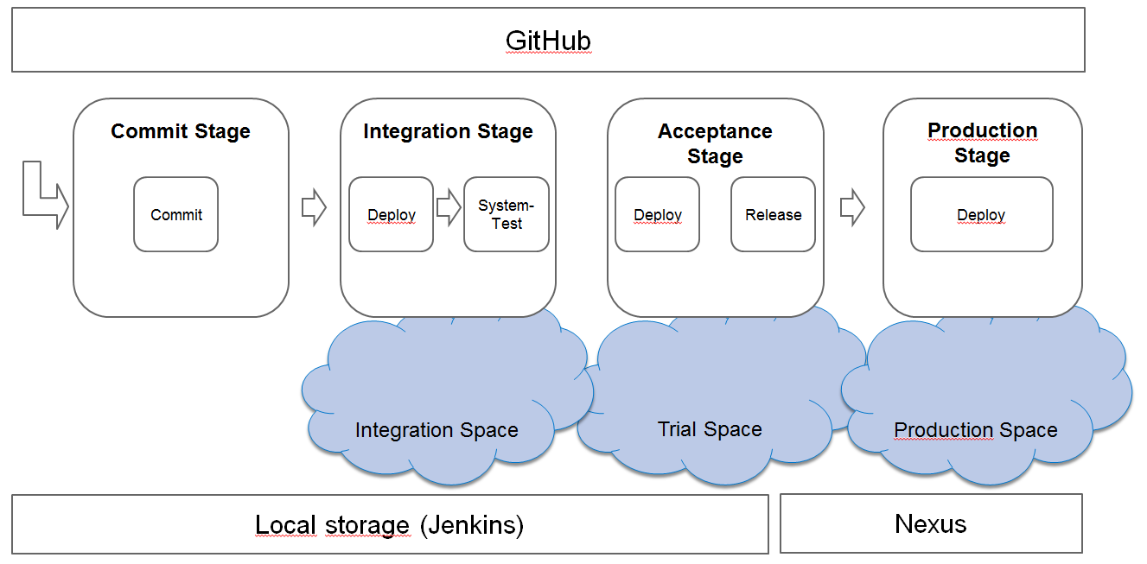
Exercises
Exercise XX: RefactorPipeline
https://github.wdf.sap.corp/cc-java-dev/cc-m4-coursematerial/blob/master/Exercises/ExerciseX-RefactorPipeline.md

Slide 19
Examples

Slide 20
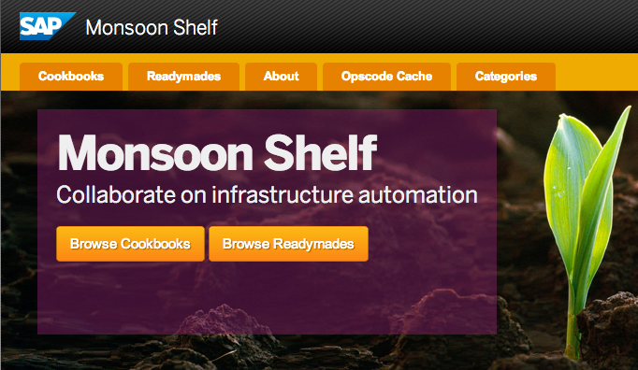


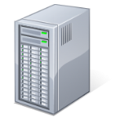



Example 1: TwoGO Use Monsoon readymades to setup/control systems → Infrastructure as code
CI-Server
Central QA Landscape
Productive Landscape
Feature Branch „He-Man“
CI-Server
FB Landscape
Feature Branch „My Little Pony“
CI-Server
FB Landscape
Master
Notes:
All Jenkins and landscape instances are setup via Monsoon. (All infrastructure is code)
Currently status: Jenkins readymade is public available in Monsoon shelf. So is the TwoGo readymade. What is missing is a TwoGo specific Jenkins readymade which also created the TwoGo Build/Test/Deploy/… jobs in Jenkins. (WIP)
Also: Current QA and Productive landscape are not in Monsoon. Migration planed in Q3.

Slide 21



TwoGo: 3 phases of transition towards daily feature delivery
Phase 1
Phase 2
Phase 3
DONE
ONGOING
ONGOING
Move from Perforce to Git(Hub)
3 branches (dev, acceptance, master)
Traditional scrum
Release every 3 weeks through „classical“ Q-Gate
Add some Kanban to Scrum
No more sprints (time boxes)
Establish (better) switch framework to release features by toggle switch
One git branch
Use minimalistic Q-Gate (E-Mail Q-gate)
Daily deployment
Release features via switch framework
Notes:
Why not stay with perforce?
CD is possible with perforce. But not in the way we (SAP) utilize Perforce. Perforce@SAP is managed centrally and e.g. branch/codeline creation is done only centrally. Also branches/codelines must follow a defined name schema when created in perforce (dev, export, patch, cons, 730_COR, 730_REL, ….) to satisfy e.g. centralized production needs.
To win flexibility we moved to git/gerrit. First we moved in 2 (UI) components of TwoGo to win some insights into git and how we should use it. Also to train developers in git. Quiet soon (~3-4 weeks after we moved) a tiny rebellion among the developers started as the whole Gerrit process was way to complicated (yes, all developers had the git/gerrit training before). Also no one really used the Gerrit review process as it was to cumbersome. So we turned of gerrit.
After ~3-4 month (beginning 2014) with 2 components in git, the team voted to move all TwoGo components into git.
Just as we were about to start to move stuff into git we heard about GitHub on DevCode. As we used GitHub already for our monsoon stuff (and some developers knew/used privately from the public GitHub), we decided to go not go into git (gerrit) but to move to GitHub.
Funny fact: Now we can see developers doing code review/code commenting. (Something which they should/could have done in Git/Gerrit but didn‘t do there, they do now in GitHub without us pushing/forcing them (again))
Also note: We‘re not moving our 2 mobile projects into GitHub and they don‘t participate in CD. Not moving into GitHub cause central production can only work with Perforce (and it‘s defiend directory structure), and CD does not bring
any benefit for mobile projects as their release is not owned/controlled by us (but by Apple and Google).
No more sprints? Isn‘t this waterfall again? No. It‘s more like 1 days sprints. (Sprint goal is to have „shipable“ software at EOS. We want to have shippable software always)

Slide 22
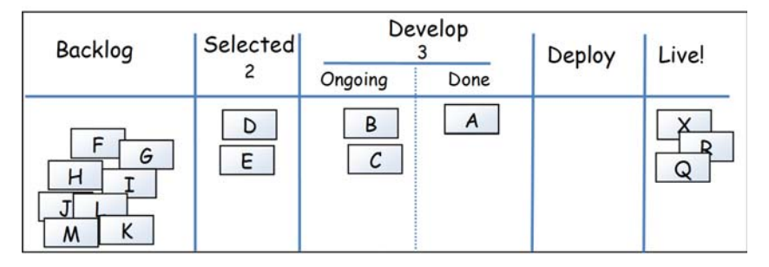



Add some Kanban to our Scrum
Use HuBoard (as part of GitHub)
For the interested: Scrum vs. Kanban
Kanban Board Example*:
Limits
1
Owner: PO
(can move tickets in and out whenever he/she wants)
Tickets pulled by developers
(Developers own ticket until release)
* = The Kanban Board setup can (should?) be always under discussion
Notes:
Tickets (Stories) are flowing without any time box (sprint) border

Slide 23
Example 1: TwoGO Use switches to release features – Pre-requisite for continuous deployment
Update „Release“ branch daily
Deploy daily to staging landscape
Deploy daily to productive landscape (all new features switches are OFF by default)
Activate feature in staging landscape (one by one)
Test feature in staging (e.g. wait until translation is done)
Once test (and translation) of new feature is OK, turn ON feature in production
Central QA Landscape
Productive Landscape
Switches
Switches
HEAD
Release
Master
Notes:
Decouple deployment (physicalle distribute files) from feature shipping (making things available for the end user)

Slide 24
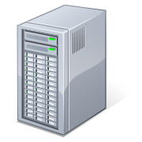









-
Backend
http port 50000
IMAPS
DB
MatchFinder
ZGA
IMAPS
JDBC
JDBC
cyrus.wdf.sap.corp
vsa059966.od.sap.biz
vsa059959.od.sap.biz
vsa059967.od.sap.biz
Customer
http port 50000
Load Balancer
https://twogo-sap-internal.cld.ondemand.com/caretaker/
Maintenance Page
JDBC
https://www.twogo.com
TwoGo Administrator
http port 8080 & SMTP
Watson
https://staging.twogo.com
IMAPS
TwoGo Quality Person
https://vsa060074.od.sap.biz:50443
Sybase 365 SMS Gateway
Proxy
TwoGo Support
http port 50000
JPaaS WTS
vsa060074.od.sap.biz
JDBC
https
https://offshoreportal.wdf.sap.corp
http port 8080 & SMTP
proxy.od.sap.biz
messaging.sybase365.com
Administrator
Test-Backend
Test-DB
Test-MatchFinder
ZGB
https
Navteq
JDBC
JDBC
https://vsa060075.od.sap.biz:50443
vsa060075.od.sap.biz
vsa060087.od.sap.biz
vsa060086.od.sap.biz
TwoGo Quality Person
prd.lbsp.navteq.com
http port 50000
Intranet
DMZ
(Prod-Rot3-Shared-Apps Network)
Internet
Date: 13.02.2013
SAP Confidential

Slide 25
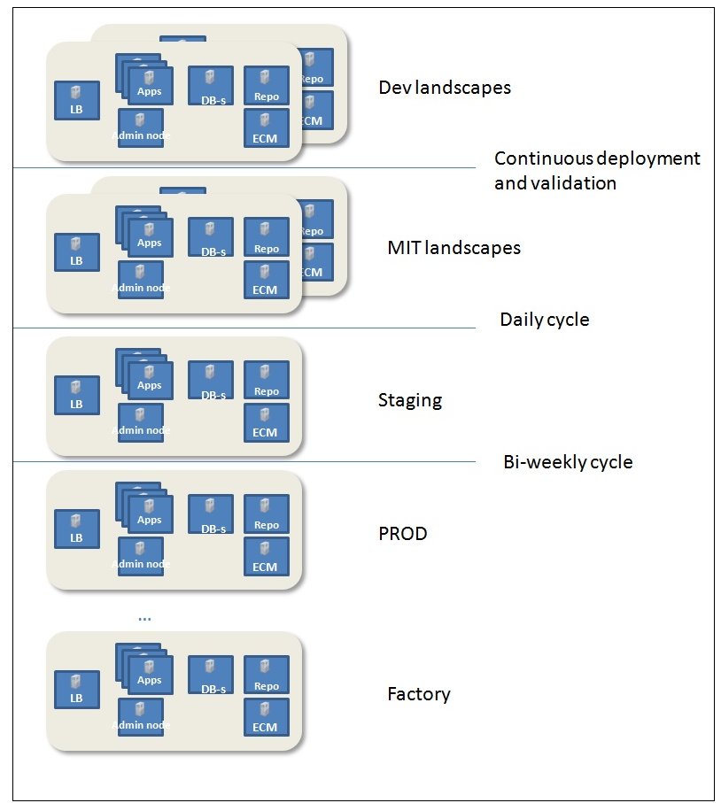
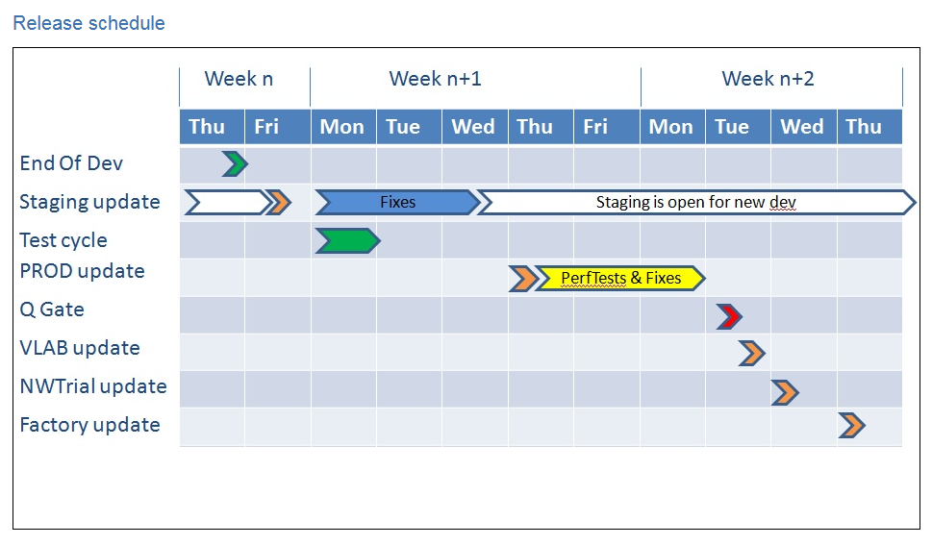
Example 2: Java Platform as a Service (JPaaS) Releasing every 2 weeks
SAP confidential
https://wiki.wdf.sap.corp/wiki/display/JPaaS/JPaaS+Integration+Process

Slide 26

Example 3: HANA Cloud Portal – High Level Overview
GIT @ WDF
QOS + daily regression
Daily regression + End Of Takt Validation
FACTORY DROP
TAG V1
TAG V2
TAG Vx
DEV
RC
MASTER
Daily by Dev Ops
by Dev Ops every fix
HOTFIX
Acceptance test before hotfix release
Push
Stabilization branch on Release Candidate
Push
….
Push per BLI priority by a push criteria process
Push when fix ready per push criteria process
Feature Branch
Feature Branch
bug Branch
fix branch
Fix
branch
Standard bi-weekly delivery
On Demand Hotfix

Slide 27
Example 3: HANA Cloud Portal – old : timeboxed
Pre-Planning
Planning Meeting
1 Day Planning
Team Sign Off For All BLIs
start
hotfix
Dev
Tests
Test & fix
signoff
BI- Weekly Delivery
E2E testing
Qgate
For all Takt BLIs
Dev
Tests
Test & fix
signoff
hotfix
Dev
Tests
Test & fix
signoff
Dev
Tests
Test & fix
signoff
Notes:
Delivery small juncks and feedback

Slide 28
Example 3: HANA Cloud Portal – new : timeboxed/ scopeboxed
Pre-Planning
Planning Meeting
1 Day Planning
Team Sign Off For All BLIs
start
hotfix
Dev
Tests
Test & fix
signoff
Ad-hoc
Delivery
E2E testing
Qgate
For all Takt BLIs
Dev
Tests
Test & fix
signoff
hotfix
Dev
Tests
Test & fix
signoff
Dev
Tests
Test & fix
signoff
Notes:
Delivery small juncks and feedback

Slide 29
Example 3: HANA Cloud Portal – Development Process Earlier and in Continuous Delivery
For all sprint BLIs
Pre-planning
Planning meeting
1 planning days
Team Sign off for all BLIs
Dev and test
End 2 End validation
Q-gate
Delivery every 2 weeks
Today
feedback
feedback
BLI1
Grooming, Planning and commit (by the relevant “sub-team”) for a date
Dev & test
“new deploy process”
BLI4
BLI5
In Continuous Delivery Days
Delivery
Grooming, Planning and commit (by the relevant “sub-team”) for a date
…..
Delivery
Grooming, Planning and commit (by the relevant “sub-team”) for a date
…..
BLI2
feedback
BLI6
Grooming, Planning and commit (by the relevant “sub-team”) for a date
Dev & test
“new deploy process”
Delivery
Grooming, Planning and commit (by the relevant “sub-team”) for a date
…..
feedback
BLI3
BLI7
Grooming, Planning and commit (by the relevant “sub-team”) for a date
Dev & test
“new deploy process”
Delivery
Grooming, Planning and commit (by the relevant “sub-team”) for a date
…..
Notes:
Delivery small juncks and feedback

Slide 30
“In order for you to keep up with customer demand, you need to create a deployment pipeline. You need to get everything in version control. You need to automate the entire environment creation process. You need a deployment pipeline where you can create test and production environments, and then deploy code into them, entirely on demand.”
(“The Phoenix Project”)

Slide 31
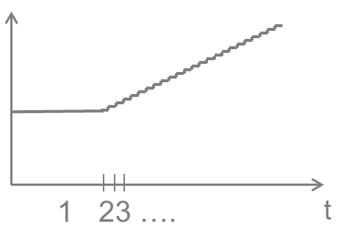
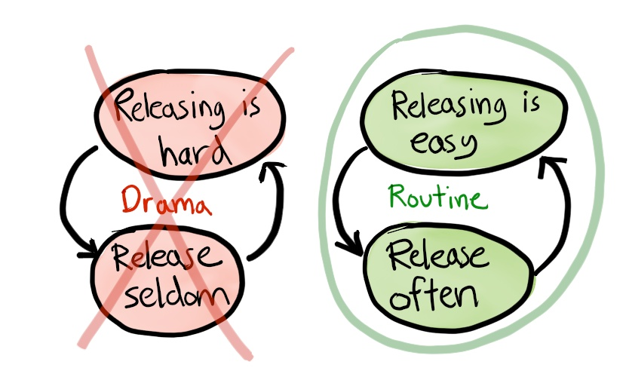
Continuous Delivery (CD)
Continuous Delivery is a practice used to automate + improve the process of software delivery in order to rapidly, reliably and repeatedly push out features + fixes at low risk and with minimal manual overhead Advantages:
Reducing dependencies and thus risks
Get innovations or important fixes (e.g. security leaks) fast to the users
Learn fast from user / usage to avoid waste
Prerequisites
Test automation, continuous integration + continuous deployment
Good software infrastructure
Releasing is easy

Slide 32
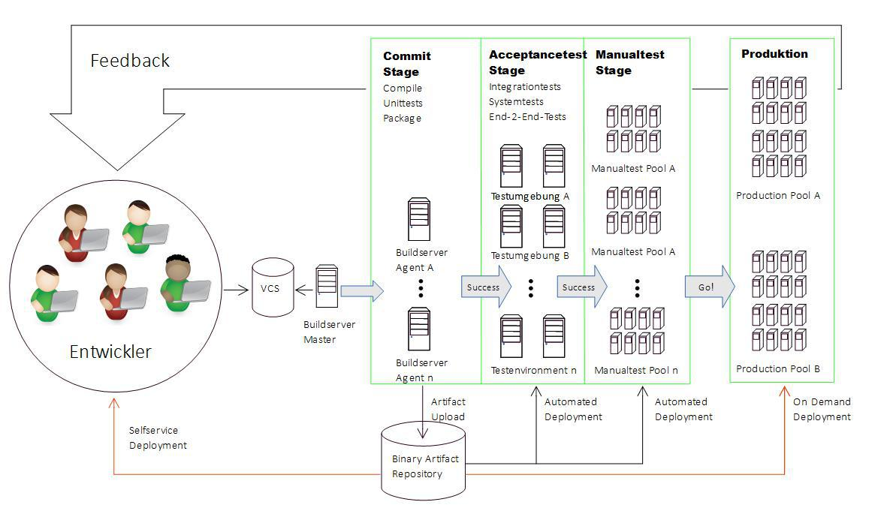

Slide 33
Benefits of fast deliveries
BIG CHANGES,
DEPLOYED RARELY
SMALL CHANGES,
DEPLOYED FREQUENTLY
CHANGE
HIGH RISK
CHANGE
LOW RISK
$ LOST
FAST ROI
TIME
TIME
Notes:
Smaller releases (packages) are easier to control and to test
Putting a developed (DONE) feature on hold increases overall costs
Faster ROI
“Why should a feature developed done in 2 days wait 2 months to be released just because it belongs to a time-box (sprint)”
A-B deliveries. Test your idea and improve it
Practice releasing software
If releasing software hurts you, do it more often
Releasing software is a boring task
Decouple deployment (physicalle distribute files) from feature shipping (making things available for the end user)
Q-Gate:
Ensure only SAP corp. Requierements (Security, Code Checks, Test Coverage, Test Reports, ECCN Classification, …)
NOT all product standards (Product risks, pricing, architecture concepts, operations guide, software lifecycle guide)
E-Mail to PPL (without waiting for a „GO“)

Slide 34
Agenda, Day 1 – part 1
Introduction → 15 min Course goals/ content/ agenda & participants (incl. expectations)
Overview Cloud, Continuous Delivery/ Deployment, DevOps, etc. → 30 min
Overview (incl. demo) Cloud Curriculum bulletinboard CD Pipeline → 30 min
Break → 15 min
Overview (incl. demo) Jenkins, Maven → 15 min
Exercise 2 + 3 → 45 min
Lunch → 60 min (11:30 – 12:30)

Slide 35
Agenda, Day 1 – part 2
Overview Cloud Foundry (incl. CF CLI) + bulletinboard System Tests → 30 min
Exercise 4.1 + 4.2 → 45 min
Break → 15 min
Jenkins SCM Integration - Polling vs. Push/ Impact on CD Pipeline → 15 min
Exercise 5 → 30 min
Automated Versioning – Deep Dive → 15 min
Exercise 6 → 30 min
CD Pipeline execution/ Releasing – Automated vs manual → 15 min
Exercise 7.1 + 7.2 → 45 min

Slide 36
Agenda, Day 2 – part 1
Wrap Up day 1 → 15 min
Deployment types , Blue-Green/ Canary, etc. → 15 min
Exercise 8.1 + 8.2 → 60 min
Canary
Automated CD Pipeline setup/ deployment descriptors with Ruby Framework → 15 min
Extend Commit Stage with Quality Metrics → 15 min
Exercise 9 → 45 min
Lunch → 60 min (12:30 – 13:30)

Slide 37
Agenda, Day 2 – part 2
CD Pipeline Visualization/ Dashboards/Trafficlights → 15 min
Exercise 10 + xx → 30 min

Slide 38
Agenda, Day 3 – part 1
? CD and Microservices → 30 min
Infrastructure-as-code
Exercise xx Infrastructure-as-code
Exercise xx Monsoon/Chef readymade
Monitoring
Exercise xx Uptime, etc.
Exercise xx Kibana
Scaling/ Autoscaling
Infrastructure-as-code
Exercise xx Infrastructure-as-code
Exercise xx Monsoon/Chef readymade

Slide 39
Agenda, Day 3 – part 2
Infrastructure as Code, Samples (e.g. Monsoon/Chef readymade) → 15 min
Exercise 1 → 15 min
CI-Connect/ xMake/ Jenkins as a Service? → <=120 min (Alexander Link)
Q&A → 30 min (16:30 – 17:00)

Slide 40
Xmake/ ci-connect Slot
Topics
Show what ci-connect/ xmake what it is and what it can do for development teams
Combined chain of team and xmake Jenkins
E.g. only parts of our CD pipeline, not final solution for “build only once”/ “promote release candidate from Nexus staging to Nexus Release
Exercise ?

Slide 41
P1941561961
c_fhAz8Ko8UAxlrgZBb

