Slide 1



Cloud Curriculum Continuous Delivery & DevOps

Slide 2

Agenda
DevOps

Slide 3
What is DevOps? – Definition in Wikipedia
DevOps (a clipped compound of "development" and "operations") is
a culture, movement or practice
that emphasizes the collaboration and communication of both software developers and other information-technology (IT) professionals
while automating the process of software delivery and infrastructure changes.
https://en.wikipedia.org/wiki/DevOps

Slide 4
What is DevOps?
3
5
plan
design
code
deliver
operate
DevOps
4
Continuous Delivery
1
Agile Development
Value
2
Collaboration

Slide 5



Why DevOps?
DevOps helps to…
…deliver higher quality of our services at lower cost
…achieve high availability, scalability & resilience efficiently
TCO with SAP
…deliver right value & features for our customers & users
Less Customer lock-in
…receive feedback faster & learn continuously
Fast innovation expected

Slide 6
How? DevOps principles!
Live Site First
The imperative for the whole organization – including Management: If the live site is down, there is no other activity more important than bringing the service back up.
Shepherd your Change
As the developer of a feature you are responsible for getting your feature to production, including delivery and operations.
Automation is your Friend
Manual processes are error prone, slow and do not scale. Automation in testing, deployment, and operations is critical for a cloud service at competitive cost.
Measure and Learn
Deliver often and learn from it. Constantly collect and proactively analyze metrics to gain insights for the future backlog.
Source: Cloud Engineering Paper, P&I Technology, Robert Kampfmann et al.
Notes:
Resilience ?

Slide 7
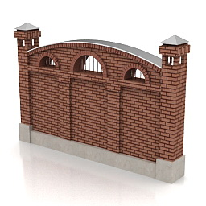
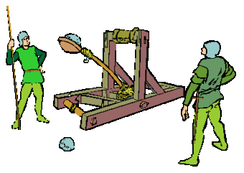
To operate or not to operate – that is the question?
Development
Operations

Slide 8


DevOps
What can we do to ease operation of the software?
Health checks and automation would help us.
Development
Operations

Slide 9
Collaboration Models between Dev & Ops
Collaboration model between Dev & Ops depends on Platform
Stronger collaboration required if team develops closer to infrastructure
Application development on ABAP
E.g. S4HANA with separation between operations & application dev, many frameworks
Dev team is consumer: even development environment is not „operated by development”
Application development on HANA Cloud Platform
E.g. IoT Predictive Maintenance using cloud services/frameworks offered by HCP
Central Cloud Service team operates
Dev Team has a dedicated Ops contact, builds up operations basics skills and drives automation
Application development on generic application servers
E.g. TwoGo with a “classical” DevOps approach
Team responsible for Dev & Ops

Slide 10
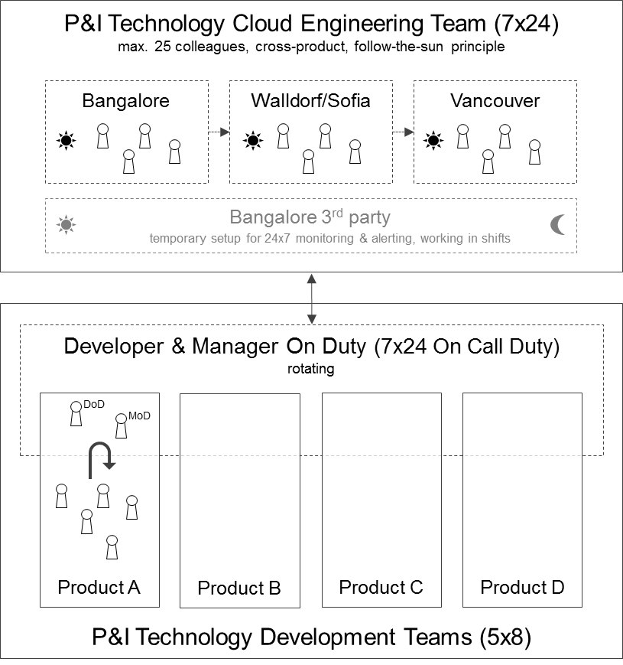
Cloud Engineering – DevOps Working Model at HCP
P&I Technology Cloud Engineering Team
Keep the site live
Incident Management
24x7 monitoring & alerting
Immediate reaction
plus continuous improvement of infrastructure, software, automation & tools
Keep the site healthy
Incident Solution
plus software lifecycle management, logfile and usage analysis, product and service improvement, etc.
P&I Technology Development Teams

Slide 11
Agenda
Continuous Delivery/ Deployment

Slide 12
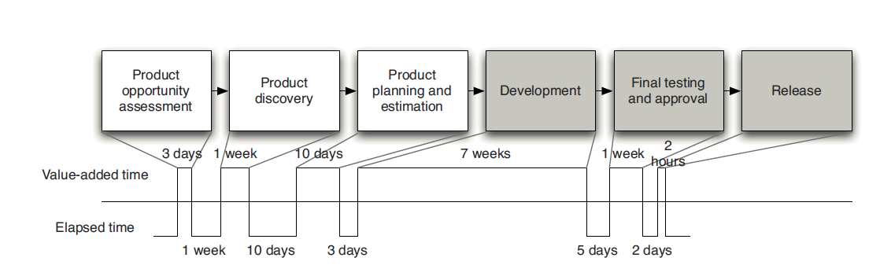
Classic Delivery Model – …where we come from
Long product definition and development phases
Release as “Big-Bang”
Manual, time consuming, complex, many involved parties, errorprone
Development/Test & Release/Provisioning

Slide 13
Trend to short Shipment Cycles and Continuous Delivery
On Premise Applications
On Premise / Cloud Applications today
Cloud Applications in the future
Functional Increase
1
2
3
t
1
2
3 ….
t
1
2
3 ….
t
Major (yearly) Releases
Quarterly Shipments
Quasi continuous delivery
TREND TOWARDS SHORTER SHIPMENT CYCLES WITH INCREMENTAL FUNCTIONAL INCREASE

Slide 14
Motivation towards Continuous Delivery
Why would companies deploy to Production multiple times a week / a day?
Smaller changes means less risk
More frequent changes means closer feedback loop to knowing when you’ve introduced a bug
Closer feedback from customers
Competitive advantage
Maximizing cloud capabilities and offering

Slide 15
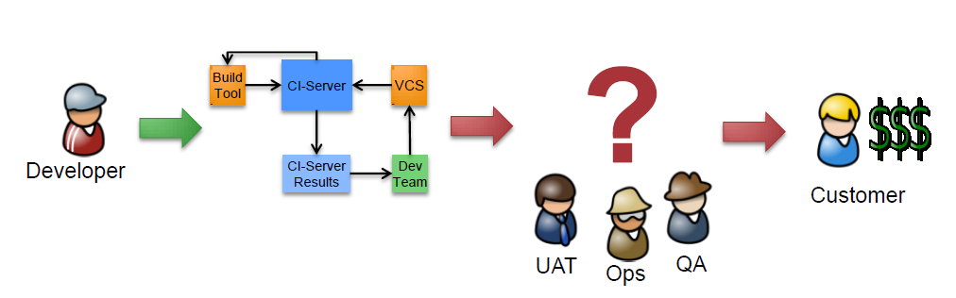

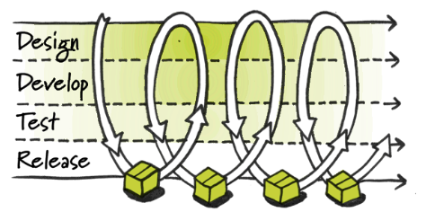
From Continuous Integration to Continuous Delivery
Continuous Integration (CI) has focus on the Developer (incl. QE): → CI Server shows green, Commit successfull, Developer/QE are happy
But how/ when does the feature come to the customer, gets used and makes money (= valuable) ?
“Our highest priority is to satisfy the customer through early and continuous delivery of valuable software“
(Agile Manifest)
Continuous Integration
Continuous Delivery
BLI
BLI
BLI
BLI
Done means released (to production)

Slide 16
Continuous Delivery – Principles & Methods
Create a Repeatable, Reliable Process for Releasing Software (to production)
“If it hurts, do it more frequently, and bring the pain forward”
“Automate (almost) everything“
“Keep everything in version control”
“Build only once”
Everybody Is Responsible for the Delivery Process
Done Means Released (to production)

Slide 17
Continuous Delivery – Principles & Methods 2
Automation
As much as possible
Includes all aspects of infrastructure as well (incl. OS level)
Defined by Development and (!) Operations
Tests
Basis for Automation and Pipeline Processing
Give Confidence for successful changes
Smoke Tests especially for Deployment
Monitoring
Give feedback for Operating
Basis for continuous optimization

Slide 18
Deployment Pipeline - Components
The Deployment Pipeline
Visualizes the status of product development
Provides feedback on each (!) change
Technical/ concentual basis for release process
The Deployment Pipeline contains a set of Stages
Commit Stage as central entry stage
Other typical stages: Integration, Acceptance, Performance, Production Deployment
Stages are connected via trigger (automatic or manual)
Stages contain a set of Jobs
„Unit of Work“
Contain of a set of tasks like Build, Deploy, Copy, Test, …

Slide 19
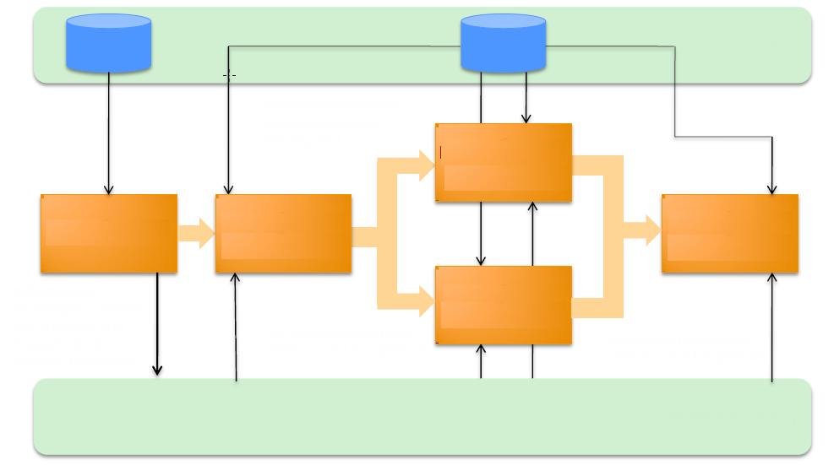
Deployment Pipeline
Version control
Source Code
Infrastr./ Appl. Config
- Config environment
- Deploy binaries
- Smoke Tests
User Accept. Stage
Commit Stage
Integration/ Acceptance Stage
Productive Stage
- Config environment
- Deploy binaries
- Smoke Tests
- Compile
- Unit Tests
- Packaging
- Code Checks
- Config environment
- Deploy binaries
- Smoke Tests
- Integr. / Accept. Tests
Performance Stage
- Config environment
- Deploy Binaries
- Smoke Tests
- Performance Tests
Artifacts repositories
Notes:
The Deployment Pipeline
Visualizes the status of product development
Provides feedback on each (!) change
Technical/ concentual basis for release process
The Deployment Pipeline contains a set of Stages
Commit Stage as central entry stage
Other typical stages: Integration, Acceptance, Performance, Production Deployment
Stages are connected via trigger (automatic or manual)
Stages contain a set of Jobs
„Unit of Work“
Contain of a set of tasks like Build, Deploy, Copy, Test, …

Slide 20
Deployment Pipeline (Example TwoGo) „…get feedback as quickly as possible…“
Source code
Env. & Job config
Version control (e.g. Git)
Env. & landscape config
Automated or manual
Compile
Unit Tests
Regression Tests
Functional Tests
Acceptance Tests
Code checks
Capacity Tests
Security Scans
Manual Tests
Anonymized prod. Data
Monitor
Analytics
Smoke Tests
Alerts
Users (Hotline, Ticket)
Commit
Integration
Acceptance
Production
Artifact repositories (e.g Nexus)
Notes:
Each resource change starts a new pipeline instance
First stage produces all the artifacts
Run through all stages until failure („Stop the line“) or
until final pipeline end is reached. Last stage does deployment to production.

Slide 21
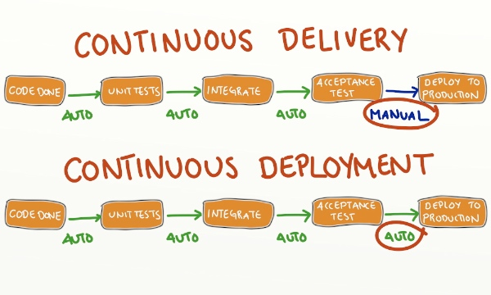
Continuous Delivery vs. Continuous Deployment
“Continuous Delivery doesn't mean every change is deployed to production ASAP. It means every change is proven to be deployable to production at any time”
Blog: continuous delivery vs continuous deployment (Humble)
Blog: continuous delivery vs continuous-deployment (Sundman)
Blog: continuous delivery vs continuous deployment, What is the diff ? (Puppet Labs)

Slide 22
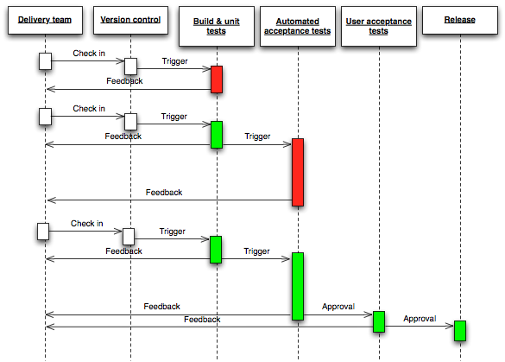
Deployment Pipeline – Sequence Diagram
Each resource change starts a new pipeline instance
First stage produces all the artifacts
Run through all stages until failure („Stop the line“) or
until final pipeline end is reached. Last stage does deployment to production.
Anatomy of a Deployment Pipeline (Humble, Farley)

Slide 23





Deployment Pipeline A software version/ artifact will be qualified through the CD pipeline from stage to stage
Commit 3
Commit 1
Commit 2
Commit 4
Version control
ü
Cloud Foundry
Build Unit Test
Qualify
Qualify
Commit
Integration
Acceptance
Production
V 1.3
V 1.1
V 1.3
V 1.3
V 1.2
V 1.3
V 1.2
V 1.1
V 1.2
V 1.2
V 1.1
V 1.1
V 1.0
V 1.3
V 1.2
V 1.3
V 1.2
V 1.0
V 1.3
Qualify
Stop the line
Stop the line
Stop the line
Artifact repositories

Slide 24


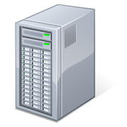
Deployment Pipeline & Infrastructure as Code Environments from code within minutes – Example VMs in Monsoon with Chef
Source code
Env. & Job config
Version control
Env. & landscape config
Monsoon
Monsoon
Monsoon
DB
APPL
MSG
DB
APPL
MSG
DB
APPL
MSG
Commit
Integration
Acceptance
Production
Artifact repositories

Slide 25

Deployment Pipeline & Infrastructure as Code Environments from code within minutes – Example: Spaces with Backing Services in Monsoon
Source code
Env. & Job config
Version control
Env. & landscape config
+ Ruby
+ Ruby
+ Ruby
Cloud Foundry
Space: Integration
Space: Acceptance
Space: Production
DB Service Instance
MSG Service Instance
DB Service Instance
MSG Service Instance
DB Service Instance
MSG Service Instance
Commit
Integration
Acceptance
Production
Artifact repositories

Slide 26
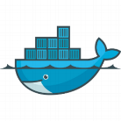
Deployment Pipeline & Infrastructure as Code Environments from code within minutes – Example instance, based on Docker
Draft !
Source code
Env. & Job config
Version control
Env. & landscape config
Xmake Docker build
Xmake Docker build
Xmake Docker build
Xmake Docker build
Docker
Docker
Docker
DB
APPL
MSG
DB
APPL
MSG
DB
APPL
MSG
Commit
Integration
Acceptance
Production
Artifact repositories

Slide 27
CC Continuous Delivery/ Deployment Pipeline Main Principles to be applied
All under version control
Build software version/ artifact only once
Each (succesful) build of a software version/ artifact is a release candidate
Qualify this software version/ artifact through the CD pipeline until production
Each Commit starts the CD Pipeline immediately
Automated versioning
Automated (Manual) release to production
Apply Infrastructure as Code principles
Automated setup/ configuration of environments in very short time (Scheduled, On Demand)
Automation scripts and meta data/ configuration under version control
Deploy in the same way with the same tools to any environment
Test- and Production environment as close as possible

Slide 28
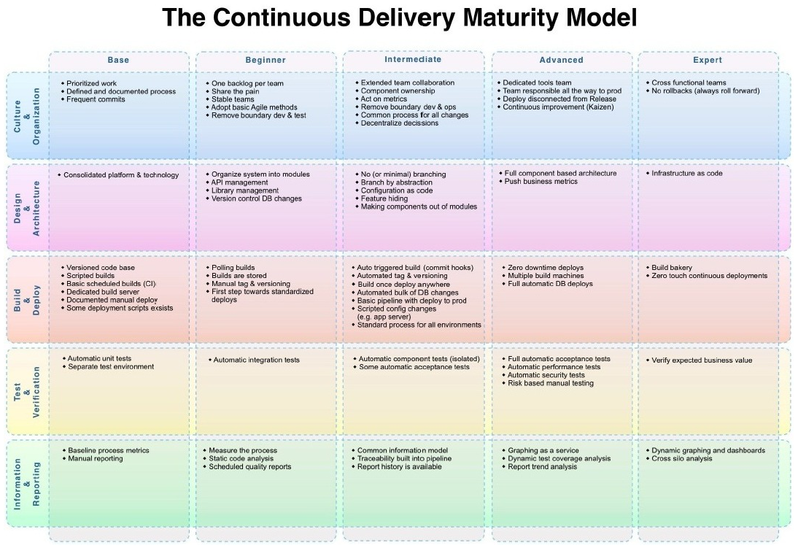
Continuous Delivery Maturity Model
http://www.infoq.com/articles/Continuous-Delivery-Maturity-Model
https://developer.ibm.com/urbancode/docs/continuous-delivery-maturity-model/

Slide 29

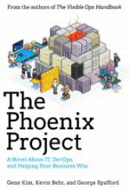
Further readings
Continuous Delivery
Reliable Software Releases through Build, Test, and Deployment Automation
Jez Humble, David Farley ISBN 0321601912
The Phoenix Project
A Novel About IT, DevOps, and Helping Your Business
Win Gene Kim, Kevin Behr, George Spafford ISBN 0988262592

Slide 30
Agenda
Cloud Curriculum bulletinboard CD Pipeline

Slide 31
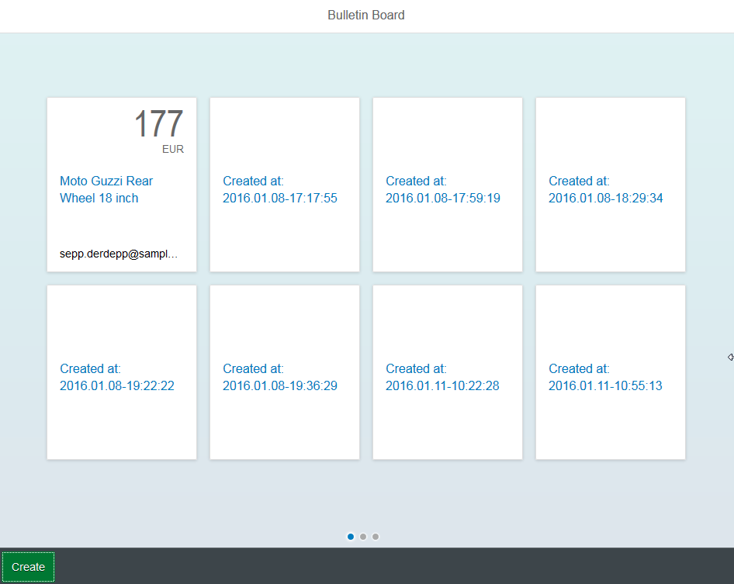
Reference/ Sample Microservices: bulletinboard
Cloud Foundry
Advertisement (ads)
HTTPS / REST
Users
Statistics
https://cc-bulletinboard-ads-prod.cfapps.sap.hana.ondemand.com/static/index.html
(backing) services
PostgreSQL
ELK

Slide 32
CC M2/M4 Continuous Delivery/ Deployment Pipeline
Source code
Env. & Job config
Version control
Env. & landscape config
Cloud Foundry
- Compile - Unit/ IntegrationTests - Static Codechecks - Code Coverage - Open Tasks/ Compiler Warnings
- System Tests
- Load/ Performance Tests
- Manual/ Explorative Tests (Not yet implemented!)
- Operate/ Monitor Cloud Application
Commit
Integration
Performance
Acceptance
Production
Artifact repositories
http://mo-f8268fdb9.mo.sap.corp:8080/jenkins/view/CD%20Pipeline/
http://mo-f8268fdb9.mo.sap.corp:8080/jenkins/view/CD%20Pipeline_DeliveryPlugin/

Slide 33
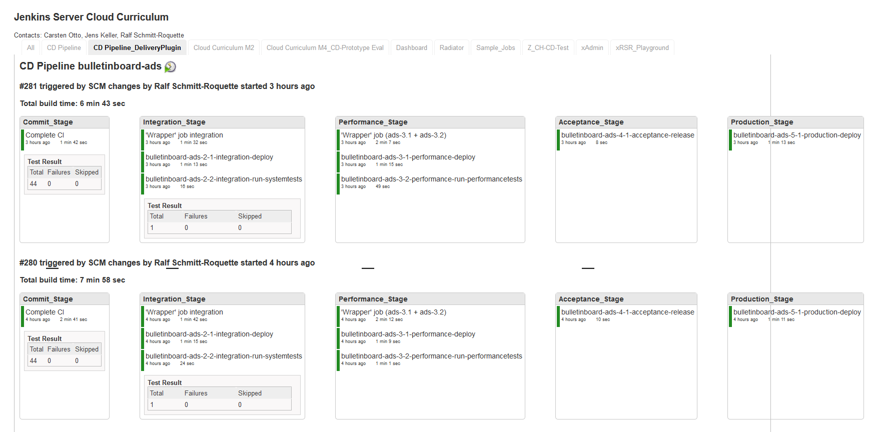
CC Continuous Delivery/ Deployment Pipeline on Jenkins
http://mo-f8268fdb9.mo.sap.corp:8080/jenkins/view/CD%20Pipeline_DeliveryPlugin/

Slide 34
CC M2/M4 Continuous Delivery/ Deployment Pipeline
Draft !
Source code
Env. & Job config
Version control
Env. & landscape config
- Compile - Unit/ IntegrationTests - Static Codechecks - Code Coverage - Open Tasks/ Compiler Warnings
- System Tests
- Load/ Performance Tests
- Manual/ Explorative Tests (Not yet implemented!)
- Monitor
Commit
Integration
Performance
Acceptance
Production
Artifact repositories
http://mo-f8268fdb9.mo.sap.corp:8080/jenkins/view/CD%20Pipeline/
http://mo-f8268fdb9.mo.sap.corp:8080/jenkins/view/CD%20Pipeline_DeliveryPlugin/

Slide 35
CD Pipeline: Current State
Version Control: Github
Commit
Integration
Performance
Acceptance
Production
Artifact Repository: Jenkins
Artifact Repository: Nexus

Slide 36
CD Pipeline: Future State
Version Control: Github
Commit
(build: XMake)
Integration
Performance
Acceptance
Production
Release candidate;, incl. e.g. MD5/ SHA1 hash and signed with certificate
Notify, that the artifact is successfully qualified release candidate → release
stage
Nexus: Staging Repo
Nexus: Release Repo
promote

Slide 37
Appendix

Slide 38
CC M2/M4 Continuous Delivery/ Deployment Pipeline
Version control
Commit
Integration
Performance
Acceptance
Production
Automated versioning
Upload artifact V 1.0
Team Jenkins
Download artifact V 1.0
Download artifact V 1.0
Download artifact V 1.0
Team Jenkins
Upload artifact V 1.0
Download artifact V 1.0
Artifact repositories
Local (Team Jenkins)
Nexus (Manual Uploads)

Slide 39
CC M2/M4 Continuous Delivery/ Deployment Pipeline
Future
Version control
xmake Jenkins
- Automated Versioning - Compile - Unit/ IntegrationTests - Static Codechecks - Code Coverage - Open Tasks/ Compiler Warnings
- System Tests
- Load Tests
- Manual Acceptance tests - tbd
- Monitor - Operate - Incident handling
Commit
Integration
Performance
Acceptance
Production
Upload artifact V 1.0
Download artifact V 1.0
Download artifact V 1.0
Download artifact V 1.0
Download artifact V 1.0
Artifact repositories
xmake Jenkins
Nexus (Temporary storage)
Nexus Release)
Promote artifact V 1.0

