Slide 1



Sample CD Pipeline Bulletin Board

Slide 2
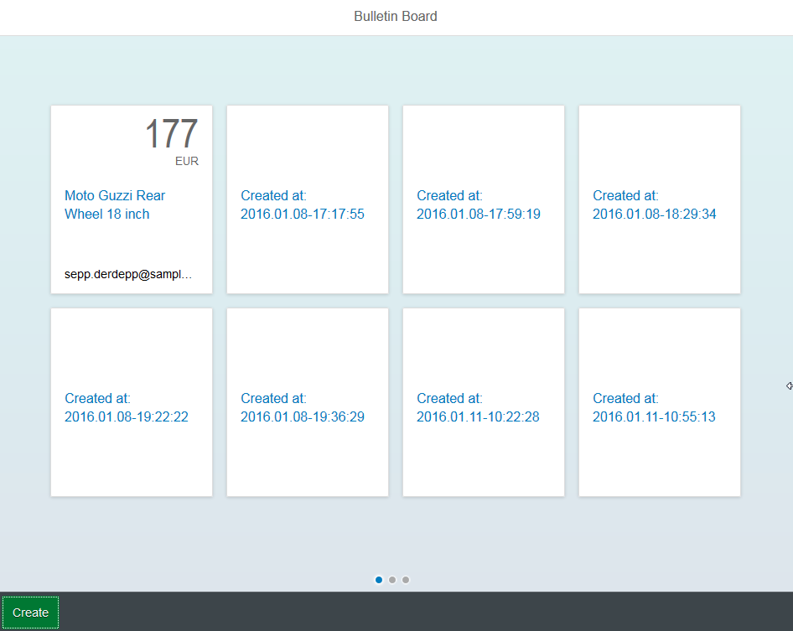
Reference Application: Bulletin Board
https://cc-bulletinboard-ads-prod.cfapps.sap.hana.ondemand.com/static/index.html

Slide 3
Reference Application: Bulletin Board
Cloud Foundry
Advertisement
Users
Client
(e.g. Browser)
HTTPS / REST
Statistics
PostgreSQL
ELK
Notes:
Cloud Foundry Terminology:
Differentiation between “apps” and “services”
Apps ~ The server code
Services ~ Backing services like data base, message queue, …

Slide 4


Bulletin Board Deployment Pipeline
Source Code Repositories
Source Code
Infrastructure Code
CloudFoundry
Commit
- Compile - Unit/Comp. Tests - Static Analysis ...
Integration
- System Tests
Performance
Acceptance
- Exploraty Tests (Not yet implemented!)
Production
Artifact Repositories
http://mo-f8268fdb9.mo.sap.corp:8080/jenkins/view/CD%20Pipeline_DeliveryPlugin/

Slide 5
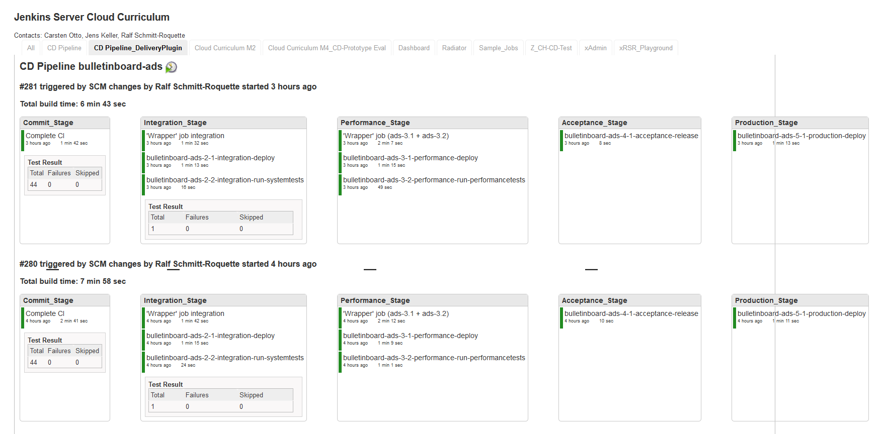
Bulletin Board CD Pipeline
http://mo-f8268fdb9.mo.sap.corp:8080/jenkins/view/CD%20Pipeline_DeliveryPlugin/

Slide 6
CD Pipeline: Current State
Version Control: Github
Commit
Integration
Performance
Acceptance
Production
Artifact Repository: Jenkins
Artifact Repository: Nexus

Slide 7
CD Pipeline: Future State
Version Control: Github
Commit
(build: XMake)
Integration
Performance
Acceptance
Production
Release candidate;, incl. e.g. MD5/ SHA1 hash and signed with certificate
Notify, that the artifact is successfully qualified release candidate → release
stage
Nexus: Staging Repo
Nexus: Release Repo
promote
Notes:
Release candidate will be created on controlled/ compliant environment (SAP corporate requirements, Product Standards) → xmake
Artifact enhanced by MD5/ SHA1 hash and/or signed with certificate
The build is a release build !
Artifact gets uploaded to Nexus staging repository by xmake
After succesfull qualification through the CD pipeline (here Acceptance Stage) xmake gets notification to promote artifact from Staging into Release repo.

Slide 8
Demo
http://mo-f8268fdb9.mo.sap.corp:8080/jenkins/view/CD%20Pipeline_DeliveryPlugin/
Notes:
How to do the demo:
Make e.g. an incompatible change to the users API
Adapt the unit and component tests if needed so that all local tests pass
Push the change, it will fail in the integration stage because ads cannot communicate with users anymore
While the CD pipeline is running, you may show the following slides
Consider also showing some of the details in the Jenkins jobs directly (show Jenkins job config)
Push then another commit with the fix and show that it reaches production

Slide 9

Commit Stage
Version Control: Github
checkout
push
trigger
Versioning
Maven Build (later: XMake)
Archive
archive
(later: stage)
Artifact Repository: Jenkins (later: Nexus)
Notes:
Maven Build: incl. unit tests, integration/component tests and static code checks

Slide 10
Integration Stage
Version Control: Github
4
Deploy
3
System Test
2
5
Integration Space
1
Artifact Repository: Jenkins (later: Nexus)

Slide 11
Performance Stage
Version Control: Github
4
Deploy
3
Performance Test
2
5
Performance Space
1
Artifact Repository: Jenkins (later: Nexus)

Slide 12
Acceptance Stage
Version Control: Github
push tag
(later: XMake)
6
Deploy
Manual Test
Release
3
5
4
7
2
Acceptance Space
1
archive
(later: promote)
Artifact Repository: Jenkins (later: Nexus)
Artifact Repository: Nexus

Slide 13
Production Stage
Deploy
2
Production Space
1
Artifact Repository: Nexus

