Slide 1


Agenda
Jenkins Basics

Slide 2
Jenkins
Jenkins is an open source continuous integration tool written in Java.
The project was forked from Hudson after a dispute with Oracle, which claims the right to trademark the Hudson name and has applied for such a trademark as of December 2010.
Jenkins provides continuous integration services for software development, primarily in the Java programming language. It is a server-based system running in a servlet container such as Apache Tomcat. It supports SCM tools including CVS, Subversion, Git, Perforce and more, and can execute Apache Ant and Apache Maven based projects as well as arbitrary shell scripts and Windows batch commands.
Builds can be started by various means, including being triggered by commit in a version control system, scheduling via a cron-like mechanism, building when other builds have completed, and by requesting a specific build URL.
http://jenkins-ci.org/

Slide 3

Continuous Integration (CI) Server – Jenkins
https://go.sap.corp/continuous_integration
Web Application to execute and monitor repeated [build] jobs
Integrates with different SCMs
Executes ant, maven, shell scripts, …
Trigger jobs periodically or by event
Collects build and test results
E-Mail notifications
Highly extensible via plugins, Groovy scripting, REST API, etc.
Others: Hudson, Bamboo, Team City, etc.
Jenkins
Jenkins Homepage: http://jenkins-ci.org/
Using Jenkins: https://wiki.jenkins-ci.org/display/JENKINS/Use+Jenkins
Administration of Jenkins: https://wiki.jenkins-ci.org/display/JENKINS/Administering+Jenkins
Available Jenkins plugins: https://wiki.jenkins-ci.org/display/JENKINS/Plugins
Best Practices Jenkins@SAP https://wiki.wdf.sap.corp/wiki/display/ASE/Best+Practices+with+Jenkins

Slide 4
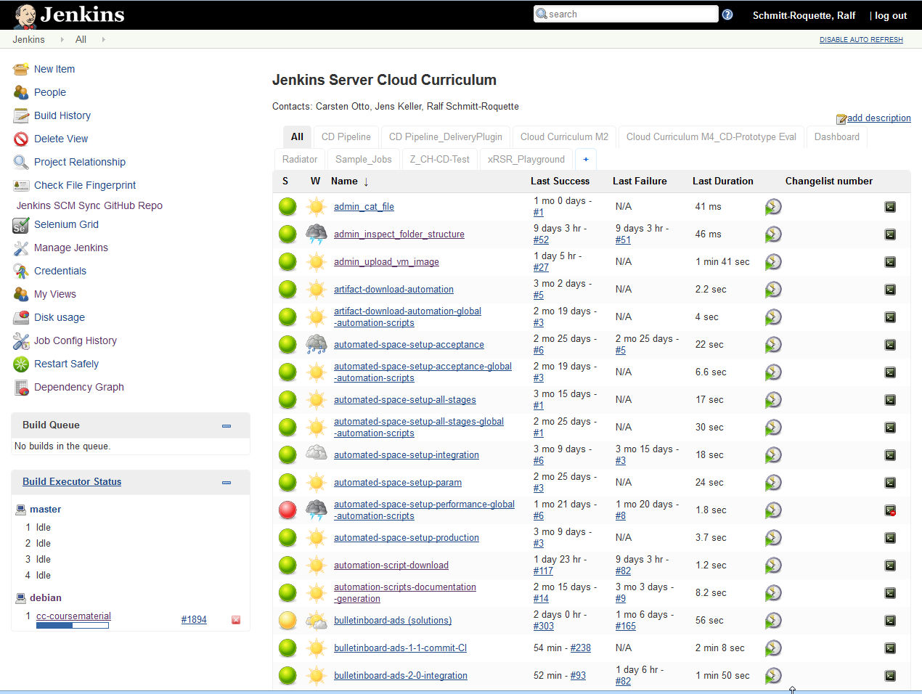
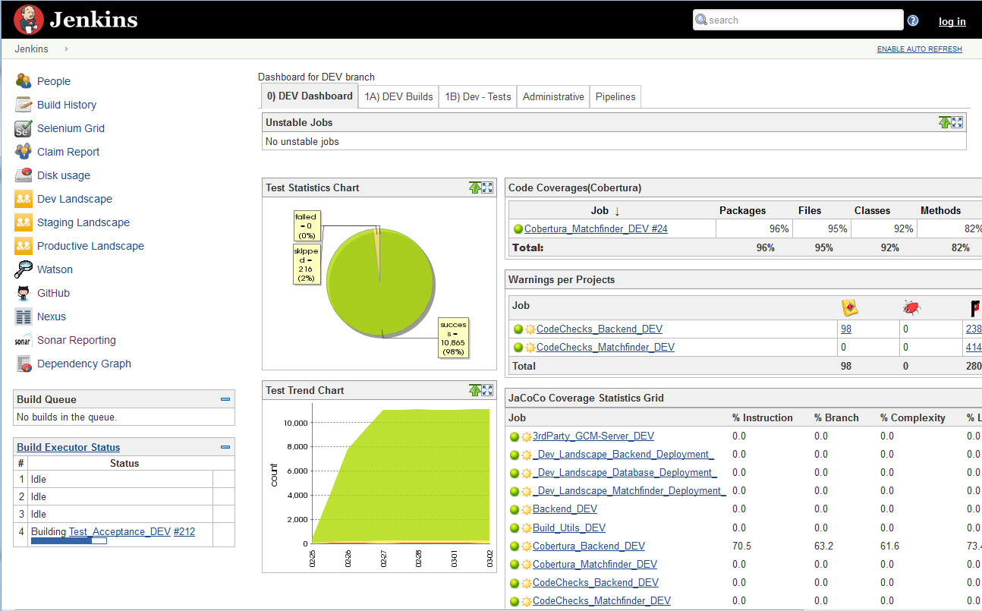
Jenkins ‚Start screen‘: e.g. flat job list, dashboard

Slide 5
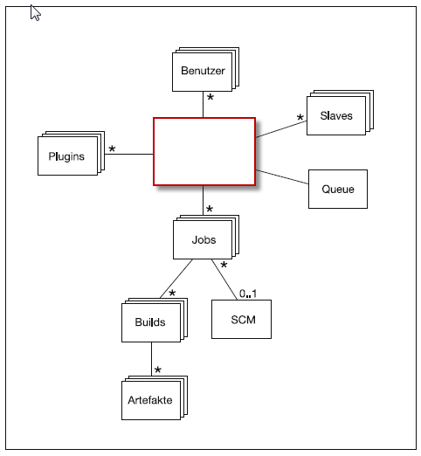
Jenkins Data Model: Overview

Slide 6
Jenkins: OS + Setup Types
OS
Linux, Windows, Mac OS
Setup types
Standalone
Jenkins as Service
Jenkins on e.g. Tomcat as Service

Slide 7
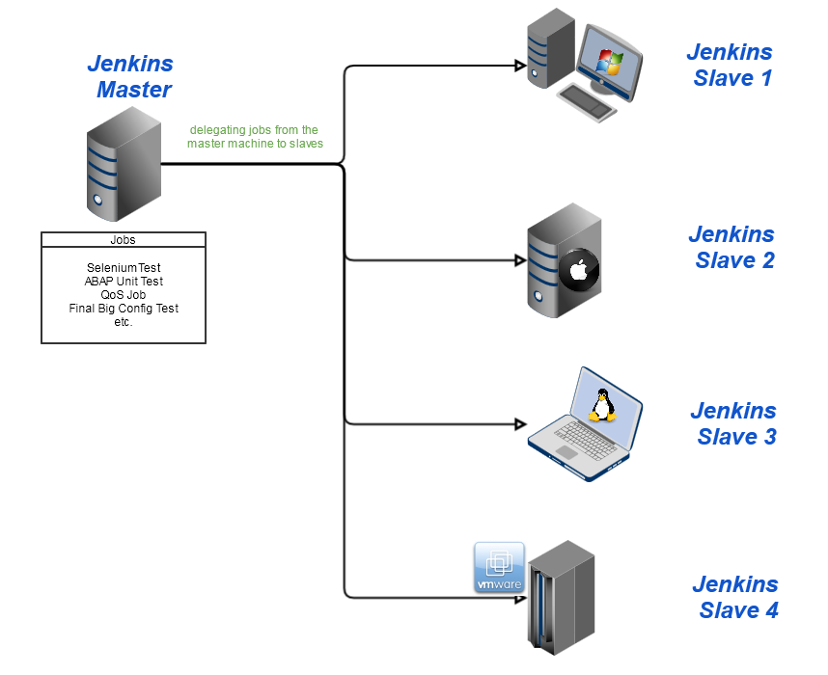
Jenkin: Distributed Build - Master/ Slave
Overview on Best Practice WIKI
Samples on Best Practice Jenkins

Slide 8





CI Server types: Team Jenkins Server
Responsibility
Facts:
One Jenkins Server per Team
Setup, config and operating by the team itself
Full responsibility for VM, OS, Jenkins within the team
Small sized VM/ HW
PROs:
Full control: on operating system/ Jenkins level
Full flexibility to use and customize Jenkins to needs of KnowHow on CI and Jenkins within team
CONs:
(High) effort for initial setup per team
Effort to operate on OS -/ Jenkins – level
Jenkins administration reduces development capacity
Jenkins CI Server
Team A
1 : 1
Jenkins admin within Team A. Either dedicate responsible or rotating responsible. ~ 25% FTE

Slide 9
CI Server types: Shared Team Jenkins Server
Team A
Responsibility
Facts:
One Jenkins Server per max. 2-3 Teams
Setup, config and operating by the teams itself
Full responsibility within the teams
Small/ Mid sized VM/HW
PROs:
Full control: on operating system/ Jenkins level
Limited flexibility to use and customize Jenkins to needs of the teams
KnowHow on CI and Jenkins within the teams
CONs:
(High) effort for initial setup for teams
Effort to operate on OS -/ Jenkins – level in team
Jenkins administration reduces development capacity
Jenkins CI Server
2-3 : 1
Team B/n
Jenkins admins shared Team A + B Either dedicate responsibles or rotating responsibles. Each ~ 25% FTE

Slide 10
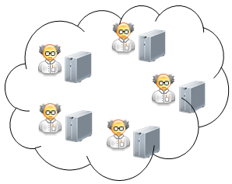
CI Server types: Dev. Program/ Central Jenkins Server
Responsibility
Responsibility
Facts:
One Jenkins Server for all Teams of a dev. program/ multiple dev. programs
Setup, config and operating outside the teams
Full responsibility in one hand/ outside the teams
Big sized VM/ HW
PROs:
Effort for initial setup only once for all teams
Standardization in CI/ Jenkins for all teams
No development capacity reduction by Jenkins admin tasks
CONs:
No/ less KnowHow on CI and Jenkins in Teams
No/ less flexibility to use/ customize Jenkins to needs of dedicate team
Team A
Team B
Jenkins CI Server
n : 1
Team C
Team D
Team n
Jenkins admin(s) outside the teams e.g. DLM or Program X >= 100% FTE

Slide 11
Ways to get a Jenkins
● SAP Jenkins Readymade https://shelf.mo.sap.corp/readymades/sap-jenkins-readymade
● Team Jenkins Readymade (sap-production) https://shelf.mo.sap.corp/readymades/Setup-xMake-Environment
● Jenkins as a Service https://jenx.neo.ondemand.com/api/
● manual… https://jenkins-ci.org

Slide 12
SAP Jenkins Readymade
Features ● https ● authentication ● standard plugins installed
More Information sapsolutions/sap-jenkins-readymade

Slide 13
Team Jenkins Readymade (sap-production)
Features ● Based on sap-jenkins-readymade https, authentication, standard plugins installed
+ Prepared for ci-connect usage Can be registered and used in ci-connect out of the box
+ Local Jobbase + Job Generator prepared Jobs automatically created/updated based on templates when service activated
More Information How to prepare and connect your own Services

Slide 14
Jenkins as a Service (Beta)
Features ● Docker based Jenkins Jenkins runs in Docker container – transparent to user
● Jenkins immediately usable Jenkins accessible right after creation of the container
Coming soon
● Image prepared for ci-connect Like Team Jenkins readymade
More Information https://account.neo.ondemand.com/cockpit → https://jenx.neo.ondemand.com/api

Slide 15
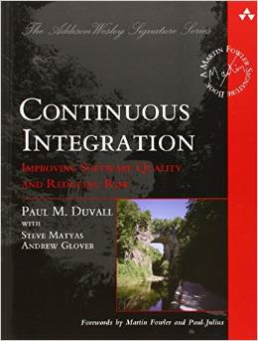
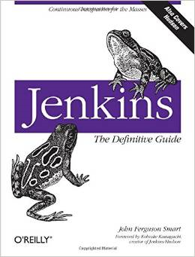
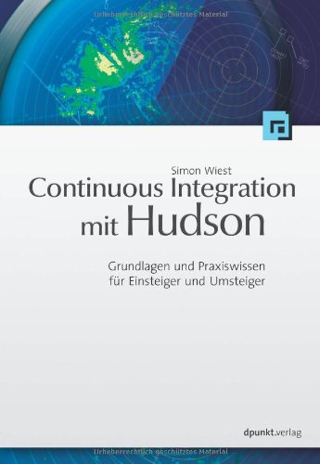
Continuous Integration & Jenkins Books
German Only
http://www.amazon.de/Jenkins-Definitive-John-Ferguson-Smart/dp/1449305350
http://www.amazon.de/Continuous-Integration-mit-Hudson-Jenkins/dp/3898646904
http://www.amazon.de/Continuous-Integration-Improving-Software-Signature/dp/0321336380
http://www.bogotobogo.com/DevOps/Jenkins/images/Intro_install/jenkins-the-definitive-guide.pdf

Slide 16
Maven Basics
Maven Basics

Slide 17

Maven – Overview
“Software project management and comprehension tool”
“The” build automation tool for Java
Convention over Configuration
De-facto standard for Java dependency management
Project definition is called project object model (POM)
Has predefined lifecycle model
Each part of the lifecycle is extendable by plugins
https://maven.apache.org/guides/getting-started/maven-in-five-minutes.html

Slide 18
Maven – Build Lifecycle
validate: validate the project is correct and all necessary information is available
compile: compile the source code of the project
test: test the compiled source code using a suitable unit testing framework. These tests should not require the code be packaged or deployed
package: take the compiled code and package it in its distributable format, such as a JAR.
integration-test: process and deploy the package if necessary into an environment where integration tests can be run
verify: run any checks to verify the package is valid and meets quality criteria
install: install the package into the local repository, for use as a dependency in other projects locally
deploy: done in an integration or release environment, copies the final package to the remote repository for sharing with other developers and projects.
https://maven.apache.org/guides/introduction/introduction-to-the-lifecycle.html

Slide 19
Maven – POM.xml
“Build, reporting and documentation from a central piece of information”
Artifact definition
<groupId>com.sap.cc</groupId> <artifactId>bulletinboard-ads</artifactId> <version>1.0.0</version>
Dependencies
<dependency> <groupId>com.sap.cc</groupId> <artifactId>bulletinboard-ads</artifactId> <version>1.0.0</version> </dependency>
Plugins
<plugin> <artifactId>maven-surefire-plugin</artifactId> </plugin>
https://maven.apache.org/guides/introduction/introduction-to-the-pom.html

Slide 20
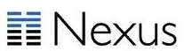
Nexus
Artifact Repository Management
Maven-style artifacts
GroupId
ArtifactId
Version
Contains both libraries and applications
Multiple repositories
For SAP: Approved libraries in internal Nexus,
https://nexus.wdf.sap.corp:8443/nexus/
http://www.sonatype.org/nexus/

Slide 21
Agenda
Exercise 02 + 03

Slide 22
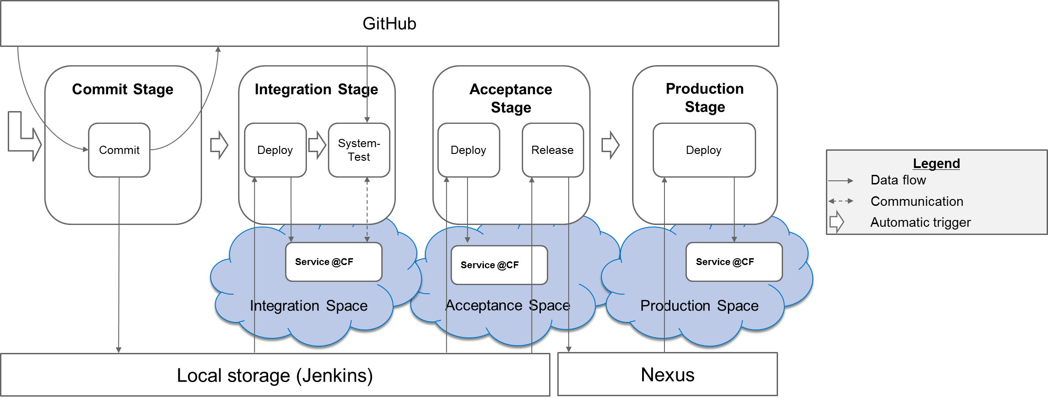
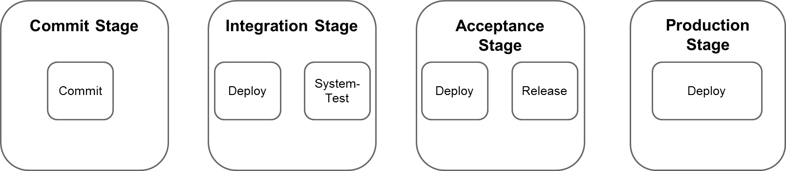
Exercises: Goal
Setup a CD pipeline in Cloud Foundry consisting of 4 stages with Jenkins

Slide 23
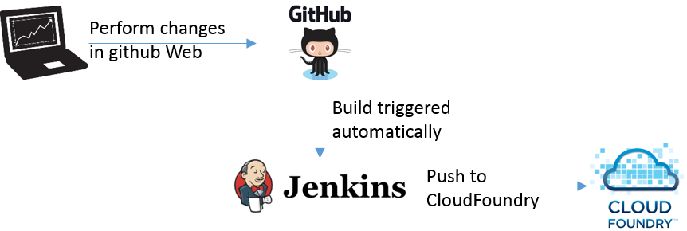
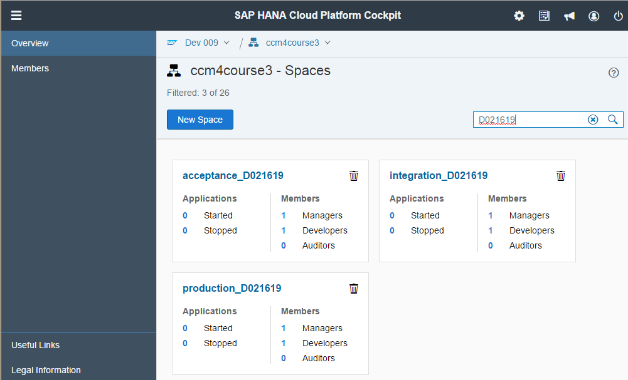
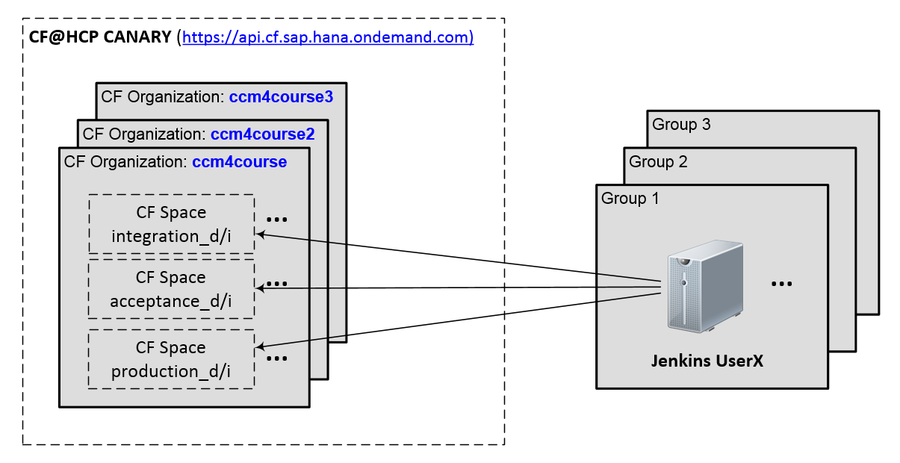
Exercises: Setup
https://accountdev009.dev009.jpaas.sapbydesign.com/cockpit#/org/c81da3eb-ee8d-4a1d-b077-73f7b887af93/overview

Slide 24
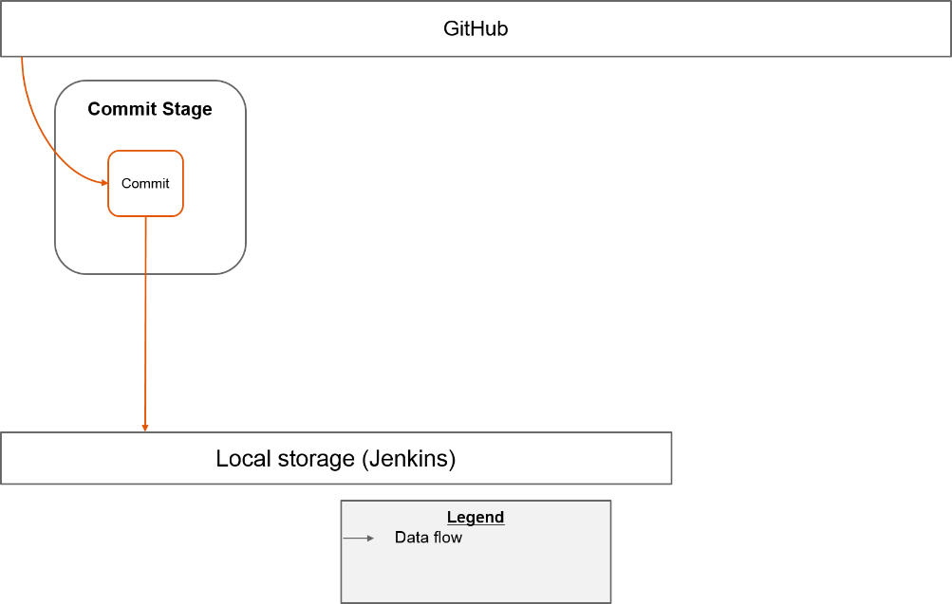
Exercises
Exercise 02: Preparations and initial steps with Jenkins
https://github.wdf.sap.corp/cc-java-dev/cc-m4-coursematerial/blob/master/Exercises/Exercise02-PreparationAndBasics.md
Exercise 03: Setup CI job in CommitStage
https://github.wdf.sap.corp/cc-java-dev/cc-m4-coursematerial/blob/master/Exercises/Exercise03-CommitStage.md

Slide 25
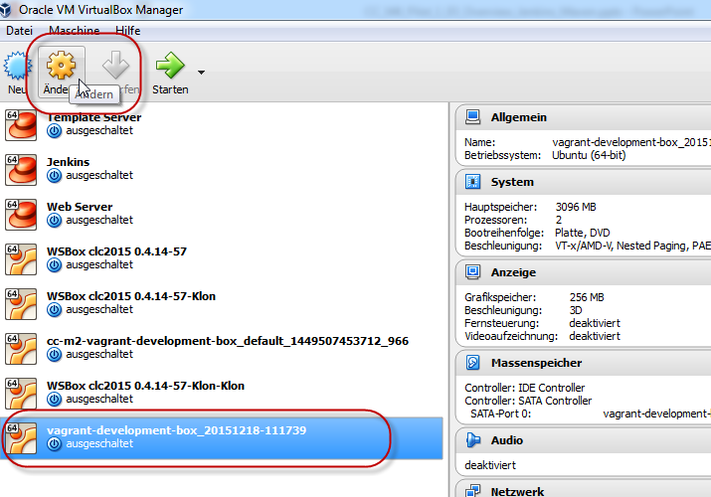
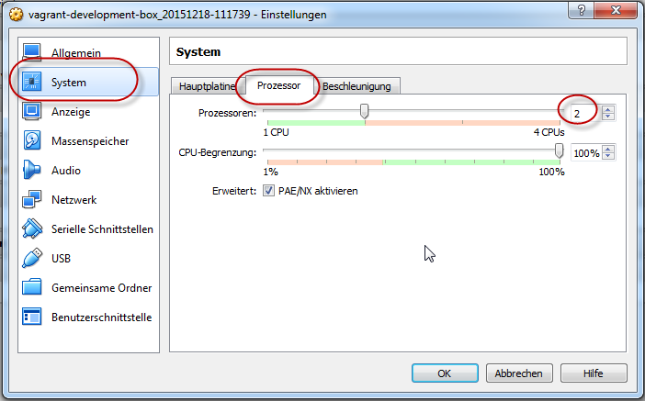
Virtual Box, VM settings: Increase CPU from 1 to 2

