Slide 1

Agenda
Cloud Foundry Basics

Slide 2
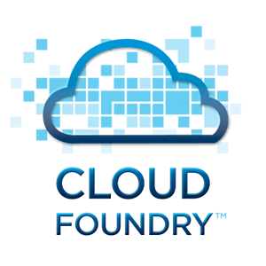
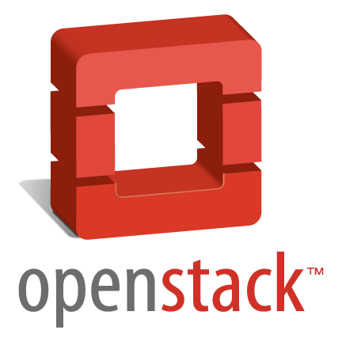
From Traditional Development to PaaS
Application Code
SaaS Applications
PaaS
Webserver
File Storage
Database
Message Bus
Search Index
OS
IaaS
[ Virtualization ]
Hardware: CPU, Memory, Disks, networks, …

Slide 3
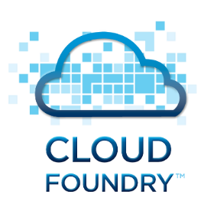
Key Elements of a PaaS / Cloud Foundry
Software as a Service (SaaS)
A PaaS (Platform-as-a-Service) is the foundation of your application
Cloud Foundry (any PaaS) gives you
Multi language environment (use what fits best): Java, Node, Go, …
Many 'backing services': DBs (SQL, No-SQL), Messaging, Blobstore, …
Resilience: High availability, no single-point-of-failure (SPOF), self-healing
Boundless scalability (theoretical): → need to program differently
All resources virtualized: CPUs, memory, disks, networks, routers, …
Monitoring: Detailed transparency on load and issues
Simple deployment (automated), simplifies devops
No manual software install, no OS maintenance
Platform as a Service (PaaS)
Infrastructure as a Service (IaaS)

Slide 4
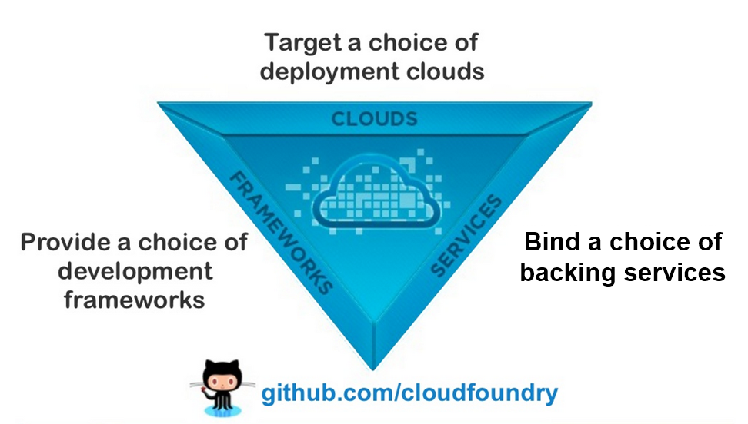
What is Cloud Foundry?
Notes:
Left: It provides a choice of development frameworks. There are many languages and frameworks to choose from and it is relatively easy for a vendor / provider to add another 'language / environment'.
Top: Cloud Foundry applications can run in any Cloud Foundry hosting environment. This means that you can write your application once and then run it in computing centers of different providers. This prevents vendor lock-in.
Right: It provides a set of backing services that can be used by your applications. These are databases etc. that are 'simply there' and the app simply can connect to it. You don't have to install a database or mail service or whatever since that is provided by the hosting company.

Slide 5
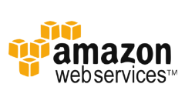



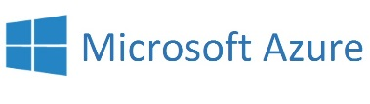

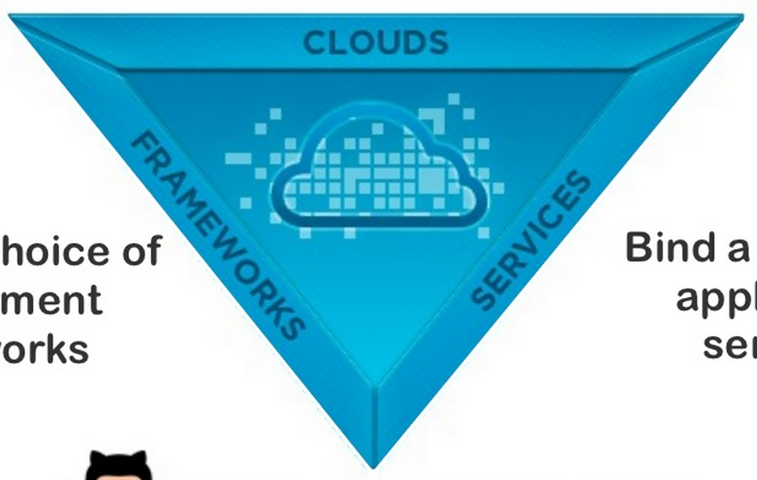



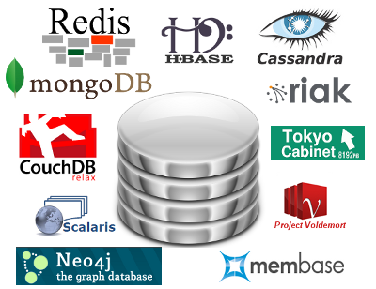



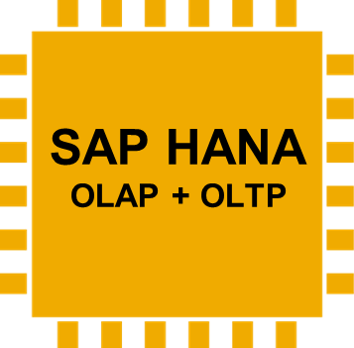

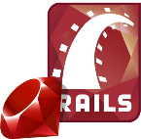







What is Cloud Foundry? Many languages, many backend services, many target platforms
Data Services
…
Messaging
Other
…
…
Notes:
Many languages, many backend services, many target platforms
Left: There are many so-called build-packs that provide many free programming languages / dev frameworks such as Java, Scala, Grails, node.js, ruby etc. and even vendor supplied packages such as .net.
Top: Here you see a list of hosters that offer Cloud Foundry. This means that you can use the cloud foundry APIs to deploy your applications to any of these environments with minimal configuration change. Even Microsoft Azure now supports CF. The CF runtime environment is Linux based.
Right: There are a few basic backing servicesthat are free and usually provided with Cloud Foundry but the actual services that are offered here are always offered and maintained by the Cloud Foundry hoster! This is how hosting companies differentiate between each other. There are several SQL databases to choose from, and many non-sql data stores like the key-value store Redis, document database MongoDB, also distributed caching services 'MemCached' and of course in our case HANA. In addition there are usually services like email, messaging (RabbitMQ), search (ElasticSearch) etc. All of these are operated by the hoster and the application simply connects to them and configures them as needed. All this means of course that the availability of the right backing services defines where you applications can really run.

Slide 6
Agenda
Cloud Foundry Organisation, Space, User/ Roles, Landscape

Slide 7
Delivery Landscape: GA Delivery 2015 & SAG Productive Test
Today
https://wiki.wdf.sap.corp/wiki/display/IoTSiemens/Landscape+and+Release+Process
PAAS
CF@HCP Dev
---------
OpenStack domain: HCP_CF
OpenStack tenant: dev01 .. devNN
CF@HCP CANARY
api.cf.neo.ondemand.com
Avail.: 20.10.
CF operated by HCP Dev
---------
OpenStack domain: HCP_CF
OpenStack tenant: hcp-canary
CF@HCP FACTORY
api.cf.hana.ondemand.com
Avail.: -
CF operated by -
---------
OpenStack domain: -
OpenStack tenant: hcp-factory
HCP (public)
CF@HCP STAGING
api.cf.staging.hanavlab.ondemand.com
Avail.: 20.10.
CF operated by HCP Dev
---------
OpenStack domain: HCP_CF
OpenStack tenant: hcp-staging
Cockpit (classical HCP)
CF@HCP Dev
Siemens
SIC-STAGING
api.cf.staging.sic.ondemand.com
Avail.: 02.10.
CF operated by SIC@sap.com
---------
OpenStack domain: HCP_IE_01
OpenStack tenant: sap-staging --> sic-staging
Backing Services
App. Security (XS2)
SAGDF-STAGING
api.cf.staging.sagdf.sic.ondemand.com
Avail.: 02.10.
CF operated by SIC@sap.com
---------
OpenStack domain: HCP_IE_01
OpenStack tenant: sagdf-staging
SAGDF-LIVE
api.cf.live.sagdf.sic.ondemand.com
Avail.:30.10.
CF operated by SIC@sap.com
---------
OpenStack domain: HCP_IE_01
OpenStack tenant: sagdf-live
HCP (virt. private)
Siemens Project
(HCP virt. private cloud)
IAAS
Converged Cloud
SWIFT
Notes:
https://github.wdf.sap.corp/cloudfoundry/cf-docs/wiki/Delivery-Process

Slide 8
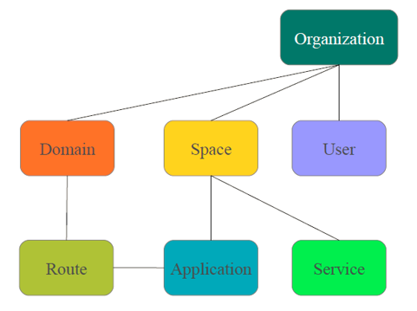
Cloud Foundry Basics – Organizations, Spaces, etc.
Micro Service e.g. bullentinboard
Backing Service e.g. PostgresSQL

Slide 9
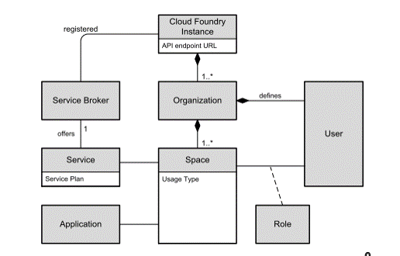
Cloud Foundry Basics – Instance, Organization, Spaces, etc.
Cloud Foundry Instance: On top level, choose the instance of the Cloud Foundry offering. For the CLI, this is called the “API endpoint”. This is like the management URL of a Web Hoster.
Organization: A development account in Cloud Foundry is called Organization. Cloud Foundry user accounts are defined per Organization.
Space: Within one Organization, multiple spaces can be used depending on the usage type, for example production, testing, sandbox. Users can have different roles depending on the space. Applications and Services are scoped to spaces.
Service Brokers: Services are offered by Service Brokers. They actually create and delete the service instances following a service plan (see below). Service Brokers are mapped to a Cloud Foundry instance.
Service Plan: One service can be offered in different service levels, called Service Plan, providing different levels of scalability and availability in the same PaaS offering. For example, a database service can be offered as a shared DB (using an application-specific DB schema and user), as an isolated DBMS instance with its own DB, or as a database cluster.
Users and Roles: You have a user within the CF instance (at SAP internally, this is connected to the central domain login so that you can use your D-/I-number and domain password). Users are assigned to organizations. Users have Roles within Spaces (e.g. Developer, Admin, etc.)
Applications / Apps: Apps are deployed into a space.

Slide 10

CF High Level Architecture
domain.com
Developer PC
Cloud Foundry
LB/router
CF PUSH app3
app1.domain.com
app2.domain.com
DEA (droplet execution agent)
32 GB RAM 16 VCPUs
cloud controller
DEA (droplet execution agent)
CLI
app1
app1
app2
app2
app3
build pack
build pack
build pack
warden
app3
OS
backing services
blob store

Slide 11
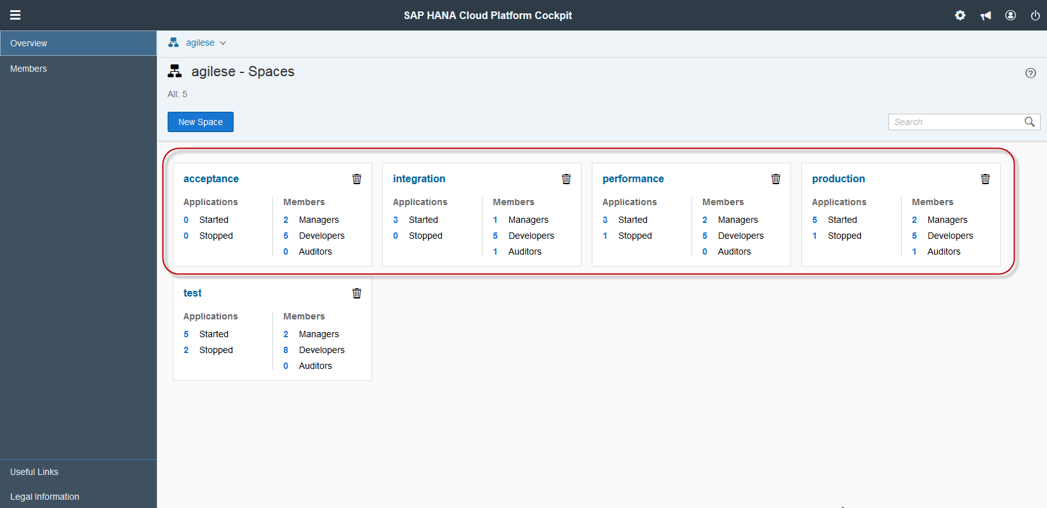
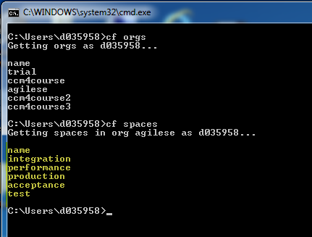
Example: Cloud Curriculum CF organization AgileSe
https://hcp-cockpit.cfapps.sap.hana.ondemand.com/cockpit

Slide 12
Reference: CF commands to deploy a service
cf api https://api.cf.sap.hana.ondemand.com/ | 'Connect' to a cloud foundry provider (URL of cloud controller). Setting is remembered.
cf login [–u username –o org] | Log in as user (use SAP domain user and password) and with an org
cf target [ –s space ] | Show or set a target space (where apps are deployed)
cf apps | Show running apps
cf push | Push app in current directory using manifest.yml to CF
cf scale –i 5 | Create 5 instances of the app
CF command cheat sheet from AnyNines

Slide 13
Cloud Foundry Roles – Organization Roles
Org Manager – Organization administration rights (full access)
Add and manage users
View users and edit org roles
View the org quota
Create, view, edit, and delete spaces
Invite and manage users in spaces
View the status, number of instances, service bindings, and resource use of each application in every space in the org
Add domains
Org Auditor – Organization view only rights
View users and org roles
View the org quota
Billing Manager – Manage billing information
Set the org spending limit
Create and set payment information
Read invoices and payment history
Create and edit the invoice notification email addresses
Official Cloud Foundry Documentation: http://docs.cloudfoundry.org/concepts/roles.html#org-roles
User Management with CF CLI: https://docs.cloudfoundry.org/adminguide/cli-user-management.html

Slide 14
Cloud Foundry Roles 2 – Space Roles
Space Manager – Space administration rights (full access)
Add and manage users in the space
View the status, number of instances, service bindings, and resource use of each application in the space
Space Developer – Manage applications and services
Deploy an application
Start or stop an application
Rename an application
Delete an application
Create, view, edit, and delete services in a space
Bind or unbind a service to an application
Rename a space
View the status, number of instances, service bindings, and resource use of each application in the space
Change the number of instances, memory allocation, and disk limit of each application in the space
Associate an internal or external URL with an application
Space Auditor – Space view only rights
View the status, number of instances, service bindings, and resource use of each application in the space
Official Cloud Foundry Documentation - http://docs.cloudfoundry.org/concepts/roles.html#space-roles

Slide 15
Cloud Foundry Role Principles 1
Only technical users (Pxxx) should be able to manipulate the spaces of the CD pipeline
Team developers should be able to view all debugging related information
Team Managers/ Project Responsibles can administer the role and space assignments of their organizations

Slide 16
Cloud Foundry Roles 2 – Organization Role User Mapping
Cloud Foundry
Team Developers
Org A
Org Auditors
D
Team Managers
Org Managers
M
T
Technical User
Billing Managers
M

Slide 17
Role Principles 3
Team Developers
have to trigger automation for deploying to staging/live environments
have full access privileges within the development space (e.g. agilese/test)
have read only access to all spaces of the CD pipeline
Team Managers
have full organization access
can manage the development team’s assignments
Technical User (Pxxx)
can only manipulate spaces of the CD pipeline
has no access to the development space

Slide 18
Cloud Foundry Roles 3 – Space Role User Mapping
M
Cloud Foundry
Org A
Team Developers
Development Space
Integration Space
Space Developers
Space Managers
Space Developers
D
M
T
Space Managers
Space Auditors
Team Managers
M
Space Auditors
D
Acceptance Space
Production Space
Space Managers
Space Developers
Space Managers
M
Space Developers
Technical User
T
T
Space Auditors
Space Auditors
D
D

Slide 19
Appendix

Slide 20
Delivery Landscape
Old
App. Services
SAP
Siemens
App. Services
PAAS
CF@HCP Dev
CF@HCP STAGING
cf.staging.ondemand.com
CF@HCP PROD
cf.neo.ondemand.com
HCP (public)
Cockpit (classical HCP Dev)
Backing Services
SIC-Staging
api.system.industrycloud-dev.sapcloud.io →
staging-mo.sic.ondemand.com
‘SIC-PROD’
api.system.industrycloud-dev.siemens.com
HCP (virt. private)
HANA
HANA
App. Security (XS 2)
IAAS
Monsoon
Notes:
https://github.wdf.sap.corp/cloudfoundry/cf-docs/wiki/Delivery-Process

Slide 21
cf push
app1.domain.com
Developer PC
Cloud Foundry
load balancer / router
DEA (droplet execution agent)
…/app1/
cloud controller
app1
container
build pack
build pack
build pack
droplet
blob store

Slide 22
Many apps, attached backing services
*.domain.com
Developer PC
Cloud Foundry
load balancer / router
app1.domain.com
app2.domain.com
DEA (droplet execution agent)
app1
app1
app2
container
container
container
backing services

Slide 23

cf push –n Orgs, Spaces, Users, …
*.domain.com
router
app1-a.domain.com
app1-b.domain.com
Org: trial (/product)
Space: D123456
Space: D654321
app1
app2
…
app1
app2
backing services

