Slide 1



Test Strategy
Speaker’s Name, SAP (delete if not needed) Month 00, 2016

Slide 2
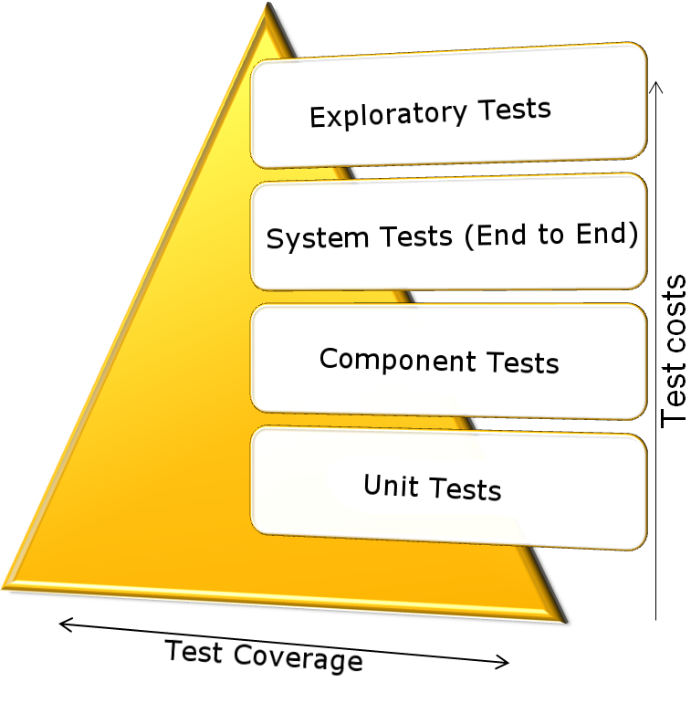
Agile Testing Strategy
Reduce Test Scope
Easier to write & maintain
Eases error localization
Focus on own functionality
System tests test service interaction
Test types complement each other
Test Pyramid on ASE WIKI
Notes:
Unit tests focus on functional correctness of (parts of) a feature. Use appropriate test doubles to focus on your own unit and isolate from classes that are not under your control, have heavyweight computation logic, are fragile, under construction etc.
You don’t want to test heavyweight computation logic of other classes in the unit tests of your class! Rather have separate unit tests for these other classes with heavyweight computation logic – and then have a component test with a few simple cases that make sure the units in your component integrate well.
Component tests focus on integration of your units (see above) as well as integration with frameworks/services/resources local to the component, such as:
Data base layer / SQL (e.g. JPA/EclipseLink – javax.persistence) – consider using an in-memory data base like derby, hsql, h2, …
Web layer / Http layer (e.g. CXF – javax.ws.rs, javax.servlet) – consider startup of an embedded server on-the-fly in the test setup
NOT TO BE TESTED IN COMPONENT TEST: integration with services/resources external to the component, such as other micro service or external web service
Component tests may also focus on testing functional correctness, but not as heavily as unit tests. Try not to test all combinations of deeply nested if/for/switch blocks in a component test – they’re too slow and more expensive to maintain (need to bring all required data into the data base, need different data for different cases, etc.!)
System tests focus on whether all components integrate well. Only a few straightforward scenarios. You know your computations are correct for all the different cases from the unit tests, and you also know your component tests that each component integrates well with its local units and services/frameworks/resources.
Now in the System tests, focus on
Errors are easier to localize: if a unit test fails, it’s an issue in the unit itself. If a component test fails, but no unit test, then your units do not integrate with each other or with the local frameworks/services/resources (e.g. incorrect javax.ws.rs annotation used). If only a system test fails then it’s an issue related to communication between micro services / external services, e.g. API changed in incompatible way.
What is left is manual tests. We want exploratory tests instead of scripted manual tests. Scripted manual tests should rather be automated, this is cheaper. We want the testers to find the issues that nobody likes to have in production, the issues that nobody expected. Such issues cannot be found by scripted tests, hence we rely on exploratory tests.
Try to cover >80% of your code in unit and component tests. What should be left is the “gluecode”, e.g. the code for the connection to the “real” database. This is straightforward code without any if/else or computation and you simply didn’t cover it because you used an in-memory db in your component test. Therefore the simplest system test is sufficient, e.g. just display all items in the system. This will connect to the data base and exercise the missing code.

Slide 3
Applying Agile Testing Strategy in Practice
Unit tests
Plain JUnit
Use test doubles to test unit in isolation from DB / web layer

Slide 4
Applying Agile Testing Strategy in Practice
Component tests
Integration with DB and web layer
Use in-memory data base like H2 and embedded Tomcat server

Slide 5
Applying Agile Testing Strategy in Practice
System tests
In integration space, setup close to production
Use HTTP client lib to send HTTP requests to the system in the cloud

Slide 6
Applying Agile Testing Strategy in Practice
Exploratory tests
Regularly in test space and production space (canary!?)
In acceptance space as part of the release process

Slide 7
Example: System Tests
Jenkins
Cloud Foundry
System Tests
My Microservice
Another Service
HTTPS / REST
Another Service
PostgreSQL
Notes:
Test the microservice in integration:
Integration with data base
Integration with other microservices
Ideally do this in an environment close to production
=> CloudFoundry is a perfect fit for this as we can just create an integration space with similar/identical setup than the production space

Slide 8
Integration Stage

Slide 9
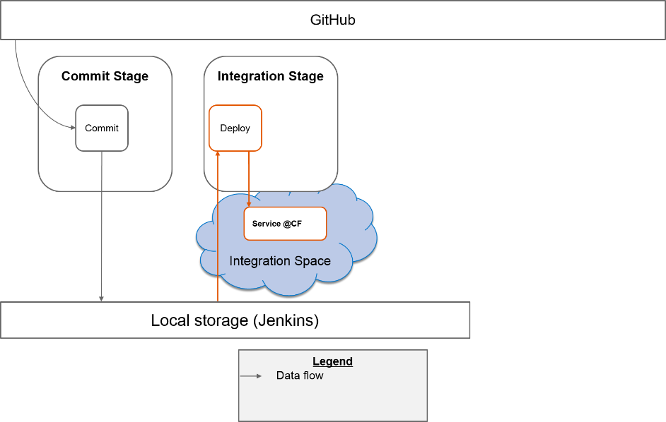
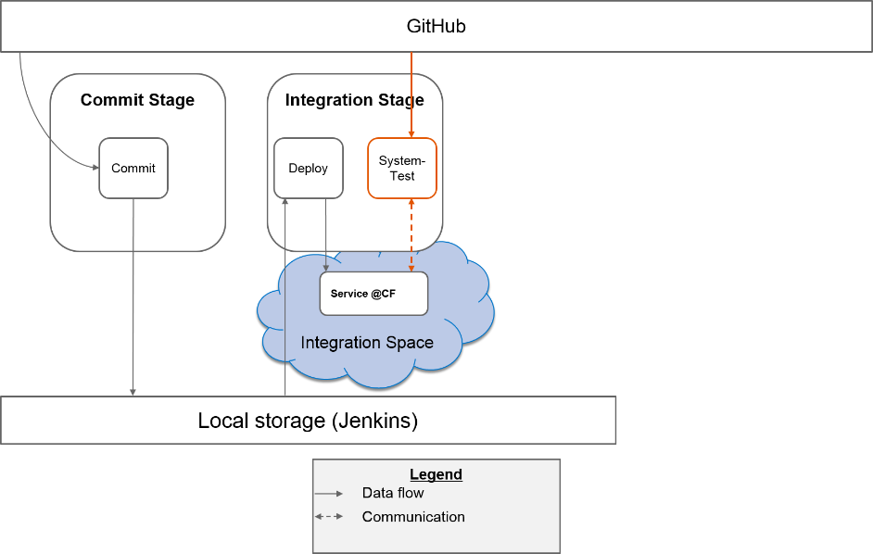
Exercise: Integration Stage
Part 1: Deploy
https://github.wdf.sap.corp/cc-java-dev/cc-m4-coursematerial/blob/master/Exercises/Exercise04-IntegrationStage-Part1.md
Part 2: System Test
https://github.wdf.sap.corp/cc-java-dev/cc-m4-coursematerial/blob/master/Exercises/Exercise04-IntegrationStage-Part2.md

Slide 10
Text
Only if needed
Text
Only if needed
Text
Notes /
Description

