Slide 1



Job Orchestration Poll vs. Commit Hook / Impact on CD Pipeline

Slide 2
Job Orchestration

Slide 3
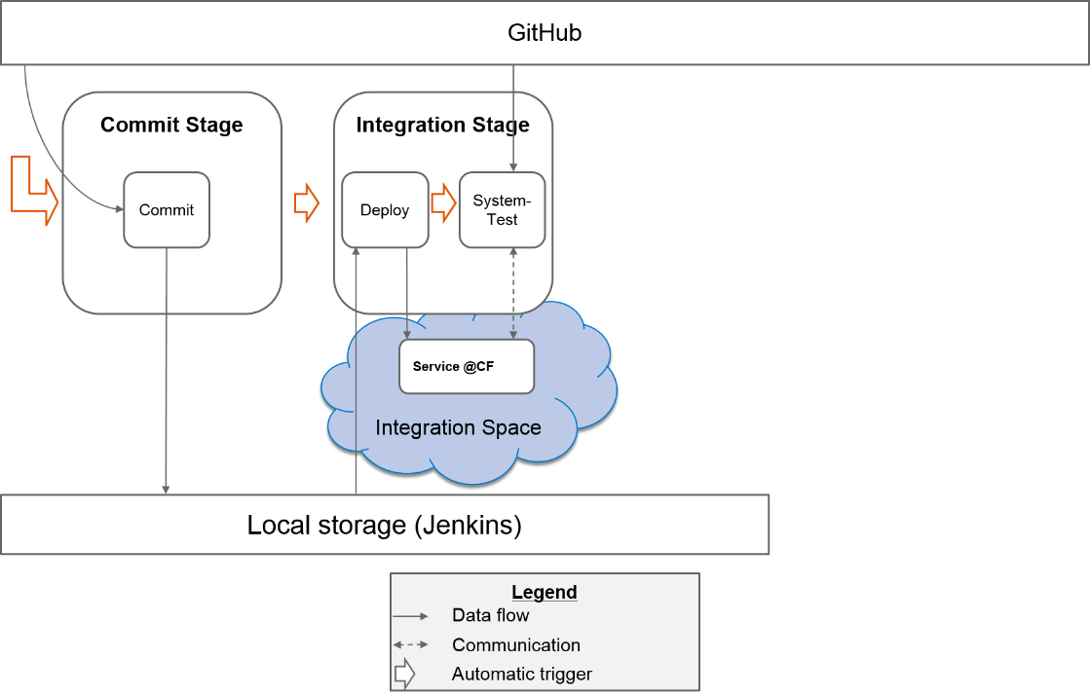
Exercise: Job Orchestration
Link to exercise:
https://github.wdf.sap.corp/cc-java-dev/cc-m4-coursematerial/blob/master/Exercises/Exercise05-AutomatePipeline.md

Slide 4
Poll vs. Commit Hook: Impact on CD Pipeline
Polling means delay
Polling is expensive
Neither strategy can guarantee ”1 commit => 1 build”
Notes:
Polling means delay:
Poll every 10 minutes => up to 10 minutes waiting time until your commit gets built
Polling is expensive:
To reduce delay, poll every minute => what if 100 Jenkins servers with 100 jobs do this?
Creates network traffic even when no changes in the repository
Limitations:
Polling: multiple commits in one build if commits pushed faster than polling interval
Commit hook: multiple commits in one build if commits pushed faster than build time
Can be avoided by allowing parallel builds

Slide 5
Demos
Simple polling:
demo_poll.mp4
Commit hook without parallelization:
demo_commithook_nonparallel.mp4
Commit hook without parallelization:
demo_commithook_parallel.mp4

Slide 6
Keeping the Pipeline Fast: Constraints & Strategies
Constraints: Job Execution Time, “Singletons”
Strategies
Fast Job Execution
Parallelization (Singletons? Cost?)
Locks (Starvation?)
Notes:
Singletons: e.g. file system directories, cloud foundry spaces, servers, …
Fast Job Execution is best
Cost of parallelization = cost of circumvent singletons: e.g. cloud foundry space pooling or other resources is not for free

