Slide 1
Automatic Versioning

Slide 2
Maven Release Plugin and Continuous Delivery
Why SNAPSHOTs?
Releasing means changing the POM – implications?
What would you like to depend upon?
Notes:
Why Snapshots?
=> Want to get new functionality from other teams quickly
Implications of changing the POM for a release
=> Need to build and test again for release
What would you like to depend upon
=> providing team of a module often considers the snapshot as a „temporary version“, and it is!
=> often not tested at all or only some smoke tests

Slide 3
Maven Release Plugin and Continuous Delivery
Build SNAPSHOT
Test
Changes not only own version, but potentially also dependencies
Deliver / Go Live
What about the tests?
Build RELEASE

Slide 4
Maven Release Plugin: Steps
Check: no uncommitted changes, no SNAPSHOT dependencies
Change version in POMs from 1.0-SNAPSHOT to 1.0
Run Maven tests
Commit modified POMs
Create SCM tag
Change version in POMs from 1.0 to 1.1-SNAPSHOT
Commit modified POMs
What about system level tests?
Can cause conflict
Can cause conflict

Slide 5
Maven Release Plugin and Continuous Delivery
Unfortunately, but naturally, users tend to think that the release plugin embodies all best practices for Maven with respect to releases, but in practice many people accept it's flaws
Jason van Zyl, creator of Maven

Slide 6
Maven Release Plugin and Continuous Delivery
Maven Mailing List
http://maven.40175.n5.nabble.com/Continuous-Delivery-and-Maven-td3245370.html
Lucas Ward - Maven and Continuous Delivery
http://www.lucasward.net/2010/11/maven-and-continuous-delivery.html
Kief Morris - The Conflict Between Continuous Delivery and Traditional Agile
http://kief.com/the-conflict-between-continuous-delivery-and-traditional-agile.html
Axel Fontaine – The Final Nail in the Coffin
http://axelfontaine.com/blog/final-nail.html

Slide 7
Automatic Versioning: A Clean Approach
Requirements
A version of a software will be built only once(!) and centrally
Each (successful) build of an artifact is a release-candidate
In case of failure in production – find the responsible commit fast
Only one branch (master)

Slide 8
Automatic Versioning In case of failure in production – find the responsible commit fast
Maven Version:
<POM-VERSION>-<DATE>-<TIME>_<COMMIT ID>
0.0.1-20151113-141613_00f64640224c46519a7e34d61da813678ee9e693
(Marked red: Fixed, taken from pom.xml 1:1. No change by automated versioning !)
Version
given by dev
32 bit integer
String

Slide 9
Automatic Versioning In case of failure in production – find the responsible commit fast
Use tags
Like most VCSs, Git has the ability to tag specific points in history as being important. Typically people use this functionality to mark release points (v1.0, and so on).
https://git-scm.com/book/en/v2/Git-Basics-Tagging
Tags:
<BUILD/RELEASE>_<VERSION>-<DATE>-<TIME>_<COMMIT ID>
BUILD_0.0.1-20151113-141613_00f64640224c46519a7e34d61da813678ee9e693
RELEASE_0.0.1-20151113-141613_00f64640224c46519a7e34d61da813678ee9e693
(Marked red: Fixed, taken from pom.xml 1:1. No change by automated versioning !)

Slide 10
Automatic Versioning Build only once and centrally
GitHub
Jenkins
Acceptance Stage
3
Performance Stage
Integration Stage
build
release
Legend
Stage
Git-Tag
Commit
Branch
master
2
Commit Stage
1
Hint: The version has to be set before the build

Slide 11
Automatic Versioning Build only once and centrally
GitHub
Jenkins
Acceptance Stage
build
Performance Stage
master
Integration Stage
build
release
Legend
Stage
Git-Tag
Commit
Branch
2
Commit Stage
1
Hint: The version has to be set before the build

Slide 12
Automatic Versioning Build only once and centrally
GitHub
Jenkins
build
release
3
Acceptance Stage
master
build
Performance Stage
Integration Stage
build
release
Legend
Stage
Git-Tag
Commit
Branch
2
1
Commit Stage
Hint: The version has to be set before the build

Slide 13
Automatic Versioning: A Clean Approach
Example: https://github.wdf.sap.corp/cc-java-dev/cc-bulletinboard-ads-spring-cxf-tomcat
GitHub
Legend
Git-Tag
Commit
Branch
master
build
release
build
build
release
build
Summary
Each (succesful) build of software version/ artifact gets tagged with a BUILD tag
Each software version/ artifact, passed the complete CD Pipeline gets tagged with a RELEASE Tag
Only one branch (master)

Slide 14
(Branchless) Tags vs separate Branch Comparison of the Git History
GitHub
GitHub
build
release
release
>merge<
master
vs
>merge<
build
release
Legend
Git-Tag
Commit
Branch
master
build
build
release

Slide 15
(Branchless) Tags vs separate Branch What the developer sees
GitHub
GitHub
build
release
release
>merge<
master
vs
>merge<
build
release
Legend
Git-Tag
Commit
Branch
master
build
build
release
Needs to be required explicitly

Slide 16
(Branchless) Tags vs separate Branch How the actual push works
GitHub
GitHub
build
release
release
>merge<
master
vs
>merge<
build
release
Legend
Git-Tag
Commit
Branch
master
build
build
release
git add pom.xml
git commit -m "update version"
git tag "BUILD_$ARTIFACT_VERSION"
git push origin "BUILD_$ARTIFACT_VERSION"
git add pom.xml
git commit -m "update version"
git merge origin/release --strategy-option ours
git push origin HEAD:release

Slide 17
(Branchless) Tags vs separate Branch How to checkout the responsible commit?
GitHub
GitHub
build
release
release
>merge<
master
vs
>merge<
build
release
Legend
Git-Tag
Commit
Branch
master
build
build
release
export RELEASE_TAG=RELEASE_$VERSION
git checkout "$RELEASE_TAG"
manual search (without using tags)

Slide 18
CD vs Classic (e.g. Fiori)
GitHub
GitHub
master
build
master
build
release
rel-1.2
vs
rel-1.1
build
release
Legend
Git-Tag
Commit
Branch
build
build
release

Slide 19
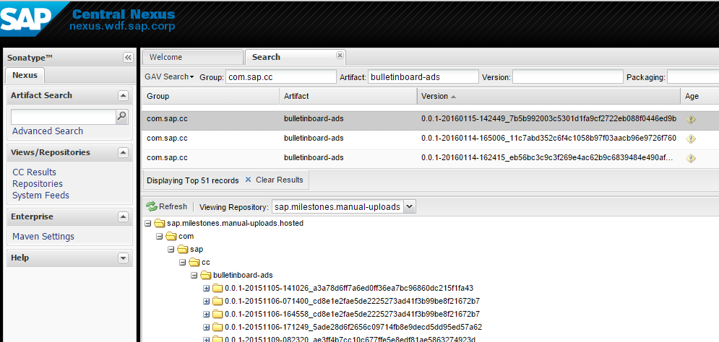
Automatic Versioning In case of failure in production – find the responsible commit fast
Screenshot Nexus

Slide 20

Agenda
Exercise 06

Slide 21
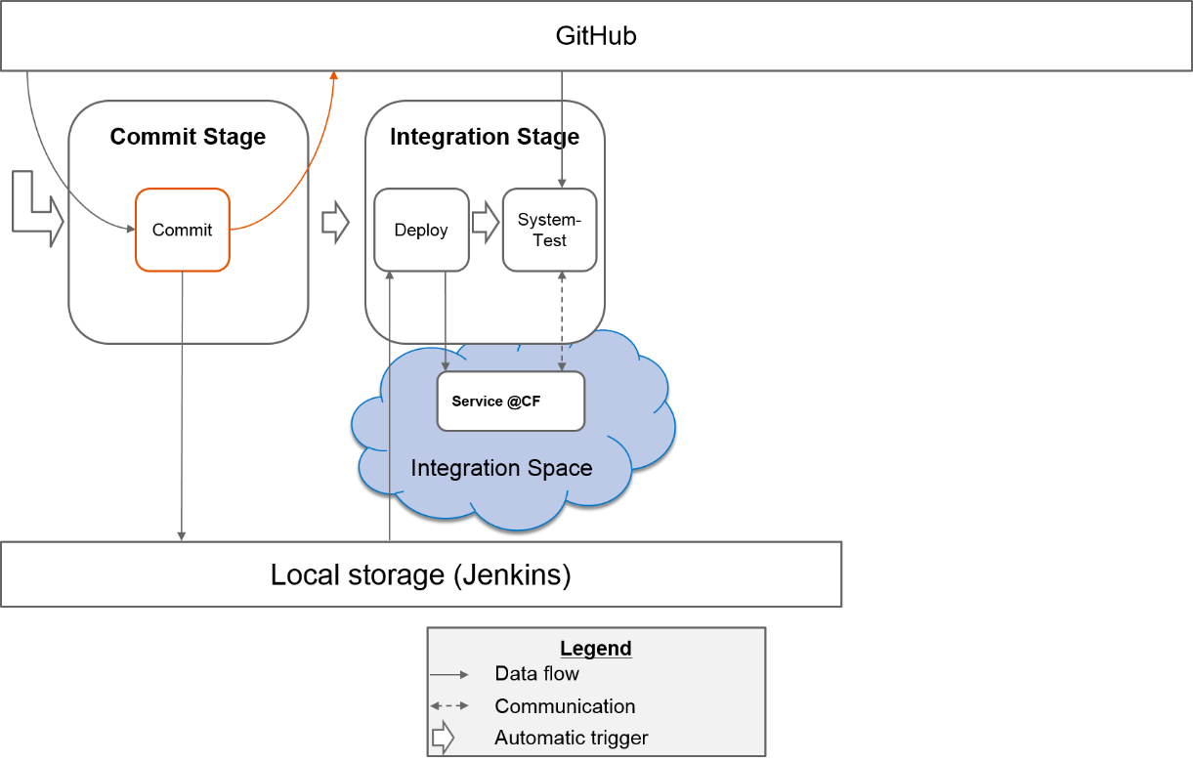
Exercises
Exercise 06: Automated Versioning
https://github.wdf.sap.corp/cc-java-dev/cc-m4-coursematerial/blob/master/Exercises/Exercise06-AutomateVersioning.md

