Slide 1

Agenda
CD Pipeline execution/ Releasing – Automated vs manual

Slide 2



Continuous Deployment Pipeline A software version/ artifact will be qualified through the CD pipeline from stage to stage
Commit 3
Commit 1
Commit 2
Commit 4
Version control
ü
Build Unit Test
Qualify
Qualify
V 1.5
Commit
Integration
Acceptance
Production
V 1.3
V 1.1
V 1.3
V 1.3
V 1.2
V 1.3
V 1.2
V 1.1
V 1.2
V 1.2
V 1.1
V 1.4
V 1.1
V 1.0
V 1.3
V 1.2
V 1.3
V 1.2
V 1.0
V 1.3
Qualify
Stop the line
Stop the line
Stop the line
Artifact repositories

Slide 3


Continuous Delivery Pipeline Manual start of Acceptance Test Stage
Version control
CD Pipeline qualifies newly build release candidates continuously
Build Unit Test
Qualify
Qualify
Commit
Integration
Acceptance
Production
Only until Integration Stage succesfully qualified release candidates are candidates for Acceptance stage
Manual decision, which which release candidates shall go into Acceptance stage
Qualify
Nexus
Release
Temp./Staging
V 1.5
V 1.4
V 1.3
V 1.2
V 1.1
V 1.0
V 1.3

Slide 5
Deployment Pipeline A software version/ artifact will be qualified through the CD pipeline from stage to stage
Commit 3
Commit 1
Commit 2
Commit 4
Version control
Build Unit Test
Qualify
Qualify
V 1.5
Commit
Integration
Acceptance
Production
V 1.3
V 1.1
V 1.3
V 1.2
V 1.4
V 1.3
V 1.2
V 1.1
V 1.2
V 1.2
V 1.1
V 1.4
V 1.1
V 1.0
V 1.3
V 1.2
V 1.4
V 1.3
V 1.2
V 1.0
V 1.5
V 1.3
Qualify
Stop the line
Stop the line
Stop the line
Artifact repositories

Slide 6
Continuous Delivery Pipeline Manual promotion to Nexus (Release)
Version control
CD Pipeline qualifies newly build release candidates continuously
Build Unit Test
Qualify
Qualify
Commit
Integration
Acceptance
Production
Only in Acceptance Stage succesfully qualified release candidates are candidates for promotion to Nexus (Release)
Manual decision, which release candidates - fully qualified in Acceptance stage - shall get promoted to Nexus (Release)
Qualify
Nexus
Release
Temp./Staging
V 1.5
V 1.4
V 1.3
V 1.2
V 1.1
V 1.0
V 1.3

Slide 8
Continuous Delivery Pipeline Manual set productive
Version control
Manual decision, which release version shall set productive
ü
Build Unit Test
Qualify
Qualify
Commit
Integration
Acceptance
Production
Only released versions are candidates for set productive
Qualify
Nexus
Release
Temp./Staging
V 1.5
V 1.2
V 1.1
V 1.0
V 1.4
V 1.3

Slide 9
Agenda
Exercise 07.1 + 07.2

Slide 10
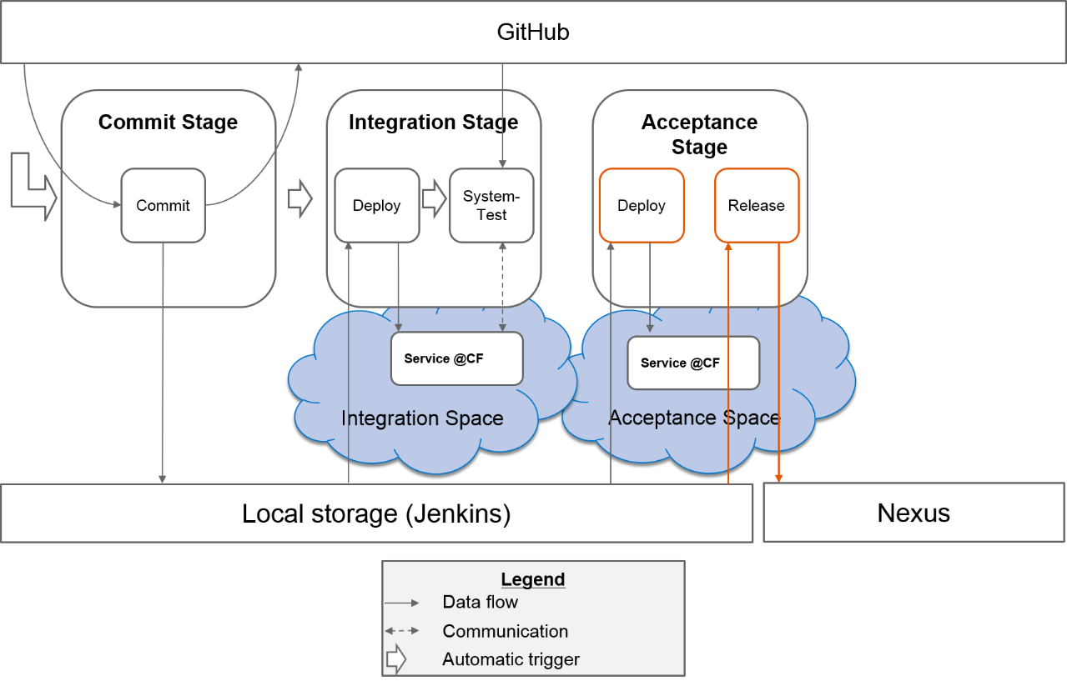
Exercises
Exercise 07: Acceptance-Stage-Part1
https://github.wdf.sap.corp/cc-java-dev/cc-m4-coursematerial/blob/master/Exercises/Exercise07-AcceptanceStage-Part1.md
Exercise 07: AcceptanceStage-Part2
https://github.wdf.sap.corp/cc-java-dev/cc-m4-coursematerial/blob/master/Exercises/Exercise07-AcceptanceStage-Part2.md

Slide 11
Appendix

Slide 12
CC M2/M4 Continuous Delivery/ Deployment Pipeline
Version control
Commit
Integration
Performance
Acceptance
Production
Automated versioning
Upload artifact V 1.0
Team Jenkins
Download artifact V 1.0
Download artifact V 1.0
Download artifact V 1.0
Team Jenkins
Upload artifact V 1.0
Download artifact V 1.0
Artifact repositories
Local (Team Jenkins)
Nexus (Manual Uploads)

Slide 13
CC M2/M4 Continuous Delivery/ Deployment Pipeline
Future
Version control
xmake Jenkins
- Automated Versioning - Compile - Unit/ IntegrationTests - Static Codechecks - Code Coverage - Open Tasks/ Compiler Warnings
- System Tests
- Load Tests
- Manual Acceptance tests - tbd
- Monitor - Operate - Incident handling
Commit
Integration
Performance
Acceptance
Production
Upload artifact V 1.0
Download artifact V 1.0
Download artifact V 1.0
Download artifact V 1.0
Download artifact V 1.0
Artifact repositories
xmake Jenkins
Nexus (Temporary storage)
Nexus Release)
Promote artifact V 1.0

