Slide 1



Zero-Downtime Deployment
© Frank Schulenburg / CC-BY-SA-3.0

Slide 2
Blue-Green Deployment
Zero downtime
Public route A.<domain>
Should be available at all times
Cf push has downtime
Cannot undeploy old version and deploy new version instead
A.<domain>
Router
A 1.0
https://docs.pivotal.io/pivotalcf/devguide/deploy-apps/blue-green.html
http://martinfowler.com/bliki/BlueGreenDeployment.html

Slide 3
Blue-Green Deployment
Upload new version of the App
cf push A-green
A-green available via default route A-green, but not via A
A.<domain>
Router
A-blue 1.0
A-green 2.0
https://docs.pivotal.io/pivotalcf/devguide/deploy-apps/blue-green.html
http://martinfowler.com/bliki/BlueGreenDeployment.html

Slide 4
Blue-Green Deployment
Map main route to new version
cf map-route A-green –n A <domain>
Both applications now available on same route
Routing algorithm round robin (on the instances)
A.<domain>
Router
A-blue 1.0
A-green 2.0
https://docs.pivotal.io/pivotalcf/devguide/deploy-apps/blue-green.html
http://martinfowler.com/bliki/BlueGreenDeployment.html

Slide 5
Blue-Green Deployment
Unmap the main route to the old version
cf unmap-route A-blue –n A <domain>
A.<domain>
Router
A-blue 1.0
A-green 2.0
https://docs.pivotal.io/pivotalcf/devguide/deploy-apps/blue-green.html
http://martinfowler.com/bliki/BlueGreenDeployment.html

Slide 6
Blue-Green Deployment
Stop the old version
cf stop A-blue
A-blue can be reused for the next version
A.<domain>
Router
A-green 2.0
https://docs.pivotal.io/pivotalcf/devguide/deploy-apps/blue-green.html
http://martinfowler.com/bliki/BlueGreenDeployment.html

Slide 7
Blue-Green Deployment
Stop the old version
(cf scale A-blue –i 0)
Make sure all pending request are answered before stopping the app
cf stop A-blue
(cf delete A-blue)
Delete is optional
A.<domain>
Router
A-green 2.0
https://docs.pivotal.io/pivotalcf/devguide/deploy-apps/blue-green.html
http://martinfowler.com/bliki/BlueGreenDeployment.html

Slide 8
8.1 + 8.2 – Production Stage

Slide 9
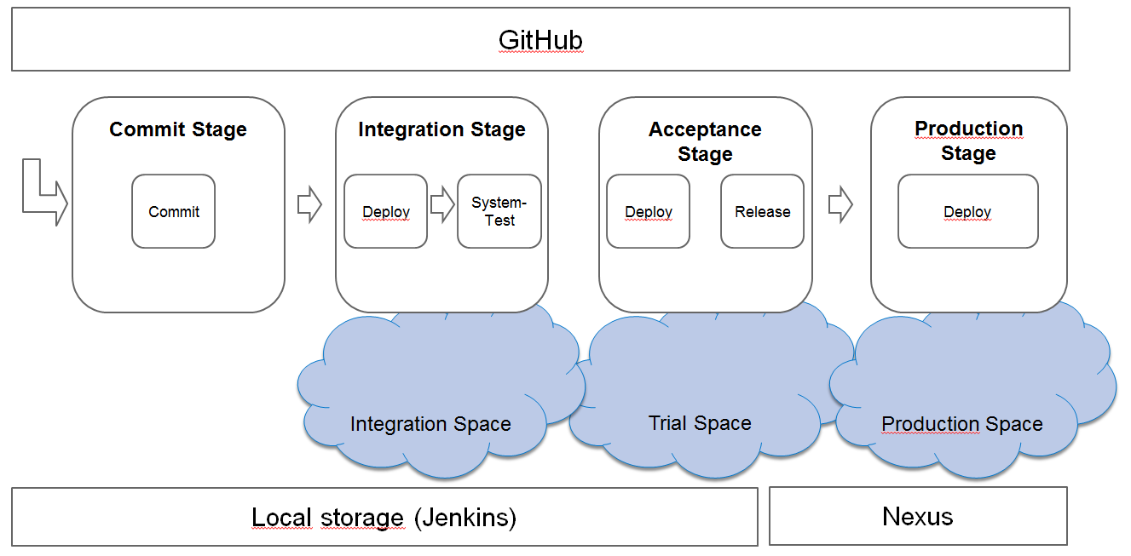
Exercises
Exercise 08: ProductionStage-Part1
https://github.wdf.sap.corp/cc-java-dev/cc-m4-coursematerial/blob/master/Exercises/Exercise08-ProductionStage-Part1.md
Exercise 08: ProductionStage-Part2
https://github.wdf.sap.corp/cc-java-dev/cc-m4-coursematerial/blob/master/Exercises/Exercise08-ProductionStage-Part2.md

Slide 10
Canary Deployment
Controlled release of new versions to a specific group of users
Fine grained variant of Blue-Green Deployment
A.<domain>
Router
A 1.0
A 2.0
http://martinfowler.com/bliki/CanaryRelease.html

Slide 11
Canary Deployment
Make new version available to only a subset of users
Internal test users
A percentage of users
A geographic subset of users
A.<domain>
Router
Most users
Small subset of users
A 1.0
A 2.0
http://martinfowler.com/bliki/CanaryRelease.html

Slide 12
Canary Deployment
Gradually increase load on new version
While closely monitoring
A.<domain>
Router
e.g. 50%
e.g. 50%
A 1.0
A 2.0
http://martinfowler.com/bliki/CanaryRelease.html

Slide 13
Canary Deployment
Switch to new version
A.<domain>
Router
A 1.0
A 2.0
http://martinfowler.com/bliki/CanaryRelease.html

Slide 14
Canary Deployment – Facebook style
Employees
Users
Router
Small subset
Most users
Canary #1
Canary #2
Canary #3
New release
http://martinfowler.com/bliki/CanaryRelease.html

Slide 15
Canary-Deployment
Not supported with plain CF API
Requires sophisticated and dynamic control over routing
Can test new version in production environment without affecting stability
Can expose new version to a small amount of users first
Good monitoring required to actually benefit from gradually increasing load on new version
Have to manage multiple running versions at once

Slide 16
Canary-Deployment – Proof of concept
Configure
Route-Distribution
CF Router
Canary-Router App
A V1.0
A V2.0
Notes:
For the demo
Login to ccm4course3/canary-XXX
Make sure approuter is started
Checkout cc-m4-automation-scripts
cd autoscaler
Check manifest.yml, show environment parameters and start-command given to script
Ruby copy.rb push
Make sure old application is started
From scripts directory, call „ruby automator/cf_automator_canary.rb <routeradress> <appname> <manifest-file>“
„https://bulletinboard-approuter.cfapps.sap.hana.ondemand.com bulletinboard-ads manifest-1.0.1.yml“
P10
Show that sometimes, the new version is displayed
P100
R
F

Slide 17
Canary-Deployment – Open Questions
Who operates the Router?
How long do I keep my Canaries?
When do I increase load?
When is the added complexity worth using it?
Is it possible to fully automate Canary Deployment based on (automated) monitoring?
Discussion?

