Slide 1
Quality Metrics

Slide 2




Quality Metrics
Jenkins plugins for code quality tools
FindBugs, PMD, Warnings, ESLint, …
Analysis usually done by Maven, not Jenkins (pom.xml)
ESLint
Notes:
Analysis: e.g. “TaskScanner” just scan the source code, “Warnings” just scans the console log => no Maven config required
ESLint: can persist in checkstyle-compliant xml, so the Jenkins checkstyle plugin can be used for visualization

Slide 3
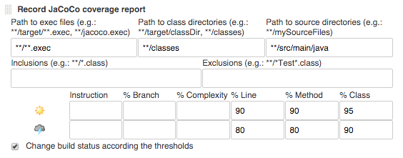
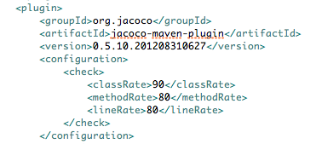
Quality Metrics
Jenkins for visualization, optionally thresholds
Local visualization: Eclipse plugins (caution!) or “mvn site” (tedious)
Thresholds: Prefer Maven over Jenkins configuration
Notes:
Local visualization:
Eclipse plugins: if Eclipse plugin needs own config, can get inconsistent with maven configuration
“mvn site” is tedious for a developer => do you even need the charts locally if they’re already visible on Jenkins?
Thresholds: if configured in Jenkins, how can developer reproduce an issue locally, e.g. if job fails because coverag <70%:
A) trial-and-error: write some tests, then push to Jenkins and hope the build passes now
B) local plugin or additional mvn config: double-maintenance=>inconsistencies + may calculate different than Jenkins plugin
Downside of threshold configuration in Maven: cannot distinguish between “unstable” and “failure”
Jenkins plugin
Instruction: single Java byte code instructions
Branch: e.g. “if” statement is one line, but 2 branches
Complexity: cyclomatic complexity (#of independent execution paths in a method => e.g. deep nesting of if/for/switch implies many execution paths => hard to test all paths)

Slide 4
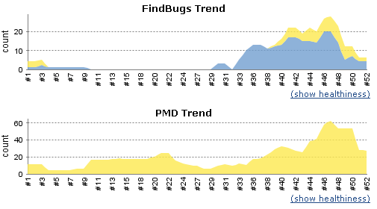
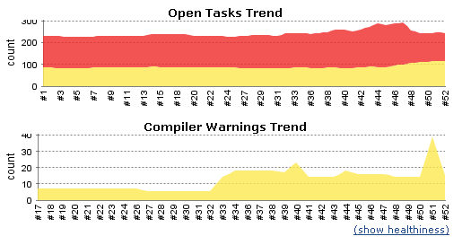
Example: Jenkins Trend Graphs

Slide 5

Exercise
Extend Commit Stage with Quality Metrics

Slide 6
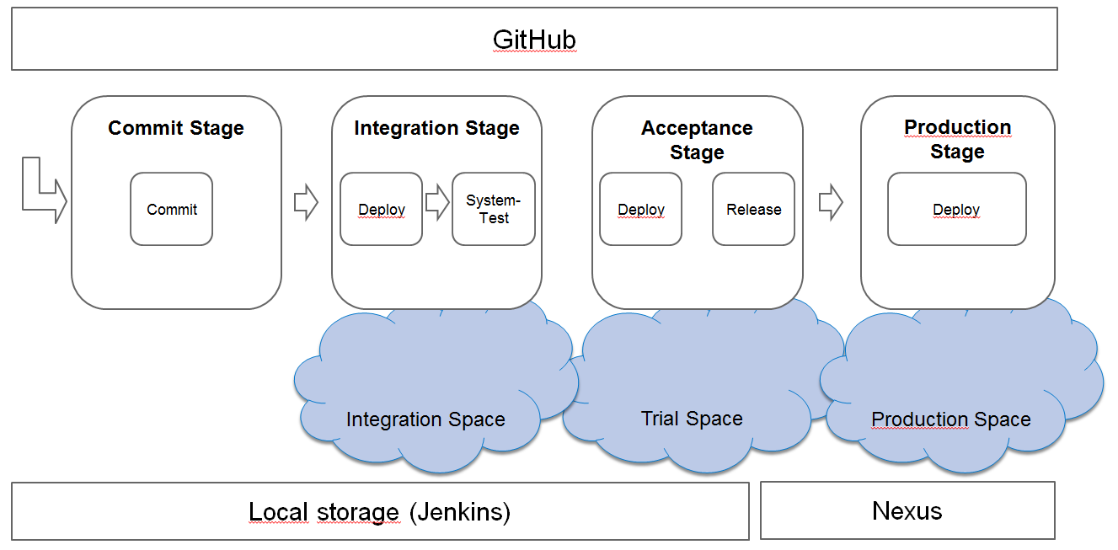
Exercise: Extend Commit Stage with Quality Metrics
Link to exercise: https://github.wdf.sap.corp/cc-java-dev/cc-m4-coursematerial/blob/master/Exercises/Exercise09-QualityMetrics.md

