Slide 1

Agenda
CD Pipeline Visualization/ Dashboards/Trafficlights

Slide 2
CD Pipeline Visualization/ Dashboards/Trafficlights
Zheng, Ralf
Dashboard
Build Pipeline
Delivery Pipeline
Traffic Lights
Remote View Plugin

Slide 3
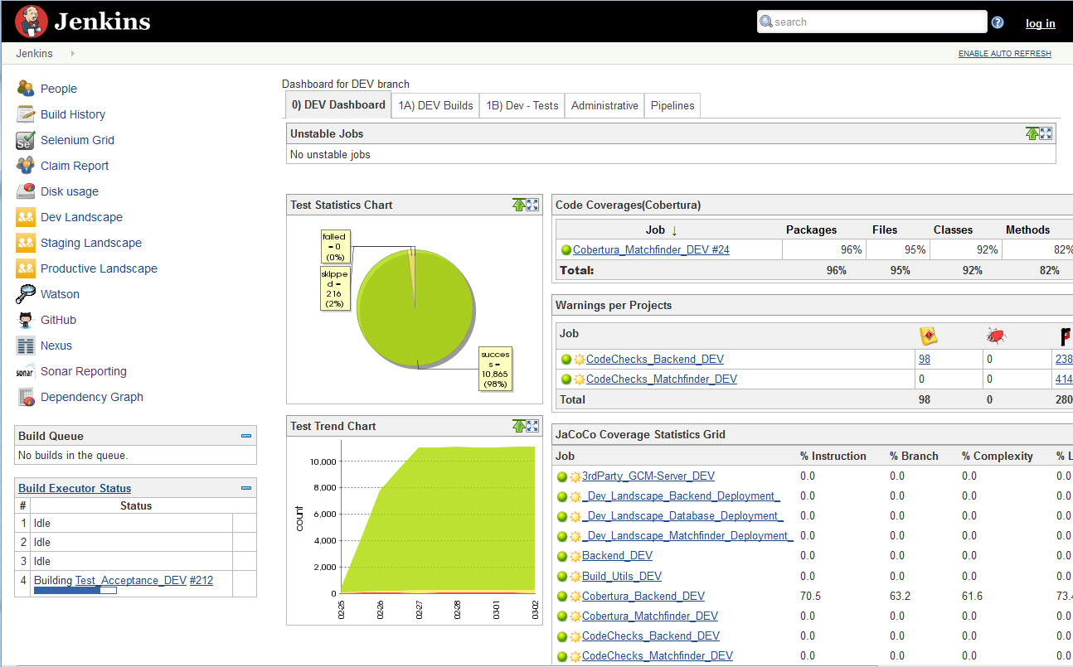
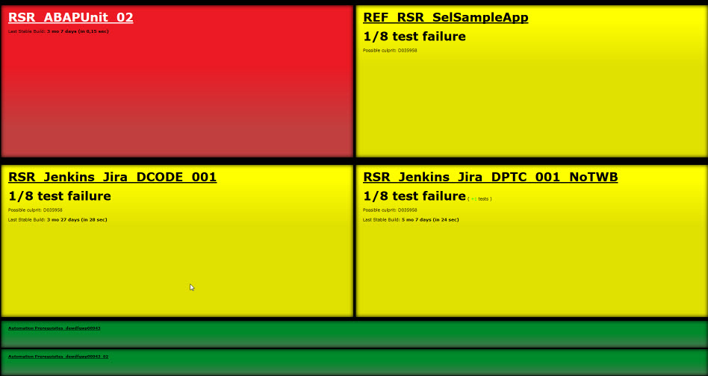
Jenkins: Dashboards & Radiator View
Transparency on/with Jenkins

Slide 4
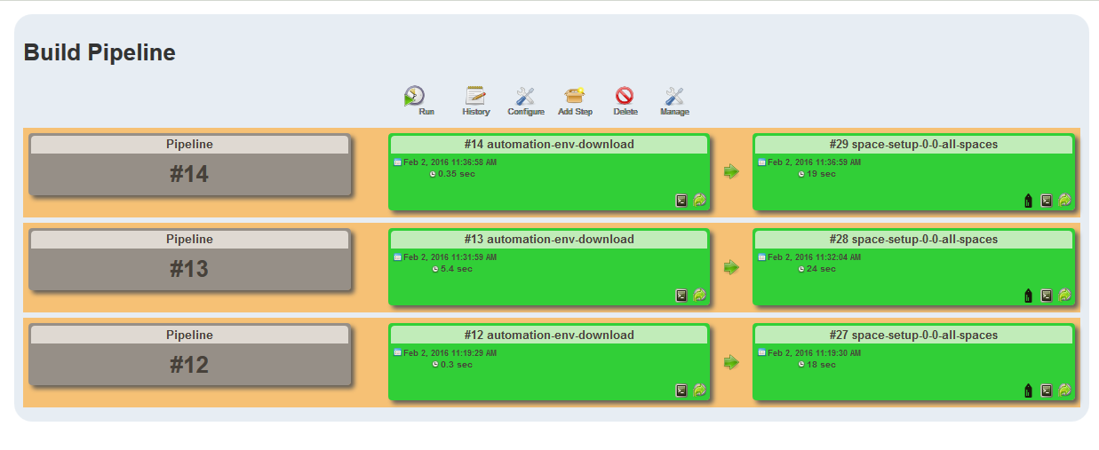
Jenkins: Build Pipeline
Transparency on/with Jenkins
http://mo-f8268fdb9.mo.sap.corp:8080/jenkins/view/Z_CC_SpaceSetup_BuildPipeline/

Slide 5
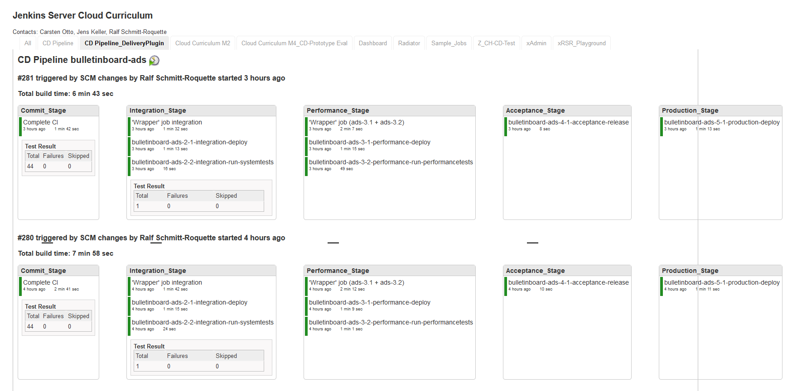
CC Continuous Delivery/ Deployment Pipeline on Jenkins
http://mo-f8268fdb9.mo.sap.corp:8080/jenkins/view/CD%20Pipeline_DeliveryPlugin/

Slide 6
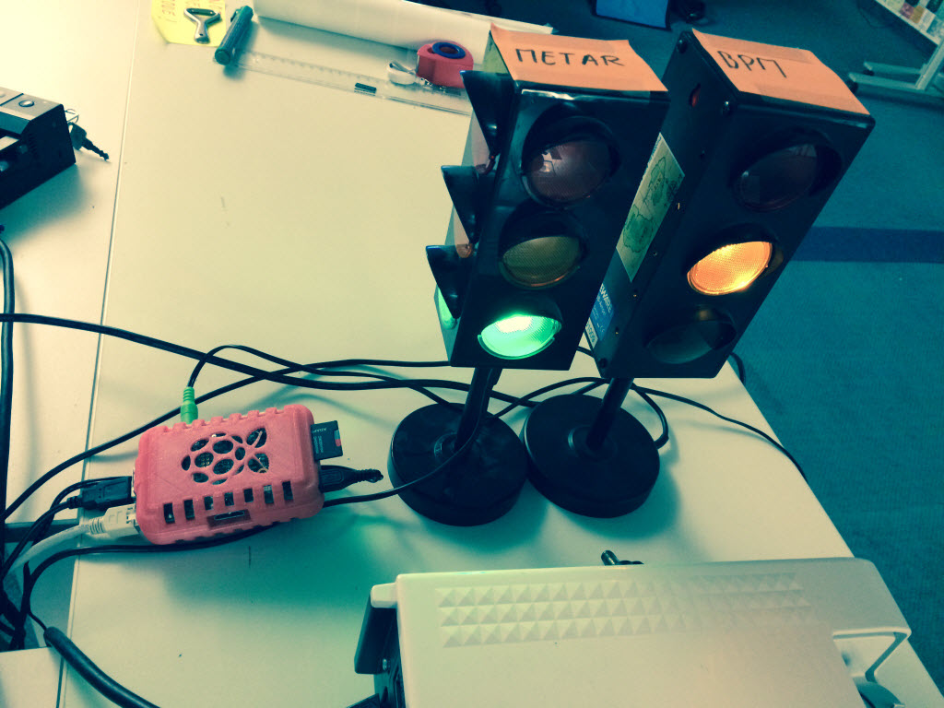
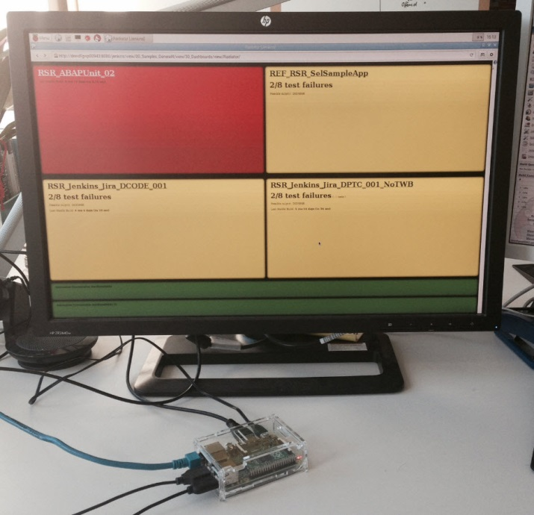
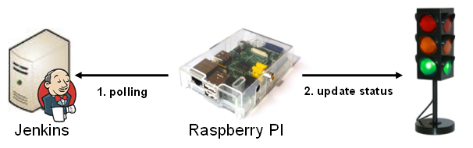
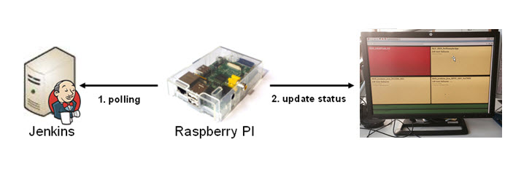
Jenkins: Raspberry PI & Traffic Lights/ Monitors
Transparency on/with Jenkins

Slide 7
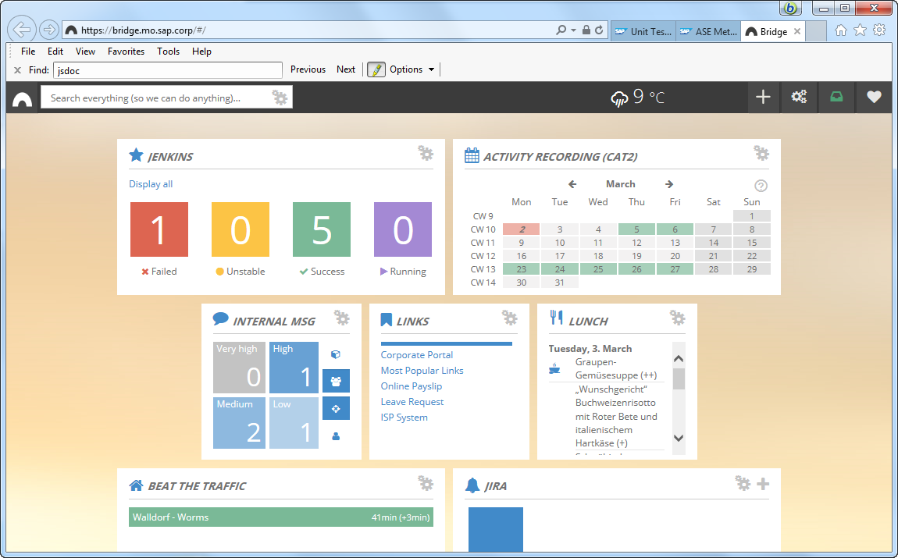
Jenkins: Bridge
Transparency on/with Jenkins

Slide 8
Agenda
Exercise 10 + xx

Slide 9
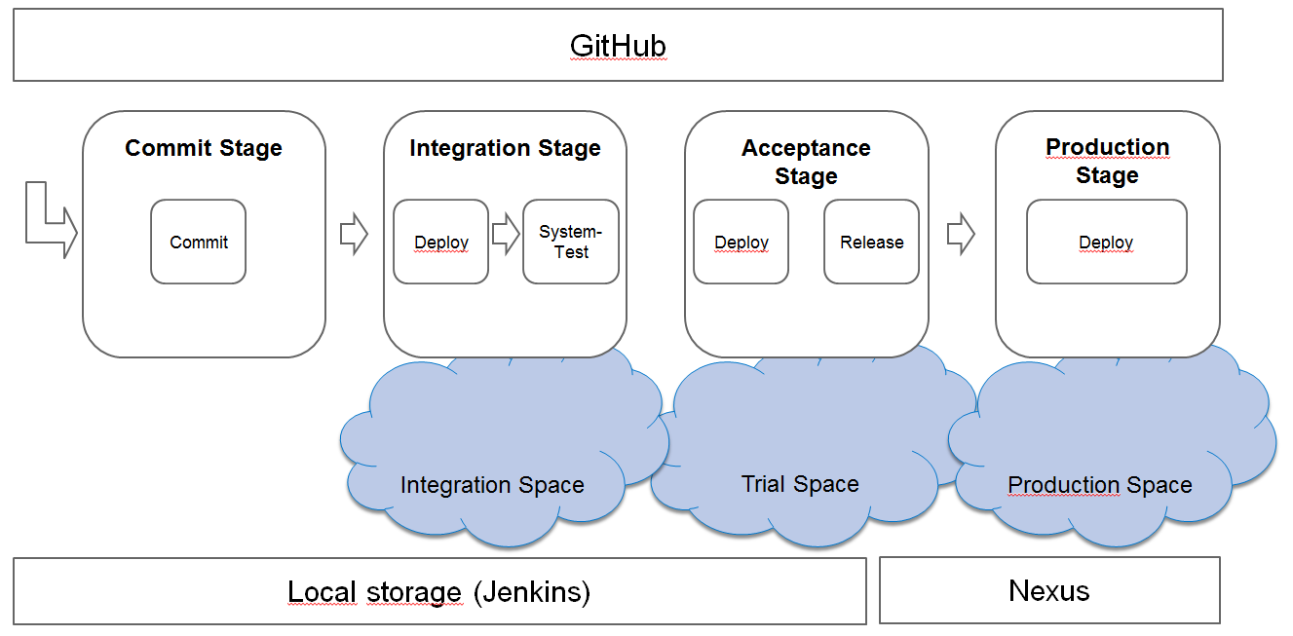
Exercises
Exercise 10: Dashboards
https://github.wdf.sap.corp/cc-java-dev/cc-m4-coursematerial/blob/master/Exercises/Exercise10-JenkinsViews.md
Exercise XX: BridgeTrafficLight
https://github.wdf.sap.corp/cc-java-dev/cc-m4-coursematerial/blob/master/Exercises/ExerciseX-BridgeTrafficLight.md

