Slide 1

Agenda
Infrastructure as Code

Slide 2



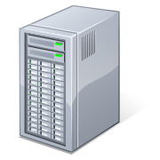
Deployment Pipeline & Infrastructure as Code Environments from code within minutes – Example VMs in Monsoon with Chef
Source code
Env. & Job config
Version control
Env. & landscape config
Monsoon
Monsoon
Monsoon
DB
APPL
MSG
DB
APPL
MSG
DB
APPL
MSG
Commit
Integration
Acceptance
Production
Artifact repositories

Slide 3


Deployment Pipeline & Infrastructure as Code Environments from code within minutes – Example: Spaces with Backing Services in Monsoon
Source code
Env. & Job config
Version control
Env. & landscape config
+ Ruby
+ Ruby
+ Ruby
Cloud Foundry
Space: Integration
Space: Acceptance
Space: Production
DB Service Instance
MSG Service Instance
DB Service Instance
MSG Service Instance
DB Service Instance
MSG Service Instance
Commit
Integration
Acceptance
Production
Artifact repositories

Slide 4
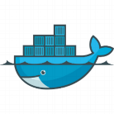
Deployment Pipeline & Infrastructure as Code Environments from code within minutes – Example instance, based on Docker
Draft !
Source code
Env. & Job config
Version control
Env. & landscape config
Xmake Docker build
Xmake Docker build
Xmake Docker build
Xmake Docker build
Docker
Docker
Docker
DB
APPL
MSG
DB
APPL
MSG
DB
APPL
MSG
Commit
Integration
Acceptance
Production
Artifact repositories

Slide 5
Infrastructure as Code (IaC) - 1
“How many times have you manually applied the same steps, when creating an infrastructure, or relied on another team to set up an environment for you ?”
“How many times it happened, that result was different, even following ‘exactly’ the setup/ installation guide ?”
“What if all of these actions were scripted and versioned just like the rest of the software system ?”

Slide 6
Infrastructure as Code (IaC) - 2
Infrastructure as code (IaC), or programmable infrastructure
is the process of scripting environments - from installing an operating system, to installing and configuring servers on instances, to configuring how the instances and software communicates with one another, etc. This is not simply writing scripts, but applies tested and proven agile software development practices like version control, testing, small increments, continuous Integration, small deployments, use of design patterns etc.
With scripting environments, you can apply the same configuration to a single node or to thousand nodes with identical results (reproducible results).
Idempotence --> Automation scripts can be applied/executed multiple times without changing the result beyond the initial application/ execution
Notes:
Multiple applications of the same action do not have side effects on the system state.
Running the tool over and over doesn't change the system after the first time.
mkdir -p /var/lib/statedir/myapp
No matter how many times we run this command, it will result in that tree being created.

Slide 7
Infrastructure as Code (IaC) - 3
“And what is about manual changes after initial setup of the environment/ infrastructure/ systems while operation of them ?”
After a while the environment/ infrastructure/ system has massively changed, no track who changed what and when and what is the current state.
No chance to reproduce such an environment/ infrastructure/ system (e.g. for substitution or additional)
Conclusion: Ideally no manual changes at all !
“Wow that’s challenging !”

Slide 8
System/ Environment setup: Classic vs Infrastructure-as-code
Classic
Infrastructure as Code
Experience
Experience
3. builds
1. automates
1. wants
2. runs
Template
Description
Script
Description
2. orders
Requestor
Operator
Requestor
Operator
Processing time due to manual operation
Operation team limits number of systems
Manual work is error prone
Fullfill individual requests
Automated provisioning
Scale out by delegation to the requestor
Possible requests need to be standardized in advance
Within SAP the IT department setup an infrastructure called „Monsoon“ enabling a Chef-solo automation

Slide 9
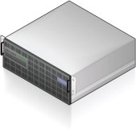

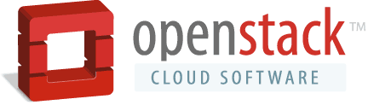




SAP Monsoon
Self Service Portal
Self Service Portal
1:n PaaS &Self-Service Layer support for multiple platforms such as Monsoon and custom-built platforms
Shelf
Chef
Templates
Orchestration
VM
VM
VM
VM
VM
VM
Monsoon (Future Global IT Standard)
API EC2 Compatible
Other Cloud Platforms (e.g. Custom-Built / Special Solutions)
1 Integration Layer Cloud Connector: make multiple (hybrid) IaaS providers available through one common API / Broker
CLOUD CONNECTOR & STANDARD API (EC2)
+
Private Cloud Provider
+
Public Cloud Provider
1:n IaaS Providers manage multiple different cloud infrastructures and public providers (names are examples)
Physical HW

Slide 10
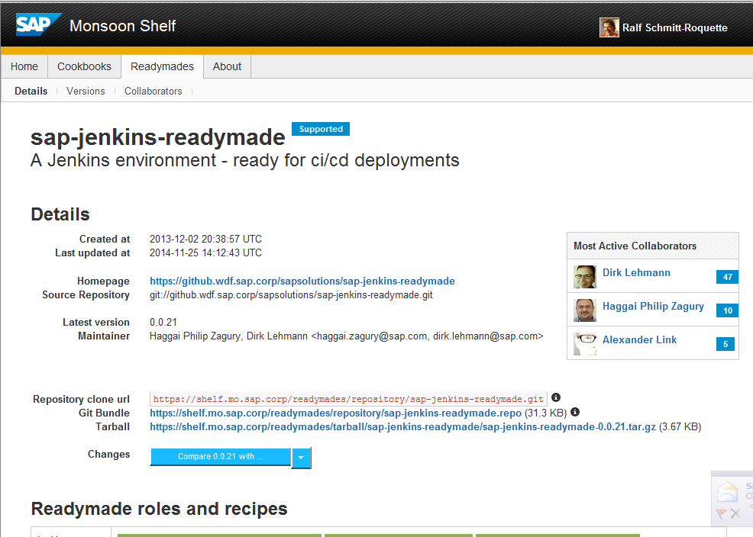
Monsoon: SAP Jenkins Readymade
https://wiki.wdf.sap.corp/wiki/pages/viewpage.action?pageId=1563161749
https://shelf.mo.sap.corp/readymades/sap-jenkins-readymade

Slide 11
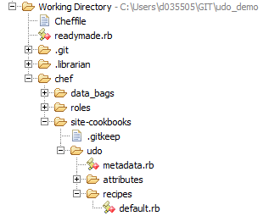
Structure of recipes, cookbooks and readymades
Readymades
collection of cookbooks that defines a ready-to-install system type
is defined inside a readymade.rb file which contains
predefined attribute values that are set on instances
templates that define a instance type like database or application server
A README.md file should be provided in the cookbook which provides a good introduction on how to use it
External cookbooks are included via the Cheffile

Slide 12
Structure of recipes, cookbooks and readymades
Cookbook
bundle that encapsulates all the necessary resources to automate the installation and configuration of a system
Recipes
Attributes
Libraries
Resources and Providers
unit of distribution and sharing in Chef
defines an installation/configuration scenario such as everything needed to install and configure MySQL or SAP component on an existing HANA DB, MyLab packages, etc.

Slide 13
Structure of recipes, cookbooks and readymades
Recipe
ruby file (*.rb) - the most fundamental machine configuration element i.e. what one writes to install and configure components on the machine
Recipes need to be idempotent
-> run over and over again with same outcome

Slide 14
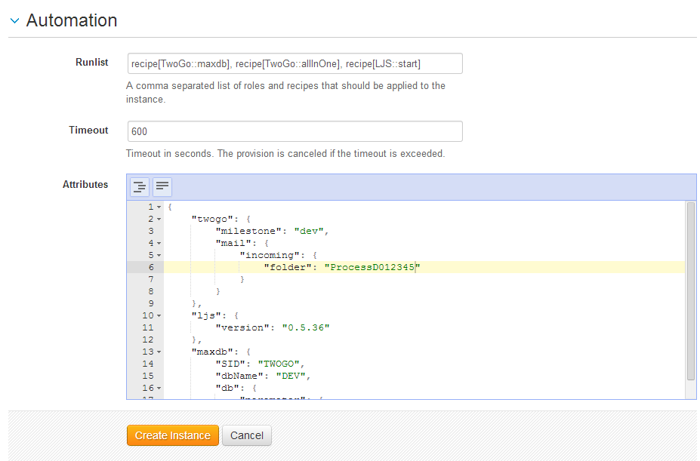
Customization
All recipes/cookbooks/readymades have attributes which can be overwritten when the instance is created
Most attributes don‘t need to be touched
Use JSON notation for attribute overwriting
All accessible attributes can be checked at the cookbook documentation in the monsoon shelf: https://shelf.mo.sap.corp

Slide 15
Mapping Git Repo – Application – cf_app – CD Pipeline Option 3
New
Git/ GitHub
Ruby FW
Cloud Foundry
CD pipelines Appl. X
Appl. A env
Integration Space
Acceptance Space
Production Space
Cf_app1
Application X
CF_app1
Cf_app2
CF_app2
Cf_app3
CF_app3
Meta information/ configuration – cf_app level (manifext.yml)
Meta information/ configuration – CD pipeline level

Slide 16
Mapping Git Repo – Application – cf_app – CD Pipeline Option 3
New
Git/ GitHub
Ruby FW
Cloud Foundry
CD pipeline cf_app1
Cf_app env
Integration Space
Acceptance Space
Production Space
Cf_app1
CF_app1
Meta information/ configuration – cf_app level (manifext.yml)
Meta information/ configuration – CD pipeline level

Slide 17
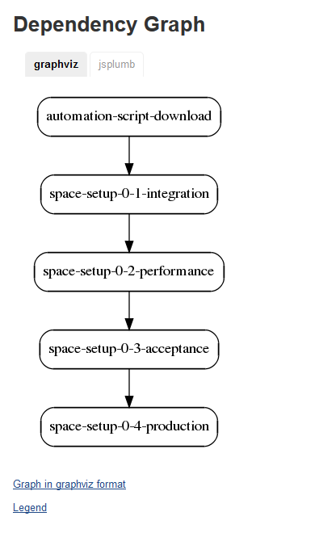
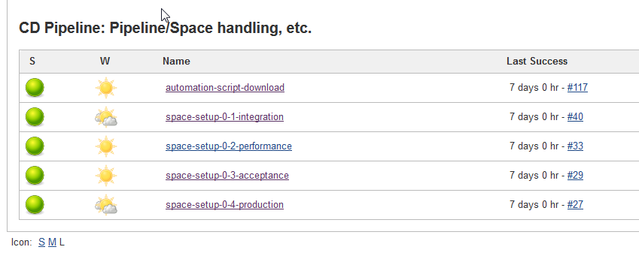
Infrastructure as Code – CC CD Pipeline - old
tbd

Slide 18
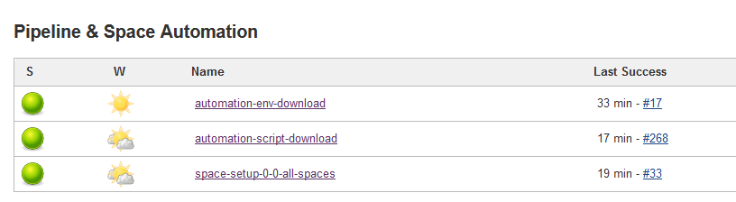
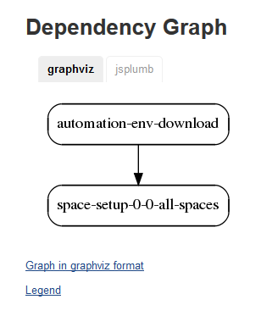
Infrastructure as Code – CC CD Pipeline
tbd

Slide 19
Application Environment/ Automation Documentation
New
Appl. Environment Repository
Appl. Automation Repository
Cf_App 1
Automation Scripts
Application deployment manifests for each environment (e.g. integration, acceptance, production)
Ruby CF automation scripts
Environment definition yaml files (Spaces, Service Instances)
Handles all CI/CD related tasks
App deployment
Production blue-green deployment
Service / Space management
Artifact repository interactions
Cf_App 2
Cf_App n

Slide 20
Workflow 1 - Space Environment Setup
Automation Scripts Repository (cc-m4-automation-scripts)
Cloud Foundry
scripts/space_manager
Integration Space
Acceptance Space
Production Space
+
env/integration-environment.yml
S1
S2
S3
S4
S5
S6
env/acceptance-environment.yml
env/acceptance-production.yml
scripts/space_manager setup-environment
Read space environment configuration from yaml file
Create CF space accordingly
Create CF service instances accordingly

Slide 21
Workflow 3 – Standard App Deployment
Automation Scripts Repository
Cloud Foundry
scripts/app_deployer
Integration Space
Acceptance Space
Production Space
+
1
1
2
1
2
3
Cf_App 1 Repository
manifest-integration.yml
manifest-acceptance.yml
scripts/app_deployer deploy cf_app1
Read application deployment.yml files
Deploy application to CF
Check application availability (http)
manifest-production.yml

Slide 22
Agenda
Exercise 1

Slide 23
Exercises
Exercise 01: Create Jenkins server on Monsoon
https://github.wdf.sap.corp/cc-java-dev/cc-m4-coursematerial/blob/master/Exercises/Exercise01-CreateJenkinsOnMonsoon.md

Slide 24
Agenda
Exercise 11

Slide 25
Exercises
Exercise 11: Infrastructure-as-Code
https://github.wdf.sap.corp/cc-java-dev/cc-m4-coursematerial/blob/master/Exercises/Optional-Exercise-InfrastructureAsCode-SpaceServiceRoles.md

Slide 26
Appendix

Slide 27
Mapping Git Repo – Application – cf_app – CD Pipeline Option 2
Used in CC M4, V1
Git/ GitHub
Appl. A
Cloud Foundry
CD pipeline Appl. A
Cf_app1
Integration Space
Acceptance Space
Production Space
Application A
CF_app1
Cf_app2
CF_app2
Cf_app3
CF_app3
Meta information/ configuration – cf_app level (manifext.yml)
Meta information/ configuration – Application A level
Meta information/ configuration – CD pipeline level

