Slide 1

Agenda
Monitoring

Slide 2
On Premise World
Operations Team
Your Team
End User
Development
Test and Release
Deploy and Operate
Use
SAP
Customer

Slide 3
Cloud World
Team-Up Dev+Ops
End User
Development
Test and Release
Deploy and Operate
Use
SAP
Customer

Slide 4
Monitoring
Monitoring is an important DevOps practice introducing a mind shift for development teams.
While in “old” days production information was invisible for development teams this information shall now be an important source to learn how your product / your service is running and whether there are possible bottlenecks for the successful use.

Slide 5
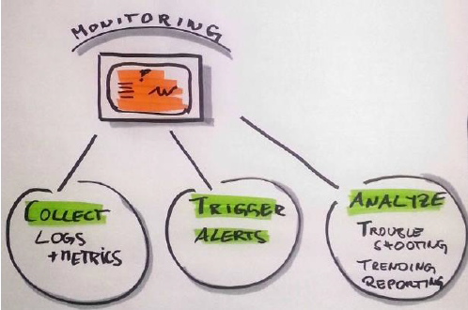
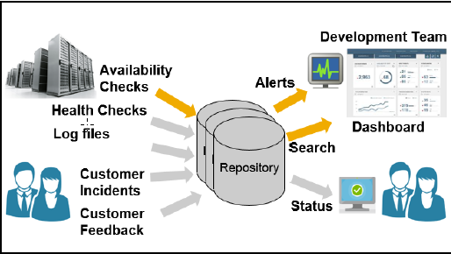
Monitoring Aspects and Sources

Slide 6
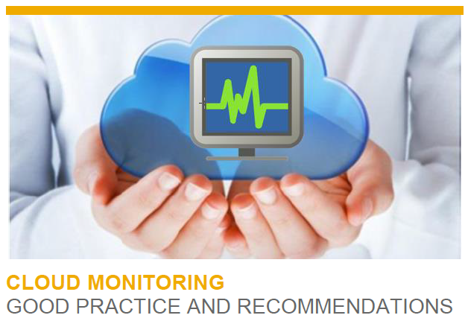
Monitoring – Monitoring Best Practices P&I Technology
https://wiki.wdf.sap.corp/wiki/download/attachments/1727860098/HCP_Monitoring_Good_Practices.pdf?version=2&modificationDate=1444410905000&api=v2

Slide 7
Availability Types
Contractual Availability
the SLA-governed guarantee that is given to a customer
Example: A general HCP service shall be 99% available where downtimes are tolerating periods of unavailability lasting less than 5 minutes
Perceived Availability
the actual customer satisfaction as it comes while using your service
Example: Typical response time goal for interactive steps is 2 seconds
Service Health
i.e. insights that are available to you (but not yet your customer) and that indicate possible availability issues in the future
Example: A typical health metrics could be about an almost exhausted resource pool.

Slide 8
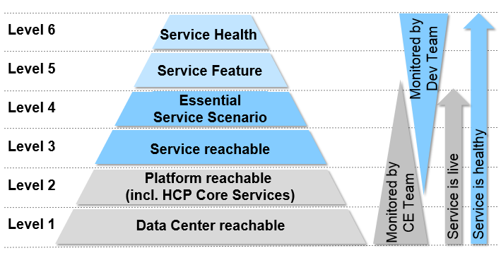
Availability Checks - Check levels
Level 6: Setup health checks
on top of all the above
Level 5: Check sub-services
complementary to the check via scenarios
Level 4: Check core scenarios
core scenarios, possibly having availability issues beyond level 3
Level 3: Check authentication
accessibility via well authenticated users
Level 2: Check service reachability
service is reachable at all., e.g. cockpit landing page
Level 1: Check datacenter reachability
via public Internet, possibly also from different geographies
Level 0: Check Internet connectivity
In order to avoid false positives of your tester

Slide 9
Availability Checks – Main Concept
Check
(e.g. measure www.sap.com every 60sec)
Evaluation
(e.g. response time < 2sec OR error occurred)
Alert
(e.g. send email after 5 minutes)

Slide 10
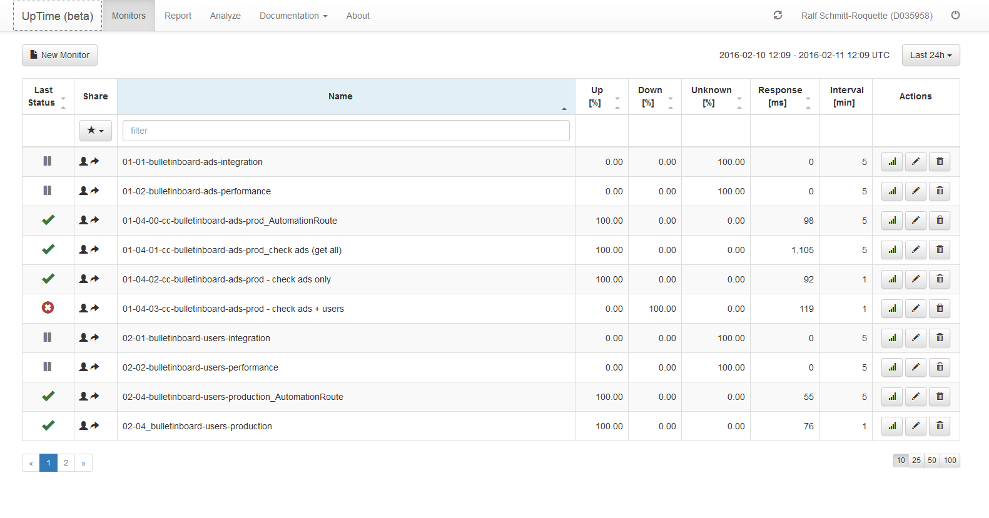
UpTime
https://uptime.neo.ondemand.com/

Slide 11
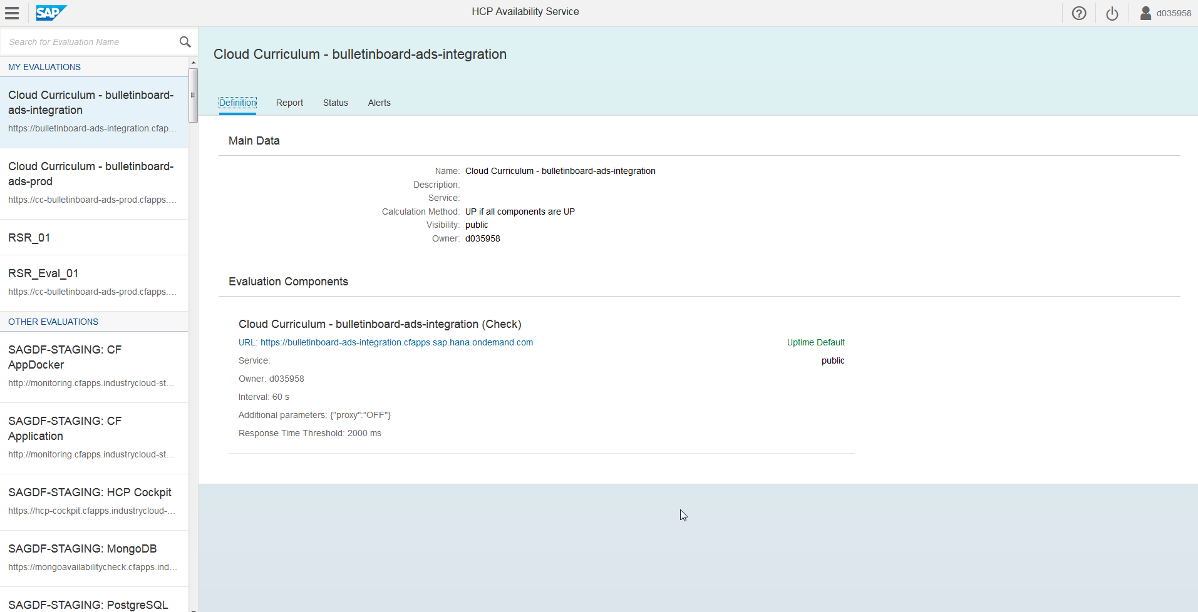
HCP Availability Service
https://availability.cfapps.sap.hana.ondemand.com/
https://wiki.wdf.sap.corp/wiki/display/hcpka/Availability+Service

Slide 12
HCP Availability Service - Features
Authentication integrated with SAP ID service
Updating of checks and evaluations now possible
Alerting via Email
Permalinks
Status pages
Promoted evaluations

Slide 13
Example: Hierarchical Evaluation Combining Internal & External Checks
Alert: DoD
(immediate)
Eval: UBER Demo
(all services)
Alert: PO
(after 10 minutes)
Eval: APIProxy
(internal & external)
Eval: APIManager
(internal & external)
Check: APIProxy
(internal via upTime)
Check: APIProxy
(external via Pingdom)
Check: APIManager
(internal via upTime)
Check: APIManager
(external via Pingdom)

Slide 14
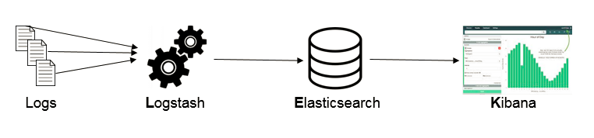
Cloud Foundry & ELK stack for application logging/tracing
The ELK Stack is a combination of Elasticsearch, Logstash and Kibana.
It is an end-to-end stack that delivers insights from almost any type of structured and unstructured data source.
https://logs.cf.sap.hana.ondemand.com

Slide 15
Agenda
Exercise 12

Slide 16
Exercises
Exercise 12: Uptime
https://github.wdf.sap.corp/cc-java-dev/cc-m4-coursematerial/blob/master/Exercises/Exercisexxx-Uptime-Monitor.md

Slide 17
Agenda
Exercise 13

Slide 18
Exercises
Exercise 13: Kibana
https://github.wdf.sap.corp/cc-java-dev/cc-m4-coursematerial/blob/master/Exercises/Exercise13-Kibana-Part1.md
https://github.wdf.sap.corp/cc-java-dev/cc-m4-coursematerial/blob/master/Exercises/Exercise13-Kibana-Part2.md

Slide 19
Appendix

Slide 20
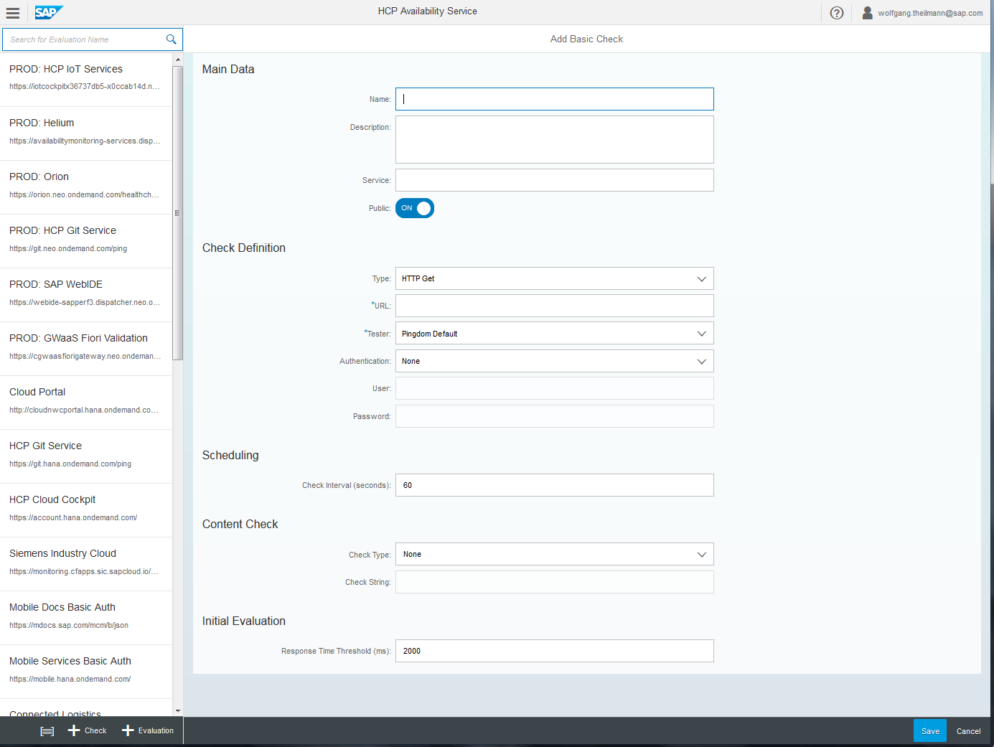
Screenshot: Create Check

Slide 21
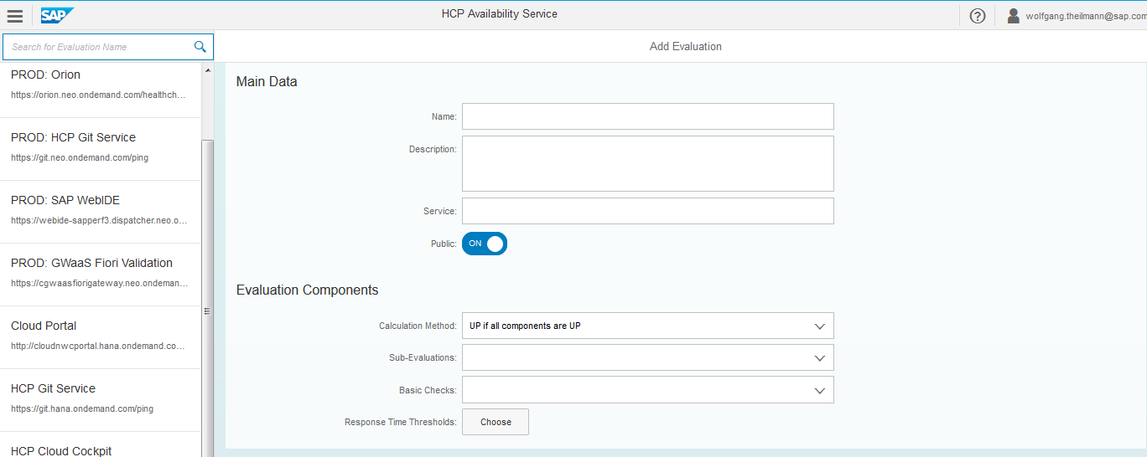
Screenshot: Create Evaluation

Slide 22
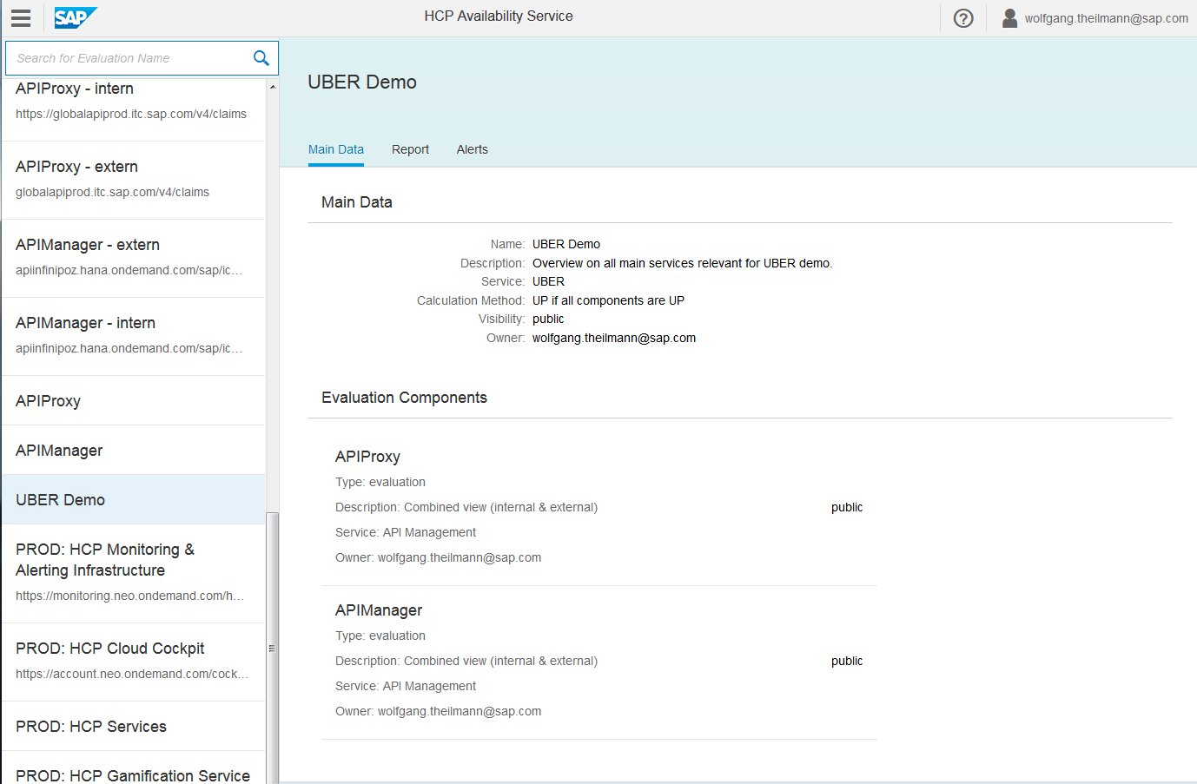
Screenshot: Display Evaluation Main Data

Slide 23
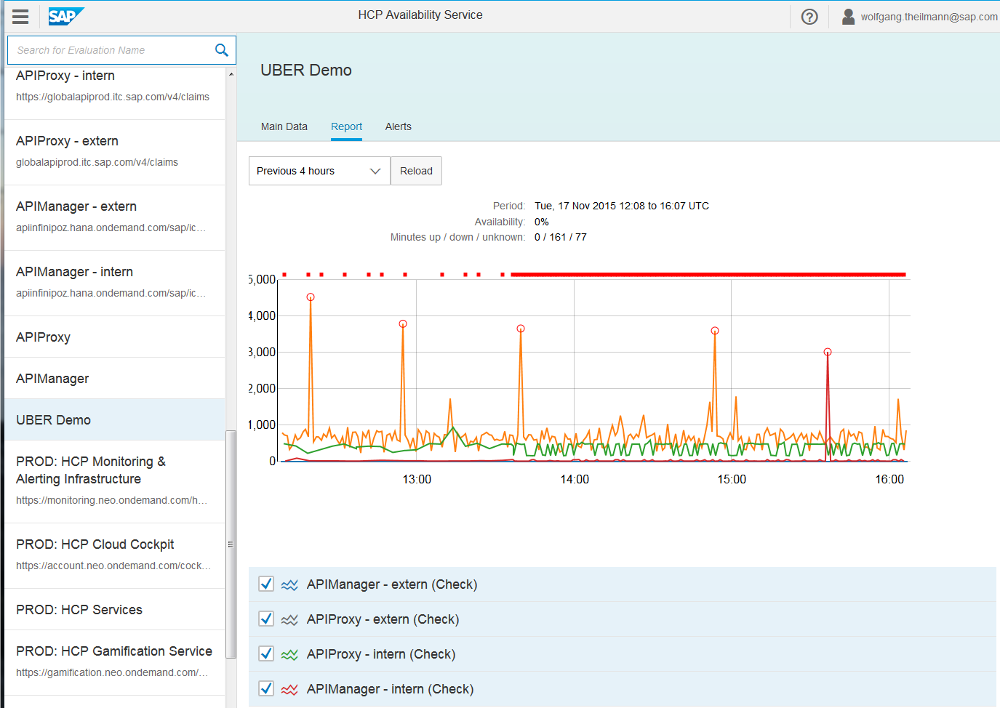
Screenshot: Display Evaluation Report

Slide 24
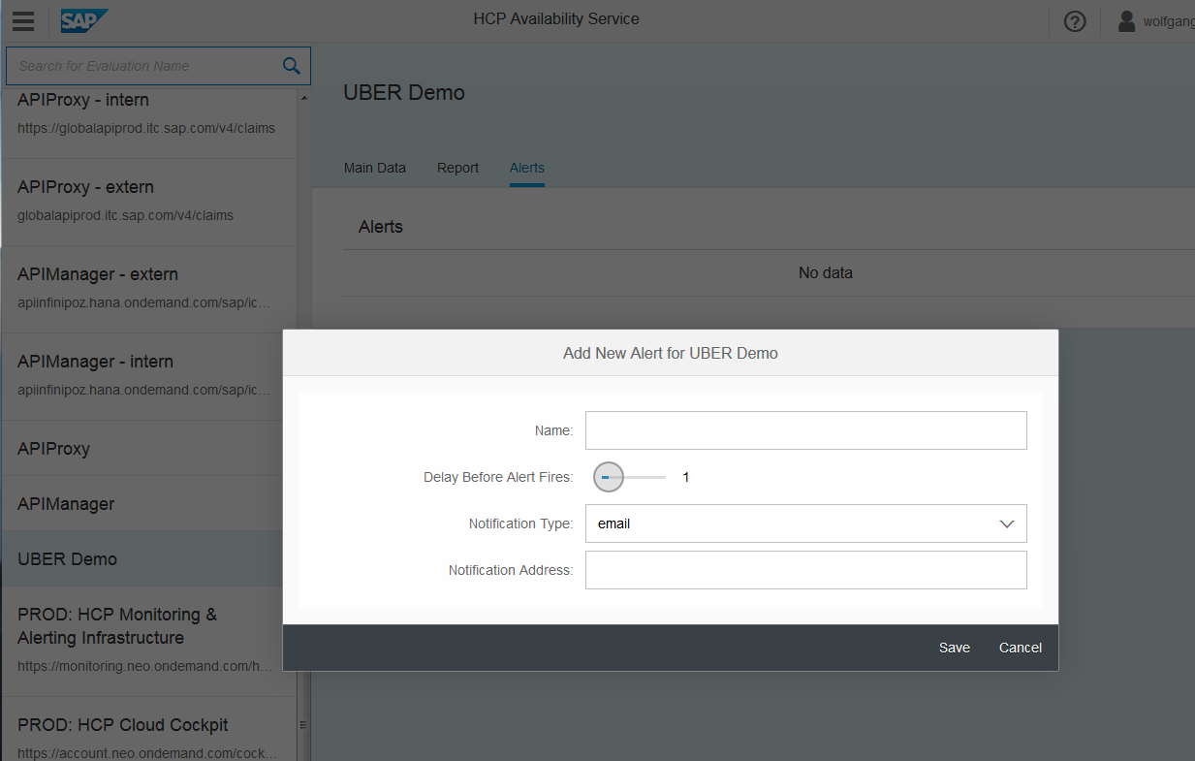
Screenshot: Create Alert

Slide 25
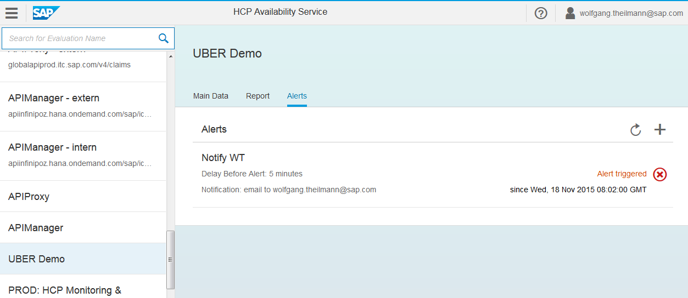
Screenshot: Display Alert

