Slide 1



Scaling Microservices

Slide 2
Scaling Microservices
What to do when traffic on an app peaks?
cf scale –i <instances>

Slide 3
Scaling Microservices
Can Cloud Foundry do that automatically?
No

Slide 4
Scaling Microservices
Can Cloud Foundry do that automatically?
No
Maybe soon? (Link)

Slide 5
Autoscaling - Proof of concept
App
#0
#1
#2
CF API
ELK
Log cpu=50% / #instances=3
Log cpu=90% / #instances=2
Poll cpu_average?
Log cpu=50% / #instances=2
Scale to 3
CPU Monitor & Autoscaler
cpu_average=90%
cpu_average=50%
Notes:
For the demo
Check dummy-space is setup correctly, main-route „cc-bulletinboard-ads-dummy“
Start the autoscaler (https://github.wdf.sap.corp/cc-java-dev/cc-m4-automation-scripts/tree/master/autoscaler)
Checkout cc-m4-automation-scripts
cd autoscaler
Check manifest.yml, show environment parameters and start-command given to script
Login to correct space (dummy)
Ruby copy.rb push
(Optional) cf a? cf logs?
Show Kibana Dashboard (autoscaler)
Generate Traffic (Jmeter)
Open Jmeter and cc-m4-automation-scripts/autoscaler/jmeter/autoscaler-cputraffic.jmx

Slide 6
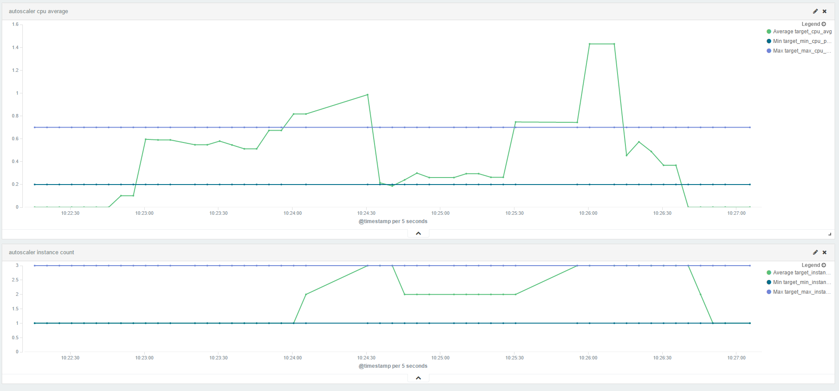
Scaling in Monitors

Slide 7
Scaling in Monitors
CPU-usage above 1?
Notes:
Optional Slide

Slide 8
CPU Measurement Values
cpu percentage per core * number of cores
On average, 1 is a single cpu core per application instance

Slide 9
CPU Distribution
CF does not allow to directly set CPU distribution
CPU cores are shared proportional to the memory allocated
Notes:
Example:
Application A has 2 GB of memory
Application B has 4 GB of memory
If A and B are running on the same machine
A will get half as many CPU cores as B

