Slide 1
C/C++ Program Design
Lab 1, environment configuration
廖琪梅, 王大兴, 于仕琪

Slide 2
Environment Configuration
Download and install GCC on Windows 10 (Based on Windows Subsystem for Linux)
Download and install LLVM on macOS
Download and install the editor (VSCode)
Compile, link and run C/C++ programs
Set output format

Slide 3
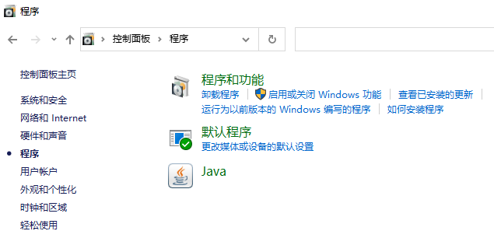
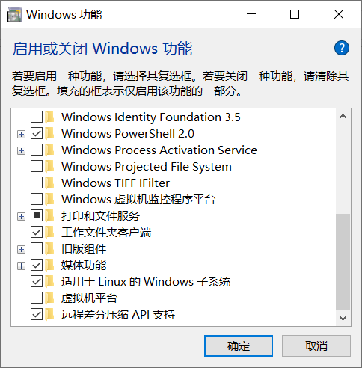
1.1 Install WSL on Windows system
1 Download and install GCC on Windows 10 (Based on WSL)
Step one: enable the Windows Subsystem for Linux
Open the Control Panel and set the Windows functions

Slide 4
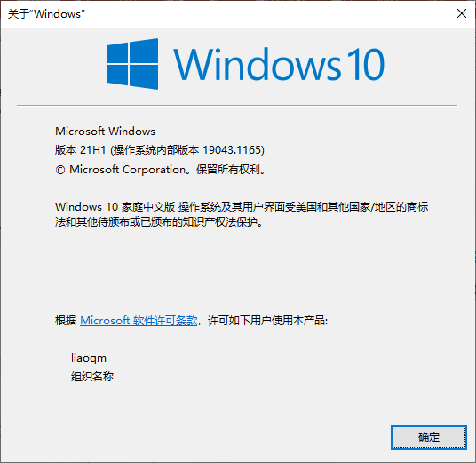
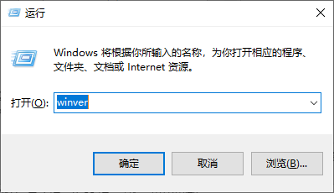
Step one: enable the Windows Subsystem for Linux
Check Prerequisites: You must be running Windows 10 version 2004 and higher (Build 19041 and higher) or Windows 11.
To check your version and build number, select Windows logo key + R, type winver, select OK.
https://learn.microsoft.com/en-us/windows/wsl/install

Slide 5
Step one: enable the Windows Subsystem for Linux
Open Powershell or Windows Command Prompt in administrator mode and enter the wsl --install command
input 命令提示符

Slide 6
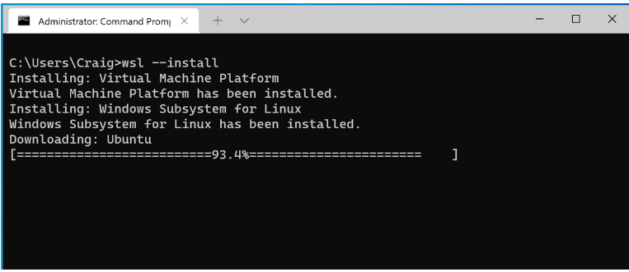
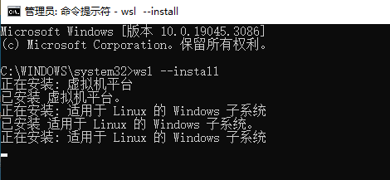
It usually downloads and installs Ubuntu in your computer.
If Ubuntu is not downloaded, terminate the current installation by Ctrl+c and restart your computer.

Slide 7
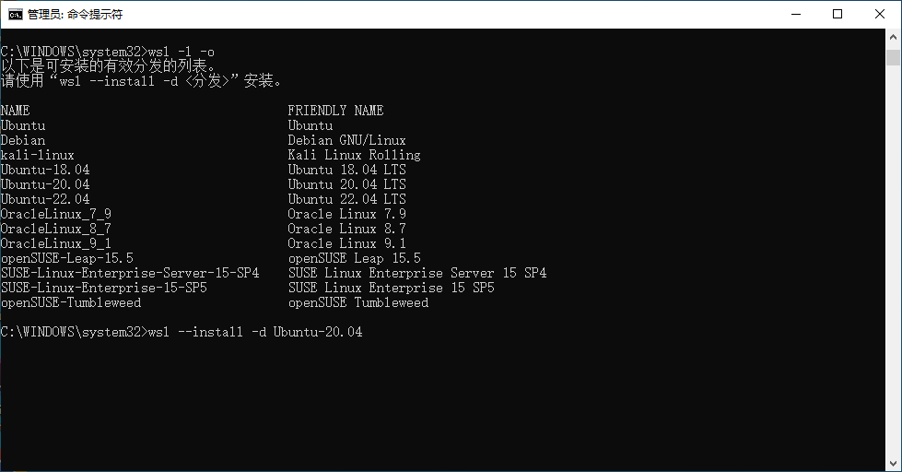
Use the command wsl -l -o to check which version of Ubuntu is valid to your system. Then use the command wsl --install –d with the name of Ubuntu. For example, wsl --install –d Ubuntu-20.04.
List the Linux distributions in your computer.
List the valid name and version of Linux in your system.
Type the installation command to install Ubuntu 20.04.

Slide 8
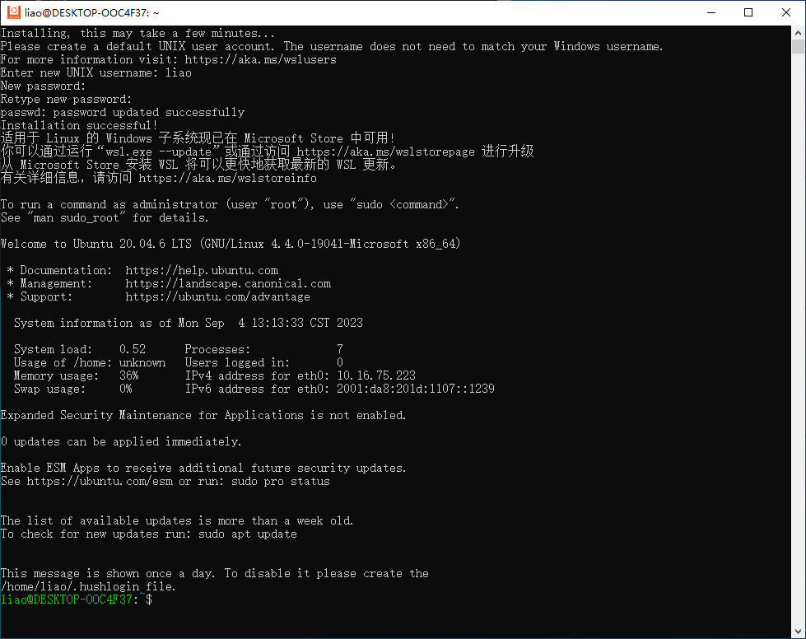
Input new UNIX username and new password.
Remember your username and password.
Note: the password is not displayed on the screen.
Linux command prompt

Slide 9
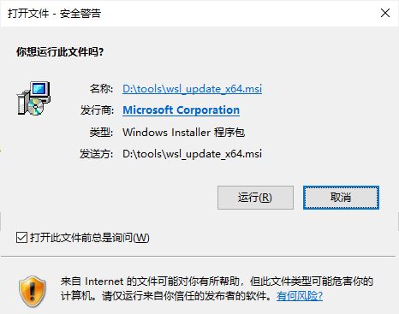
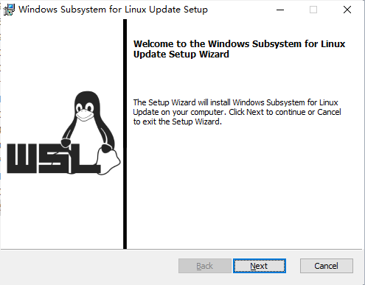
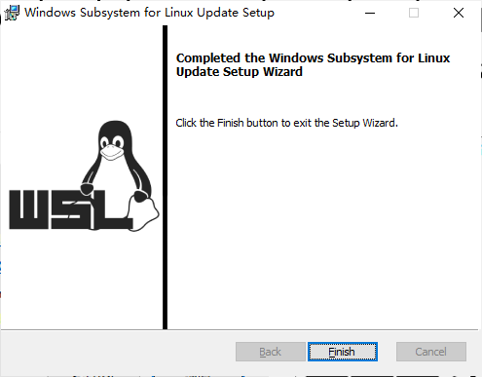
1.1 Install WSL on Windows 10(cont.)
Step two: Update WSL kernel
Download the latest package and run the update package
https://wslstorestorage.blob.core.windows.net/wslblob/wsl_update_x64.msi
If you're using an ARM64 machine, please download the ARM64 package instead.
https://wslstorestorage.blob.core.windows.net/wslblob/wsl_update_arm64.msi

Slide 10
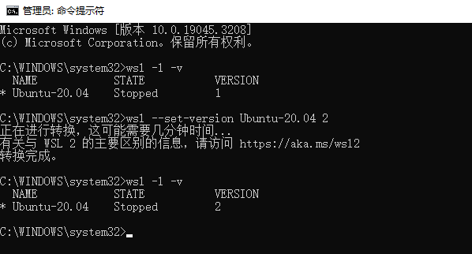
1.1 Install WSL on Windows 10(cont.)
Step three: Set WSL version as 2
Open PowerShell or Windows command prompt and run this command to set WSL version as 2 : wsl --set-version Ubuntu-20.04 2
Check the version of WSL.

Slide 11
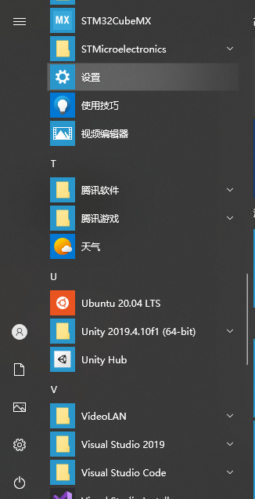
1.2 Install GCC on WSL
Once you finished the installation of Ubuntu 20.04 LTS, you can find it on your start menu.
Open it and you will see a Terminal for Linux
You can set username and password for your system (Please remember this password as you need it to switch to root user later)
Use the two commands below to install GNU: (If you are using any Linux distribution based on debian you can use below to install, too)
sudo apt update this command will update your apt library (apt: Advanced Packaging Tools)
sudo apt install g++ -y this command will install g++ and its independence

Slide 12
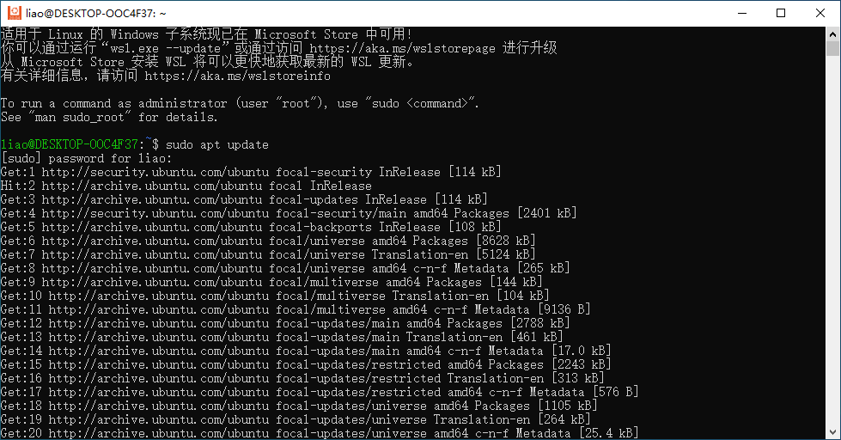
input the command and your password

Slide 13
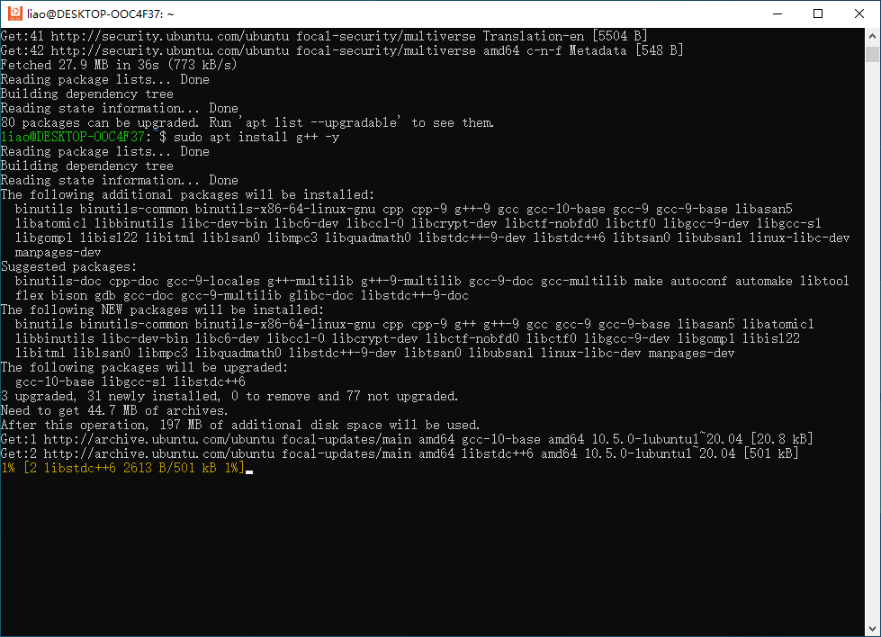
input the command to install g++

Slide 14
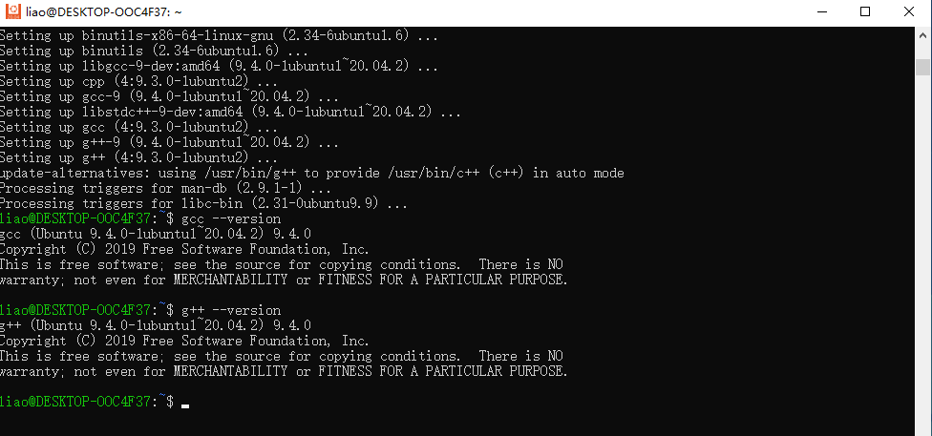
1.3 Verify GCC on WSL
You can input command: gcc --version or g++ --version to check whether the GCC is installed well
Input gcc –version or g++ --version to check if the compiler is installed successfully

Slide 15
2.1 Install CLT (Xcode Command Line Tool) on macOS
2 Download and install LLVM on macOS
Open the Terminal on your Mac
Input g++ to check whether the CLT or GCC is installed
If not, the system will guide you to install CLT
You can also install CLT by package provided by Apple: https://developer.apple.com/download/more/
For more info regarding the CLT installation you can refer to https://www.easeus.com/computer-instruction/install-xcode-command-line-tools-on-mac.html

Slide 16
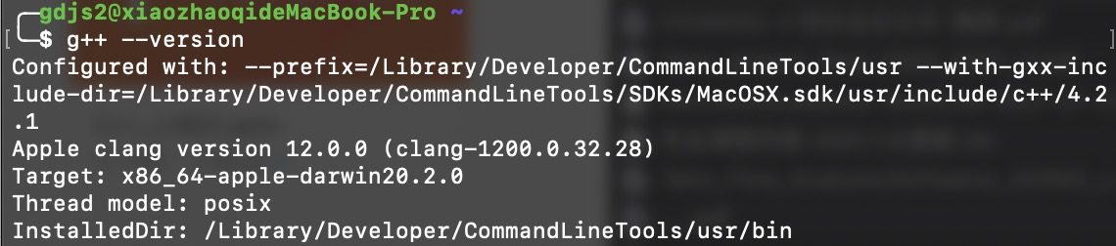
2.2 Verify LLVM on macOS
The same as verifying GNU, using: g++ --version

Slide 17
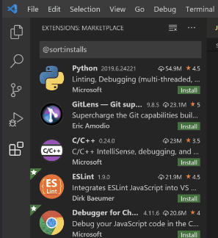
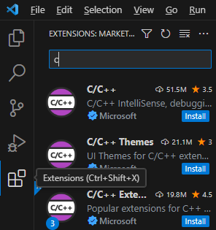
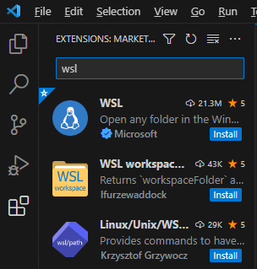
3.Download and install editor
To install VSCode, you can visit: https://code.visualstudio.com/ to download the package for your platform (Linux, Windows or macOS).
After you install VSCode, you need to install two plugins at least to support your development:
1. C/C++ plugin
2. WSL plugin
Start VSCode, press the “Extensions” icon on the left margin, select the two plugins or search c and wsl key words respectively to find the two plugins.

Slide 18
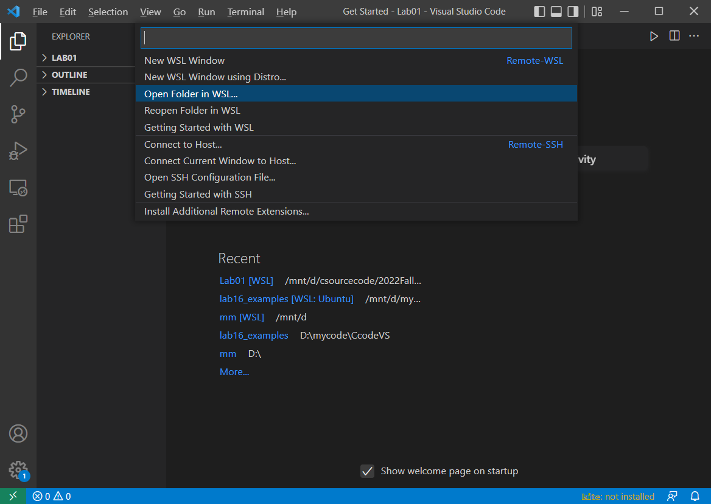
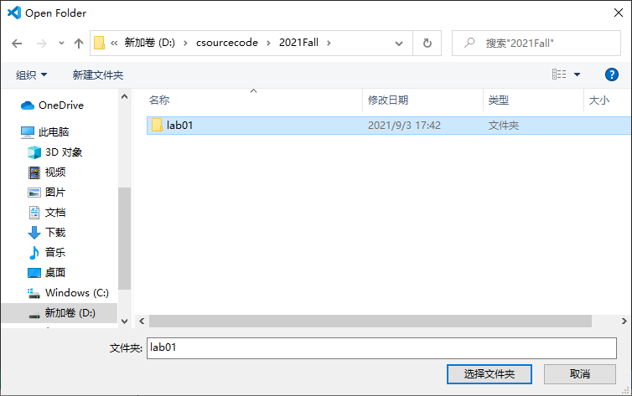
3.Download and install editor (Cont.)
Now, you need to switch your VSCode to WSL system.
Click the green button on left of the bottom, and choose Open Folder in WSL…
Select the item
Find the folder and select it
Press the “select the folder” button

Slide 19
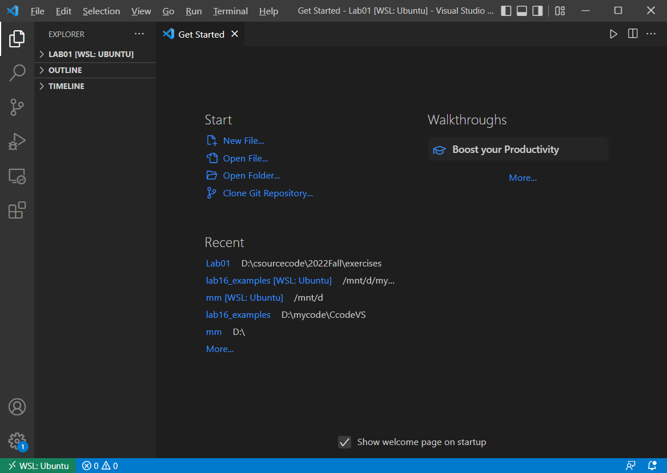
Now VSCode is working on the WSL system. We can create your first C/C++ program.
The folder is in your VS Code.
Note: The suffix of the program must be .c or .cpp for c program and c++ program respectively.

Slide 20
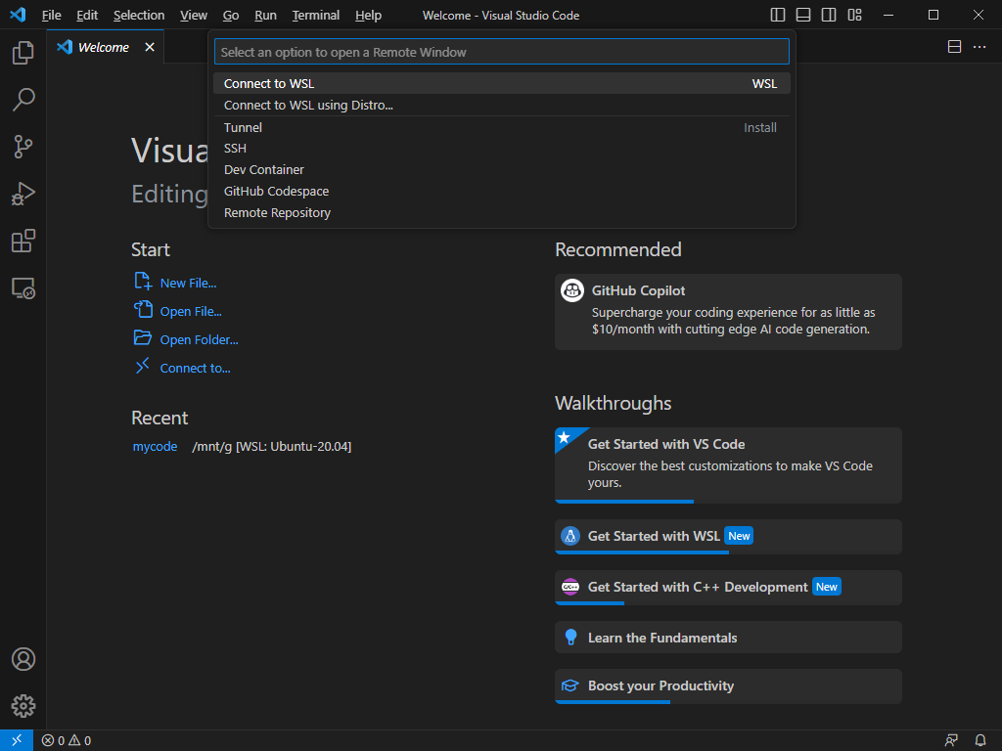
If your VSCode is with blue button on the left bottom, click it, and select “Connect to WSL”
Select this item

Slide 21
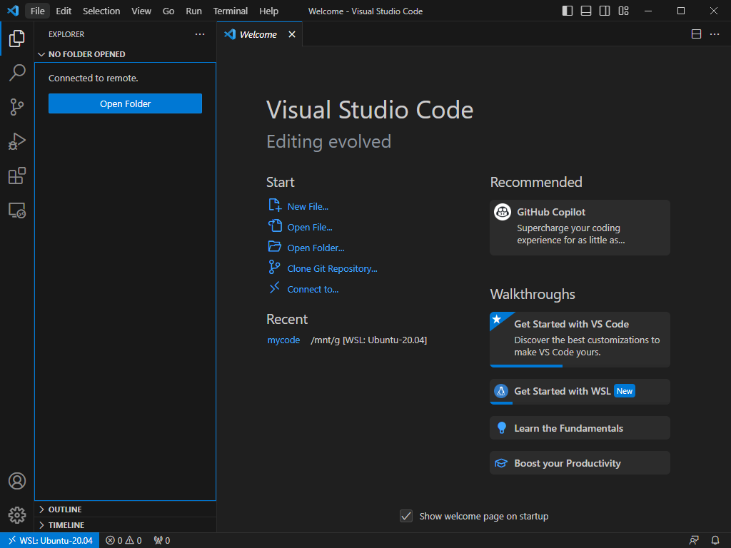
Click “Open Folder…”in Welcome page or “Open Folder” button in Explorer or “File”→”Open Folder…” menu item.

Slide 22
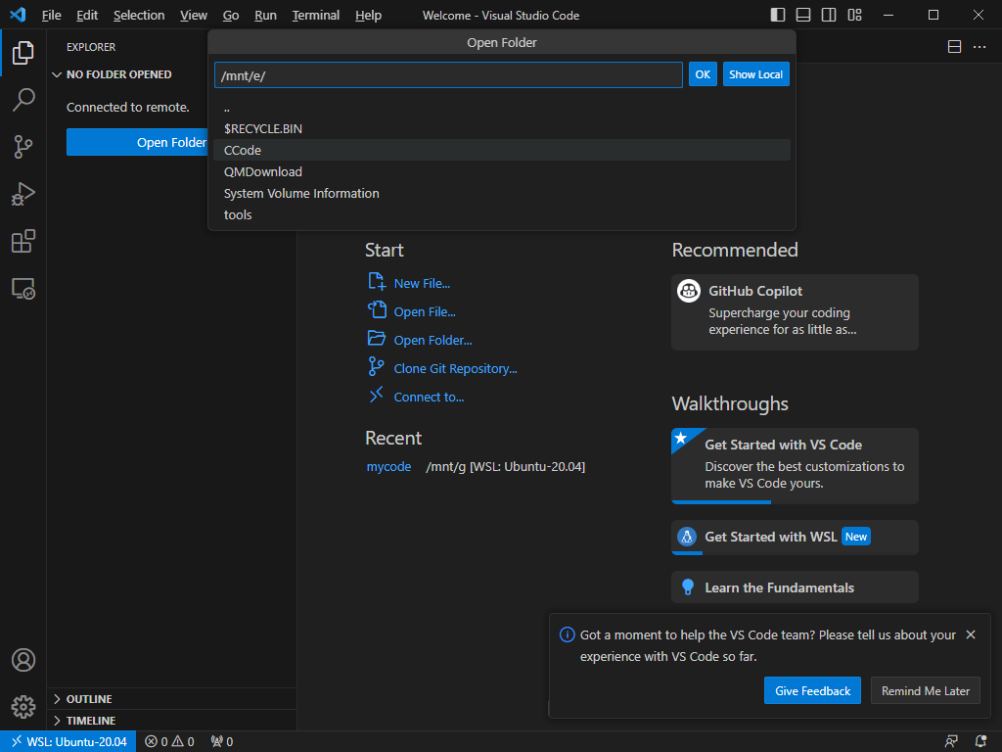
Type /mnt/,you can see all drives in your computer, and select one, such as e
Select the folder

Slide 23
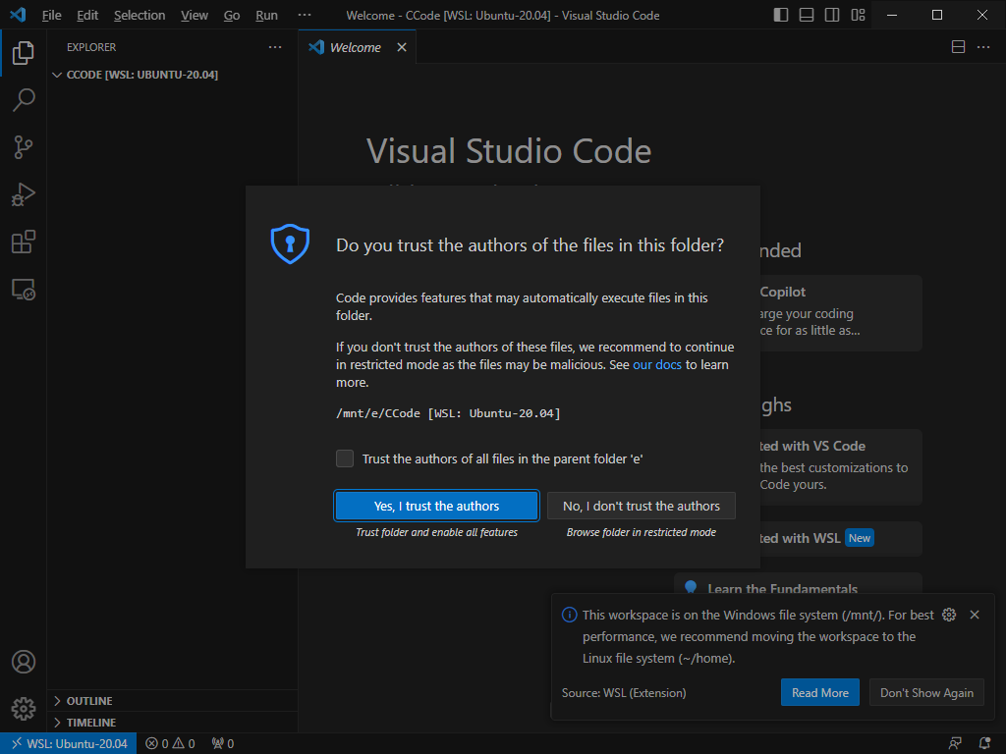

Slide 24
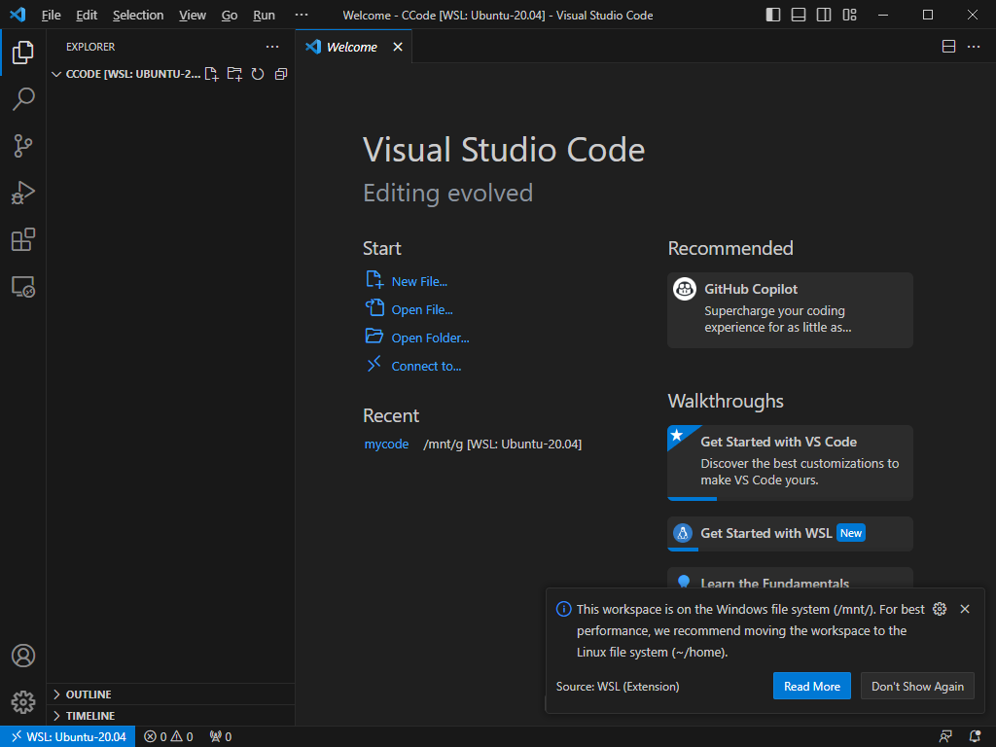
Click “New Folder” button and input a new folder name to create in the current directory.
Click “New File” button to create a new file in the current directory.

Slide 25
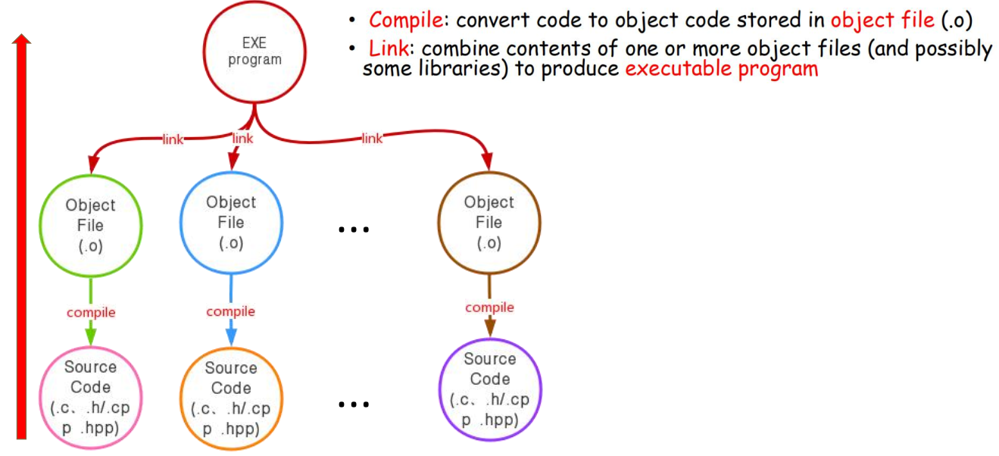
4 Compile, Link and Run C/C++ Programs
4.1 The program compilation process

Slide 26
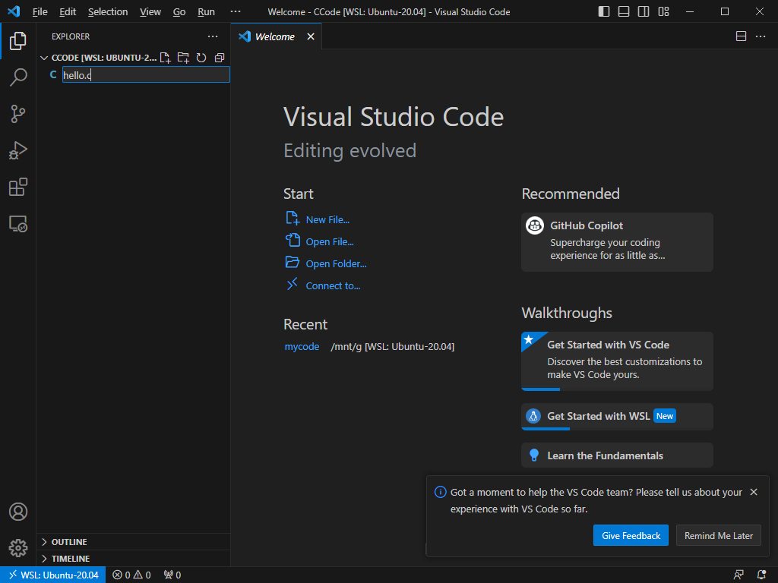
4.2 Compile, Link and Run C programs
Compile/Link/Run a simple C program – hello.c
Click “New File” button or select “File”→”New File” menu item and input the new file name with .c extension name. Then press “Enter” key.

Slide 27
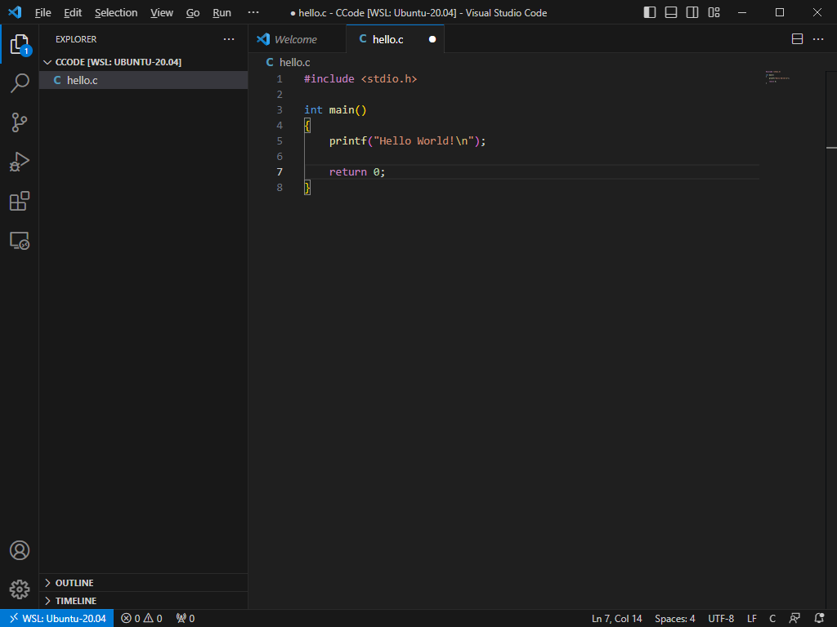
Input your code in the new file and save it by Ctrl+s or select “File”→”Save” menu item.

Slide 28
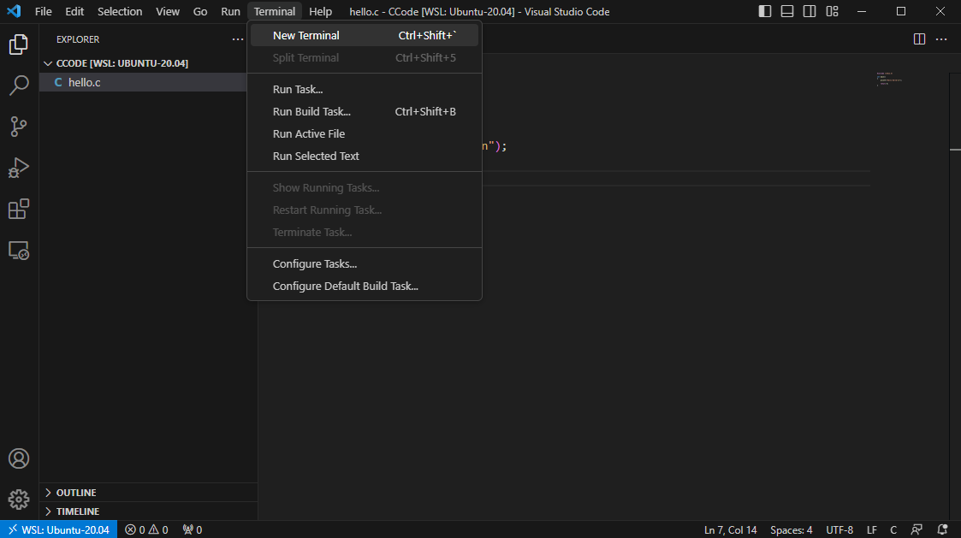
Select “Terminal”→”New Terminal” menu item to open the Terminal window.

Slide 29
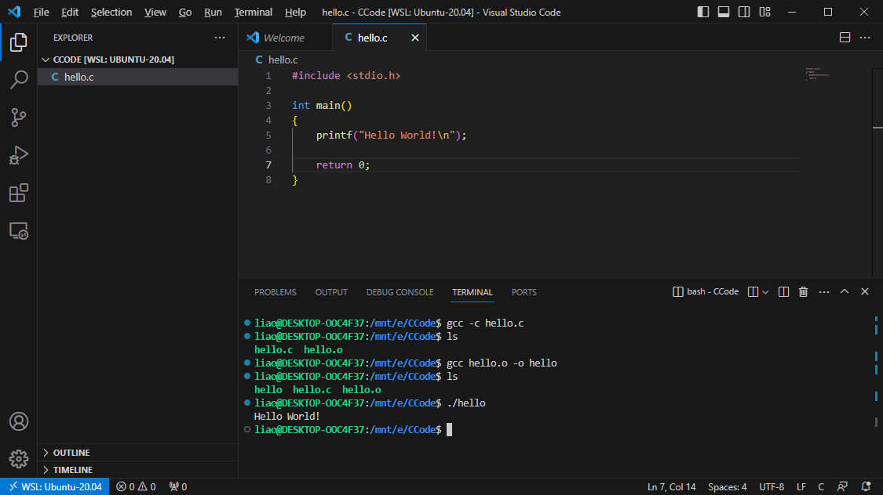
Use gcc to compile the .c file.
compile
link
run
The output

Slide 30
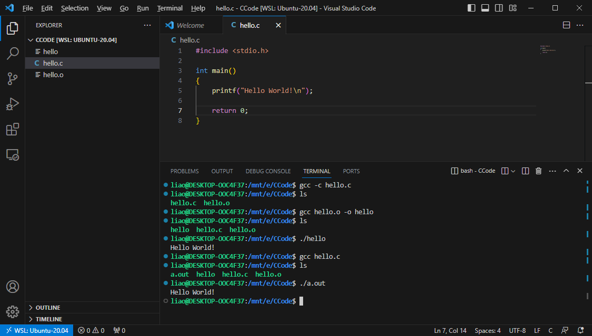
The default output executable file is called “a.exe”(Windows) or “a.out”(Unix and Mac OS) if you don’t specify the name in compiling and linking step.
compile and link
run
The output

Slide 31

4.3 Compile, Link and Run C++ programs
Compile/Link/Run a simple C++ program – helloworld.cpp
Click “New Folder” button to create a new folder in the current directory and input the folder name.

Slide 32
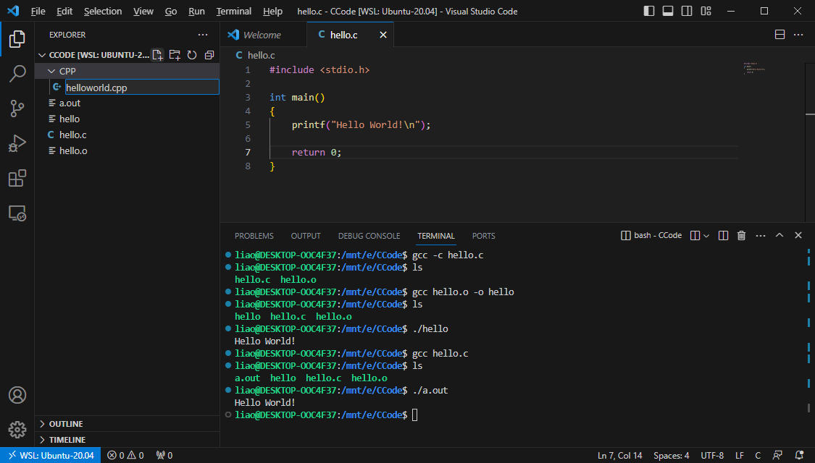
Click “New File” button and input the file name with .cpp extension name in the current folder.

Slide 33
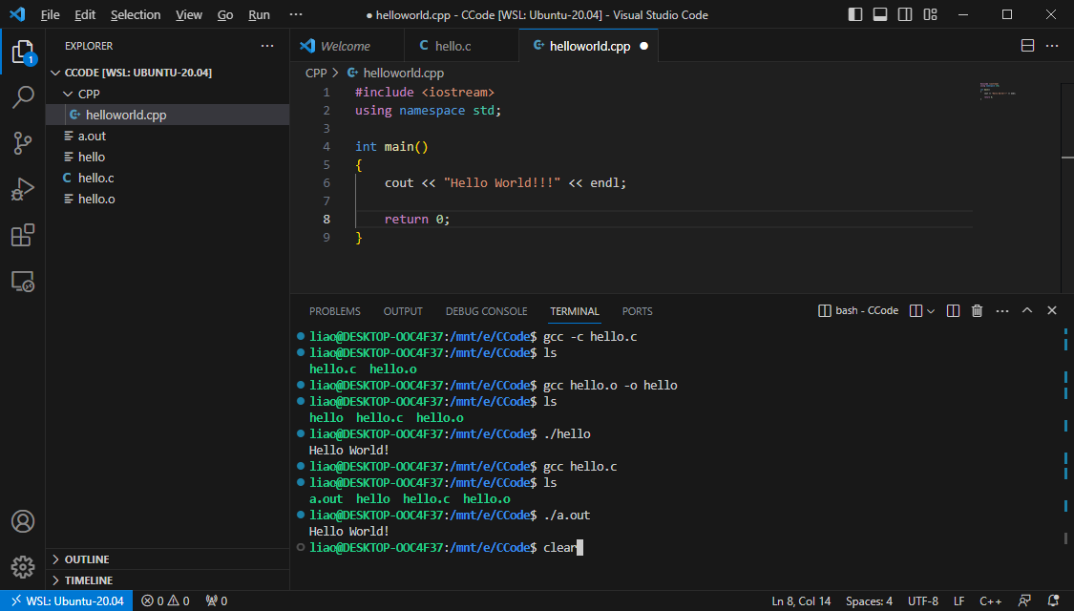
Input your code in the file .
Input “clear” command to delete all the commands.

Slide 34
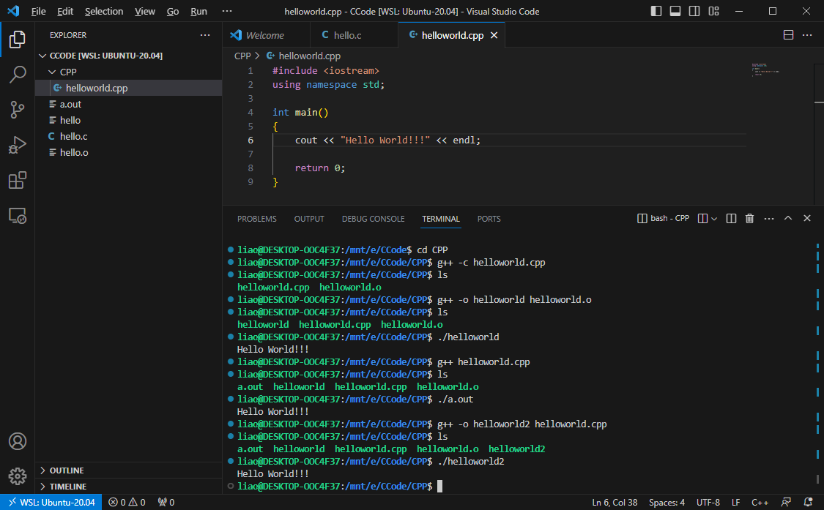
You need to use g++ to compile C++ program. The -o option is used to specify the output file name.
compile
link
The output
run
compile
and link
run
The output
compile
and link
run
The output

Slide 35
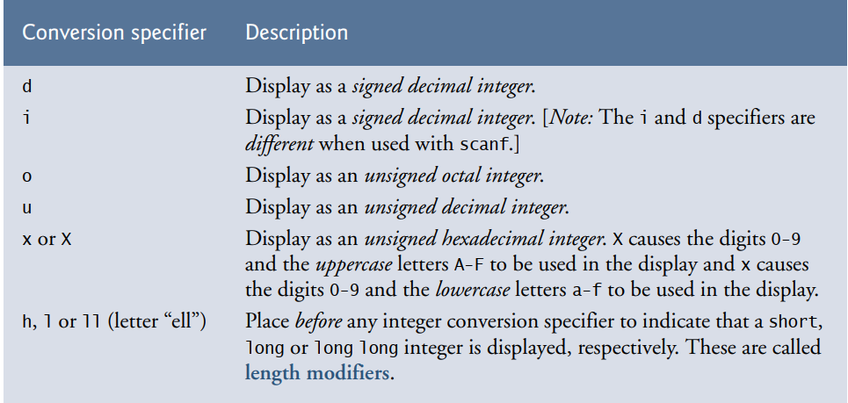
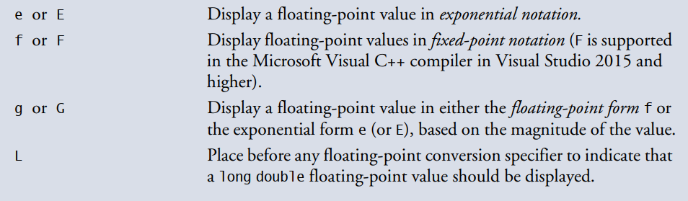
5 Terminal Output
5.1 Formatting output with printf
printf (format-control-string, other-arguments)
format-control-string describes the output format, which consists of conversion specifiers, field widths, precisions and literal characters with percent sign(%).

Slide 36
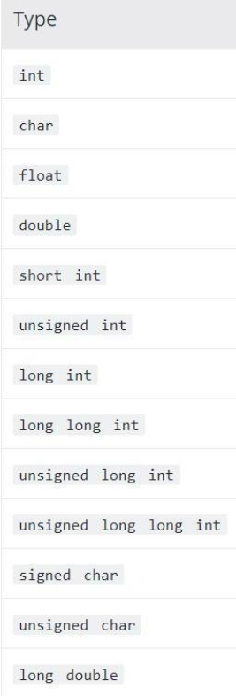
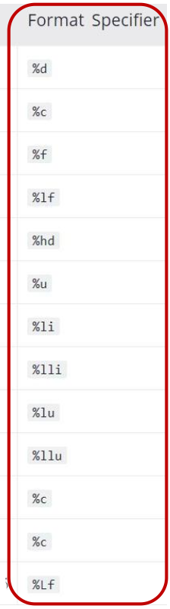
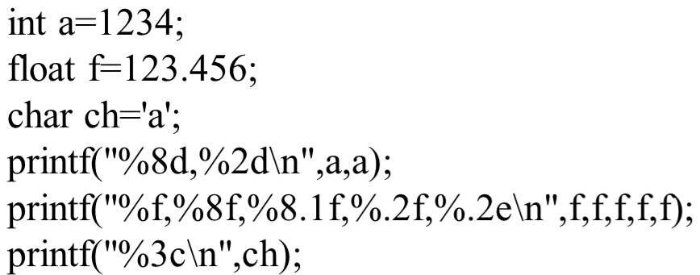

Example:
Sample output:

Slide 37
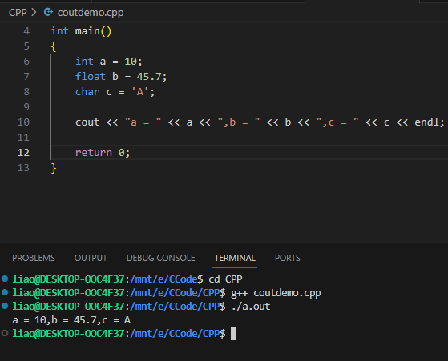
5.2 cout
cout << variable1(expression1) [<< variable2 << variable n];

Slide 38
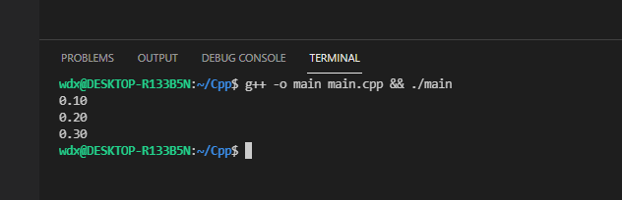
6.1 Exercises
Write a program to initialize three variables which equal to 0.1, 0.2, 0.3, then print them with two decimal points.
Your output should look like something above. You can use printf to achieve this, or you can explore the cout way.

Slide 39
6.2 Exercises
Copy the following code into 3 files, and compile them together to an executable file. Find the bugs if there are some.
Step 1: Compile main.cpp
Step 2: Compile add.cpp
Step 3: Link the two object files.
main.cpp
add.h
#include <iostream>
#include "Add.h"
int main()
{
int num1 = 2147483647;
int num2 = 1;
int result = 0;
result = add(num1, num2)；
cout << “The result is ” << result << endl;
return 0;
}
#pragma once
int add(int n1, int n2);
add.cpp
#include "add.h"
int Add(int number1, int number2);
{
return n1 + n2;
}

